Slide 1

Predicting Flight Fares: A Data-Driven Approach
Flight pricing is complex, fluctuating based on factors like timing, destination, and demand. This project aims to predict flight fares using a data-driven approach.
by Denistan
Notes:
1

Slide 2
Objective: Leveraging Data for Optimized Pricing
Accurate Predictions
Dynamic Pricing
Informed Decisions
Generate reliable flight fare predictions using historical and real-time data.
Enable airlines to adjust prices in response to market changes and demand fluctuations.
Empower travelers to make informed decisions by providing accurate fare forecasts.
Notes:
2

Slide 3
Workflow: Data Collection, Preprocessing, and Analysis
Data Collection
1
Gather flight data from various sources including airlines, travel agencies, and online booking platforms.
2
Data Preprocessing
Clean and prepare the data for analysis by handling missing values, outliers, and inconsistencies.
Exploratory Analysis
3
Explore the dataset to identify trends, patterns, and potential relationships between variables.
4
Model Building
Develop and train predictive models using machine learning algorithms.
Model Evaluation
5
Evaluate the performance of the models using various metrics and validation techniques.
Notes:
3

Slide 4




Architecture: Scalable and Modular Design
Data Pipeline
1
Data ingestion, preprocessing, and feature engineering.
2
Model Training
Train and optimize machine learning models.
3
Prediction Engine
Real-time fare predictions based on input parameters.
4
Visualization Dashboard
Interactive visualization for insights and monitoring.
Notes:
4

Slide 5
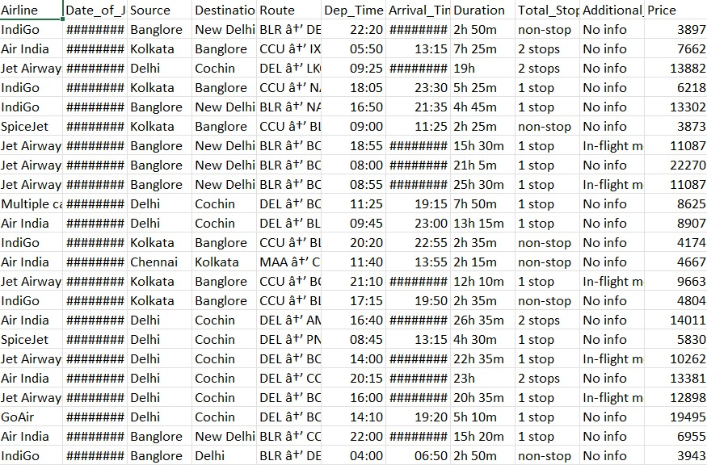
Dataset: Sources, Features, and Considerations
Data Sources
Features
Airlines, travel agencies, and online booking platforms.
Origin and destination airports, flight date, time, duration, airline, class, and previous fare data.
Preprocessing
Handling missing values, outlier detection, and feature scaling.
Notes:
5

Slide 6
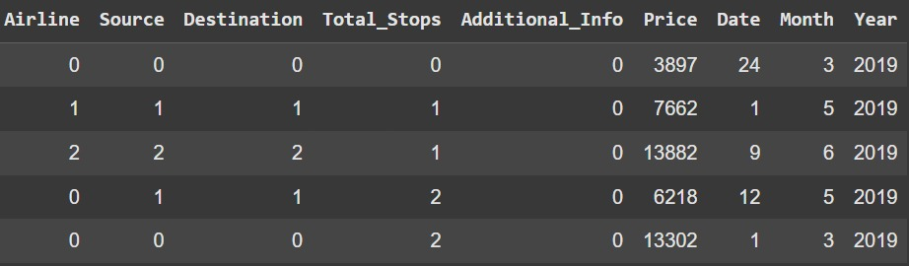
Feature Engineering: Extracting Insights
1
Airline
2
Stops
The airline operating the flight, as different airlines may have different pricing strategies
Whether the flight is direct or has layovers, with non-stop flights generally being more expensive.
3
Destination and Origin
The departure and arrival airports, as flight fares are affected by the
distance and demand between locations.
Notes:
6

Slide 7




Predictive Modeling: Algorithms and Techniques
Linear Regression
Random Forest Regression
SGD Regression
Predict fare based on a linear relationship with features.
Create a tree-based model to make decisions based on features.
Update model parameters iteratively using random data subsets to minimize loss function.
Notes:
7

Slide 8
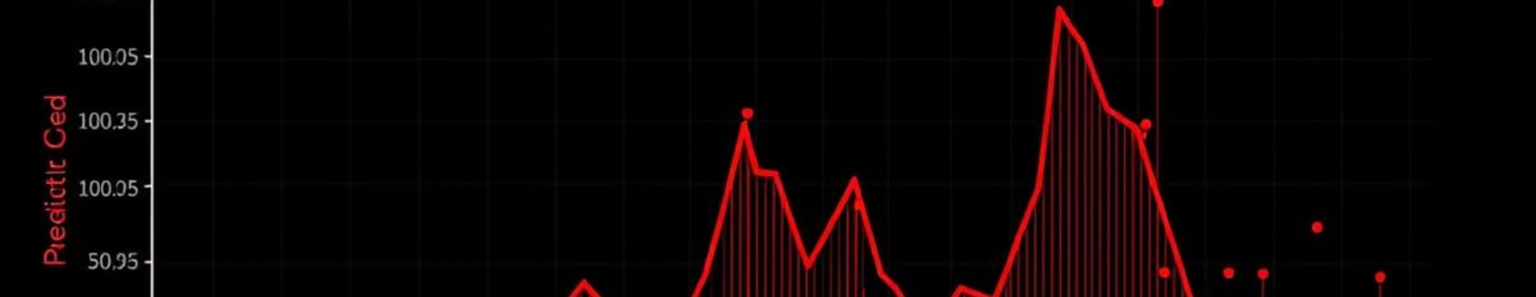
Model Evaluation: Metrics and Validation
R^2
MSE
MAE
R-squared
MSE
MAE
Measure of model fit and variance explained.
Average prediction error in the original units.
Average absolute error between predictions and actual values.
Notes:
8

Slide 9
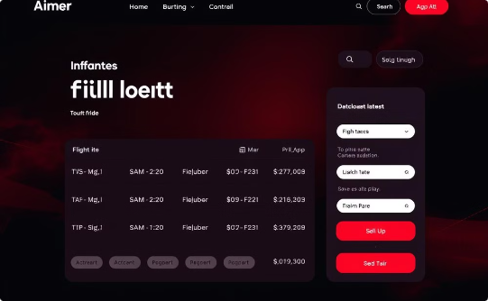
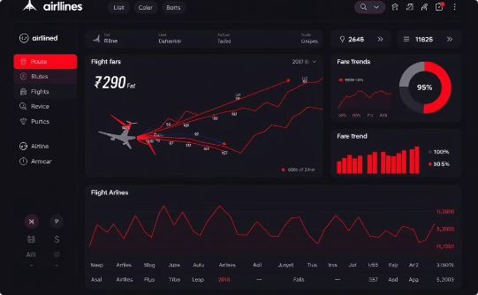

Real-World Applications: Dynamic Pricing and More
Dynamic Pricing
Route Optimization
Customer Strategies
Adjust prices based on real-time demand and market conditions.
Identify profitable routes and adjust flight schedules.
Provide personalized recommendations and targeted promotions.
Notes:
9

Slide 10
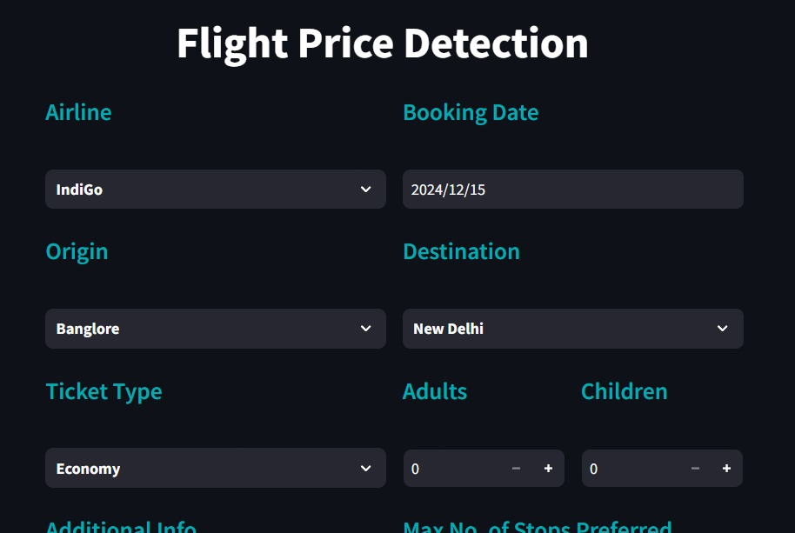
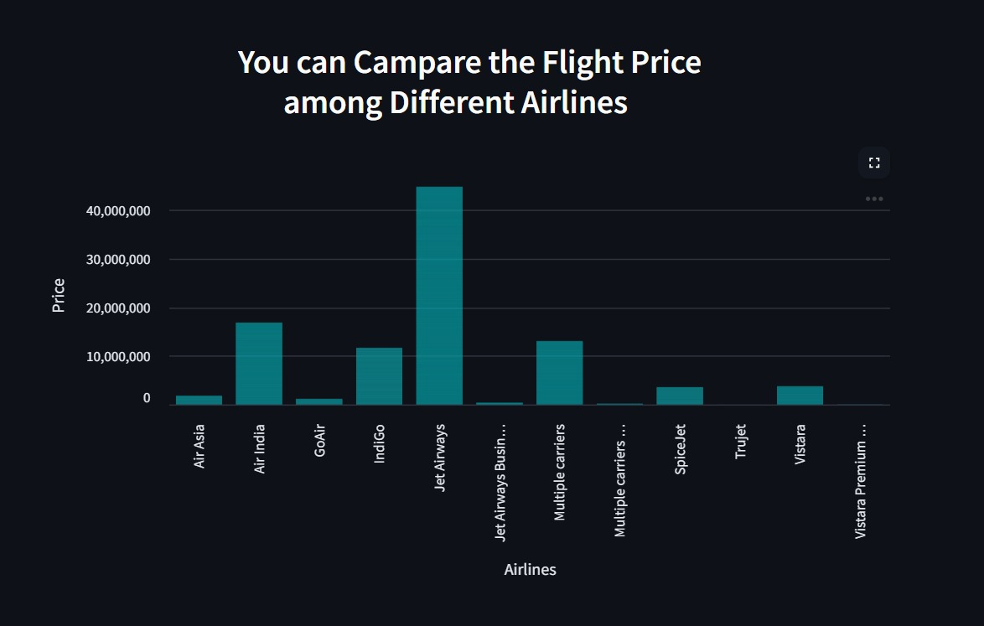
App View

Slide 11
Conclusion: Key Takeaways and Future Directions
1
Data-Driven Insights
Harness the power of data for accurate flight fare predictions.
2
Optimized Pricing
Maximize revenue and customer satisfaction through dynamic pricing.
Future Enhancements
3
Incorporate additional features, improve model accuracy, and explore real-time prediction capabilities.
Notes:
10

