Slide 1
functions
PHP web development 2019/2020
Milena Tomova
Vratsa Software
https://vratsasoftware.com/

Slide 2
Table of Contents
function declaration/definition/satement
function expression
IIFE

Slide 3
function declaration

Slide 4
function declaration
*also function definition, function statement
function name(parameter1, parameter2, parameter3) {
// code to be executed
}
Function parameters are listed inside the parentheses () in the function definition.
Function arguments are the values received by the function when it is invoked.

Slide 5
function declaration
The code inside the function will execute when "something" invokes (calls) the function:
When an event occurs (when a user clicks a button)
When it is invoked (called) from JavaScript code
Automatically (self invoked)

Slide 6
function declaration
invoking a function - example 1
name(arg1, arg2, arg3);

Slide 7
function declaration
example 2.a
function toCelsius(fahrenheit) {
return (5/9) * (fahrenheit-32);
}
A
var x = toCelsius(77),
text = "The temperature is " + x + " Celsius";
B
var text = "The temperature is " + toCelsius(77) + " Celsius";

Slide 8
function expression

Slide 9
function expression
The main difference between a function expression and a function declaration is the function name, which can be omitted in function expressions to create anonymous functions.
const getRectArea = function(width, height) {
return width * height;
};
console.log(getRectArea(3, 4));
// expected output: 12

Slide 10
function declaration
A function expression can be used as an IIFE (Immediately Invoked Function Expression) which runs as soon as it is defined. See also the chapter about functions for more information.

Slide 11
IIFE

Slide 12
IIFE
Immediately Invoked Function Exppressions
- a shielded scope in the global scope
a function that dies immediately after it came to life - after it is invoked
executes immediately the script is loaded
global scope is not poluted with variables and functions
the variables and functions declared inside of the IIFE are shielded - cannot be reached from the outside of the IIFE scope accidentally or intentionally

Slide 13
IIFE
.
(function () {
//statements - variables, functions declared and invoked inside the IIFE
})();

Slide 14
IIFE
.
(function () {
//statements - variables, functions declared and invoked inside the IIFE
})()
anonymous function with lexical scope enclosed within the Grouping Operator ()

Slide 15
IIFE
.
(function () {
//statements - variables, functions declared and invoked inside the IIFE
})()
creates the immediately invoked function expression () through which the JavaScript engine will directly interpret the function.

Slide 16
IIFE - examples
.
(function () {
var aName = "Barry";
})();
console.log( aName );
// Variable aName is not accessible from the outside scope
aName // throws "Uncaught ReferenceError: aName is not defined"

Slide 17
IIFE - examples
.
var result = (function () {
var name = "Barry";
return name;
})();
// Immediately creates the output:
result; // "Barry"

Slide 18
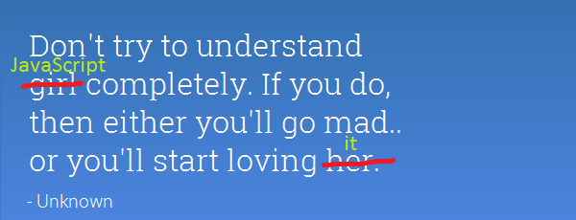
Projects

Slide 21



Trainings @ Vratsa Software
Vratsa Software – High-Quality Education, Profession and Jobs
www.vratsasoftware.com
The Nest Coworking
www.nest.bg
Vratsa Software @ Facebook
www.fb.com/VratsaSoftware
Slack Channel
www.vso.slack.com

