Slide 1

Piri Reis University
Faculty of Economics and Administrative Sciences
Management Information Systems Department
GRADUATION THESIS – YBS421
Real – Time Ship Detection With Using Yolov8
Deniz İlkiz 20210305036
Supervisor: Dr. Volkan Uslan

Slide 2
Contents
Introduction
Methodology
Results
Conclusion

Slide 3
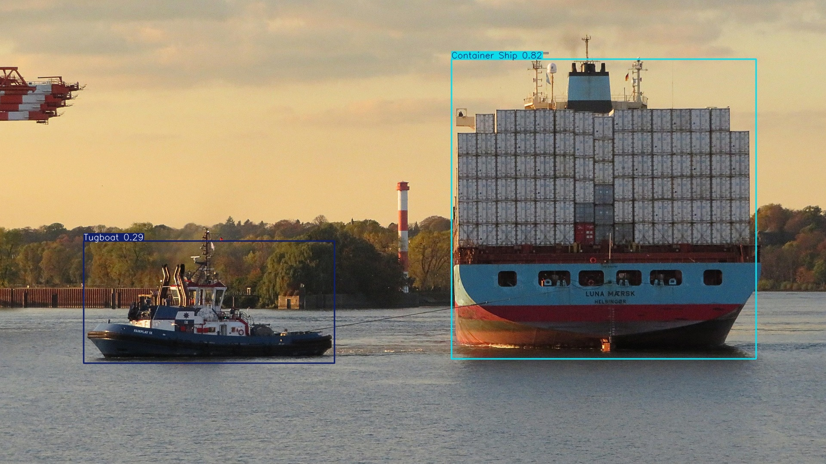
Introduction
Project Title : Real Time Ship Detection With Using YOLOv8
Why This Subject?
Traditional bottleneck in Maritime ship monitoring.
That is why develop a automic real time ship detection system.
Computer Vision integration for ship detection and classification is technological solution.

Slide 4



Methodology
Roboflow :
It is end to end data pipeline platform enables data labeling etc. Transfer dataset via API.
Google Colab:
A cloud-based development environment that provides support for NVIDIA T4/A100 GPUs, which require high computing power in the project process.
Yolov8:
This is the most up-to-date anchor-free object detection algorithm for real-time ship detection. It is preferred due to its balance of FPS and accuracy.

Slide 5
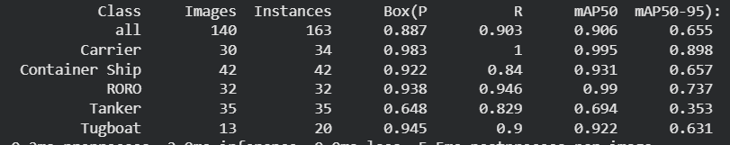
Results
mAP50 all 90.6% model successfully detect most ships.
Carrier and Roro were achieved most high confidence scores.

Slide 6
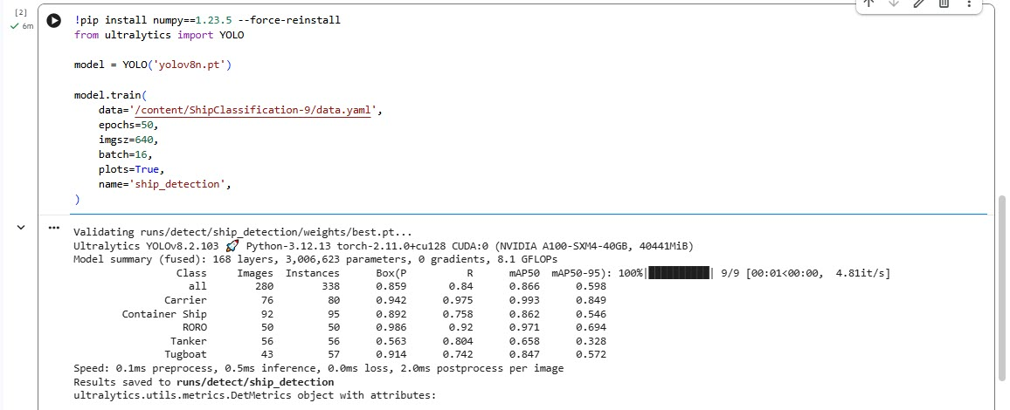
Result
Augmentation Version mAP50 all is 86.6% model successfully detect ships.
Carrier and Roro class achieved most high confidence scores.
Model collapse in mAP50 Tanker.
Performance Decrease happened when augmentation steps done. mAP scores decreased from 90.6% to 86.6%.

Slide 7
Conclusion
Model Success
Limit
Model Weakness
Suggestion
Project achieved 90.6% and 86.6% ship detection score.
Models trained with limited data are causing to overfitting. The 90.6% success rate drops to 86.6% under environmental noise.
The model's high tendency to perceive background noise as tankers and tugboats creating false positives results.
Deploy the model in real-time maritime monitoring systems.

Slide 8
THANK YOU

