Slide 1

AMLF RESERVATIONS
Monday, Jan 30th, 2023
 | LAB 1 | LAB 2 | LAB 3
8:30 – 9:00
9:00 – 9:30
9:30 – 10:00
10:00 – 10:30
10:30 – 11:00
11:00 – 11:30
11:30 – 12:00
12:00 – 12:30
12:30 – 1:00
1:00 – 1:30
1:30 – 2:00
2:00 – 2:30
2:30 – 3:00
3:00 – 3:30
3:30 – 4:00
4:00 – 4:30
4:30 – 5:30
5:30 – 8:30

Slide 2
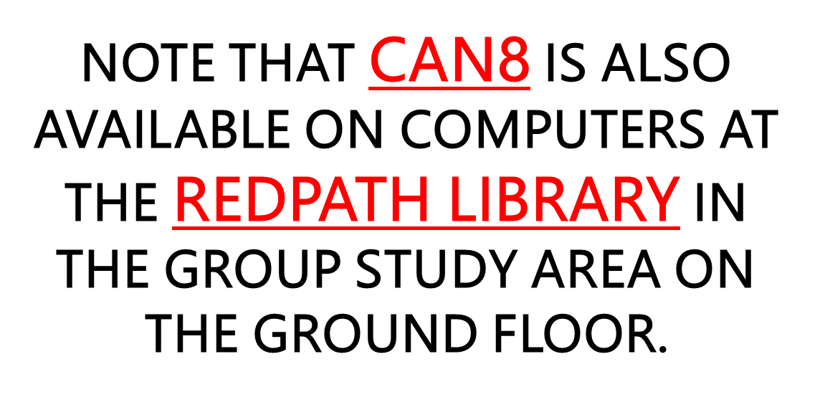
AMLF RESERVATIONS
Saturday, Oct. 5th, 2020
 | LAB 1 | LAB 2 | LAB 3
8:30 – 9:00 |  | MOSTLY FOR INDIVIDUAL PRACTICE
9:00 – 9:30
9:30 – 10:00
10:00 – 10:30
10:30 – 11:00
11:00 – 11:30
11:30 – 12:00
12:00 – 12:30
12:30 – 1:00
1:00 – 1:30
1:30 – 2:00
2:00 – 2:30
2:30 – 3:00
3:00 – 3:30
3:30 – 4:00
4:00 – 4:30
4:30 – 5:00

