Slide 2
Fundamentals of Programming
Lecture 3. Flow control

Slide 3
Agenda
To be able to implement decisions using if statements
To learn how to compare integers, floating-point numbers, and strings
To recognize the correct ordering of decisions in multiple branches
To program conditions using Boolean operators and variables

Slide 4
IF statement
amount ≤ balance?
false
true
balance =
balance – amount

Slide 5
IF/ELSE statement
amount ≤ balance?
true
false
balance =
balance – amount
balance =
balance – amount – overdraftPenalty

Slide 6
IF and IF/ELSE statements
if (condition) { statements } | if (condition) { statements } else { statements }

Slide 7
Examples
if (amount <= balance)
{
balance = balance – amount
}
if (amount <= balance)
balance = balance – amount
else
balance = balance – amount – overdraftPenalty

Slide 8
Relational Operators
Operator | Description
> | Greater than
>= | Greater than or equal
< | Less than
<= | Less than or equal
= | Equal
<> | Not equal

Slide 9
Multiple Alternatives
if (condition1) statement1 else if (condition2) statement2 else if (condition3) statement3 else statement4 | The first matching condition is executed Order matters

Slide 10
Multiple Alternatives
Order matters:
…
Do not omit “else”:
if (richter >= 0) //always passes
r = "Generally not felt by people“;
else if (richter >= 3.5) //not tested
r = "Felt by many people, no destruction“;
if (richter >= 8.0)
r = "Most structures fall";
if (richter >= 7.0) //omitted Else, ERROR is returned
r = "Many buildings destroyed";

Slide 11
Nested Branches
Branch inside another branch:
if (condition1)
{
if (condition1a) statement1a else statement1b
} else statement2

Slide 12
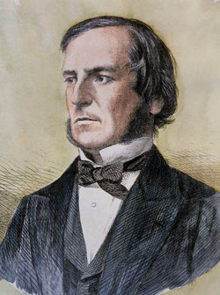
The Boolean Type
George Boole (1815-1864): pioneer in the study of logic
Value of expression amount < 1000 is true or false
Boolean type: one of these 2 truth values

Slide 13
Boolean Variables
bool married
Set to truth value: married = true
Use in conditions: if married if (!married)
Don't test Boolean variables against truth values - sign of cluelessness: if (married == true) // DON'T if (married = false) // DON'T if (married != false) // NO!!

Slide 14
Boolean Operators
&& – and (conjunction)
|| – or (disjunction)
! – not (negation)
…
…
if (0 < amount && amount < 1000)
if (input == "S" || input == "M")

Slide 15
AND, OR Operators
0 < amount
false
input = “S”
false
input = “M”
false
true
true
true
amount < 100
false
true
“AND” condition fulfilled
“OR” condition fulfilled

Slide 16
Typical mistakes
Wrong:
Correct:
if (price > 10 && < 20) ...
if (value == "S" || "M") ...
if (price > 10 && price < 20) ...
if (value = "S" || value == "M") ...

Slide 17
Truth Table – And (conjunction)
A | B | A and B
True | True | True
True | False | False
False | False | False

Slide 18
Truth Table – Or (disjunction)
A | B | A or B
True | True | True
True | False | True
False | False | False

Slide 19
Truth Table – Not (negation)
A | Not A
True | False
False | True

Slide 20
String Comparison
Usual “==” operator can be used if exact match is required
Don't use “=“ for strings if comparison is case insensitive
Use Compare method:
if (input == "Y")
if (input == "Y")
//WRONG for input = "y"!
if (String.Compare(input, "Y", True) == 0)

Slide 21
Comparing Strings
When comparing string the comparison starts from the left most character and the case matters
Place True or False in the 3rd column:
StrA | StrB | StrA < StrB
Apple | Basket | True
Geese | Geek | False
Hello | Hello World | True

Slide 22
Select … Case
If the selection happens from the multiple number of choices then the if structure could be replaced with switch…case structure
It is easier to modify and more readable

Slide 23
Select … Case structure
switch (expression)
{
case <case clause>:
<actions>
break;
case <case clause>:
<actions>
break;
…
default:
<actions>
break;
}

Slide 24
Select … Case example
switch (DeptNum)
{
case 11:
case 18:
case 19:
Building = "A";
break;
case int n when (n <= 6):
Building = "B";
break;
default:
Building = "C";
break;
}
The Case clause may:
list individual values,
list a range of values using the when keyword
must end with break keyword

Slide 25
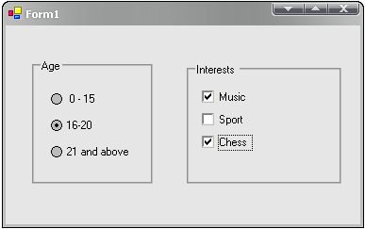
CheckBox and RadioButton

Slide 26
CheckBox and RadioButton
To identify the state of the CheckBox or the RadioButton (checked or unchecked) use ‘Checked’ property of the component.
If the value is True then the component is checked.
If the value is False – the component is unchecked.

Slide 27
The End

