Slide 1
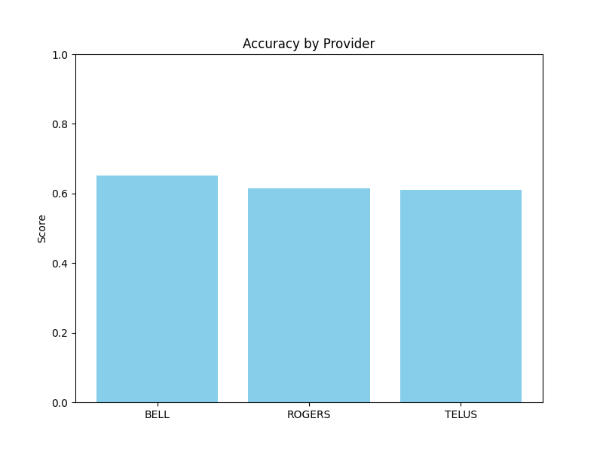
Accuracy by Provider

Slide 2
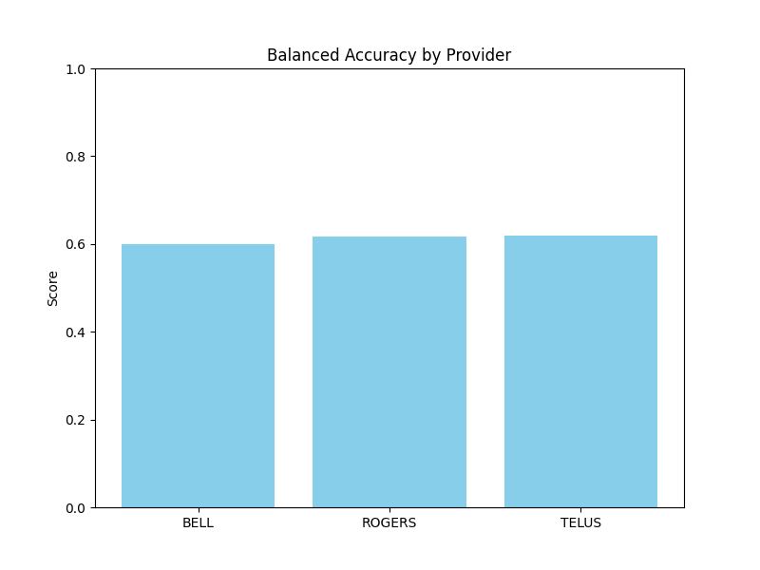
Balanced Accuracy by Provider

Slide 3
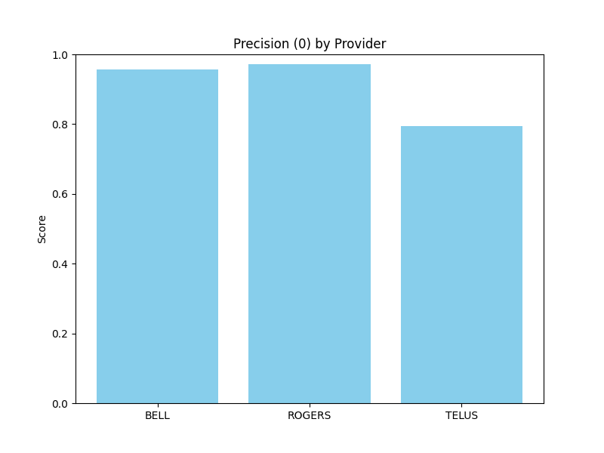
Precision (0) by Provider

Slide 4
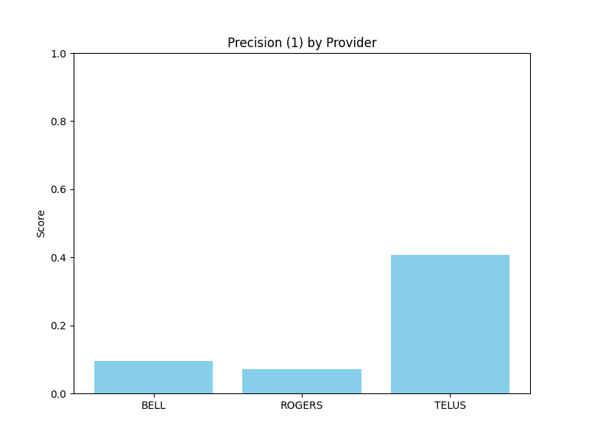
Precision (1) by Provider

