Slide 1
BBM384 Software Engıneerıng Laboratory SocIal Interest e-Club
Team Members:
Atakan Ak – 21626862
Deniz Ece Aktaş – 21626901
Volkan Erciyas – 21627208
Elif Ayça Çoşkun - 21727077

Slide 2





Task management AND COmmunıcatıon

Slide 3
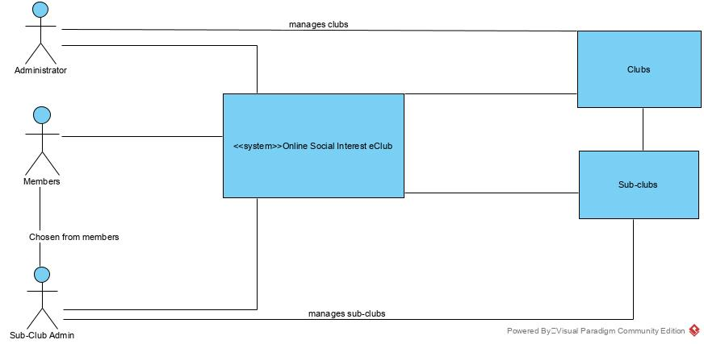
PROJECT OVERVIEW/CONTEXT DIAGRAM

Slide 4




BACKEND TECHNOLOGIES

Slide 5

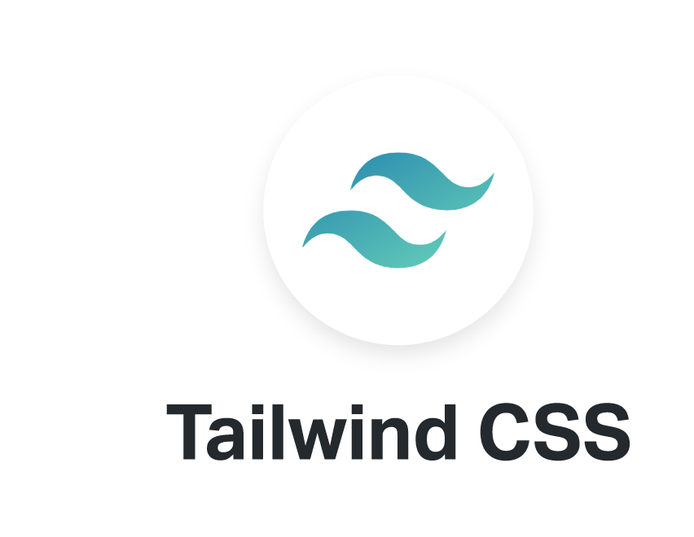

FRONTEND TECHNOLOGIES

Slide 6
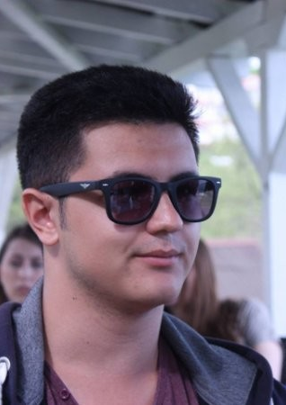
ATAKAN AK
Software developer, software analyst, software configuration manager
Designed the web application’s interfaces using Figma.
Implemented the frontend and connected the frontend to backend with end points.
Identified the configuration desicisons like documents and databases
Analyzed the system to make sure requirenments are met.
Wrote the parts of documentations I was responsible for.

Slide 7
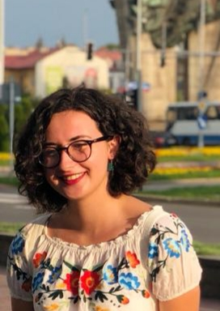
DENİZ ECE AKTAŞ
Software developer, software analyst, software project manager
Designed the interfaces as well.
Implemented the frontend and connected the frontend to backend with end points.
Scheduled some extra meetings and assigned the tasks about the delivery documents, kept track of the documents and their due dates.
Analyzed the system to make sure requirenments are met.
Filled the parts I was responsible for with documents.

Slide 8
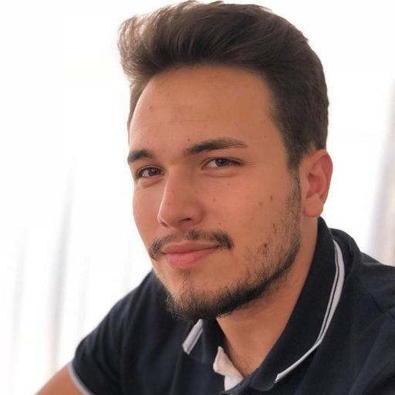

VOLKAN ERCİYAS
Software developer, software analyst, software Architect
Developed the backend with Elif Ayça Çoşkun.
Did research on the technology standards that should be met.
Analyzed the system to make sure requirenments are met.
Filled the documents I had to write.

Slide 9
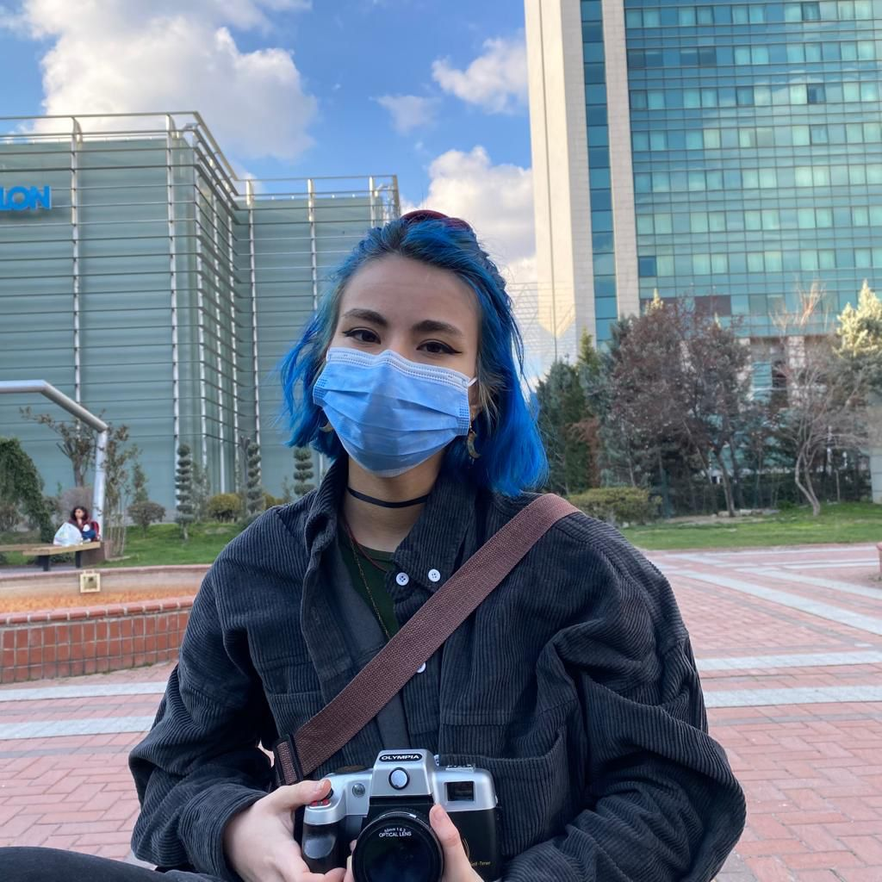
ELİF AYÇA ÇOŞKUN
Software developer, software analyst, software tester
Worked on creation of test cases and tested the system with the team by using Postman.
Developed the backend with Volkan Erciyas by using Java Spring framework.
Analyzed the system to make sure requirenments are met.
Wrote the deliverey documents I was assigned to.

Slide 10

WORK DONE BY ALL MEMBERS
We had weekly meetings where we discussed the project and our progress.
For the delivery reports, we divided the diagrams and parts of the documents and before the due date in our weekly meetings we thought each other what we learned.
We decided the designs of interfaces and the architectural designs and Project’s features together during meetings.

