Slide 1
BBM 419 DESIGN PROJECT I
WEB PAGE COMPLEXITY STUDY

Slide 2
TEAM:
Ece Omurtay
21627543
Ömer Bilal Yay
21627802
Deniz Ece Aktaş
21626901

Slide 3
INTRODUCTION:
Classification of the visual complexity level of web pages through CNN based learning methods.
The visual appearance of web pages affects the way a user will interact with the web page contents. The layout which shapes the visual characteristics of overall appearance, the placement and visual presentation of these components influence the perceived visual complexity. At this point, the literature suggests that the visual complexity of a web page impacts the cognitive load and effort of the users when they interact with web pages.

Slide 4
This project investigates the use of convolution neural network-based deep learning methods for understanding the visual complexity level of the web pages.
To do this, we first of gathered a base case by making a website and gathering user scores that provide an insight of how visually complex a website is from the screenshots we provided. Afterwards we sectored the base case and made a database and then we found the feature vectors of websites and optimized the vectors and finally we are working with different machine learning methods to classify the level of complexity of web pages based on dimensionally reduced vectors.

Slide 5
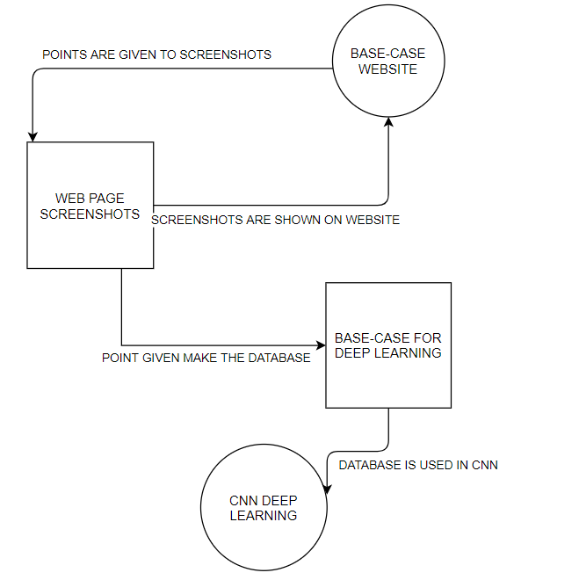
METHOD:

Slide 6
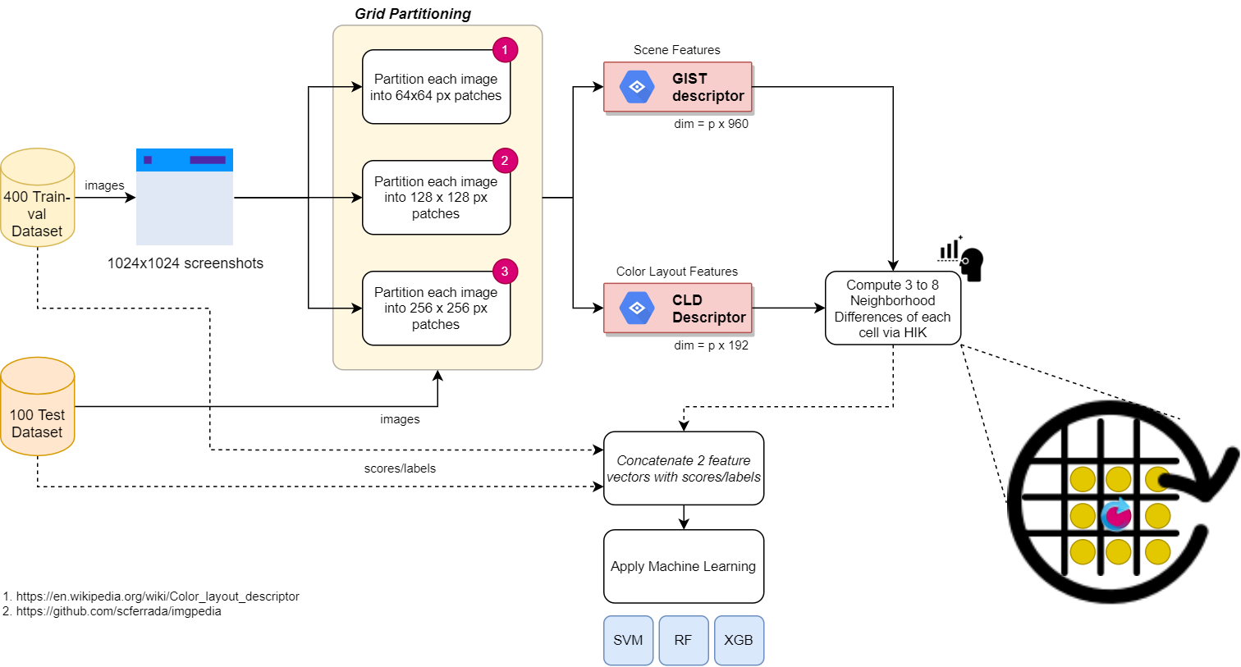
TECHNICAL METHOD:

Slide 7
TASKS:
To get the base-case webpage development.
Implementing the point acquired from website into database.
Using the data base and implementing CNN and testing.

Slide 8
PERSONAL ACCOMPLISHMENTS
Did research on the topic.
Worked with asp.net in Microsoft Visual Studio to implement a survey website for the purpose of getting base-case inputs for machine learning part.
Spread the word about the survey and encouraged people to take the survey.
Grid partitioned the dataset images. Wrote the reports and presentation.

Slide 9
RISKS WE ENCOUNTERED AND SOLUTIONS
If the user points are given in the start of the project is given with errors or given not seriously.
We implemented a confirmation system for points by taking five backup points and comparing them to other points.
The hardware that we have (windows pc) doesn’t run the programs needed.
The GIST descriptor we planned to use didn’t work on windows pcs and we do not possess or have access to a Linux device so we decided to use HOG descriptor instead.

Slide 10
SELF EVALUATION
The biggest problem we had was about time management and not the content itself. As a team we worked well together and did the most of the work together but because of COVID-19 we couldn’t meet up so we only met up online and this brought up some issues like if someone’s internet was down we had to delay our meeting.

Slide 11
LESSONS LEARNED
As a team all of the material in this project was new knowledge to us, so we learnt a lot of information about a lot of fields like computer vision, machine learning, web development and database management but because we had to learn a lot of things from scratch we were a little slow during implantation.

Slide 12
Thank You.

