Slide 1
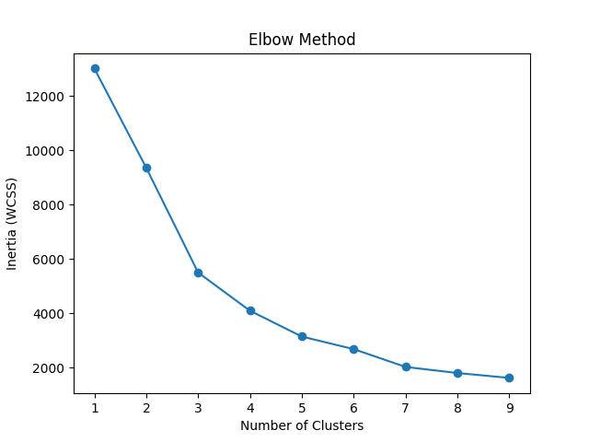
Elbow Method for KMeans

Slide 2
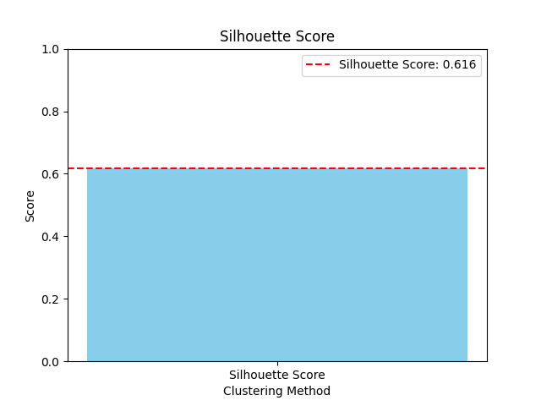
Silhouette Score

Slide 3
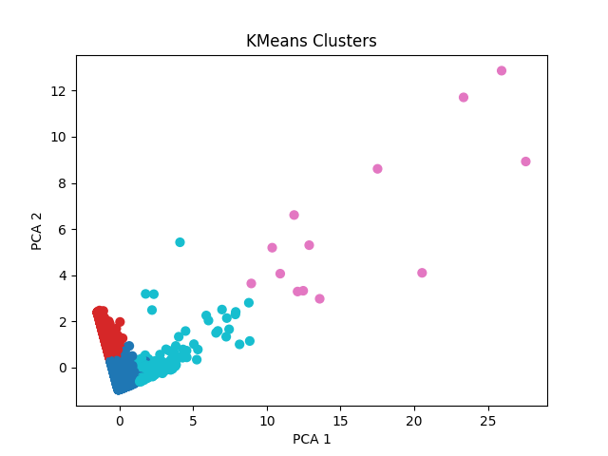
KMeans Clusters

Slide 4
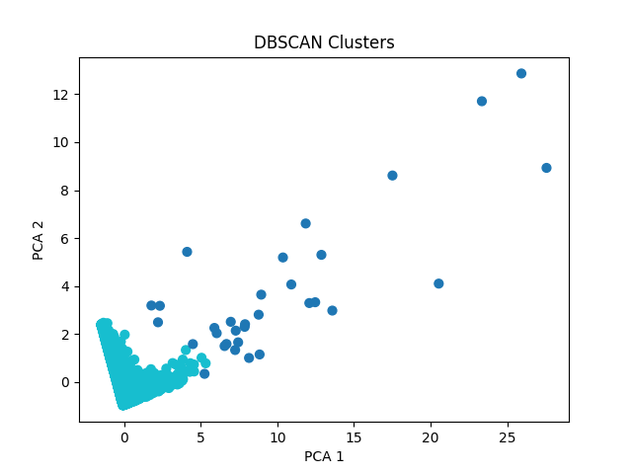
DBSCAN Clusters

