Slide 1
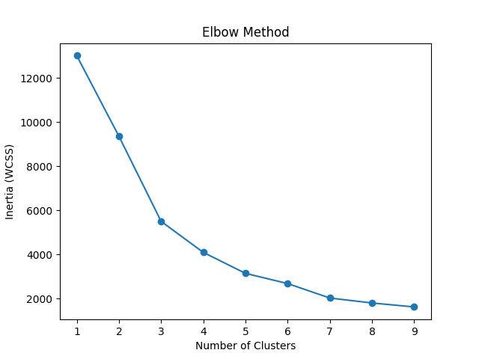
Elbow Method for KMeans

