Slide 1
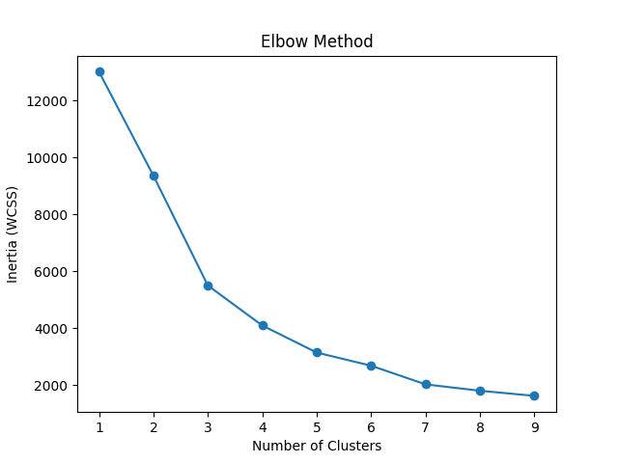
Elbow Method for KMeans

Slide 2
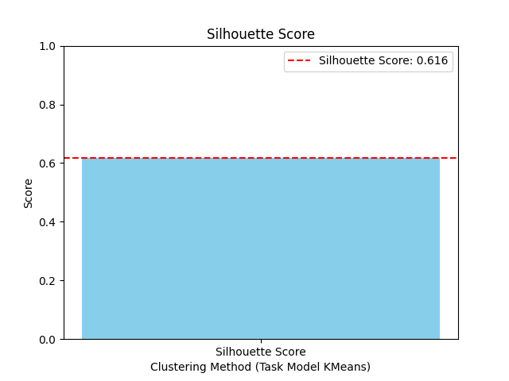
KMeans

Slide 3
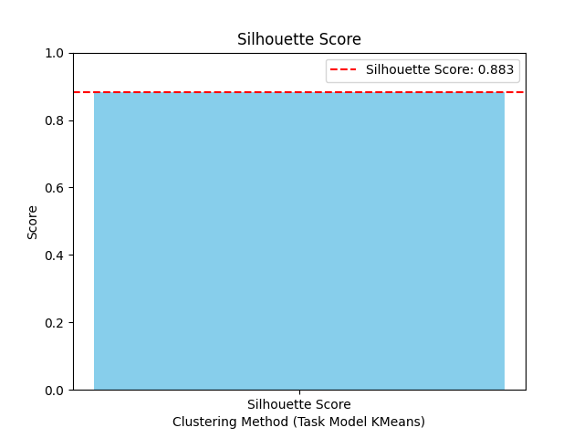
DBScan

Slide 4
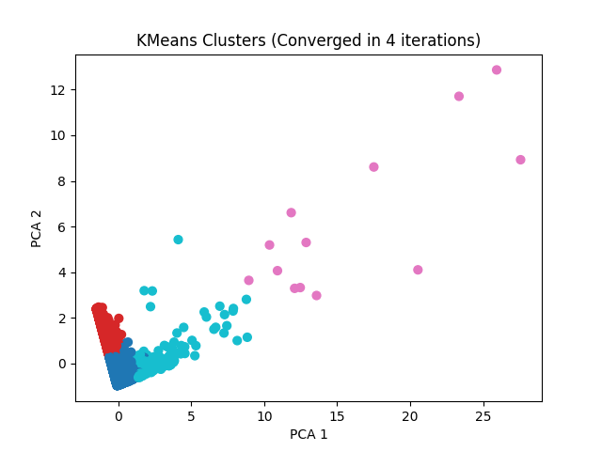
KMeans Clusters (Converged in 4 iterations)

Slide 5
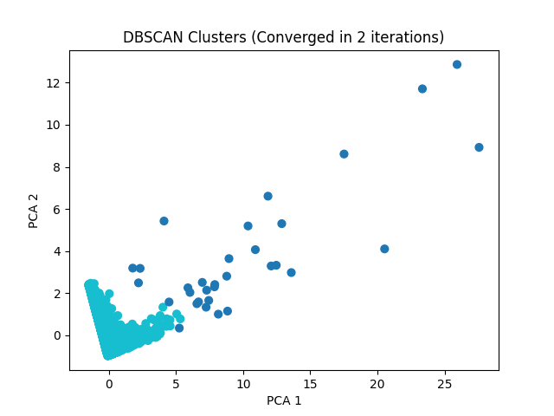
DBSCAN Clusters (Converged in 2 iterations)

