Slide 1
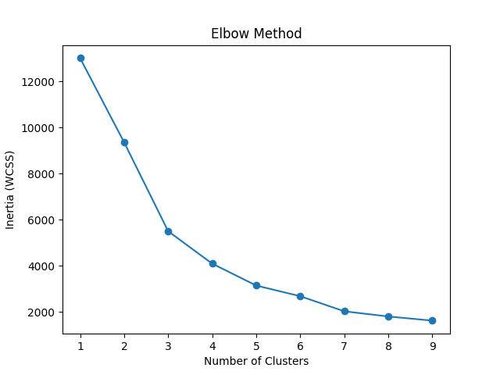
Elbow Method for KMeans

Slide 2
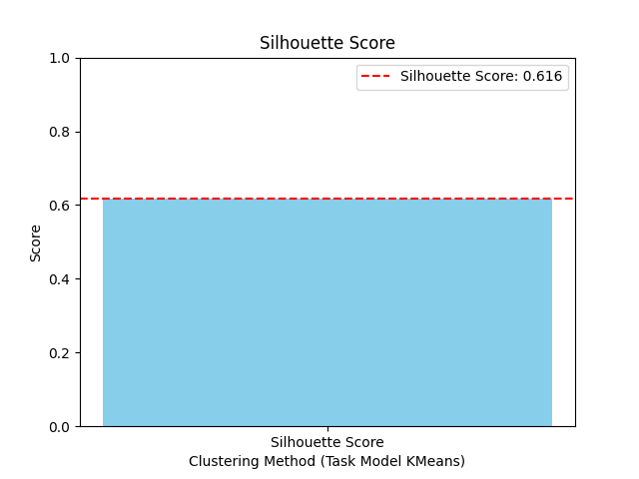
Silhouette Score

Slide 3
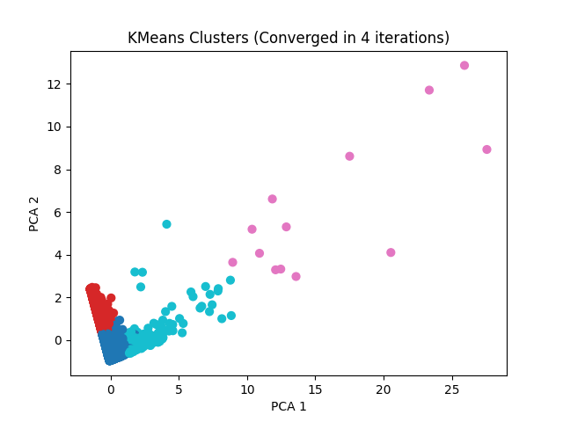
KMeans Clusters (Converged in 4 iterations)

Slide 4
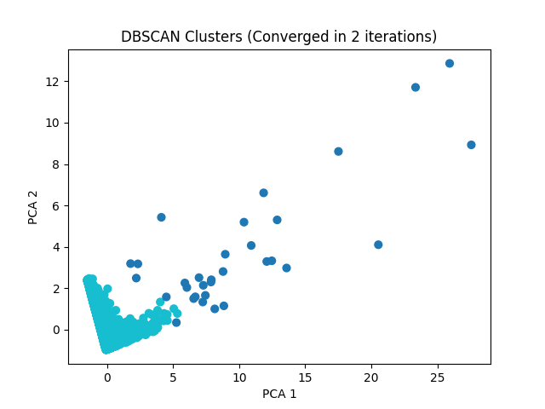
DBSCAN Clusters (Converged in 2 iterations)

