Slide 1
Automating Robust Multi-Scale Landform Identification
Charlie Frye, Sean Breyer, Randy Vaughan, Esri, Redlands

Slide 2
Landform Identification
In support of Ecological Classification
Big Goal: Automate global assignment of ecological characteristics
How it works: Combine weighted characteristics of landforms, climate, rock type, and land cover to produce ecological land units.
Our first effort would have benefitted from better data.
Esri’s opportunity is to improve on landforms, which are derived from elevation
Notes:
Elevation, vs. mapping or climate science where we have insufficient expertise.

Slide 3
What are landforms?
Derived from Digital Elevation Models
Plains | Hills | Mountains
Flat | Low | High
Smooth | General* | Low*
Irregular* | Foothills* | Canyons*
 |  | Escarpments*
*Problematic or frequently perceived as misclassified

Slide 4
What are landforms?
Derived from Digital Elevation Models
Plains | Hills | Mountains
Flat | Low | High
Smooth | General | Low
Irregular | Foothills | Canyons
Basins in Mountain Ranges | Badlands | Escarpments
Plateaus… |  | …or Table-top Mountains
Coastal vs. High
Notes:
Sky Islands are an example of a special case of Plateaus.

Slide 5
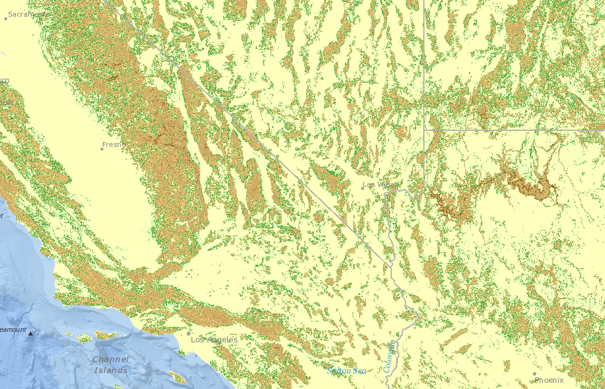
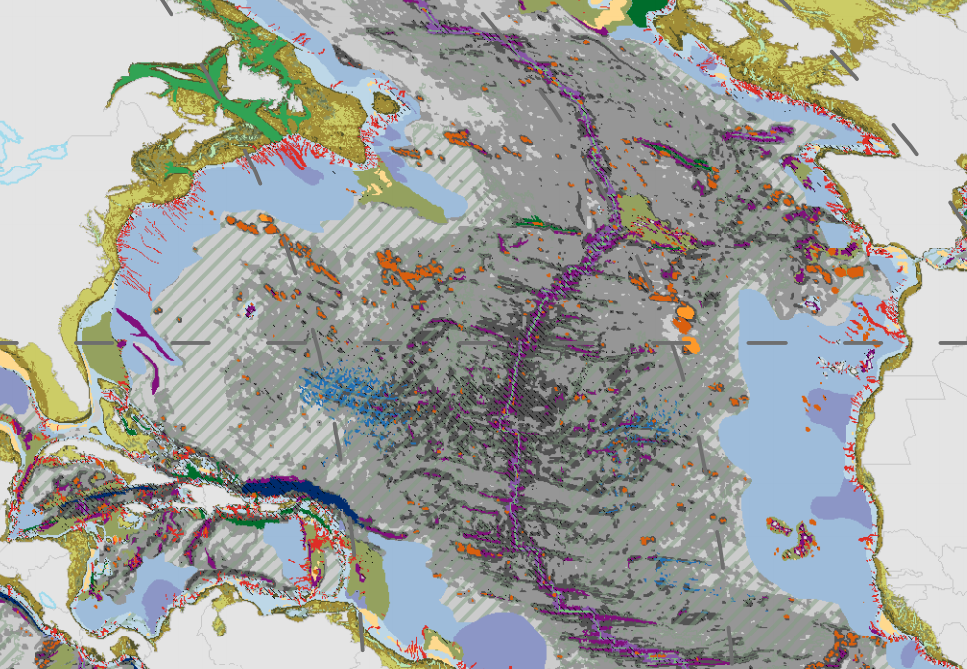
From Current (fragmented) to more like Seafloor Work
Seafloor from GRIDa by Miles Macmillan-Lawler

Slide 6
Current Data
Produced by USGS from GMTED (250m resolution DEM)
Earth is divided into two characteristics based on 8% slope threshold (Plains and not Plains)
The relief in each are evaluated to assign the relative smoothness of plains and a progression from low hills to high mountains
The elevation model is “flipped” to find canyons (versus mountains).
The results are too often confusing, not fully relevant to ecological work, and very fragmented

Slide 7
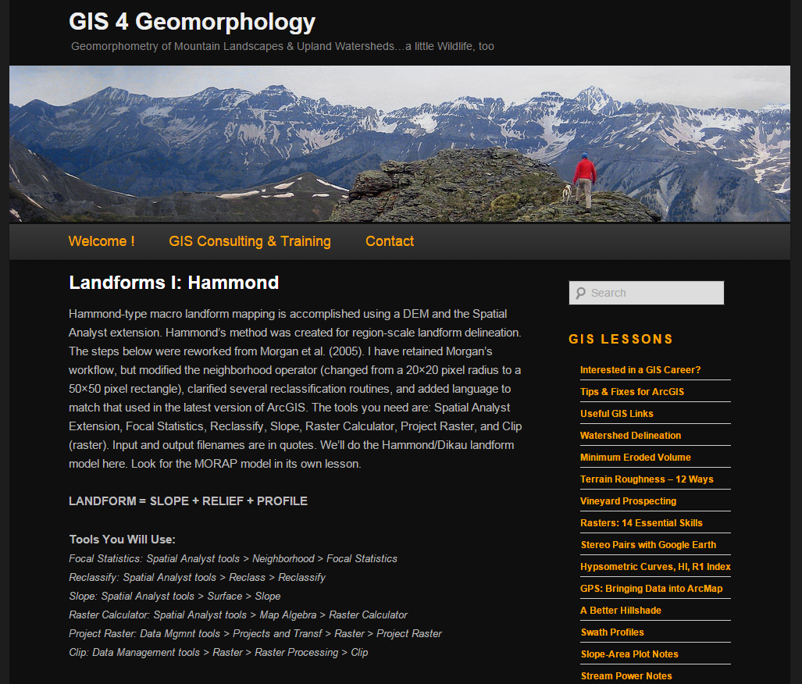
Initial Prototype
Implement Hammond’s Landform model
A 42-step model to create a more robust classification with 24 classes:
11-Flat or nearly flat plains 12-Smooth plains with some local relief 13-Irregular plains with low relief 14-Irregular plains with moderate relief 21-Tablelands with moderate relief 22-Tablelands with considerable relief 23-Tablelands with high relief 24-Tablelands with very high relief 31-Plains with hills 32-Plains with high hills 33-Plains with low mountains 34-Plains with high mountains 41-Open very low hills 42-Open low hills 43-Open moderate hills 44-Open high hills 45-Open low mountains 46-Open high mountains 51-Very low hills 52-Low hills 53-Moderate hills 54-High hills 55-Low mountains 56-High mountains
Notes:
11-Flat or nearly flat plains 12-Smooth plains with some local relief 13-Irregular plains with low relief 14-Irregular plains with moderate relief 21-Tablelands with moderate relief 22-Tablelands with considerable relief 23-Tablelands with high relief 24-Tablelands with very high relief 31-Planis with hills 32-Plains with high hills 33-Plains with low mountains 34-Plains with high mountains 41-Open very low hills 42-Open low hills 43-Open moderal hills 44-Open high hills 45-Open low mountains 46-Open high mountains 51-Very low hills 52-Low hills 53-Moderate hills 54-High hills 55-Low mountains 56-High mountains

Slide 8
Results are promising, but… not fully ecologically useful
Incomplete, and not quite specific and in places too much detail
Missing Canyons, Terraces, Escarpments
Plateaus/tablelands (high and low) are just ribbons around edges of larger features
Coastal vs. High plains (Global/Continental versus excerpt processing)
Parameterize thresholds such as % slope level that differentiates between plains and low hills.
Need to be based on minimum mapping units for each kind of landform based on input elevation resolution

Slide 9
Qualifications and Skills that will be developed.
GIS Project Set-up and Management
Python (model automation and scripting with ArcPy)
Landform Identification and Geomorphology understanding

Slide 10
Deliverables
A robust Python code base that:
Adaptively runs on 10 to 250 meter resolution data
Addresses as many of the issues (slide 8) as possible
Test by producing
Study area & global results on 250m data
Study area & continental results on 30m data
Ongoing progress demonstrated by archived intermediate results datasets
A collection of final datasets to be documented as proof of progress

Slide 11
Esri will supply
Data and access to data
Initial prototype script
Documentation
Ongoing advisement

Slide 12
Thank you
Sponsor’s Contact Information:
Charlie Frye, Esri, Redlands
cfrye@esri.com
909.793.2853 x2115
Sean Breyer, Esri, Redlands
sbreyer@esri.com
909.793.2853 x2869
Randy Vaughan, Esri, Redlands
rvaughan@esri.com
909.793.2853 x2618

