Slide 1
Rewind
Deniz Skantz

Slide 2

Purpose / Initial Thoughts
Purpose
Rewind is a fun app that shows you information about the day that you were born. What were the top 10 hits?
All you have to do is put in your birth date and hit enter.
If you like any of list on the results add it to your playlist, you can edit, delete and add a new song to your playlist.
Initial Thoughts
Have multiple sources of data from different apis so that whoever puts in the date would get information on top music, top news and the fashion trends.
User should only make edits or deletes when they are logged in with their username and password. And they should be able to store their information when they re-login.
Have an image of the top song pop up.

Slide 3
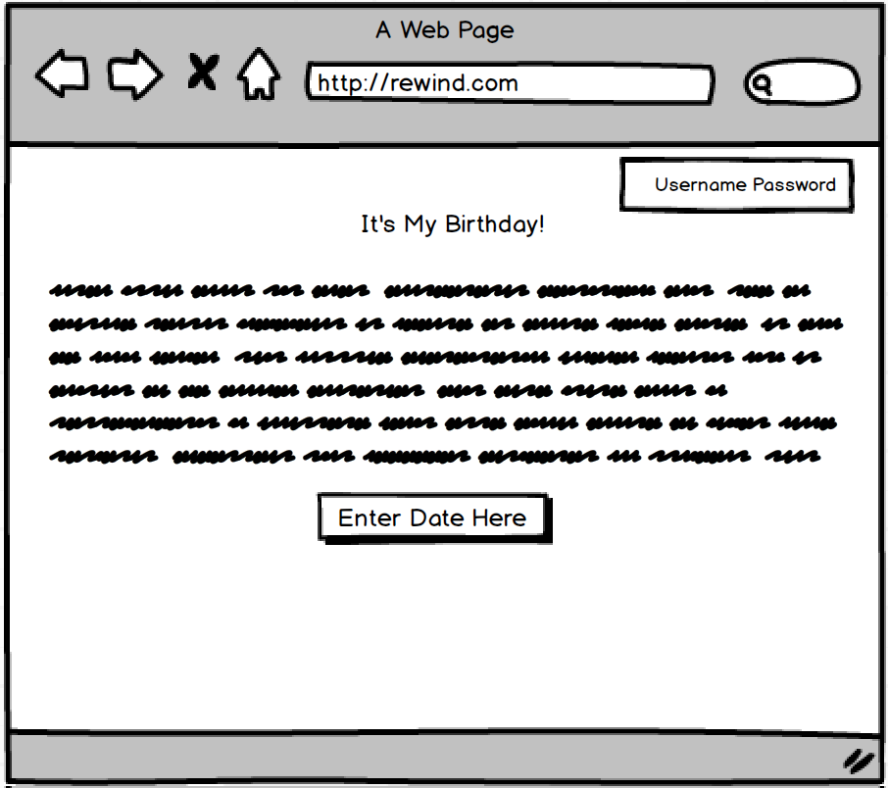
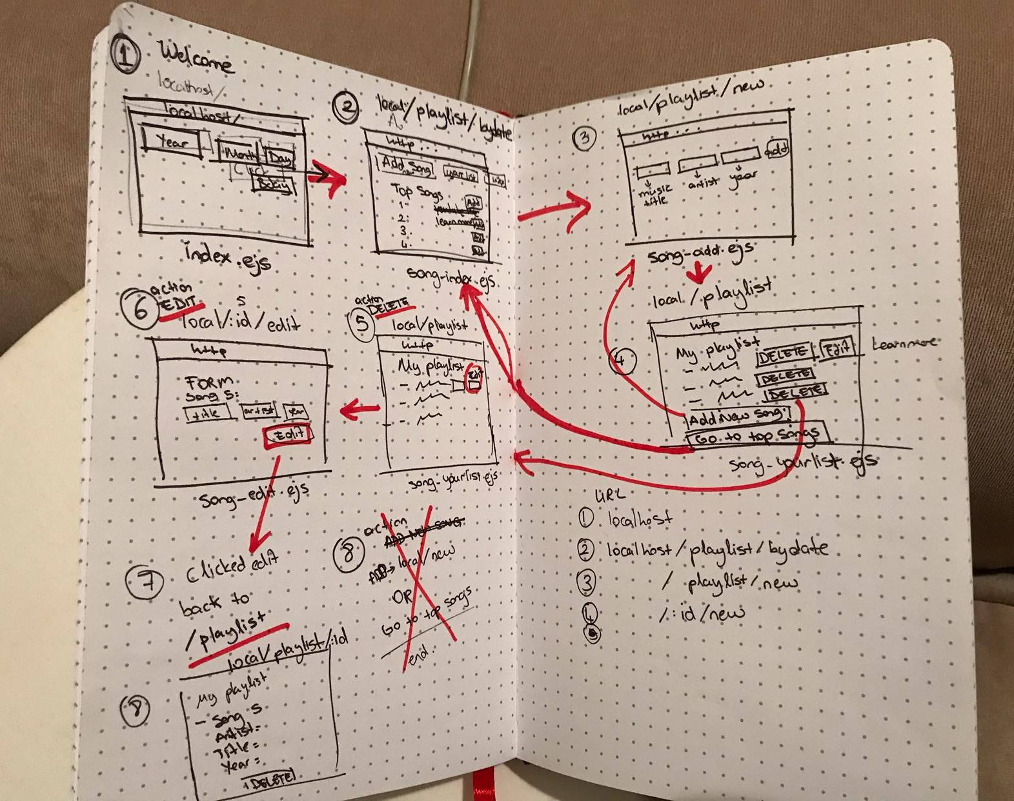
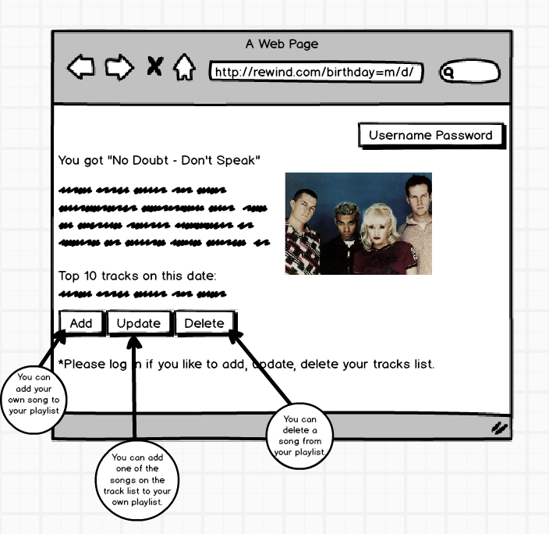
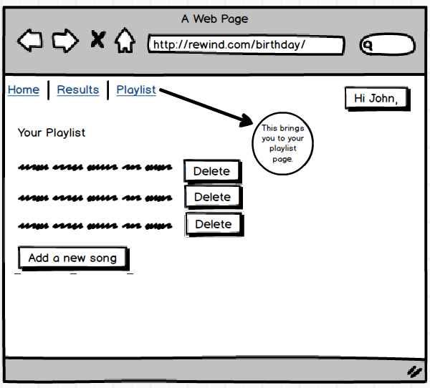
Wireframes
Welcome
Updated User Flow
API Call
Your Saved Playlist

Slide 4
Wins / Challenges
Wins
CRUD is working on the dummy database.
Understood the Importance of drawing. Especially user flow.
How do each file connect to each other?
Great at reading errors. (many git commits)
Challenges
So many errors
Connecting to api and saving that result on user’s playlist
SQL joins difference of left join – inner join.
Getting the CRUD elements to work with the new data and api.
Time management

