Slide 1
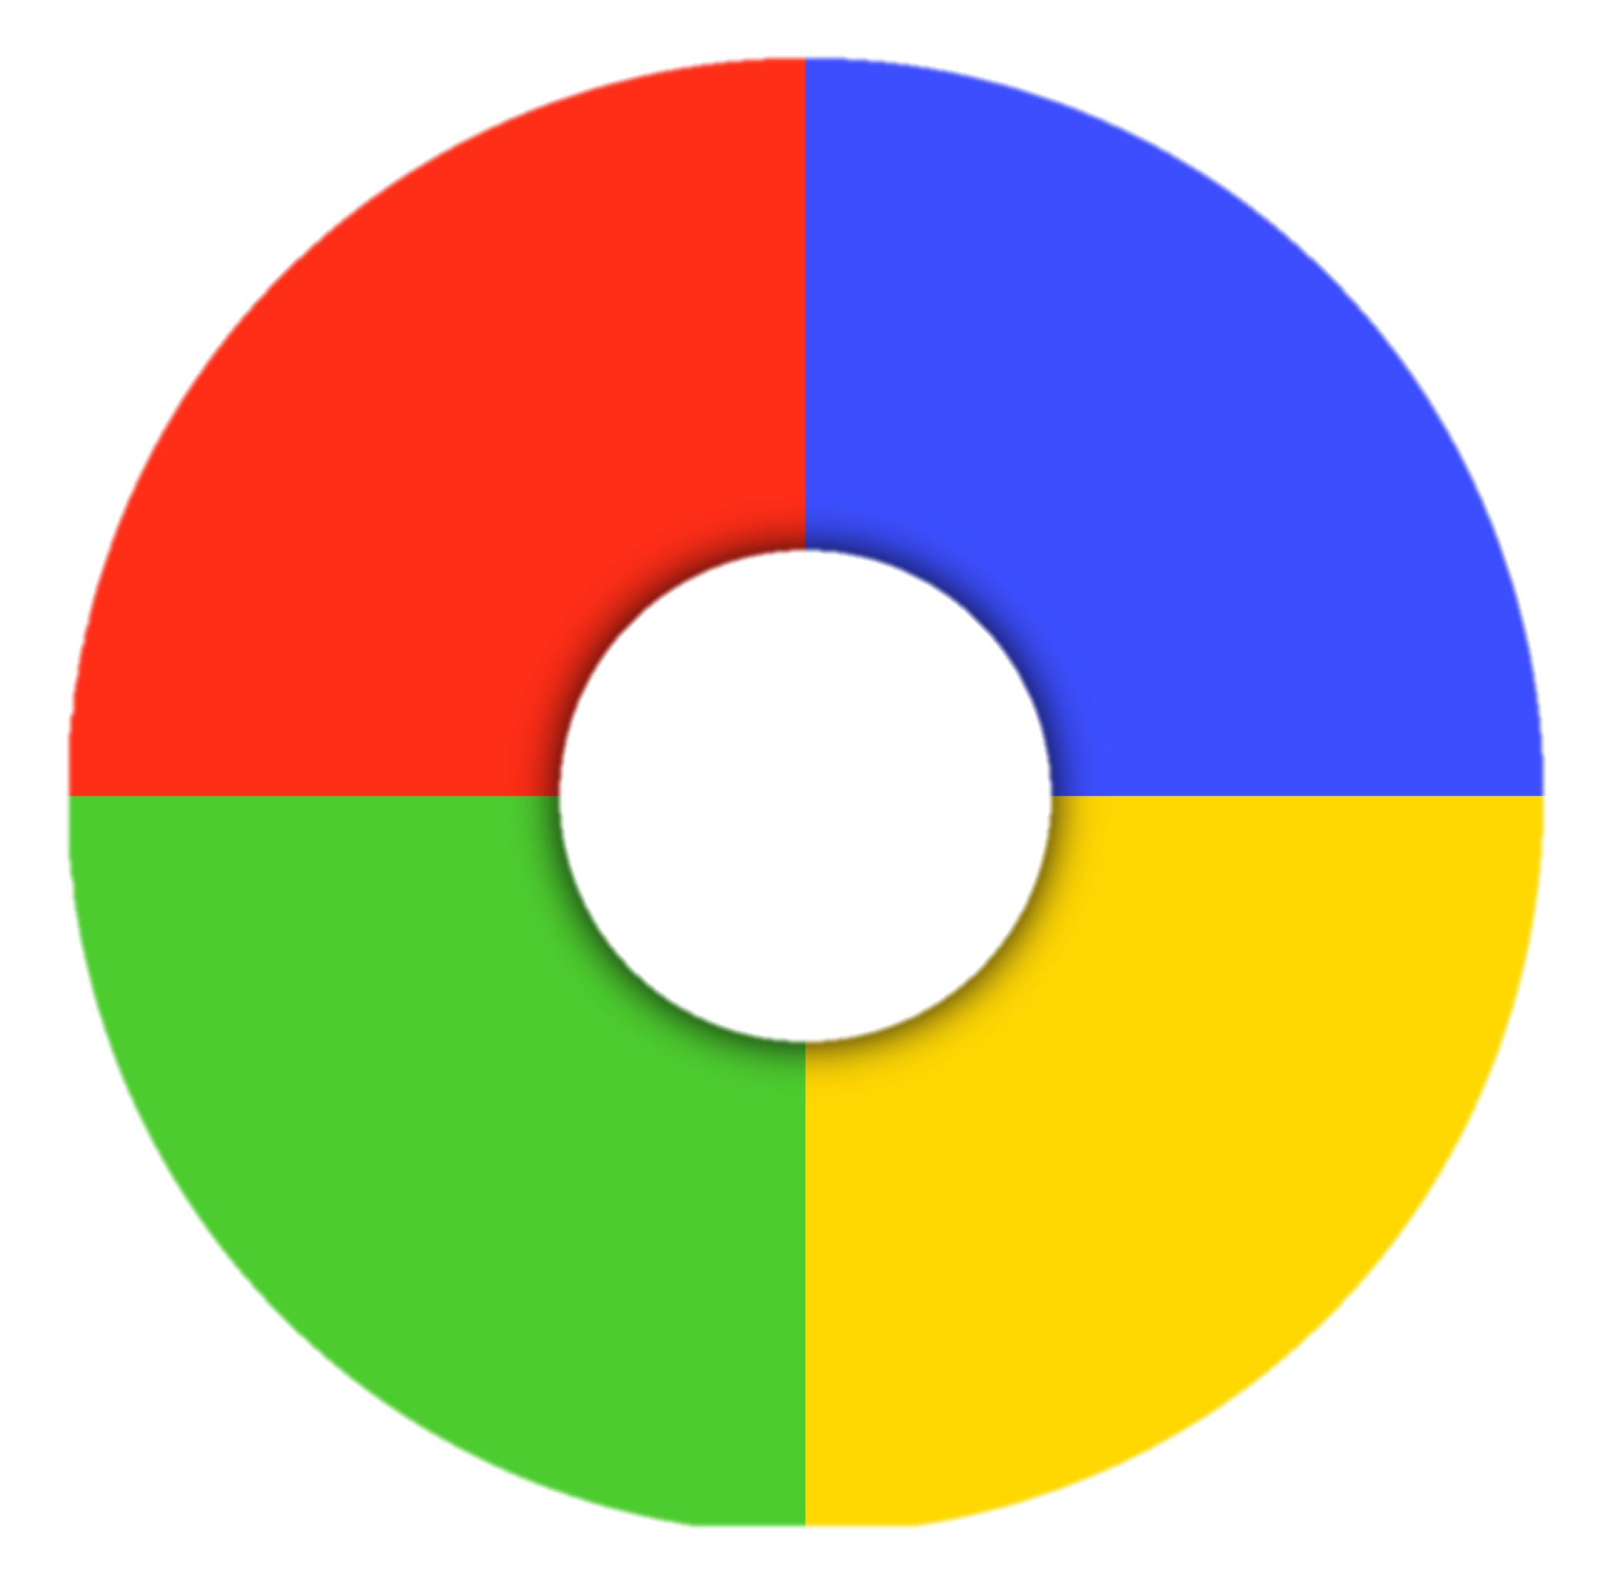
SIMON GAME
Project 1 – Presentation By Deniz
Notes:
http://project1-simon.bitballoon.com/

Slide 2
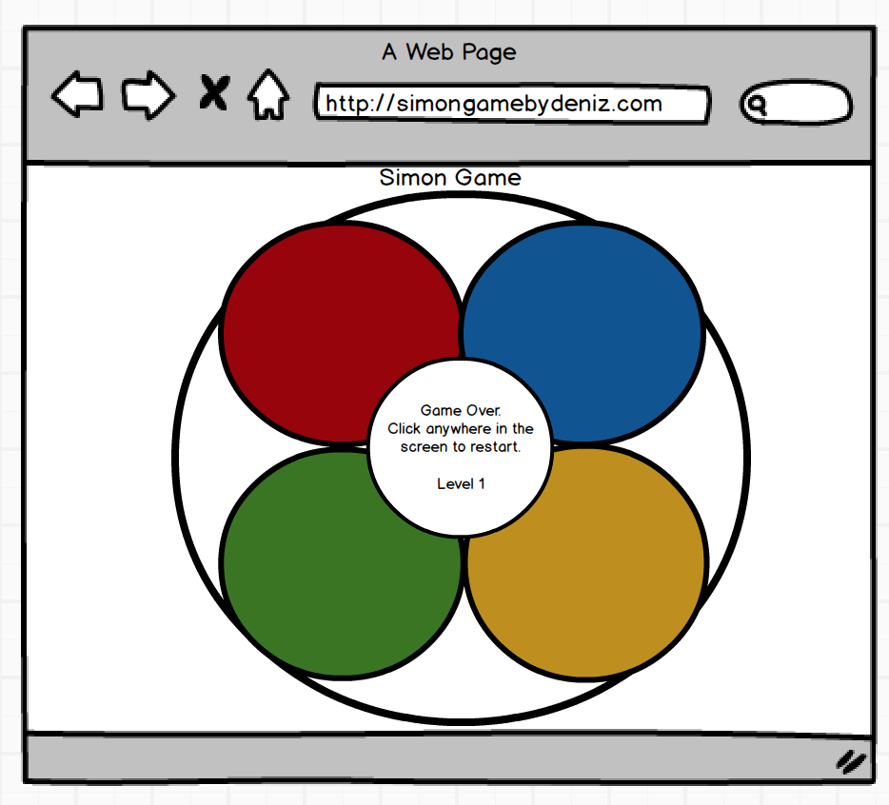
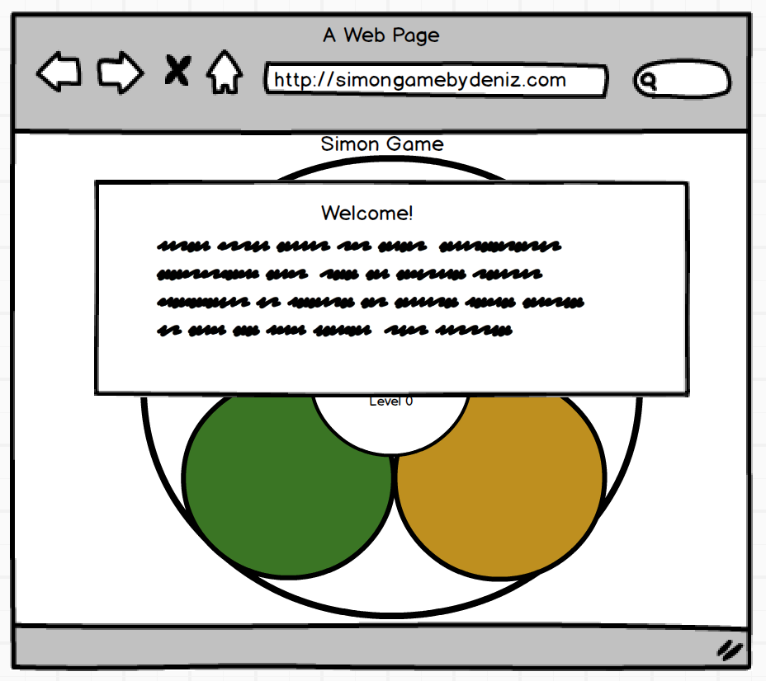
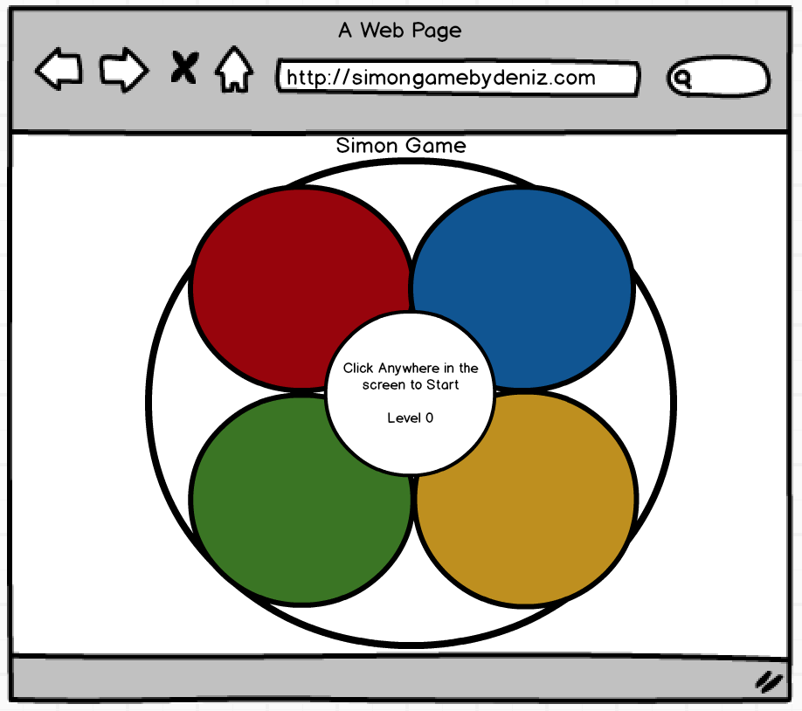
Wireframes
Landing Page
Game over
Start Game
2

Slide 3
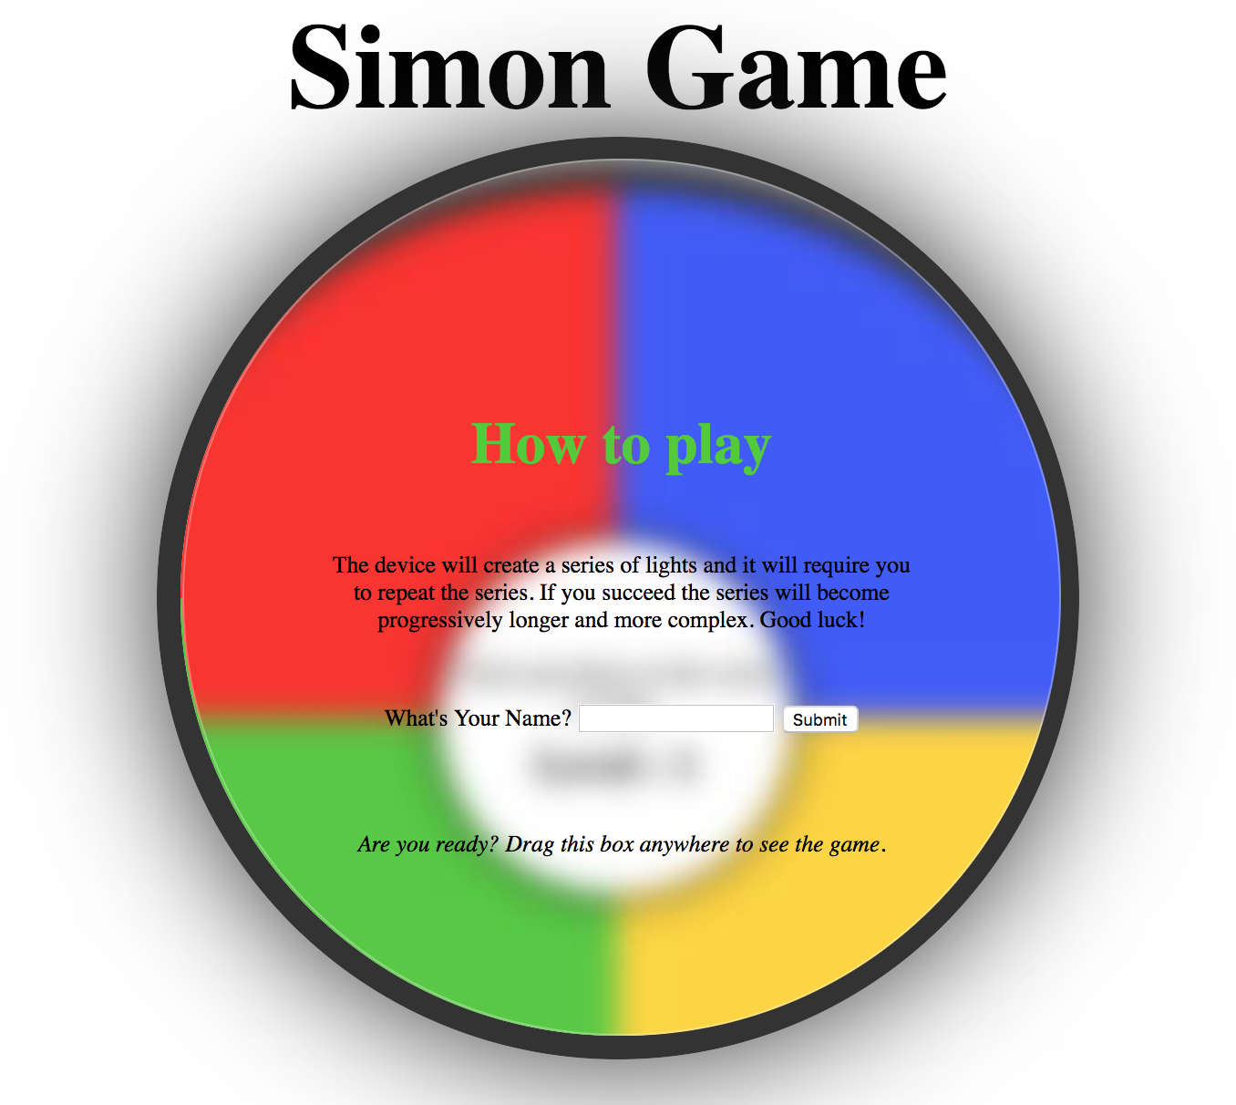
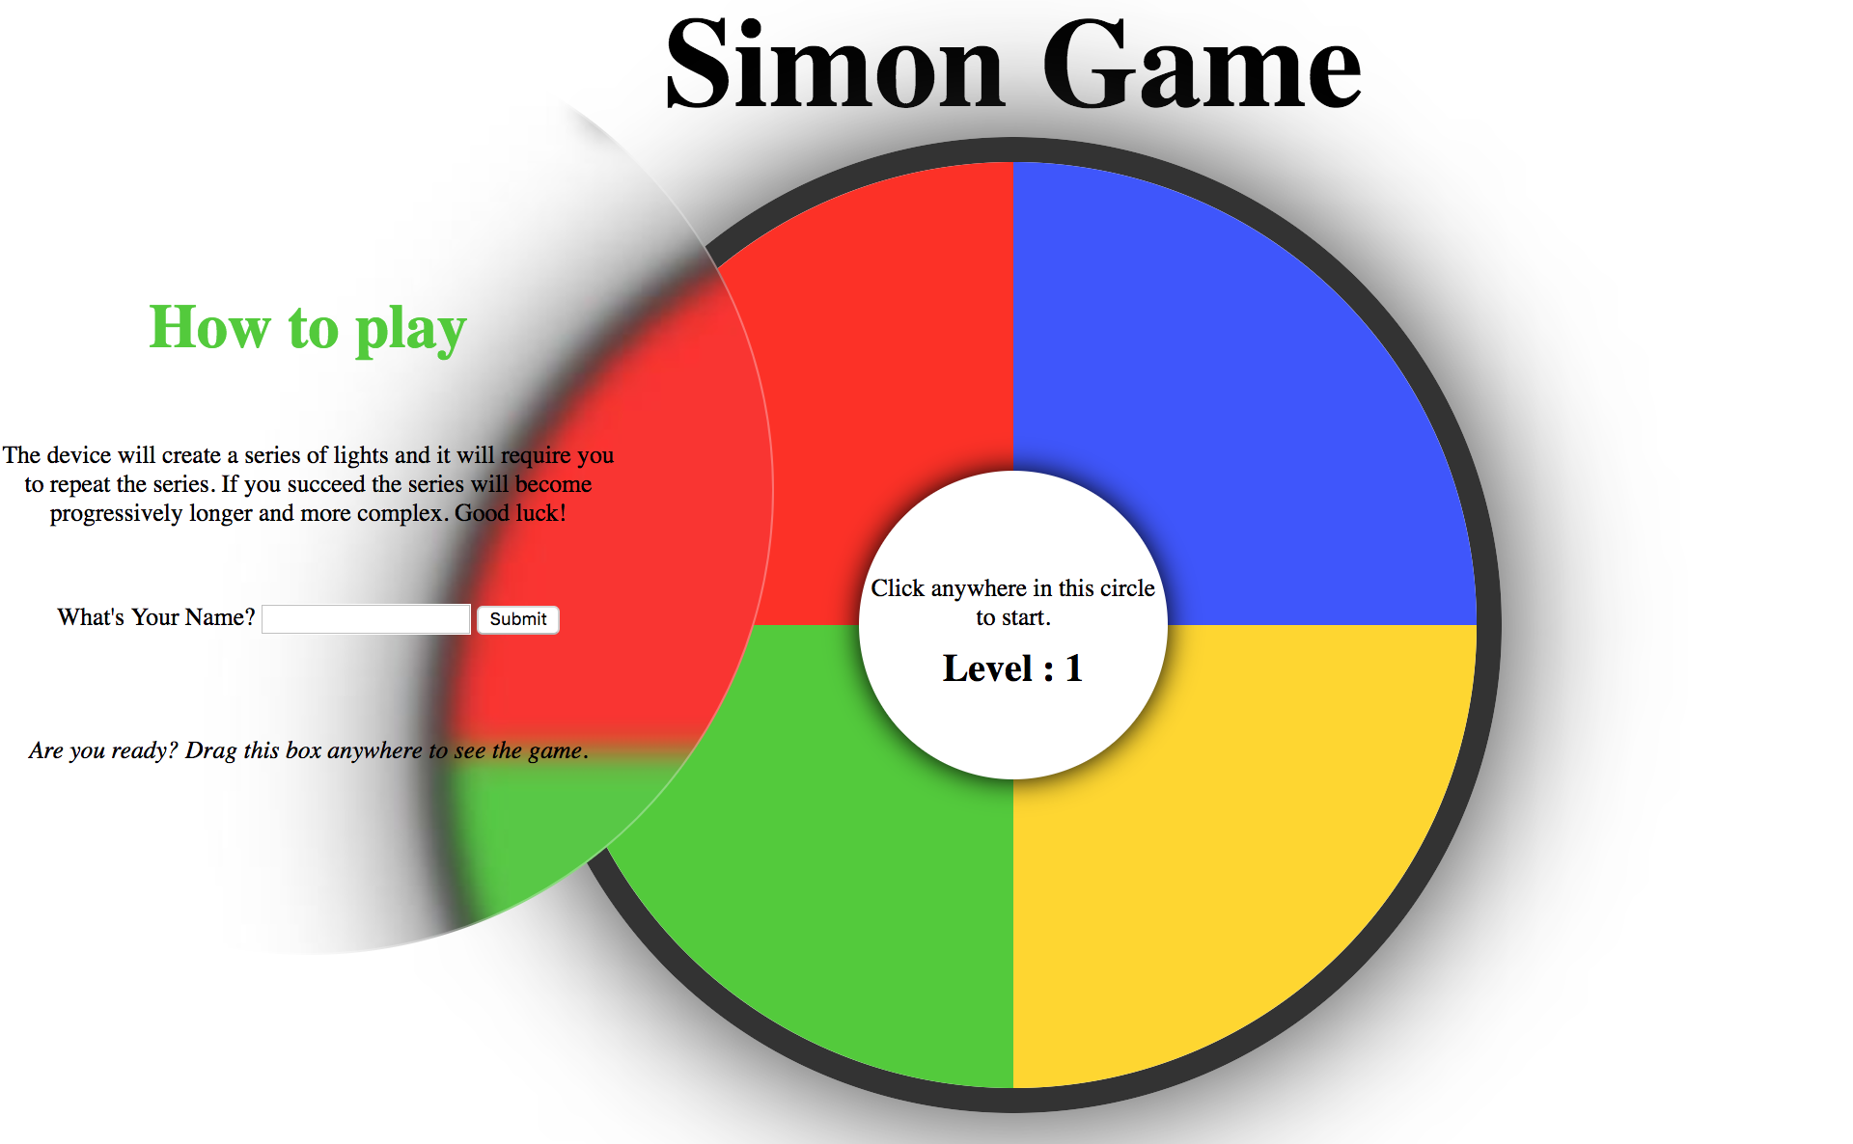
Live Page
Landing Page – Drag
Game State
http://project1-simon.bitballoon.com/
3

Slide 4
Functions / Complications
Predefined Functions Used:
Array(), fill(), map(), math.floor(), math.random() -> To make random series of code for computer.
Event Listener (‘mousedown’, ‘mouseup’, ‘click’)
Animate() -> Make buttons do something when clicked
ParseInt() -> To get the user moves.
Join() -> Check the win / lose conditions
draggable(), blur() -> For the blurred box
Complications:
Page Load Phase -> UserClick array pushes all the clicked boxes in the array. I needed to make an unbind click listener so that the user clicks would only work when the computer's turn was over. I struggled a lot with where to call that function.
Gameover Phase -> Userclicks array is set to empty at this point. But when the userMoves is being called, userClicks array takes one clicked id two times instead of one. So it can never check if the level is won or lost.
4

Slide 5
Code Snippet
Listen User:
Check Win:
let userClicks = []; //Keep track of user moves. And collect them in userClicks array.
function userMoves(){
$circle.click(function() {
userClicks.push(parseInt(event.target.id))
//console.log(userClicks)
console.log(userClicks, 'user numbers');
checkWin();
});
}
// Compare computer vs users array to see if user its a pass or gameover.
function checkWin (){
userClicks.join();
computerTurnNumbers.join();
if (userClicks.join() === computerTurnNumbers.join()) {
userClicks = [];
level++;
$('h2').html('Level :' + level);
computerClick();
} else if (userClicks.length === computerTurnNumbers.length){
$('h2').html('Game Over').css({
fontSize: 36,
marginBottom: 15, });
$('p').html('Click anywhere on circle to Restart');
$('.white').on('click', event => gameOver());
} }
5

Slide 6
THANK YOUUUUU!!!
6

