Slide 1

Campus Assıstant
Mobile Application Programming Project
Beykent University
Onur Kardeş
Computer Engineering Department

Slide 2
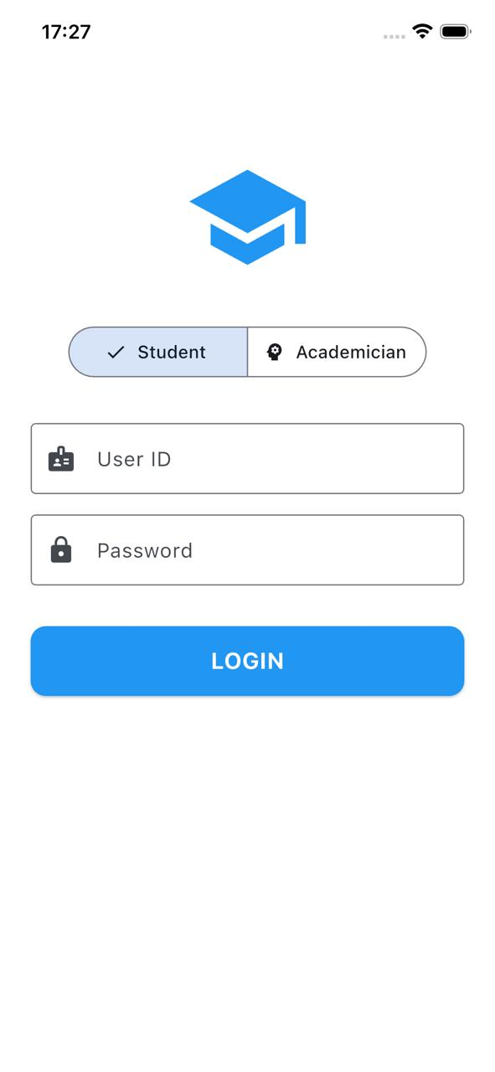
Campus Assistant

Slide 3
Project Team & Responsibilities
Türkü Çağlar – Application Logic & Feature Integration
Rukiye Ebrar Gerçek – UI/UX Design & Screen Layouts
Melis Özyazıcı – Flutter UI Implementation
Deniz Umut Bayrak – Testing, Debugging & Presentation
Kaan Yiğit Arslan – Research, Analysis & Documentation

Slide 4
Problem Definition
Students are required to access academic information through multiple platforms.
Newly enrolled students have difficulty finding classrooms and lecture locations.
Communication between students and academic staff is insufficient.
There is a lack of a Beykent University-specific centralized digital platform
There is no unified system that manages course schedules, cafeteria menus, campus events, and grade calculations

Slide 5
Solution Provided by Campus Assistant
We developed Campus Assistant, the first Beykent University–specific mobile application that brings all essential academic services together in a single platform.
Navigation support was integrated to help students easily locate classrooms and lecture halls.
A chatbox was developed to enable direct communication between students and instructors.

Slide 6
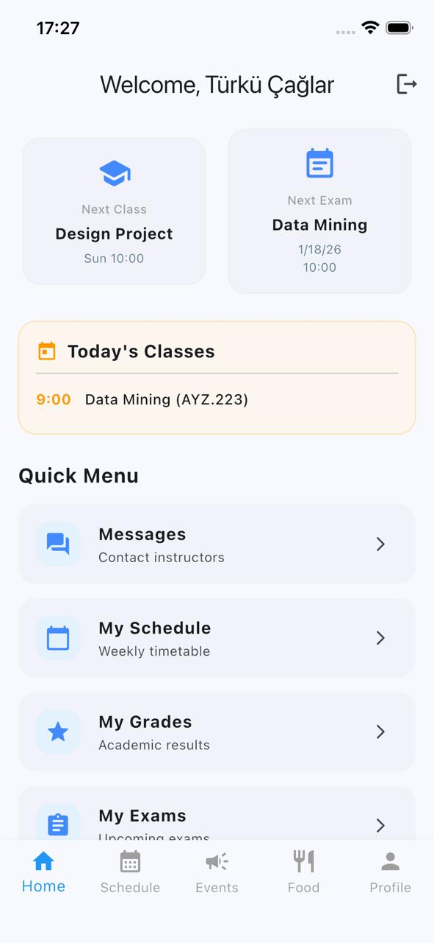
Solution 1 – Campus Asisstant

Slide 7
Solution Provided by Campus Assistant
We developed Campus Assistant, the first Beykent University–specific mobile application that brings all essential academic services together in a single platform.
Navigation support was integrated to help students easily locate classrooms and lecture halls.
A chatbox was developed to enable direct communication between students and instructors.

Slide 8
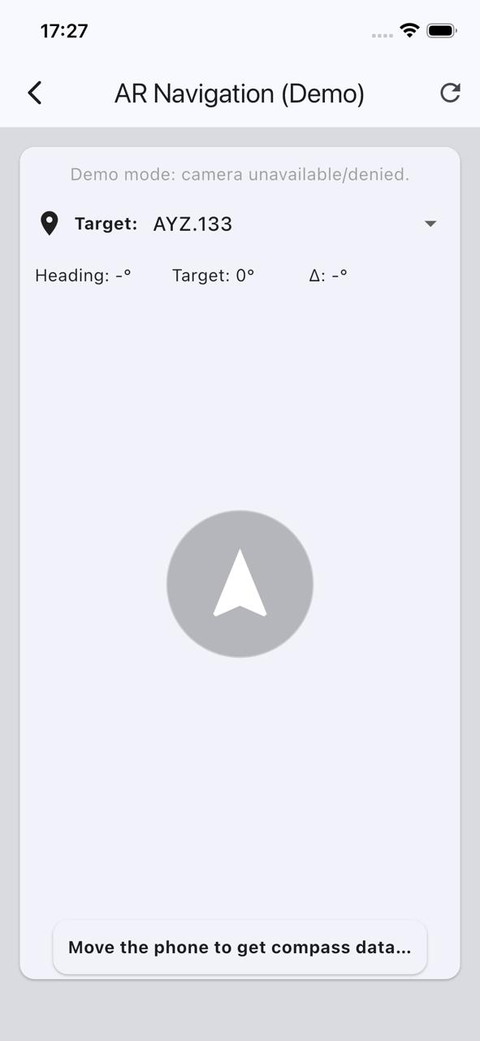
Solution 2 – Class Finder

Slide 9
Solution Provided by Campus Assistant
We developed Campus Assistant, the first Beykent University–specific mobile application that brings all essential academic services together in a single platform.
Navigation support was integrated to help students easily locate classrooms and lecture halls.
A chatbox was developed to enable direct communication between students and instructors.

Slide 10
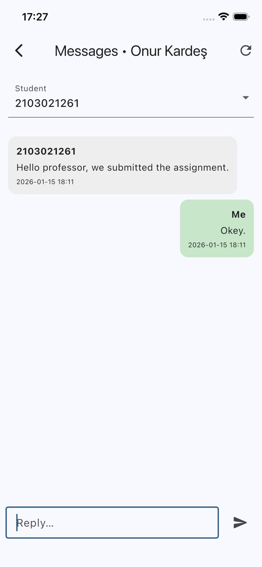
Solution 3 - Chatbox

Slide 11
Technologies & Tools Used
Flutter
Material Design
Mobile UI/UX principles
Scalable architecture

Slide 12
Future Improvements
Integration with OBS system
Real-Time Cafeteria API
Push Notifications
Dark Mode
Campus Map Expansion

Slide 13
Thank you for your time and attention

