Slide 1

Chapter 4—Statement Forms
Java
The Art and Science of
An Introduction
C H A P T E R 4
ERIC S. ROBERTS
to Computer Science
Statement Forms
The statements was interesting but tough.
—Mark Twain, The Adventures of Huckleberry Finn, 1884
CS101 @ Özyeğin University
Slides are adapted from the originals available at
http://www-cs-faculty.stanford.edu/~eroberts/books/ArtAndScienceOfJava/

Slide 2
The Add4Integers Program
If you don’t have access to control statements, the only way you can increase the number of input values is to add a new statement for each one, as in the following example:
public class Add4Integers extends ConsoleProgram {
public void run() {
println("This program adds four numbers.");
int n1 = readInt("Enter n1: ");
int n2 = readInt("Enter n2: ");
int n3 = readInt("Enter n3: ");
int n4 = readInt("Enter n4: ");
int total = n1 + n2 + n3 + n4;
println("The total is " + total + ".");
}
}
This strategy, however, is difficult to generalize and would clearly be cumbersome if you needed to add 100 values.

Slide 3
The Repeat-N-Times Idiom
One strategy for generalizing the addition program is to use the Repeat-N-Times idiom, which executes a set of statements a specified number of times. The general form of the idiom is
for (int i = 0; i < repetitions; i++) {
statements to be repeated
}
for (int i = 0; i < repetitions; i++) {
statements to be repeated
}
The information about the number of repetitions is specified by the first line in the pattern, which is called the header line.
As is true for all idiomatic patterns in this book, the italicized words indicate the parts of the pattern you need to change for each application. To use this pattern, for example, you need to replace repetitions with an expression giving the number of repetitions and include the statements to be repeated inside the curly braces.
The statements to be repeated are called the body of the for statement and are indented with respect to the header line.
A control statement that repeats a section of code is called a loop.
Each execution of the body of a loop is called a cycle or iteration.

Slide 4
The AddNIntegers Program
This program uses the Repeat-N-Times idiom to compute the sum of a predetermined number of integer values, specified by the named constant N.
The for loop in this example works correctly only if the variable total is initialized to 0 before executing the loop.
This body of the loop consists of two statements. The first reads an integer from the user into the variable value, and the second adds that value to the variable total.
This program uses the Repeat-N-Times idiom to compute the sum of a predetermined number of integer values, specified by the named constant N.
public class AddNIntegers extends ConsoleProgram {
public void run() {
println("This program adds " + N + " numbers.");
int total = 0;
for (int i = 0; i < N; i++) {
int value = readInt(" ? ");
total += value;
}
println("The total is " + total + ".");
}
private static final int N = 100;
}
public class AddNIntegers extends ConsoleProgram {
public void run() {
println("This program adds " + N + " numbers.");
int total = 0;
for (int i = 0; i < N; i++) {
int value = readInt(" ? ");
total += value;
}
println("The total is " + total + ".");
}
private static final int N = 100;
}

Slide 5
The Repeat-Until-Sentinel Idiom
A better approach for the addition program that works for any number of values is to use the Repeat-Until-Sentinel idiom, which executes a set of statements until the user enters a specific value called a sentinel to signal the end of the list:
while (true) {
prompt user and read in a value
if (value == sentinel) break;
rest of loop body
}
You should choose a sentinel value that is not likely to occur in the input data. It also makes sense to define the sentinel as a named constant to make the sentinel value easy to change.

Slide 6
The AddIntegerList Program
This program uses the Repeat-Until-Sentinel idiom to add a list of integers, stopping when the user enters a value that matches the named constant SENTINEL.
public class AddIntegerList extends ConsoleProgram {
public void run() {
println("This program adds a list of integers.");
println("Enter values, one per line, using " + SENTINEL);
println("to signal the end of the list.");
int total = 0;
while (true) {
int value = readInt(" ? ");
if (value == SENTINEL) break;
total += value;
}
println("The total is " + total + ".");
}
private static final int SENTINEL = 0;
}

Slide 7
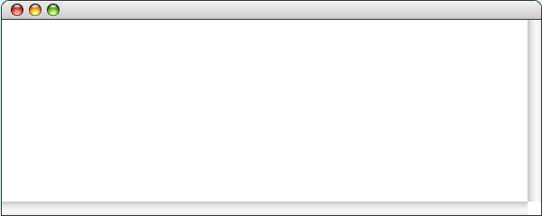
The AddIntegerList Program
public void run() {
println("This program adds a list of integers.");
println("Enter values, one per line, using " + SENTINEL);
println("to signal the end of the list.");
int total = 0;
while (true) {
int value = readInt(" ? ");
if (value == SENTINEL) break;
total += value;
}
println("The total is " + total + ".");
}
public void run() {
println("This program adds a list of integers.");
println("Enter values, one per line, using " + SENTINEL);
println("to signal the end of the list.");
int total = 0;
while (true) {
int value = readInt(" ? ");
if (value == SENTINEL) break;
total += value;
}
println("The total is " + total + ".");
}
value
value
total
total
1
2
3
0
0
0
1
3
6
6
AddIntegerList
This program adds a list of integers.
Enter values, one per line, using 0
to signal the end of the list.
?
1
?
2
?
3
?
0
The total is 6.
skip simulation

Slide 8
Exercise: Control Patterns
Using the AddIntegerList program as a model, write a new AverageList program that reads a set of integers from the user and displays their average. Because 0 values might well appear, for example, in an average of exam scores, change the sentinel value so that the input stops when the user enters -1. It is important to keep in mind that the average of a set of integers is not necessarily an integer.
The AverageList program will require the following changes:
  Convert the variable total to a double before computing the average
  Change the definition of the SENTINEL constant
  Keep a count of the number of input values along with the sum
  Update the user messages and program documentation

Slide 9
The AverageList Program
public class AverageList extends ConsoleProgram {
public void run() {
println("This program averages a list of numbers.");
println("Enter values, one per line, using " + SENTINEL);
println("to signal the end of the list.");
int total = 0;
int count = 0;
while (true) {
int value = readInt(" ? ");
if (value == SENTINEL) break;
total += value;
count++;
}
double average = (double) total / count;
println("The average is " + average + ".");
}
private static final int SENTINEL = -1;
}

Slide 10
Simple Graphical Animation
The while and for statements make it possible to implement simple graphical animation. The basic strategy is to create a set of graphical objects and then execute the following loop:
for (int i = 0; i < N_STEPS; i++) {
update the graphical objects by a small amount
pause(PAUSE_TIME);
}
for (int i = 0; i < N_STEPS; i++) {
update the graphical objects by a small amount
pause(PAUSE_TIME);
}
On each cycle of the loop, this pattern updates each animated object by moving it slightly or changing some other property of the object, such as its color. Each cycle is called a time step.
After each time step, the animation pattern calls pause, which delays the program for some number of milliseconds (expressed here as the constant PAUSE_TIME). Without the call to pause, the program would finish faster than the human eye can follow.

Slide 11
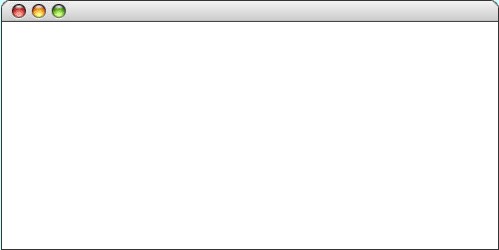
The AnimatedSquare Program
public void run() {
GRect square = new GRect(0, 0, SQUARE_SIZE, SQUARE_SIZE);
square.setFilled(true);
square.setFillColor(Color.RED);
add(square);
double dx = (getWidth() - SQUARE_SIZE) / N_STEPS;
double dy = (getHeight() - SQUARE_SIZE) / N_STEPS;
for (int i = 0; i < N_STEPS; i++) {
square.move(dx, dy);
pause(PAUSE_TIME);
}
}
public void run() {
GRect square = new GRect(0, 0, SQUARE_SIZE, SQUARE_SIZE);
square.setFilled(true);
square.setFillColor(Color.RED);
add(square);
double dx = (getWidth() - SQUARE_SIZE) / N_STEPS;
double dy = (getHeight() - SQUARE_SIZE) / N_STEPS;
for (int i = 0; i < N_STEPS; i++) {
square.move(dx, dy);
pause(PAUSE_TIME);
}
}
i
i
dx
dx
dy
dy
square
square
101
3.0
3.0
1.7
1.7
AnimatedSquare
AnimatedSquare
AnimatedSquare
skip simulation

Slide 12
The if Statement
The simplest of the control statements is the if statement, which occurs in two forms. You use the first form whenever you need to perform an operation only if a particular condition is true:
if (condition) {
statements to be executed if the condition is true
}
You use the second form whenever you want to choose between two alternative paths, one for cases in which a condition is true and a second for cases in which that condition is false:
if (condition) {
statements to be executed if the condition is true
} else {
statements to be executed if the condition is false
}

Slide 13
Choosing between if and if/else
As is true with most programming constructs, there is no hard-and-fast rule that will tell you whether you need the basic if statement or the if/else form.
As is true with most programming constructs, there is no hard-and-fast rule that will tell you whether you need the basic if statement or the if/else form.
public void run() {
println("This program averages a list of numbers.");
println("Enter values, one per line, using " + SENTINEL);
println("to signal the end of the list.");
int total = 0;
int count = 0;
while (true) {
int value = readInt(" ? ");
if (value == SENTINEL) break;
if (value != 0) {
}
The best general guideline is to think about the English description of the problem you are trying to solve. If that description contains the words else or otherwise, there is a good chance that the solution will use the else keyword.
The best general guideline is to think about the English description of the problem you are trying to solve. If that description contains the words else or otherwise, there is a good chance that the solution will use the else keyword.
total += value;
count++;
As an example, suppose that you wanted to change the AverageList program so that it didn’t include any zero values in the average. Here, you need a simple if statement that makes sure that the score is not equal to 0.
As an example, suppose that you wanted to change the AverageList program so that it didn’t include any zero values in the average. Here, you need a simple if statement that makes sure that the score is not equal to 0.
}
double average = (double) total / count;
println("The average is " + average + ".");
}
If you also wanted to count the zero scores, you would need to add an else clause to increment a counter variable in the case that value was equal to 0.

Slide 14
Choosing between if and if/else
As is true with most programming constructs, there is no hard-and-fast rule that will tell you whether you need the basic if statement or the if/else form.
public void run() {
println("This program averages a list of numbers.");
println("Enter values, one per line, using " + SENTINEL);
println("to signal the end of the list.");
int total = 0;
int count = 0;
int zeroCount = 0;
while (true) {
int value = readInt(" ? ");
if (value == SENTINEL) break;
if (value != 0) {
total += value;
count++;
} else {
zeroCount++;
}
The best general guideline is to think about the English description of the problem you are trying to solve. If that description contains the words else or otherwise, there is a good chance that the solution will use the else keyword.
As an example, suppose that you wanted to change the AverageList program so that it didn’t include any zero values in the average. Here, you need a simple if statement that makes sure that the score is not equal to 0.
}
double average = (double) total / count;
println("The average is " + average + ".");
println("There are " + zeroCount + "zero scores.");
}

Slide 15
Common Forms of the if Statement
The examples in the book use the if statement in the following forms:
Single line if statement
Multiline if statement with curly braces
if (condition) statement
if (condition) {
statement
. . . more statements . . .
}
if/else statement with curly braces
Cascading if statement
if (condition) {
statements_{true}
} else {
statements_{false}
}
if (condition₁) {
statements₁
} else if (condition₂) {
statements₂
. . . more else/if conditions . . .
} else {
statements_{else}
}

Slide 16
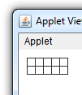
Example: SmallSquares
int x = 10;
int y = 10;
for(int i = 0; i < 10; i++) {
GRect rect = new GRect(x, y, 10, 10);
add(rect);
x = x + 10;
if(i == 4) {
x = 10;
y = y + 10;
}
}

Slide 17

Exercise: SmallSquares
int x = 10;
int y = 10;
for(int i = 0; i < 10; i++) {
GRect rect = new GRect(x, y, 10, 10);
add(rect);
x = x + 10;
if(i > 4) {
x = 10;
y = y + 10;
}
}
What would be the output of this program?

Slide 18
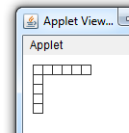
Exercise: SmallSquares
int x = 10;
int y = 10;
for(int i = 0; i < 10; i++) {
GRect rect = new GRect(x, y, 10, 10);
add(rect);
x = x + 10;
if(i > 4) {
x = 10;
y = y + 10;
}
}

Slide 19
The while Statement
The while statement is the simplest of Java’s iterative control statements and has the following form:
while ( condition ) {
statements to be repeated
}
while ( condition ) {
statements to be repeated
}
When Java encounters a while statement, it begins by evaluating the condition in parentheses, which must have a boolean value.
If the value of condition is true, Java executes the statements in the body of the loop.
At the end of each cycle, Java reevaluates condition to see whether its value has changed. If condition evaluates to false, Java exits from the loop and continues with the statement following the closing brace at the end of the while body.

Slide 20
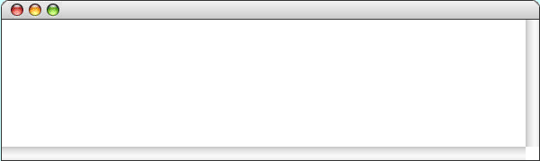
The DigitSum Program
public void run() {
println("This program sums the digits in an integer.");
int n = readInt("Enter a positive integer: ");
int dsum = 0;
while ( n > 0 ) {
dsum += n % 10;
n /= 10;
}
println("The sum of the digits is " + dsum);
}
public void run() {
println("This program sums the digits in an integer.");
int n = readInt("Enter a positive integer: ");
int dsum = 0;
while ( n > 0 ) {
dsum += n % 10;
n /= 10;
}
println("The sum of the digits is " + dsum);
}
public void run() {
println("This program sums the digits in an integer.");
int n = readInt("Enter a positive integer: ");
int dsum = 0;
while ( n > 0 ) {
dsum += n % 10;
n /= 10;
}
println("The sum of the digits is " + dsum);
}
n
n
dsum
dsum
1
0
0
1729
172
17
18
19
19
0
9
11
DigitSum
This program sums the digits in an integer.
1729
Enter a positive integer:
The sum of the digits is 19.
skip simulation

Slide 21
The Loop-and-a-Half Pattern
The while statement in Java always tests the condition at the beginning of each cycle of the loop. Sometimes, however, you need to perform some computation before you can make the test. In those situations, the loop-and-a-half pattern is very useful:
while (true) {
computation necessary to make the test
if (test for completion) break;
computation for the rest of the loop cycle
}
Because the condition in the while statement itself is always true, this loop would continue forever without some other strategy to indicate completion. The loop-and-a-half pattern uses the if and break statements to exit the loop. When the test for completion becomes true, Java executes the break statement, which causes the loop to exit, skipping the rest of the cycle.

Slide 22
Repeat-Until-Sentinel Revisited
The repeat-until-sentinel pattern presented at the beginning of the chapter is an example of the loop-and-a-half pattern.
while (true) {
prompt user and read in a value
if (value == sentinel) break;
rest of loop body
}
while (true) {
computation necessary to make the test
if (test for completion) break;
computation for the rest of the loop cycle
}
Although it might at first seem as if this pattern is more complex than the more basic form of the while statement, it turns out to be considerably easier for most students to use. Several studies have demonstrated that students who use the loop-and-a-half pattern are far more likely to write correct code than those who don’t.

Slide 23
The for Statement
The for statement in Java is a particularly powerful tool for specifying the control structure of a loop independently from the operations the loop body performs. The syntax looks like this:
for ( init ; test ; step ) {
statements to be repeated
}
for ( init ; test ; step ) {
statements to be repeated
}
Java evaluates a for statement by executing the following steps:
1.
Evaluate init, which typically declares a control variable.
2.
Evaluate test and exit from the loop if the value is false.
3.
Execute the statements in the body of the loop.
4.
Evaluate step, which usually updates the control variable.
5.
Return to step 2 to begin the next loop cycle.

Slide 24
Comparing for and while
The for statement
for ( init ; test ; step ) {
statements to be repeated
}
is functionally equivalent to the following code using while:
init;
while ( test ) {
statements to be repeated
step;
}
The advantage of the for statement is that everything you need to know to understand how many times the loop will run is explicitly included in the header line.

Slide 25
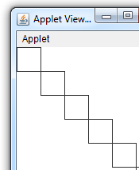
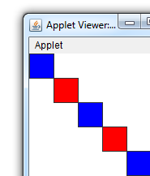
Exercise: while and if
int n = 0;
while(n < 10) {
GRect rect = new GRect(n*30, n*30, 30, 30);
rect.setFilled(true);
rect.setFillColor(Color.WHITE);
add(rect);
n = n + 1;
}
Modify the program to obtain the output below
current output

Slide 26
Exercise: while and if
int n = 0;
while(n < 10) {
GRect rect = new GRect(n*30, n*30, 30, 30);
rect.setFilled(true);
if(n%2 == 0) {
rect.setFillColor(Color.BLUE);
} else {
rect.setFillColor(Color.RED);
}
add(rect);
n = n + 1;
}

Slide 27
Exercise: Reading for Statements
Describe the effect of each of the following for statements:
1.
for (int i = 1; i <= 10; i++)
This statement executes the loop body ten times, with the control variable i taking on each successive value between 1 and 10.
2.
for (int i = 0; i < N; i++)
This statement executes the loop body N times, with i counting from 0 to N - 1. This version is the standard Repeat-N-Times idiom.
3.
for (int n = 99; n >= 1; n -= 2)
This statement counts backward from 99 to 1 by twos.
4.
for (int x = 1; x <= 1024; x *= 2)
This statement executes the loop body with the variable x taking on successive powers of two from 1 up to 1024.

Slide 28
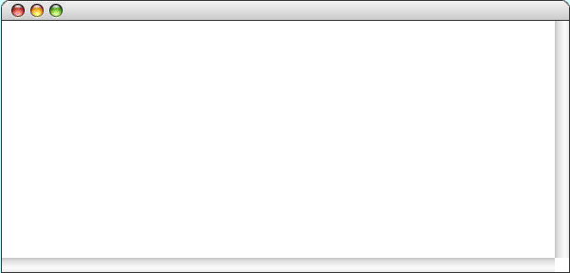
The Countdown Program
public void run() {
for ( int t = 10 ; t >= 0 ; t-- ) {
println(t);
}
println("Liftoff!");
}
public void run() {
for ( int t = 10 ; t >= 0 ; t-- ) {
println(t);
}
println("Liftoff!");
}
public void run() {
for ( int t = 10 ; t >= 0 ; t-- ) {
println(t);
}
println("Liftoff!");
}
t
t
10
9
8
7
6
5
4
3
2
1
0
–1
–1
Countdown
10
9
8
7
6
5
4
3
2
1
0
Liftoff!
skip simulation

Slide 29
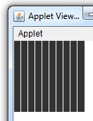
Example:
int y = 0;
GRect r = new GRect(0, 0, 100, 100);
r.setFilled(true);
add(r);
for(int x = 0; x < 100; x += 10) {
GLine line = new GLine(x, y, x, y + 100);
line.setColor(Color.WHITE);
add(line);
}
Can you write this program using a while loop?

Slide 30
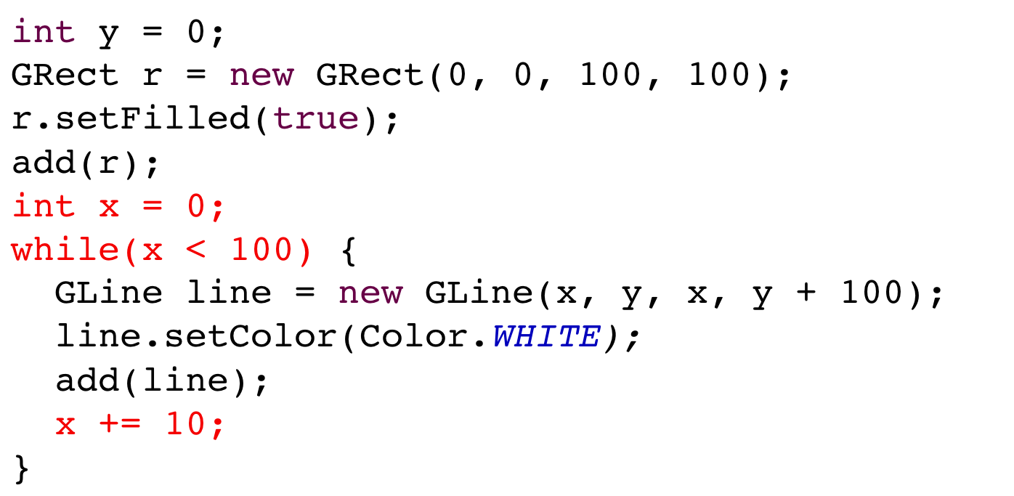
Example:
Can you write this program using a while loop?

Slide 31
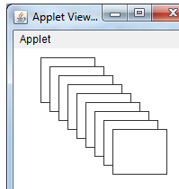
Example 2:
int h = 50;
int w = 60;
int x = 30;
int y = 10;
int n = 1;
while(n <= 9) {
GRect rect = new GRect(x, y, w, h);
rect.setFilled(true);
rect.setFillColor(Color.WHITE);
add(rect);
x = x + 10;
y = y + 10;
n = n + 1;
}

Slide 32
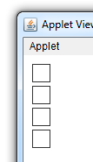
Exercise: Squares
Write a program (using a loop) that would generate the figure below
10,10
20
5

Slide 33
Exercise: Squares
int y = 10;
int n = 0;
while(n < 4) {
GRect r = new GRect(10, y, 20, 20);
add(r);
y = y + 25;
n = n + 1;
}

Slide 34
Exercise: Squares
int y = 10;
for(int n = 0; n < 4; n++) {
GRect r = new GRect(10, y, 20, 20);
add(r);
y = y + 25;
}

Slide 35
Nested for Statements
The body of a control statement can contain other statements. Such statements are said to be nested.
Many applications require nested for statements. The next slide, for example, shows a program to display a standard checkerboard in which the number of rows and number of columns are given by the constants N_ROWS and N_COLUMNS.
The for loops in the Checkerboard program look like this:
for (int i = 0; i < N_ROWS; i++) {
for (int j = 0; j < N_COLUMNS; j++) {
Display the square at row i and column j.
}
}
Because the entire inner loop runs for each cycle of the outer loop, the program displays N_ROWS ^{x} N_COLUMNS squares.

Slide 36

The Checkerboard Program
public void run() {
double sqSize = (double) getHeight() / N_ROWS;
for (int i = 0; i < N_ROWS; i++) {
for (int j = 0; j < N_COLUMNS; j++) {
double x = j * sqSize;
double y = i * sqSize;
GRect sq = new GRect(x, y, sqSize, sqSize);
sq.setFilled((i + j) % 2 != 0);
add(sq);
}
}
}
public void run() {
double sqSize = (double) getHeight() / N_ROWS;
for (int i = 0; i < N_ROWS; i++) {
for (int j = 0; j < N_COLUMNS; j++) {
double x = j * sqSize;
double y = i * sqSize;
GRect sq = new GRect(x, y, sqSize, sqSize);
sq.setFilled((i + j) % 2 != 0);
add(sq);
}
}
}
Execute the inner loop seven times to complete the checkerboard.
Execute these statements six more times to complete the row.
sqSize
sqSize
i
i
j
j
x
x
y
y
sq
sq
30.0
30.0
0
1
8
0
1
2
8
8
0.0
30.0
60.0
210.0
210.0
0.0
210.0
8
210.0
Checkerboard
skip simulation

Slide 37
Exercise: Triangle Number Table
Write a program that duplicates the sample run shown at the bottom on this slide, which displays the sum of the first N integers for each value of N from 1 to 10. As the output suggests, these numbers can be arranged to form a triangle and are therefore called triangle numbers.
TriangleTable
1 = 1
1 + 2 = 3
1 + 2 + 3 = 6
1 + 2 + 3 + 4 = 10
1 + 2 + 3 + 4 + 5 = 15
1 + 2 + 3 + 4 + 5 + 6 = 21
1 + 2 + 3 + 4 + 5 + 6 + 7 = 28
1 + 2 + 3 + 4 + 5 + 6 + 7 + 8 = 36
1 + 2 + 3 + 4 + 5 + 6 + 7 + 8 + 9 = 45
1 + 2 + 3 + 4 + 5 + 6 + 7 + 8 + 9 + 10 = 55

Slide 38
Design Issues: Triangle Number Table
As you think about the design of the TriangleTable program, it will help to keep the following thoughts in mind:
The program involves two nested loops. The outer loop runs through each of the values of N from 1 to the maximum; the inner loop prints a series of values on each output line.
The individual elements of each output line are easier to display if you call print instead of println. The print method is similar to println but doesn’t return the cursor position to the beginning of the next line in the way that println does. Using print therefore makes it possible to string several output values together on the same line.
The n^{th} output line contains n values before the equal sign but only n – 1 plus signs. Your program therefore cannot print a plus sign on each cycle of the inner loop but must instead skip one cycle.

Slide 39
The TriangleTable Program
public class TriangleTable extends ConsoleProgram {
public void run() {
for (int n = 1; n <= MAX_VALUE; n++) {
int total = 0;
for (int i = 1; i <= n; i++) {
if (i > 1) print(" + ");
print(i);
total += i;
}
println(" = " + total);
}
}
/* Private constants */
private static final int MAX_VALUE = 10;
}

