Slide 1

Chapter 11—Arrays and ArrayLists
Java
The Art and Science of
An Introduction
C H A P T E R 1 1
ERIC S. ROBERTS
to Computer Science
Arrays and ArrayLists
Little boxes, on a hillside, little boxes made of ticky-tacky
Little boxes, little boxes, little boxes, all the same
There’s a green one and a pink one and a blue one and a yellow one
And they're all made out of ticky-tacky and they all look just the same
—Malvina Reynolds, “Little Boxes,” 1962
Note: These slides are the ones that were used in the lecture. They are substantially
different from the textbook’s slides.
CS101 @ Özyeğin University
Slides are adapted from the originals available at
http://www-cs-faculty.stanford.edu/~eroberts/books/ArtAndScienceOfJava/

Slide 2
Motivating Example
Get a set of numbers from the user
Print out the numbers that are above the average of the whole set of numbers
Comp 101 | Özyeğin University

Slide 3
Motivating Example
Get a set of numbers from the user
Print out the numbers that are above the average of the whole set of numbers
Requires us to process the set of numbers twice
  First, to calculate the average
  Second, to pick up numbers that are above the average
Hence, requires us to store these numbers somehow
Comp 101 | Özyeğin University

Slide 4
The Need for a Data Structure
We cannot ask the user to enter the numbers again
  Inconvenient
  Error-prone
We cannot store numbers in separate variables
  Not practical for large amount of numbers
  Total amount of numbers is not always known priori
Comp 101 | Özyeğin University

Slide 5
Definition: Arrays
A named, ordered collection of variables of identical type
We do not name every individual element in the collection
Instead, we give a name to the whole collection
We access individual elements in the collection by specifying its order in the collection
  This is called the index
Comp 101 | Özyeğin University

Slide 6
Introduction to Arrays
An array is a collection of individual data values
An array is
1.
ordered. You can say things like “here is the first”, “here is the second”, and so on.
2.
homogeneous. Every value in the array must have the same type. An integer array contains integers only.
The number of elements is called the length of the array.
Each element is identified by its position number in the array, which is called its index.
In Java, index numbers always begin with 0 and therefore extends up to one less than the length of the array.

Slide 7
An Example of Array Declaration
This easiest way to visualize arrays is to think of them as a sequence of boxes.
int score = 0;
int[] scores = new int[10];
score
Element type
Length
0
scores
0
0
0
0
0
0
0
0
0
0
0
1
2
3
4
5
6
7
8
9
index
Java automatically initializes each element of a newly created array to its default value, which is zero for numeric types, false for values of type boolean, and null for objects.

Slide 8
Array Selection
Use the array selection syntax to access and change the elements of an array.
int[] scores = new int[10];
scores
0
0
0
0
0
0
0
0
0
0
0
1
2
3
4
5
6
7
8
9
scores[0] = 25;
scores
25
0
0
0
0
0
0
0
0
0
0
1
2
3
4
5
6
7
8
9
scores[1] = 17;
scores
25
17
0
0
0
0
0
0
0
0
0
1
2
3
4
5
6
7
8
9

Slide 9
Array Selection
Use the array selection syntax to access and change the elements of an array.
int[] scores = new int[10];
println("First element is " + scores[0]);
println("Second element is " + scores[1]);
println("Third element is " + scores[2]);
println("------------------------------");
scores[0] = 25;
scores[1] = 17;
println("First element is " + scores[0]);
println("Second element is " + scores[1]);
println("Third element is " + scores[2]);
println("------------------------------");
scores[2] = scores[0] + scores[1];
println("First element is " + scores[0]);
println("Second element is " + scores[1]);
println("Third element is " + scores[2]);
println("------------------------------");
First element is 0
Second element is 0
Third element is 0
--------------------------------
First element is 25
Second element is 17
Third element is 0
--------------------------------
First element is 25
Second element is 17
Third element is 42
--------------------------------

Slide 10
Array Length
You can query the length of an array by accessing its length field.
int[] scores = new int[10];
println("Length of the array is " + scores.length);
Length of the array is 10

Slide 11
Exercise 1
What does the following program print?
int[] scores = new int[10];
scores[5] = scores.length;
scores[5] = scores[5] + 1;
println(scores[5]);
A) 42
B) 11
C) 10
D) There is an error

Slide 12
Exercise 2
What does the following program print?
int[] scores = new int[10];
scores[5] = scores.length;
scores[5]++;
scores[1]++;
println(scores[5] + scores[1]);
A) 10
B) 11
C) 12
D) There is an error

Slide 13
Exercise 3
What does the following program print?
int[] scores = new int[10];
scores[scores.length] = 42;
println(scores[10]);
scores
0
0
0
0
0
0
0
0
0
0
0
1
2
3
4
5
6
7
8
9
A) 10
B) 11
No element at index 10!
C) 42
D) There is an error

Slide 14
Exercise 3
What does the following program print?
int[] scores = new int[10];
scores[scores.length] = 42;
println(scores[10]);
java.lang.ArrayIndexOutOfBoundsException: 10
at ch11.ArrayElementAccess.run(ArrayElementAccess.java:13)
at acm.program.Program.runHook(Program.java)
at acm.program.Program.startRun(Program.java)
at acm.program.Program.start(Program.java)
at sun.applet.AppletPanel.run(AppletPanel.java:464)
at java.lang.Thread.run(Thread.java:680)

Slide 15
Exercise 4
How does the array look like after executing
int[] scores = new int[10];
for(int i=0; i < scores.length; i++) {
scores[i] = i;
}
A)
0
1
2
3
4
5
6
7
8
9
B)
0
0
0
0
0
0
0
0
0
0
C)
10
10
10
10
10
10
10
10
10
10
D)
1
2
3
4
5
6
7
8
9
10

Slide 16
Exercise 5
Write a method sumArray that takes an array of integers and returns the sum of those values.
public int sumArray(int[] array) {
int sum = 0;
for (int i = 0; i < array.length; i++) {
sum += array[i];
}
return sum;
}
A
B
public int sumArray(int[] array) {
int sum = 0;
for (int i = array.length-1; i >= 0; i--) {
sum += array[i];
}
return sum;
}
public int sumArray(int[] array) {
int sum = 0;
for (int i = 1; i <= array.length; i++) {
sum += array[i-1];
}
return sum;
}
C
D) All

Slide 17
Exercise (printing an array)
Write a program that prints an array of integers as a comma-separated string.
int[] squares = new int[10];
for(int i=0; i < squares.length; i++) {
squares[i] = i*i;
}
print("[");
for(int i=0; i < squares.length; i++) {
if(i > 0) {
print(", ");
}
print(squares[i]);
}
println("]");
[0, 1, 4, 9, 16, 25, 36, 49, 64, 81]

Slide 18
Internal Representation of Arrays
Arrays in Java are implemented as objects, which means that they are stored in the heap. The value stored in an array variable is simply a reference to the actual array.
int score = 0;
int[] scores = new int[10];
score
0
scores
0
0
0
0
0
0
0
0
0
0
0
1
2
3
4
5
6
7
8
9

Slide 19
Internal Representation of Arrays
int score = 5;
int foo = score;
foo++;
println(score); // prints 5
println(foo); // prints 6
score
foo
5

Slide 20
Internal Representation of Arrays
int score = 5;
int foo = score;
foo++;
println(score); // prints 5
println(foo); // prints 6
score
foo
5
5

Slide 21
Internal Representation of Arrays
int score = 5;
int foo = score;
foo++;
println(score); // prints 5
println(foo); // prints 6
score
foo
5
6

Slide 22
Internal Representation of Arrays
int score = 5;
int foo = score;
foo++;
println(score); // prints 5
println(foo); // prints 6
score
foo
5
6

Slide 23
Internal Representation of Arrays
int[] scores = new int[10];
int[] numbers = scores;
numbers[5] = 42;
println(scores[5]); // prints 42
println(numbers[5]); // prints 42
scores[0] = 77;
println(scores[0]); // prints 77
println(numbers[0]); // prints 77
scores
numbers
0
0
0
0
0
0
0
0
0
0
0
1
2
3
4
5
6
7
8
9

Slide 24
Internal Representation of Arrays
int[] scores = new int[10];
int[] numbers = scores;
numbers[5] = 42;
println(scores[5]); // prints 42
println(numbers[5]); // prints 42
scores[0] = 77;
println(scores[0]); // prints 77
println(numbers[0]); // prints 77
scores
numbers
0
0
0
0
0
0
0
0
0
0
0
1
2
3
4
5
6
7
8
9

Slide 25
Internal Representation of Arrays
int[] scores = new int[10];
int[] numbers = scores;
numbers[5] = 42;
println(scores[5]); // prints 42
println(numbers[5]); // prints 42
scores[0] = 77;
println(scores[0]); // prints 77
println(numbers[0]); // prints 77
scores
numbers
0
0
0
0
0
42
0
0
0
0
0
1
2
3
4
5
6
7
8
9

Slide 26
Internal Representation of Arrays
int[] scores = new int[10];
int[] numbers = scores;
numbers[5] = 42;
println(scores[5]); // prints 42
println(numbers[5]); // prints 42
scores[0] = 77;
println(scores[0]); // prints 77
println(numbers[0]); // prints 77
scores
numbers
0
0
0
0
0
42
0
0
0
0
0
1
2
3
4
5
6
7
8
9

Slide 27
Internal Representation of Arrays
int[] scores = new int[10];
int[] numbers = scores;
numbers[5] = 42;
println(scores[5]); // prints 42
println(numbers[5]); // prints 42
scores[0] = 77;
println(scores[0]); // prints 77
println(numbers[0]); // prints 77
scores
numbers
77
0
0
0
0
42
0
0
0
0
0
1
2
3
4
5
6
7
8
9

Slide 28
Internal Representation of Arrays
int[] scores = new int[10];
int[] numbers = scores;
numbers[5] = 42;
println(scores[5]); // prints 42
println(numbers[5]); // prints 42
scores[0] = 77;
println(scores[0]); // prints 77
println(numbers[0]); // prints 77
scores
numbers
77
0
0
0
0
42
0
0
0
0
0
1
2
3
4
5
6
7
8
9

Slide 29
Exercise (Swapping)
Write a program that swaps the values of two integer variables.
public void run() {
int first = readInt("Enter 1st: ");
int second = readInt("Enter 2nd: ");
// swap the values
first = second;
second = first;
println("First value after swapping: " + first);
println("Second value after swapping: " + second);
}

Slide 30
Exercise (Swapping)
What’s printed by the program below, if first is 17, second is 25?
public void run() {
int first = readInt("Enter 1st: ");
int second = readInt("Enter 2nd: ");
// swap the values
first = second;
second = first;
println("First value after swapping: " + first);
println("Second value after swapping: " + second);
}
A) 17, 25
C) 17, 17
B) 25, 17
D) 25, 25

Slide 31
Exercise (Swapping)
public void run() {
int first = readInt("Enter 1st: ");
int second = readInt("Enter 2nd: ");
// swap the values
first = second;
second = first;
println("First value after swapping: " + first);
println("Second value after swapping: " + second);
}
first
second
Enter 1st: 17
17

Slide 32
Exercise (Swapping)
public void run() {
int first = readInt("Enter 1st: ");
int second = readInt("Enter 2nd: ");
// swap the values
first = second;
second = first;
println("First value after swapping: " + first);
println("Second value after swapping: " + second);
}
first
second
Enter 1st: 17
Enter 2nd: 25
17
25

Slide 33
Exercise (Swapping)
public void run() {
int first = readInt("Enter 1st: ");
int second = readInt("Enter 2nd: ");
// swap the values
first = second;
second = first;
println("First value after swapping: " + first);
println("Second value after swapping: " + second);
}
first
second
Enter 1st: 17
Enter 2nd: 25
25
25

Slide 34
Exercise (Swapping)
public void run() {
int first = readInt("Enter 1st: ");
int second = readInt("Enter 2nd: ");
// swap the values
first = second;
second = first;
println("First value after swapping: " + first);
println("Second value after swapping: " + second);
}
first
second
Enter 1st: 17
Enter 2nd: 25
25
25

Slide 35
Exercise (Swapping)
public void run() {
int first = readInt("Enter 1st: ");
int second = readInt("Enter 2nd: ");
// swap the values
first = second;
second = first;
println("First value after swapping: " + first);
println("Second value after swapping: " + second);
}
first
second
Enter 1st: 17
Enter 2nd: 25
First value after swapping: 25
Second value after swapping: 25
25
25

Slide 36
Exercise (Swapping)
What’s printed by the program below, if first is 17, second is 25?
public void run() {
int first = readInt("Enter 1st: ");
int second = readInt("Enter 2nd: ");
// swap the values
first = second;
second = first;
println("First value after swapping: " + first);
println("Second value after swapping: " + second);
}
incorrect
!!!
A) 17, 25
C) 17, 17
B) 25, 17
D) 25, 25

Slide 37
Exercise (Swapping)
Write a program that swaps the values of two integer variables.
Correct version:
public void run() {
int first = readInt("Enter 1st: ");
int second = readInt("Enter 2nd: ");
// swap the values
int temp = first;
first = second;
second = temp;
println("First value after swapping: " + first);
println("Second value after swapping: " + second);
}

Slide 38
Exercise (Swapping)
public void run() {
int first = readInt("Enter 1st: ");
int second = readInt("Enter 2nd: ");
// swap the values
int temp = first;
first = second;
second = temp;
println("First value after swapping: " + first);
println("Second value after swapping: " + second);
}
Enter 1st: 17
Enter 2nd: 25
first
second
temp
17
25

Slide 39
Exercise (Swapping)
public void run() {
int first = readInt("Enter 1st: ");
int second = readInt("Enter 2nd: ");
// swap the values
int temp = first;
first = second;
second = temp;
println("First value after swapping: " + first);
println("Second value after swapping: " + second);
}
Enter 1st: 17
Enter 2nd: 25
first
second
temp
17
25
17

Slide 40
Exercise (Swapping)
public void run() {
int first = readInt("Enter 1st: ");
int second = readInt("Enter 2nd: ");
// swap the values
int temp = first;
first = second;
second = temp;
println("First value after swapping: " + first);
println("Second value after swapping: " + second);
}
Enter 1st: 17
Enter 2nd: 25
first
second
temp
25
25
17

Slide 41
Exercise (Swapping)
public void run() {
int first = readInt("Enter 1st: ");
int second = readInt("Enter 2nd: ");
// swap the values
int temp = first;
first = second;
second = temp;
println("First value after swapping: " + first);
println("Second value after swapping: " + second);
}
Enter 1st: 17
Enter 2nd: 25
first
second
temp
25
17
17

Slide 42
Exercise (Swapping)
public void run() {
int first = readInt("Enter 1st: ");
int second = readInt("Enter 2nd: ");
// swap the values
int temp = first;
first = second;
second = temp;
println("First value after swapping: " + first);
println("Second value after swapping: " + second);
}
Enter 1st: 17
Enter 2nd: 25
First value after swapping: 25
Second value after swapping: 17
first
second
temp
25
17
17

Slide 43
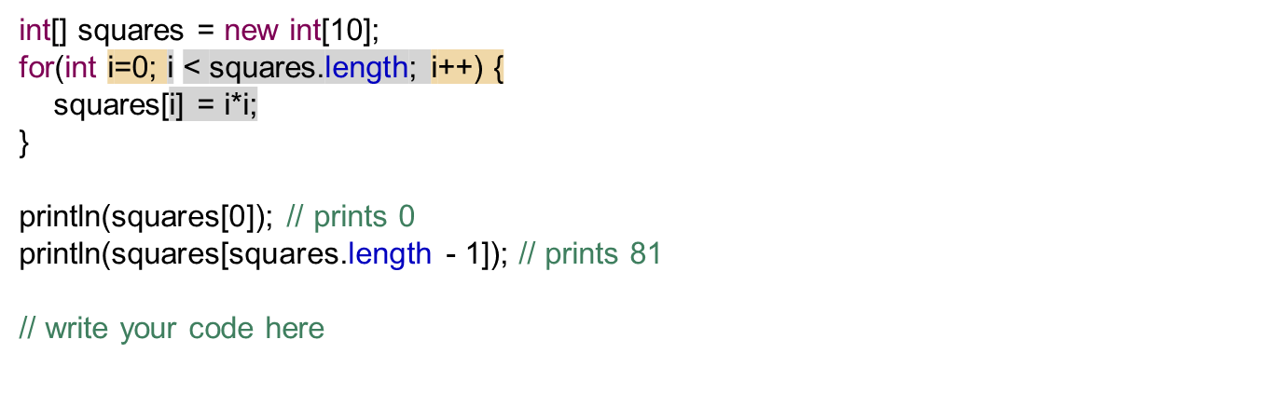

Exercise: Swapping Array Elements
Write a program that swaps the first and last values of an array.

Slide 44
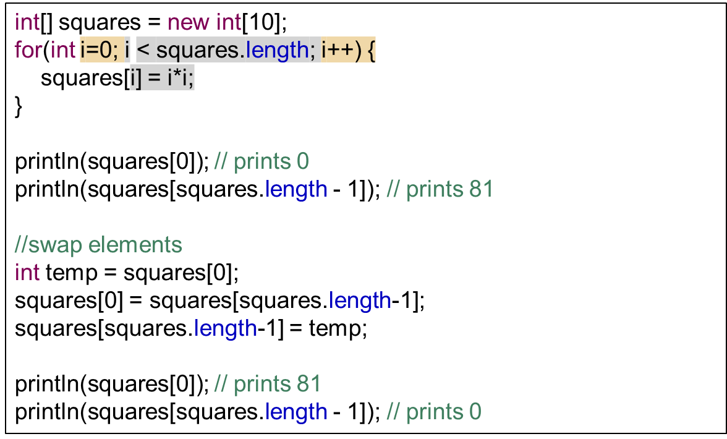
Swapping Array Elements
Write a program that swaps the first and last values of an array.

Slide 45
Swapping Array Elements
Write a Java method named swapElements that takes an integer array and two indices, and swaps the elements.
public void swapElements(int[] array, int i, int j) {
int temp = array[i];
array[i] = array[j];
array[j] = temp;
}

