Slide 1
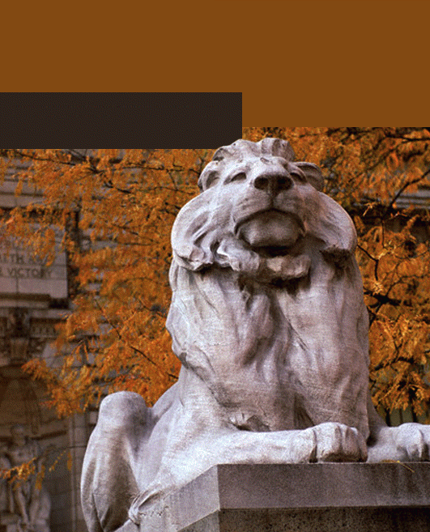
Chapter 14—Looking Ahead
Java
The Art and Science of
An Introduction
C H A P T E R 1 4
ERIC S. ROBERTS
to Computer Science
Looking Ahead
The best way to predict the future is to invent it.
—Alan Kay, Xerox Palo Alto Research Center, 1972
Recursion
CS101 @ Özyeğin University
Slides are adapted from the originals available at
http://www-cs-faculty.stanford.edu/~eroberts/books/ArtAndScienceOfJava/

Slide 2
Recursion
Recursion is the process of solving a problem by dividing it into smaller subproblems of the same form.
The fact that recursive decomposition generates subproblems that have the same form as the original problem means that recursive programs will use the same method to solve subproblems at different levels of the solution.
In recursive problems, you will have methods that call themselves, directly or indirectly.

Slide 3
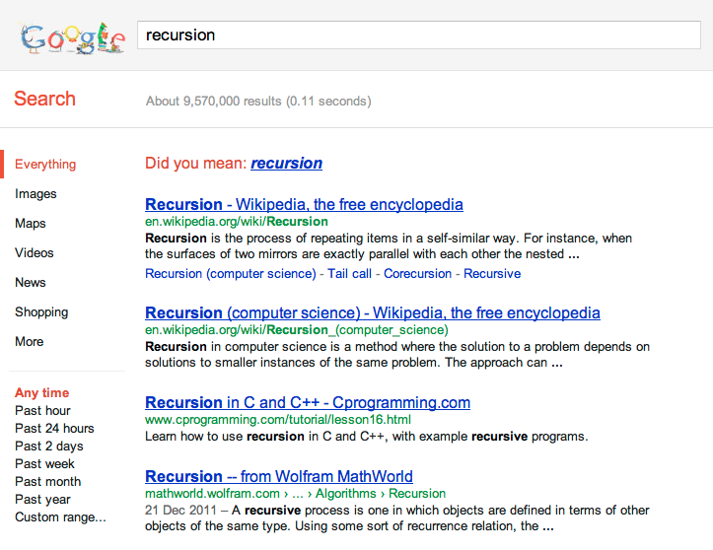
Recursion
In order to understand recursion, you have to understand recursion.

Slide 4
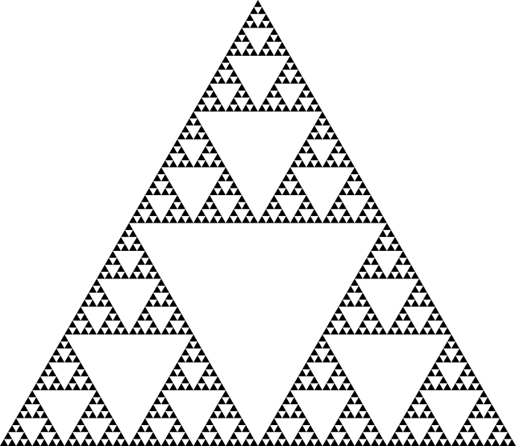
Sierpinski Triangle
http://en.wikipedia.org/wiki/File:Sierpinski_Triangle.svg

Slide 5
A Simple Illustration of Recursion
Suppose that you are the national fundraising director for a charitable organization and need to raise $1,000,000.
One possible approach is to find a wealthy donor and ask for a single $1,000,000 contribution. The problem with that strategy is that individuals with the necessary combination of means and generosity are difficult to find. Donors are much more likely to make contributions in the $10 range.
Another strategy would be to ask 100,000 friends for $10 each. Unfortunately, most of us don’t have 100,000 friends.
There are, however, more promising strategies. You could, for example, find ten regional coordinators and charge each one with raising $100,000. Those regional coordinators could in turn delegate the task to local coordinators, each with a goal of $10,000, continuing the process reached a manageable contribution level.

Slide 6
A Simple Illustration of Recursion
The following diagram illustrates the recursive strategy for raising $1,000,000 described on the previous slide:
Goal:
$1,000,000
Goal:
$100,000
Goal:
$100,000
Goal:
$100,000
Goal:
$100,000
Goal:
$100,000
Goal:
$100,000
Goal:
$100,000
Goal:
$100,000
Goal:
$100,000
Goal:
$100,000
Goal:
$10,000
Goal:
$10,000
Goal:
$10,000
Goal:
$10,000
Goal:
$10,000
Goal:
$10,000
Goal:
$10,000
Goal:
$10,000
Goal:
$10,000
Goal:
$10,000
Goal:
$1000
Goal:
$1000
Goal:
$1000
Goal:
$1000
Goal:
$1000
Goal:
$1000
Goal:
$1000
Goal:
$1000
Goal:
$1000
Goal:
$1000
Goal:
$100
Goal:
$100
Goal:
$100
Goal:
$100
Goal:
$100
Goal:
$100
Goal:
$100
Goal:
$100
Goal:
$100
Goal:
$100

Slide 7
A Pseudocode Fundraising Strategy
If you were to implement the fundraising strategy in the form of a Java method, it would look something like this:
private void collectContributions(int n) {
if (n <= 100) {
Collect the money from a single donor.
} else {
Find 10 volunteers.
Get each volunteer to collect n/10 dollars.
Combine the money raised by the volunteers.
}
}
What makes this strategy recursive is that the line
Get each volunteer to collect n/10 dollars.
will be implemented using the following recursive call:
collectContributions(n / 10);

Slide 8
Recursive Functions
The easiest examples of recursion to understand are functions in which the recursion is clear from the definition. As an example, consider the factorial function from Chapter 5, which can be defined in either of the following ways:
n! = n ^{x} (n - 1) ^{x} (n - 2) ^{x} . . . ^{x} 3 ^{x} 2 ^{x} 1
1
if n is 0
n! =
n ^{x} (n - 1)!
otherwise
The second definition leads directly to the following code, which is shown in simulated execution on the next slide:
private int factorial(int n) {
if (n == 0) {
return 1;
} else {
return n * factorial(n - 1);
}
}

Slide 9
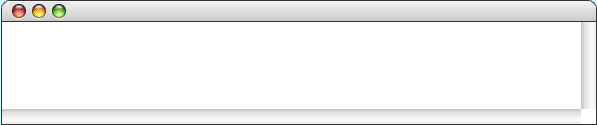
Simulating the factorial Method
public void run() {
int n = readInt("Enter n: ");
println(n + "! = " + factorial(n) );
}
private int factorial(int n) {
if (n == 0) {
return 1;
} else {
return n * factorial(n - 1);
}
}
private int factorial(int n) {
if (n == 0) {
return 1;
} else {
return n * factorial(n - 1);
}
}
120
n
private int factorial(int n) {
if (n == 0) {
return 1;
} else {
return n * factorial(n - 1);
}
}
5
private int factorial(int n) {
if (n == 0) {
return 1;
} else {
return n * factorial(n - 1);
}
}
n
5
private int factorial(int n) {
if (n == 0) {
return 1;
} else {
return n * factorial(n - 1);
}
}
24
n
4
private int factorial(int n) {
if (n == 0) {
return 1;
} else {
return n * factorial(n - 1);
}
}
private int factorial(int n) {
if (n == 0) {
return 1;
} else {
return n * factorial(n - 1);
}
}
6
n
3
2
n
2
1
n
1
n
1
n
0
0
Factorial
Enter n:
5
5! = 120
skip simulation

Slide 10
The Recursive “Leap of Faith”
The purpose of going through the complete decomposition of the calculation of factorial(5) is to convince you that the process works and that recursive calls are in fact no different from other method calls, at least in their internal operation.
As you write a recursive program, it is important to believe that any recursive call will return the correct answer as long as the arguments define a simpler subproblem. Believing that to be true—even before you have completed the code—is called the recursive leap of faith.

Slide 11
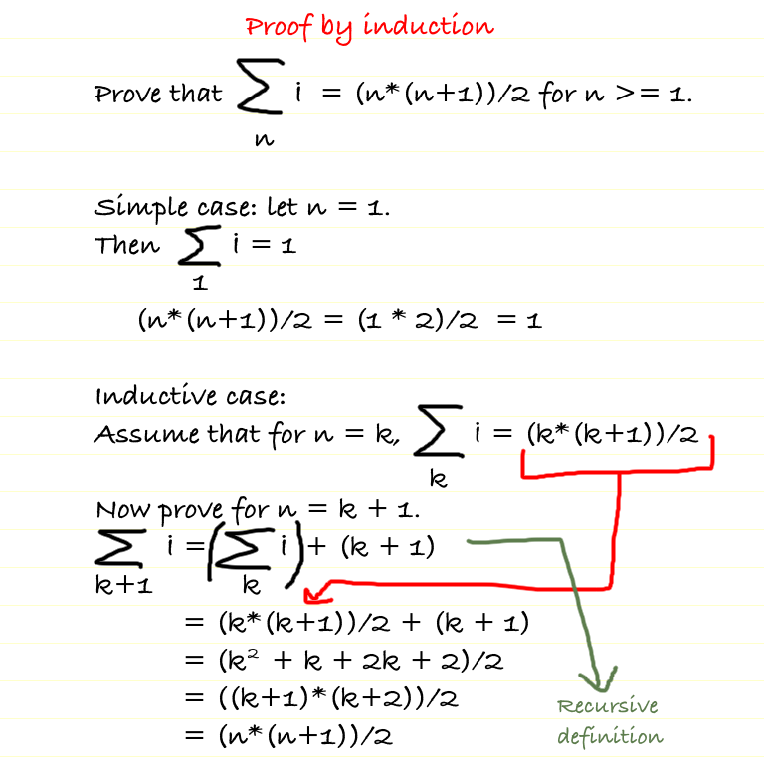
Recursion vs Induction

Slide 12
The Recursive Paradigm
Most recursive methods you’ll encounter fit the following general pattern:
if (test for a simple case) {
Compute and return the simple solution without using recursion.
} else {
Divide the problem into one or more subproblems that have the same form.
Solve each of the problems by calling this method recursively.
Return the solution from the results of the various subproblems.
}
Finding a recursive solution is mostly a matter of figuring out how to break it down so that it fits the paradigm. When you do so, you must do two things:
1.
Identify simple cases that can be solved without recursion.
2.
Find a recursive decomposition that breaks each instance of the problem into simpler subproblems of the same type, which you can then solve by applying the method recursively.

Slide 13
Containment
Problem: Does a string s contain a given character c?
Solution:
  Base case: Empty string does not contain the character.
  Recursive case: s contains c if its first character is equal to c, or the rest of s contains c.

Slide 14
public boolean contains(String s, char c) {
if(s.length() == 0) {
return false;
} else {
String rest = s.substring(1);
return (s.charAt(0) == c) || contains(rest, c);
}
}

Slide 15
Palindromes
A Palindrome is a string that is spelled the same way backward and forward.
  Mom, radar, kayak, tras adanada sart
Empty string is palindrome.
Single-character string is palindrome.
A string s is palindrome if its first and last characters are the same and its middle substring is a palindrome as well.
ey edip adanada pide ye

Slide 16
public boolean isPalindrome(String line) {
if(line.length() == 0 || line.length() == 1) {
return true;
} else {
int lastIndex = line.length() - 1;
return (line.charAt(0) == line.charAt(lastIndex))
&& isPalindrome(line.substring(1,lastIndex));
}
}

Slide 17
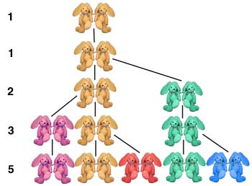
Fibonacci Series
Named after the Italian mathematician Leonardo Fibonacci.
Story: A pair of rabbits becomes mature in a month, then produces one pair of rabbits.
Current # of bunnies =
“Bunnies from previous month”
+ “offsprings of bunnies from
two months ago”
bunnies(n) = bunnies(n-1)
+ bunnies(n-2)
From: bbc.co.uk

Slide 18
Fibonacci Series
0, 1, 1, 2, 3, 5, 8, 13, 21, …
This series occurs in nature and describes a form of spiral.
The ratio of successive Fibonacci numbers converges on a constant value of 1.618…,
  called the golden ratio or the golden mean.
The Fibonacci series may be defined recursively as follows:
fibonacci(0) = 0
fibonacci(1) = 1
fibonacci(n) = fibonacci(n – 1) + fibonacci(n – 2)

Slide 19
Fibonacci Series
Two base cases for
  fib(0) is defined to be 0
  fib(1) to be 1
public int fib(int n) {
if(n == 0 || n == 1) {
return n;
} else {
return fib(n-1) + fib(n-2);
}
}

Slide 20
fib(4)
+
fib(3)
fib(2)
+
fib(2)
fib(1)
+
fib(1)
fib(0)
public int fib(int n) {
if(n == 0 || n == 1) {
return n;
} else {
return fib(n-1) + fib(n-2);
}
}

Slide 21
fib(4)
2
+
fib(3)
fib(2)
1
+
1
fib(2)
fib(1)
1
+
0
fib(0)
public int fib(int n) {
if(n == 0 || n == 1) {
return n;
} else {
return fib(n-1) + fib(n-2);
}
}

Slide 22
3
fib(4)
2
+
1
fib(2)
1
+
0
fib(1)
fib(0)
public int fib(int n) {
if(n == 0 || n == 1) {
return n;
} else {
return fib(n-1) + fib(n-2);
}
}

Slide 23
Method Call Stack
public int fib(int n) {
if(n == 0 || n == 1) {
return n;
} else {
return fib(n-1) + fib(n-2);
}
}
run
(C) 2010 Pearson Education, Inc. All rights reserved.

Slide 24
Method Call Stack
public int fib(int n) {
if(n == 0 || n == 1) {
return n;
} else {
return fib(n-1) + fib(n-2);
}
}
fib(4)
run
(C) 2010 Pearson Education, Inc. All rights reserved.

Slide 25
Method Call Stack
public int fib(int n) {
if(n == 0 || n == 1) {
return n;
} else {
return fib(n-1) + fib(n-2);
}
}
fib(3)
fib(4)
run
(C) 2010 Pearson Education, Inc. All rights reserved.

Slide 26
Method Call Stack
public int fib(int n) {
if(n == 0 || n == 1) {
return n;
} else {
return fib(n-1) + fib(n-2);
}
}
fib(2)
fib(3)
fib(4)
run
(C) 2010 Pearson Education, Inc. All rights reserved.

Slide 27
Method Call Stack
public int fib(int n) {
if(n == 0 || n == 1) {
return n;
} else {
return fib(n-1) + fib(n-2);
}
}
fib(1)
fib(2)
fib(3)
fib(4)
run
(C) 2010 Pearson Education, Inc. All rights reserved.

Slide 28
Method Call Stack
public int fib(int n) {
if(n == 0 || n == 1) {
return n;
} else {
return fib(n-1) + fib(n-2);
}
}
fib(2)
fib(3)
fib(4)
run
(C) 2010 Pearson Education, Inc. All rights reserved.

Slide 29
Method Call Stack
public int fib(int n) {
if(n == 0 || n == 1) {
return n;
} else {
return fib(n-1) + fib(n-2);
}
}
fib(0)
fib(2)
fib(3)
fib(4)
run
(C) 2010 Pearson Education, Inc. All rights reserved.

Slide 30
Method Call Stack
public int fib(int n) {
if(n == 0 || n == 1) {
return n;
} else {
return fib(n-1) + fib(n-2);
}
}
fib(2)
fib(3)
fib(4)
run
(C) 2010 Pearson Education, Inc. All rights reserved.

Slide 31
Method Call Stack
public int fib(int n) {
if(n == 0 || n == 1) {
return n;
} else {
return fib(n-1) + fib(n-2);
}
}
fib(3)
fib(4)
run
(C) 2010 Pearson Education, Inc. All rights reserved.

Slide 32
Method Call Stack
public int fib(int n) {
if(n == 0 || n == 1) {
return n;
} else {
return fib(n-1) + fib(n-2);
}
}
fib(1)
fib(3)
fib(4)
run
(C) 2010 Pearson Education, Inc. All rights reserved.

Slide 33
Method Call Stack
public int fib(int n) {
if(n == 0 || n == 1) {
return n;
} else {
return fib(n-1) + fib(n-2);
}
}
fib(3)
fib(4)
run
(C) 2010 Pearson Education, Inc. All rights reserved.

Slide 34
Method Call Stack
public int fib(int n) {
if(n == 0 || n == 1) {
return n;
} else {
return fib(n-1) + fib(n-2);
}
}
fib(4)
run
(C) 2010 Pearson Education, Inc. All rights reserved.

Slide 35
Method Call Stack
public int fib(int n) {
if(n == 0 || n == 1) {
return n;
} else {
return fib(n-1) + fib(n-2);
}
}
fib(2)
fib(4)
run
(C) 2010 Pearson Education, Inc. All rights reserved.

Slide 36
Method Call Stack
public int fib(int n) {
if(n == 0 || n == 1) {
return n;
} else {
return fib(n-1) + fib(n-2);
}
}
fib(1)
fib(2)
fib(4)
run
(C) 2010 Pearson Education, Inc. All rights reserved.

Slide 37
Method Call Stack
public int fib(int n) {
if(n == 0 || n == 1) {
return n;
} else {
return fib(n-1) + fib(n-2);
}
}
fib(2)
fib(4)
run
(C) 2010 Pearson Education, Inc. All rights reserved.

Slide 38
Method Call Stack
public int fib(int n) {
if(n == 0 || n == 1) {
return n;
} else {
return fib(n-1) + fib(n-2);
}
}
fib(0)
fib(2)
fib(4)
run
(C) 2010 Pearson Education, Inc. All rights reserved.

Slide 39
Method Call Stack
public int fib(int n) {
if(n == 0 || n == 1) {
return n;
} else {
return fib(n-1) + fib(n-2);
}
}
fib(2)
fib(4)
run
(C) 2010 Pearson Education, Inc. All rights reserved.

Slide 40
Method Call Stack
public int fib(int n) {
if(n == 0 || n == 1) {
return n;
} else {
return fib(n-1) + fib(n-2);
}
}
fib(4)
run
(C) 2010 Pearson Education, Inc. All rights reserved.

Slide 41
Method Call Stack
public int fib(int n) {
if(n == 0 || n == 1) {
return n;
} else {
return fib(n-1) + fib(n-2);
}
}
run
(C) 2010 Pearson Education, Inc. All rights reserved.

Slide 42
Fibonacci Series
Calculating the Fibonacci value of 20 using the recursive version requires 21,891 calls to the fib method; calculating the Fibonacci value of 30 requires 2,692,537 calls!
Prefer iterative version (i.e. for-loop) to recursion in such cases.

Slide 43
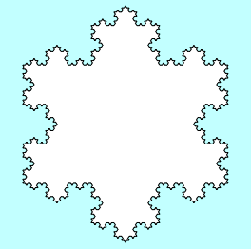
Graphical Recursion
Recursion comes up in certain graphical applications, most notably in the creation of fractals, which are mathematical structures that consist of similar figures repeated at various different scales. Fractals were popularized in a 1982 book by Benoit Mandelbrot entitled The Fractal Geometry of Nature.
One of the simplest fractal patterns to draw is the Koch fractal, named after its inventor, the Swedish mathematician Helge von Koch (1870-1924). The Koch fractal is sometimes called a snowflake fractal because of the beautiful, six-sided symmetries it displays as the figure becomes more detailed. as illustrated in the following diagram:

Slide 44
Drawing Koch Fractals
The process of drawing a Koch fractal begins with an equilateral triangle, as shown in the diagram on the lower left.
From the initial position (which is called a fractal of order 0), each higher fractal order is created by replacing each line segment in the figure by four segments that connect the same endpoints but include an equilateral wedge in the middle.
order 0
order 1
order 2
The figure on the previous slide is the Koch fractal of order 4.

Slide 45
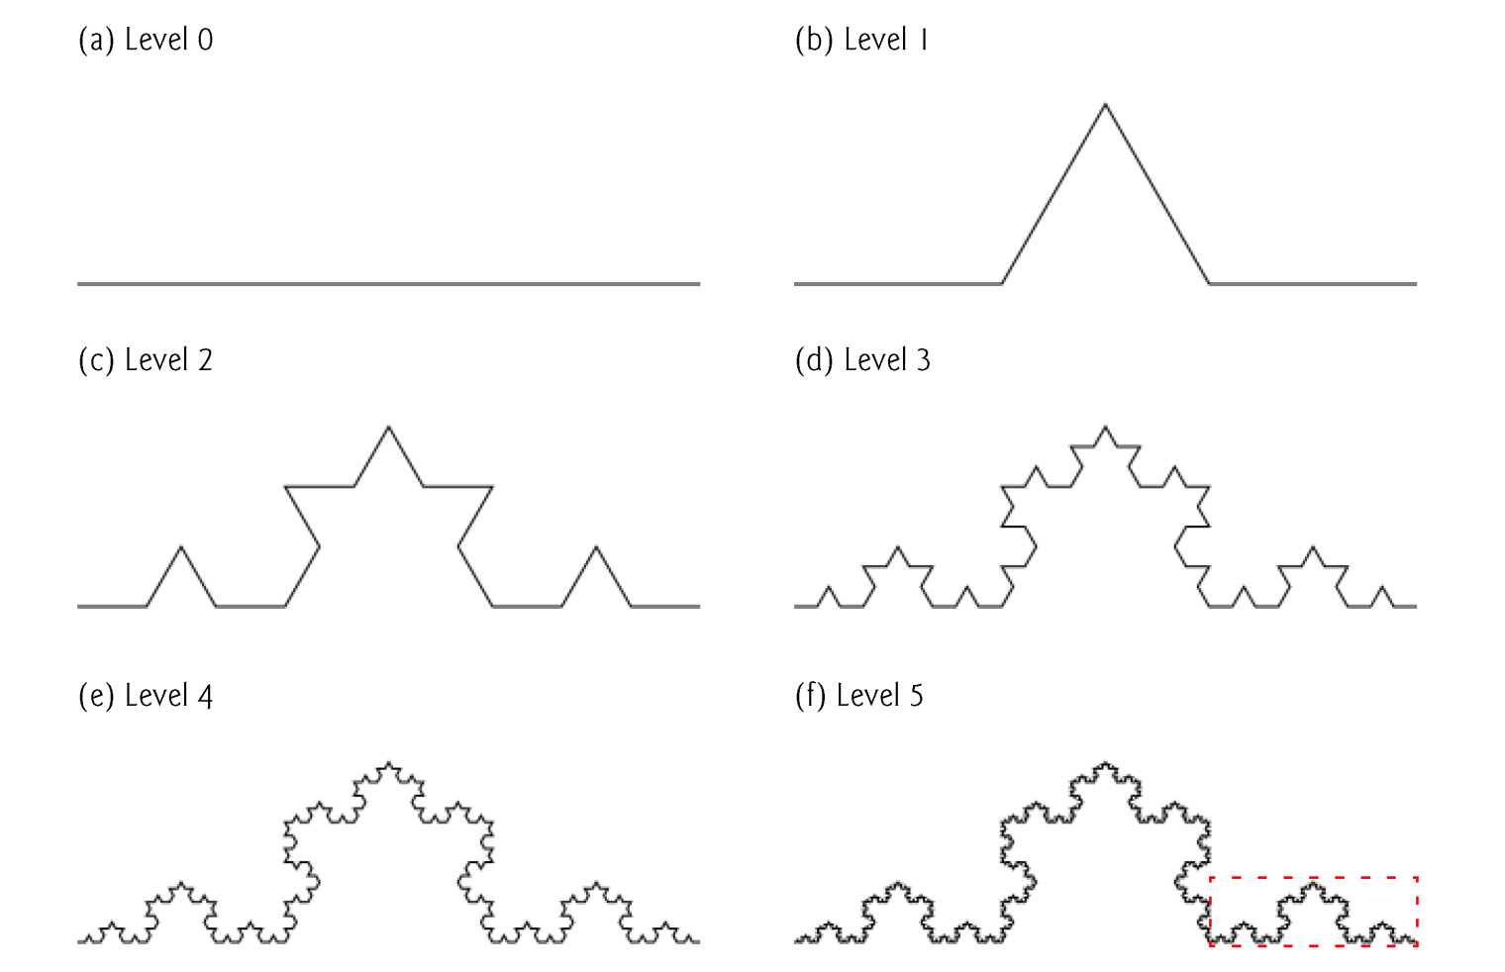
Drawing Koch Fractals
(C) 2010 Pearson Education, Inc. All rights reserved.

Slide 46
public void drawFractal( int level, int x1, int y1, int x5, int y5) {
if ( level == 0 ) {
add(new GLine(x1, y1, x5, y5));
} else {
int x2 = x1 + ( x5 - x1 ) / 3;
int y2 = y1 + ( y5 - y1 ) / 3;
int x4 = x1 + ( x5 - x1 ) * 2 / 3;
int y4 = y1 + ( y5 - y1 ) * 2 / 3;
// calculate the mid point
int xM = (x1 + x5) / 2;
int yM = (y1 + y5) / 2;
// calculate the tip point
// using some analytic geometry
int x3 = (int)(xM - Math.sqrt(3) / 2.0 * (y2 - y4));
int y3 = (int)(yM - Math.sqrt(3) / 2.0 * (x4 - x2));
// recursively draw the Fractal
drawFractal( level - 1, x1, y1, x2, y2);
drawFractal( level - 1, x2, y2, x3, y3);
drawFractal( level - 1, x3, y3, x4, y4);
drawFractal( level - 1, x4, y4, x5, y5);
}
}

Slide 47
Towers of Hanoi
Purpose:
  Move stack of disks from one peg to another.
Constraints:
  Exactly one disk is moved at a time
  A larger disk may not be placed above a smaller disk.
Three pegs are provided, one being used for temporarily holding disks.

Slide 48
PEG 1
PEG 2
PEG 3

Slide 49
PEG 1
PEG 2
PEG 3

Slide 50
PEG 1
PEG 2
PEG 3

Slide 51
PEG 1
PEG 2
PEG 3

Slide 52
PEG 1
PEG 2
PEG 3

Slide 53
Towers of Hanoi
Moving n disks can be viewed as follows:
  Move n – 1 disks from peg 1 to peg 2, using peg 3 as a temporary holding area.
  Move the last disk (the largest) from peg 1 to peg 3.
  Move n – 1 disks from peg 2 to peg 3, using peg 1 as a temporary holding area.
Base case:
  If there is only one disk to move, move it directly.

Slide 54
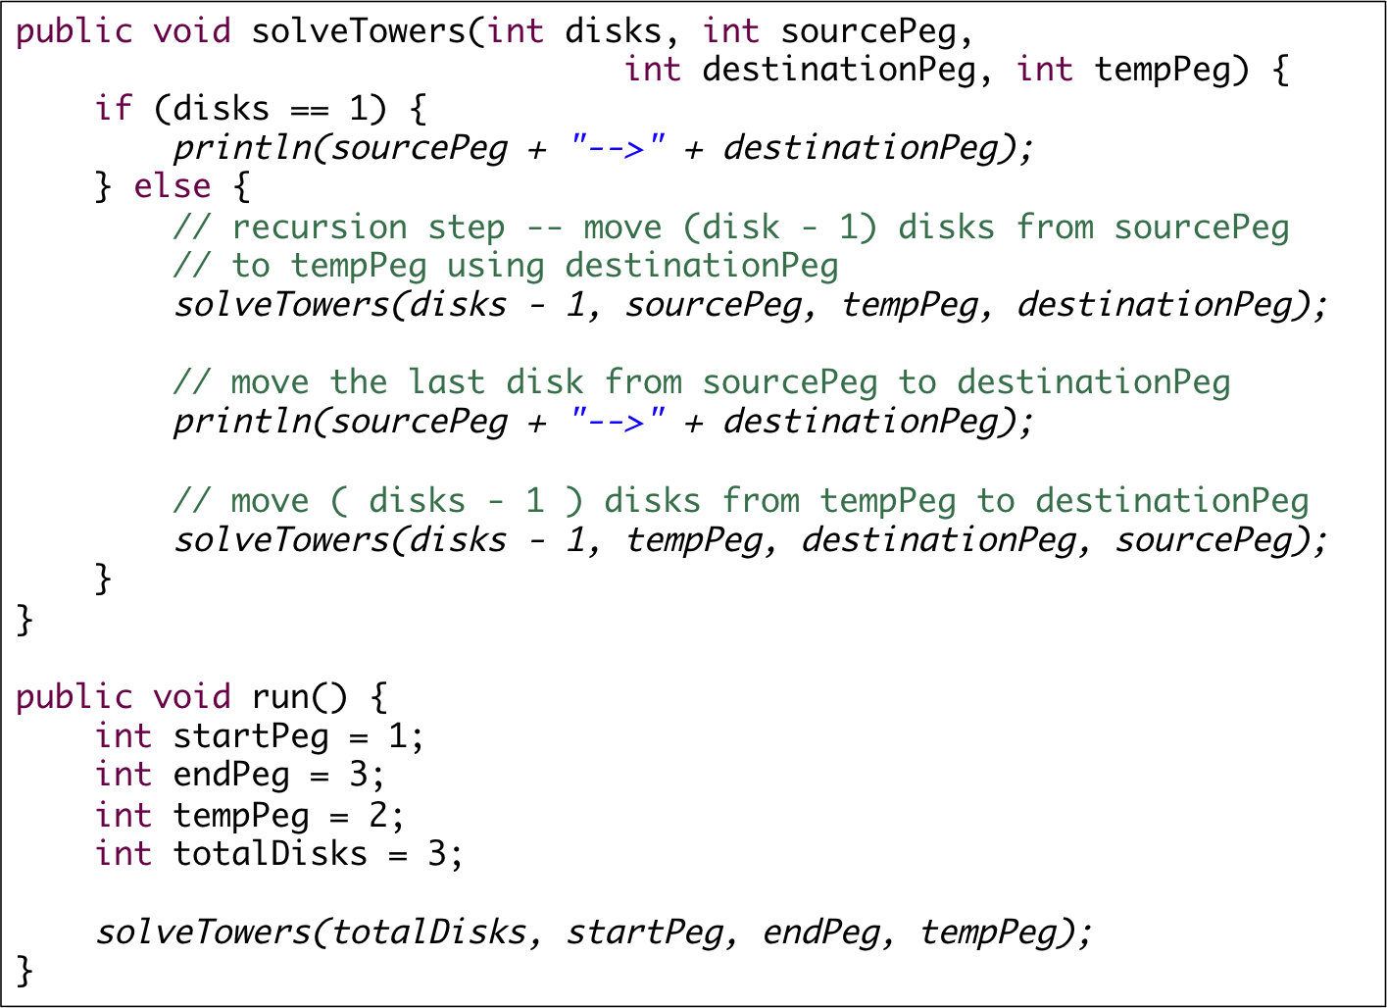

Slide 55
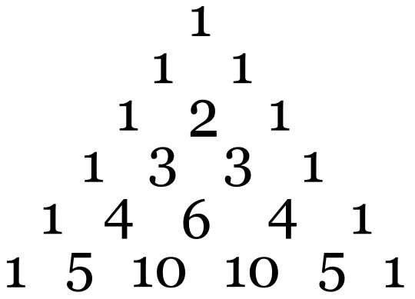
Pascal’s Triangle
Below is a picture of Pascal’s (not Nouma; the mathematician Pascal!) triangle. Indexing of rows starts from 0.
Task: Implement the method called pascal that takes a nonnegative integer n and returns an array of integers that contains the numbers in row n.
Hint: Recursion is about solving a problem using the solution of the same problem for a smaller size. Which Pascal row do you need to know to compute row n? What is the base case?

Slide 56
public int[] pascal(int n) {
if (n == 0) {
int[] row = { 1 };
return row;
} else {
int[] row = new int[n + 1];
row[0] = 1;
row[n] = 1;
int[] previousRow = pascal(n - 1);
for (int i = 1; i < n; i++) {
row[i] = previousRow[i - 1] + previousRow[i];
}
return row;
}
}

Slide 57
Exercise: A Recursive gcd Function
Solution: A Recursive gcd Function
In the discussion of algorithmic methods in Chapter 5, one of the primary examples was Euclid’s algorithm for computing the greatest common divisor of two integers, x and y. Euclid’s algorithm can be implemented using the following code:
public int gcd(int x, int y) {
if (y == 0) {
return x;
} else {
return gcd(y, x % y);
}
}
public int gcd(int x, int y) {
int r = x % y;
while (r != 0) {
x = y;
y = r;
r = x % y;
}
return y;
}
As always, the key to solving this problem lies in identifying the recursive decomposition and defining appropriate simple cases.
Rewrite this method so that it uses recursion instead of iteration, taking advantage of Euclid’s insight that the greatest common divisor of x and y is also the greatest common divisor of the y and the remainder of x divided by y.

Slide 58
Exercise: Recursive reverse
Solution: A Recursive gcd Function
Write a recursive version of the reverse method that takes a string and returns its reverse.
public String reverse(String s) {
}

Slide 59
Exercise: Recursive toUpperCase
Solution: A Recursive gcd Function
Write a recursive version of the toUpperCase method that takes a string and returns another string that has all the characters of the argument converted to uppercase.
public String toUpperCase(String s) {
}

Slide 60
Exercise: Recursive binarySearch
Solution: A Recursive gcd Function
Write a recursive version of the binarySearch method below.
public int binarySearch(int key, int[] array) {
int lh = 0;
int rh = array.length - 1;
while (lh <= rh) {
int mid = (lh + rh) / 2;
if (key == array[mid]) return mid;
if (key < array[mid]) {
rh = mid - 1;
} else {
lh = mid + 1;
}
}
return -1;
}
Hint: Change the method to receive lh and rh as arguments.

