Slide 1

GROUP 3
BAKERY-RECIVE FUNCTIONAL

Slide 2


USER TABLE
GUEST | Any customer visit website without log-in
USER | GUEST after Register and Login into the website
Retail Store | GUEST after Register to be a Store and Login into the website
Admin | All the colors used in this presentation

Slide 3





GUEST
- View recipe, blog.
- View Store List
- Add Ingredient to cart
- CRUD cart
- Register/Login to User
- Register/Login to Store

Slide 4
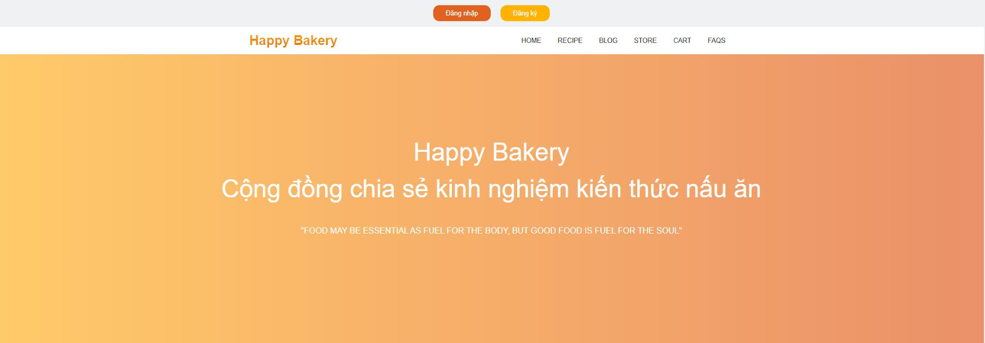
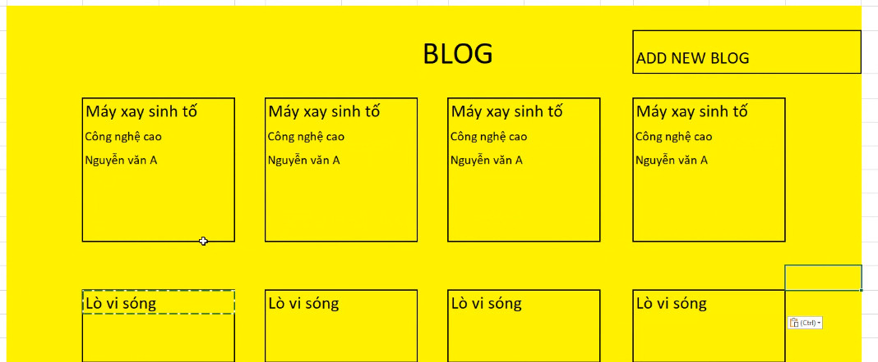
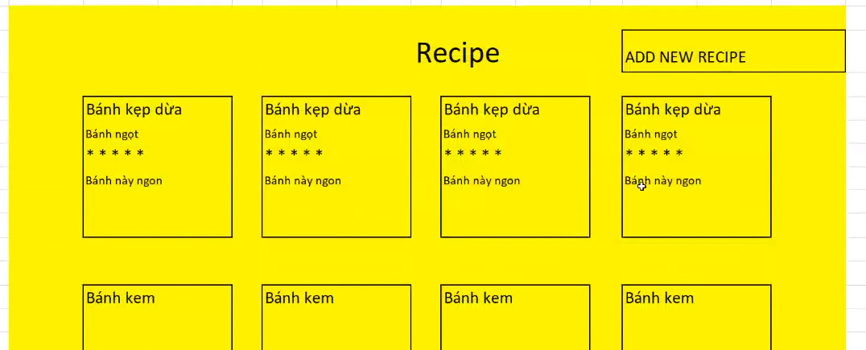
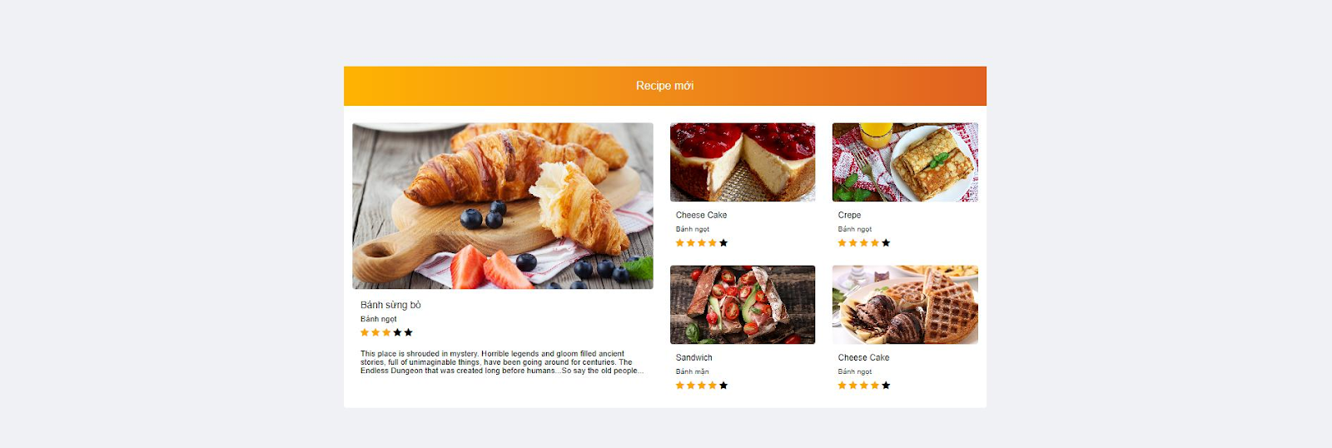
GUEST
View recipe, blog

Slide 5
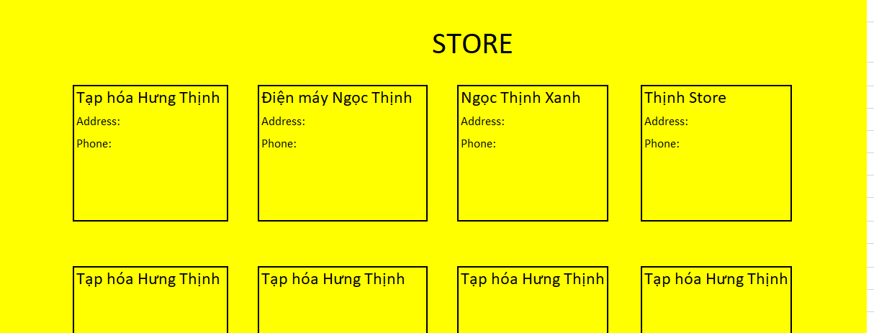
GUEST
View Store List

Slide 6
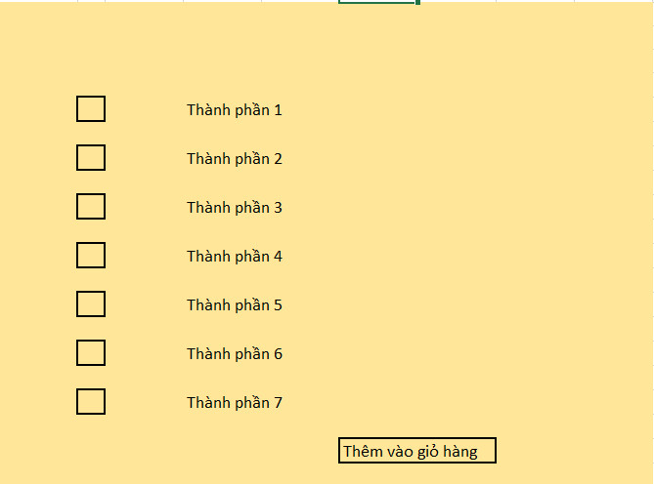
GUEST
Add Ingredient to cart

Slide 7
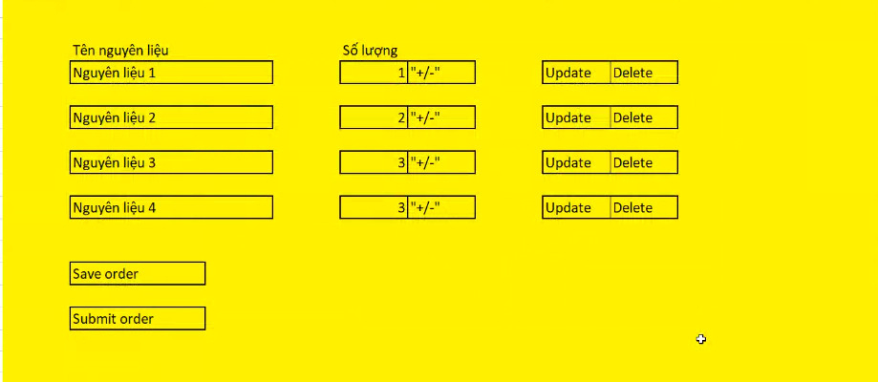
GUEST
CRUD cart

Slide 8
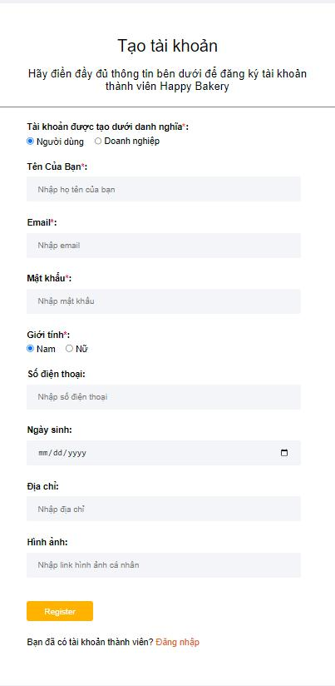
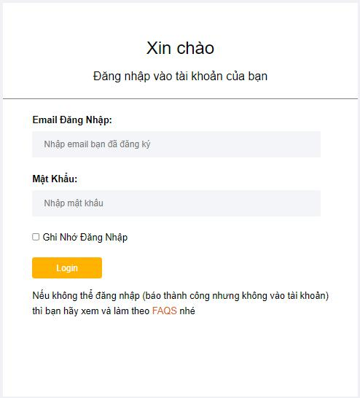
GUEST
Register/Login to User and Store

Slide 9
User
- CRUD Recipe
- Edit profile
- Comment, Rating recipe
- Edit cart and checkout

Slide 10
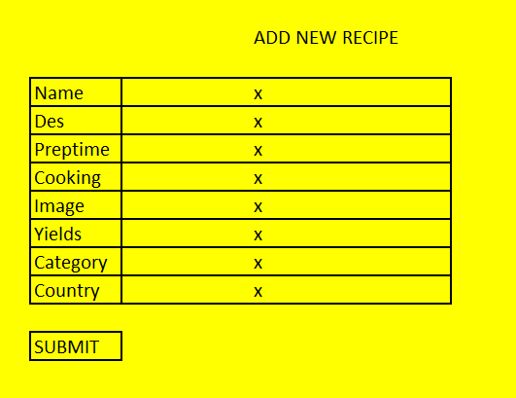
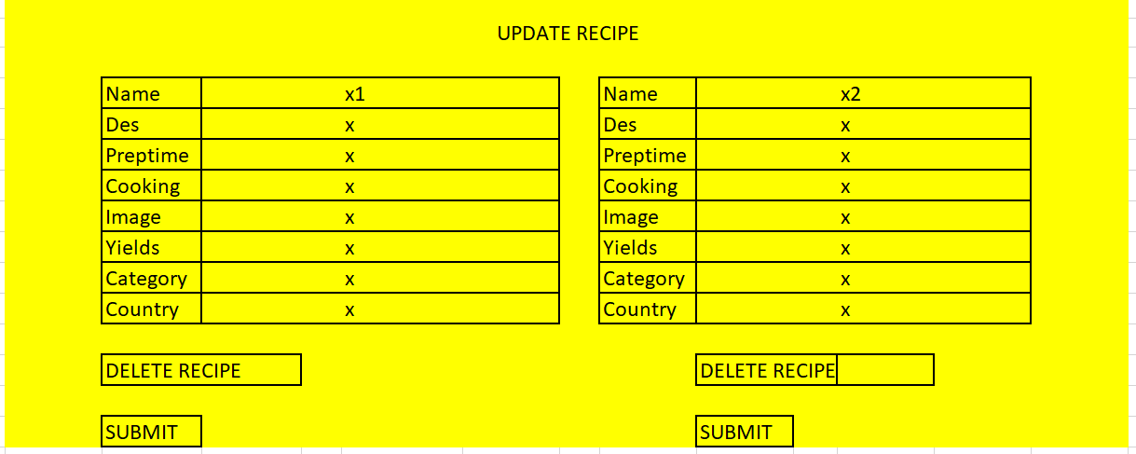
User CRUD Recipe

Slide 11
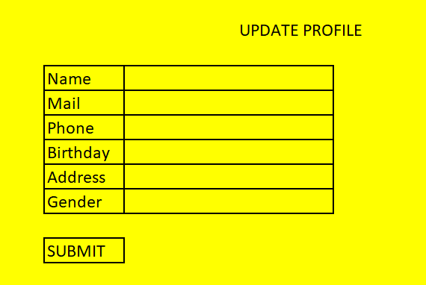
User Edit profile

Slide 12
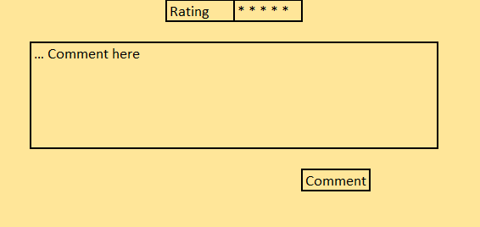
User Comment, Rating recipe

Slide 13
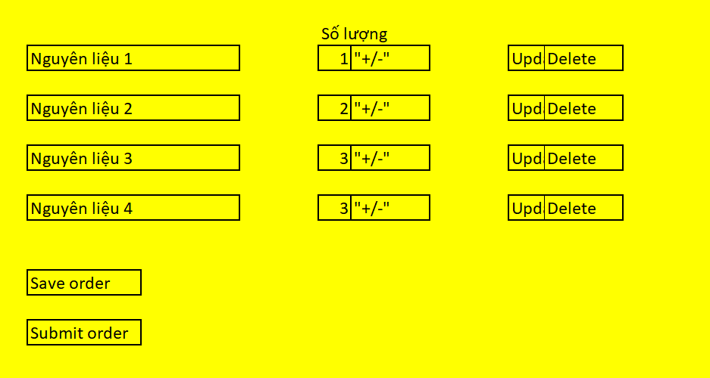
User Edit cart and checkout

Slide 14
Retail Store
- Accept and reject a order
- View user information
- CRUD Blog

Slide 15
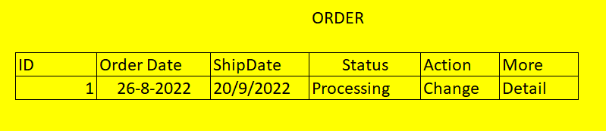
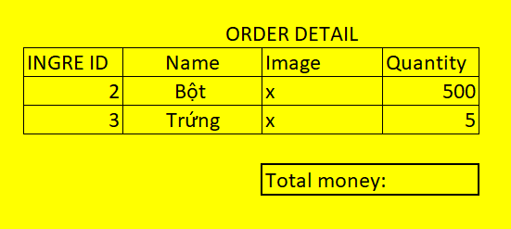
Retail Store Accept and reject a order

Slide 16
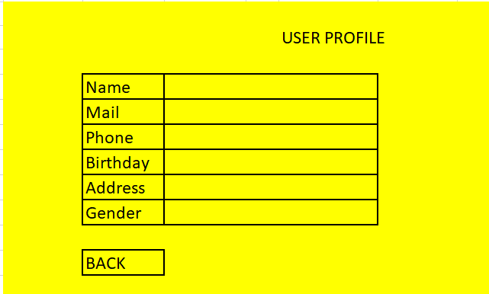
Retail Store View user information

Slide 17
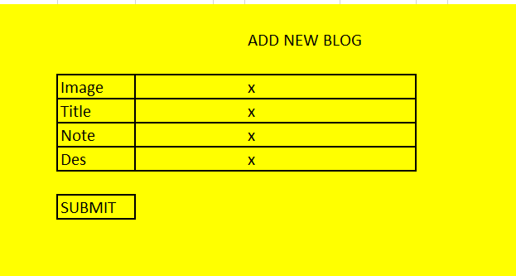
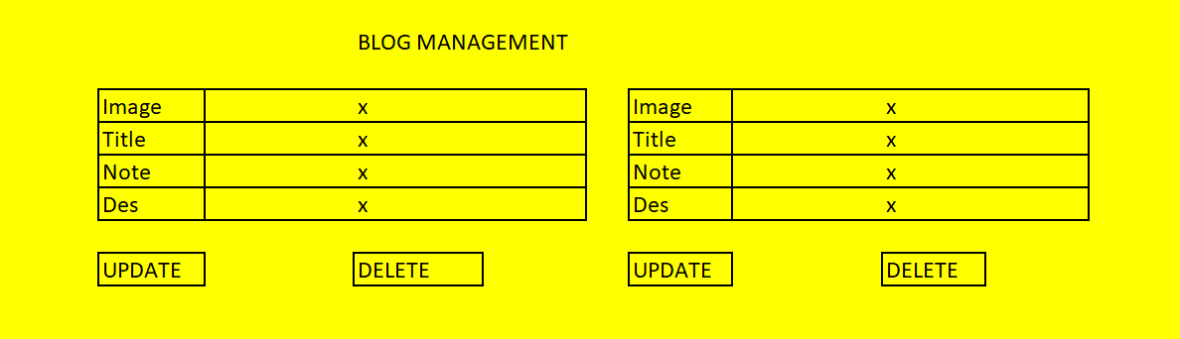
Retail Store CRUD Blog

Slide 18
Admin
- Block/Unblock Store/User
- Accept or reject blog and recipe
- RD Blog and Recipe

Slide 19
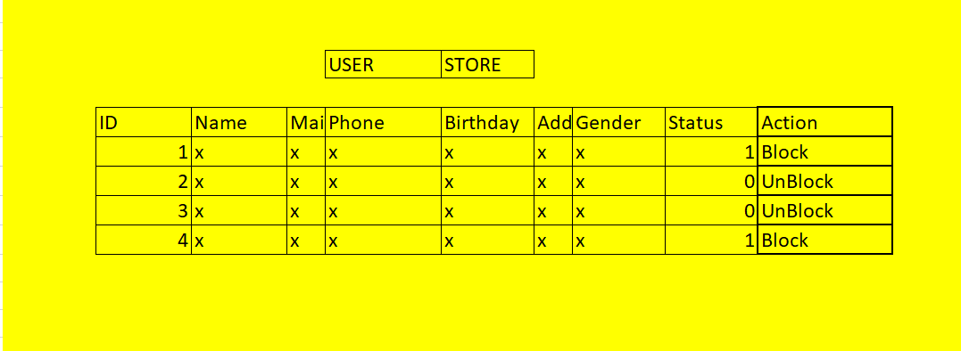
Admin Block/Unblock Store/User

Slide 20
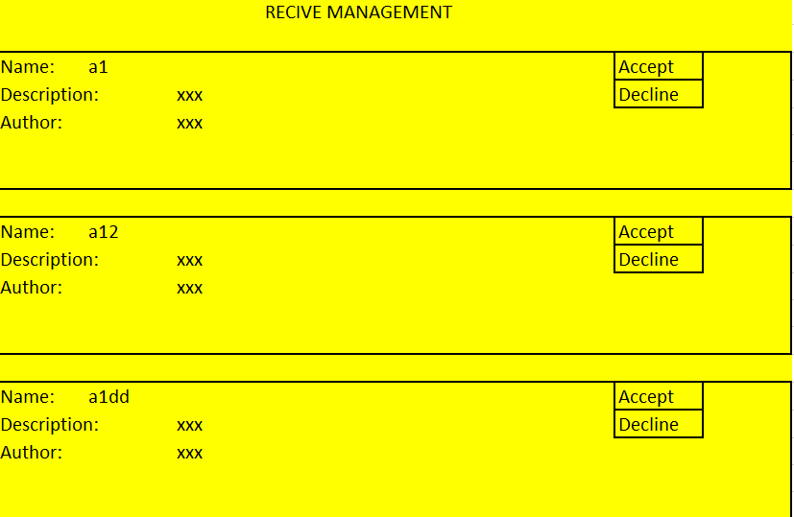
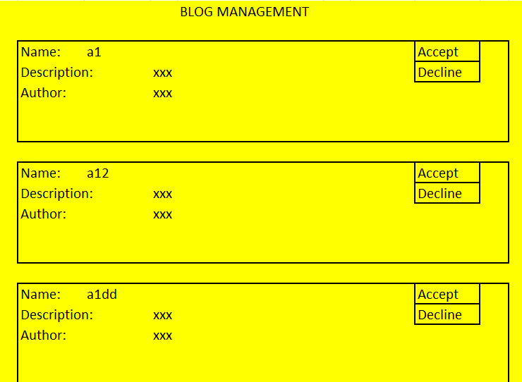
Admin Accept or reject blog and recipe

Slide 21
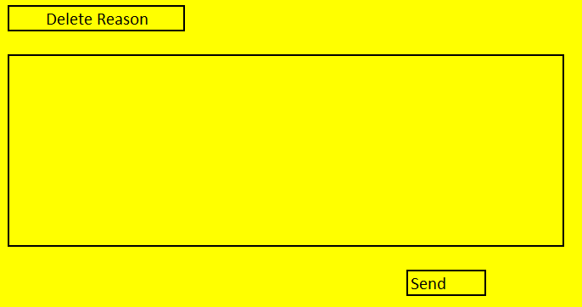
Admin RD Blog and Recipe

Slide 22




Thanks!
Do you have any questions?

