Slide 1

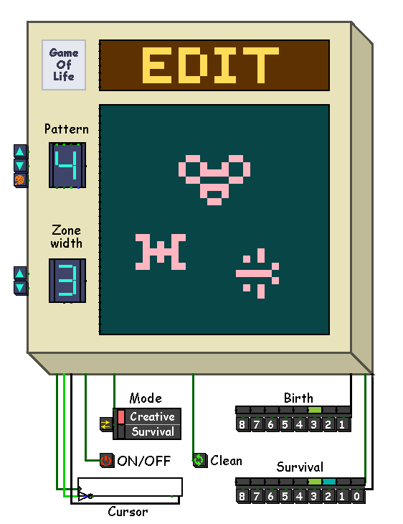
Conway game of life
Filippova Daria 24216
Muruev Denis 24216
Vilegzhanin Maksim 24216

Slide 2
Goal
Create a workable model of Conway Game of Life game combining hardware and software using CDM-8e
Filippova Daria 24216
Muruev Denis 24216
Vilegzhanin Maksim 24216

Slide 3

Classic rules of the
Game of life
If there are 3 or more living cells near to dead cell it comes to life.

Slide 4

Classic rules of the
Game of life
If there are 2 or 3 living cells near a living cell, the cell continues to live. Otherwise, the living cell dies

Slide 5
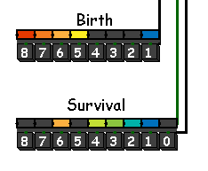
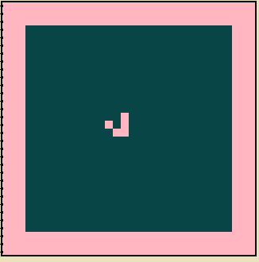
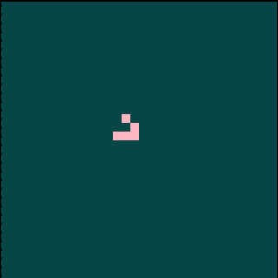
Project extensions
Parameterized birth/survival conditions
Two modes: “creative” (fixed field) and “survival” (zone shrinking).

Slide 6
Project extensions
Parameterized birth/survival conditions
Game modes:
Two modes: “creative” (fixed field) and “survival” (zone shrinking).
Survival
Creative

Slide 7



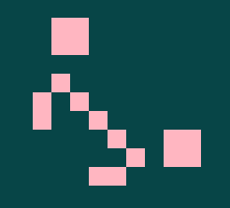
HARDWARE
Project extensions
Also added the ability to set one on of the 8 ready-made deferent patterns

Slide 8
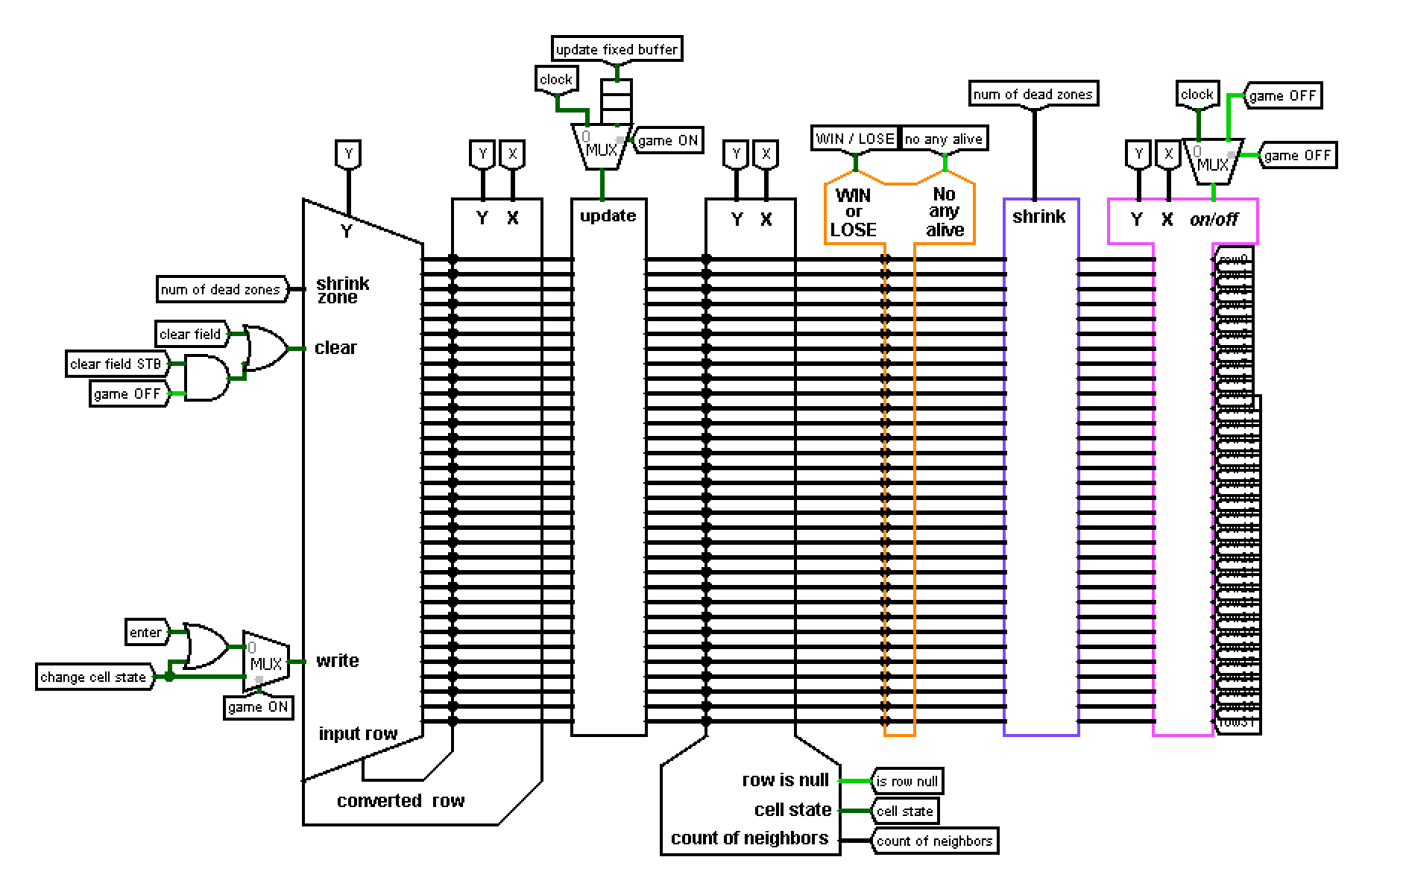
Hardware
Main sсheme
HARDWARE
combines all parts of the circuit together

Slide 9
Hardware
converter
Change X cell in the current Y row to the opposite and sends the result row to write buffer

Slide 10
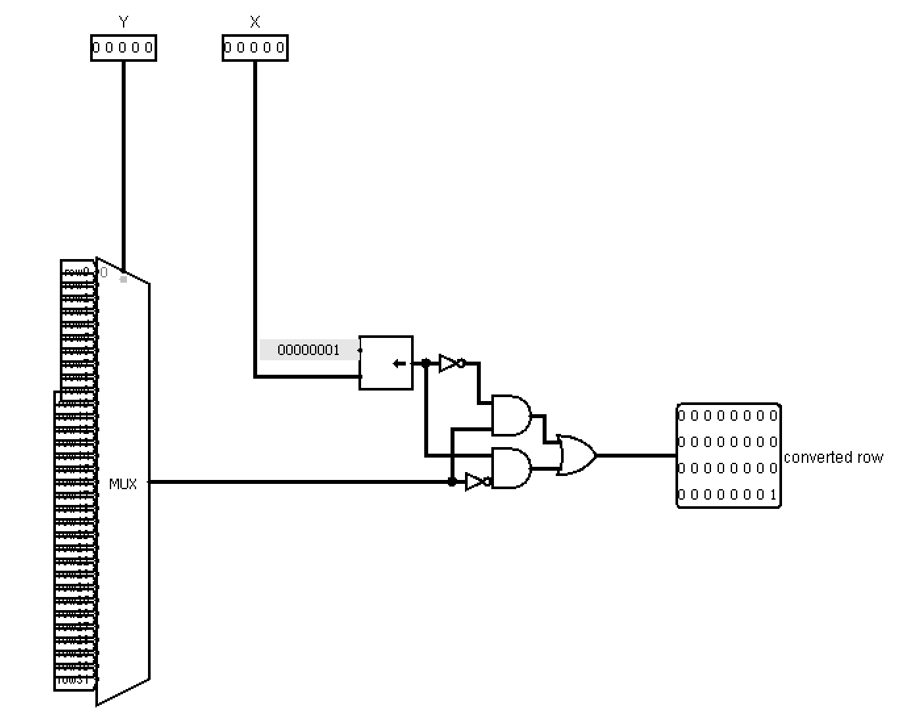
Hardware
converter
Change X cell in the current Y row to the opposite and sends the result row to write buffer

Slide 11
Hardware
converter
Change X cell in the current Y row to the opposite and sends the result row to write buffer

Slide 12
buffers
Hardware
Write
Fixed
There are two field states. one can be edited in the Write buffer. The other is static in the Fixed buffer.

Slide 13
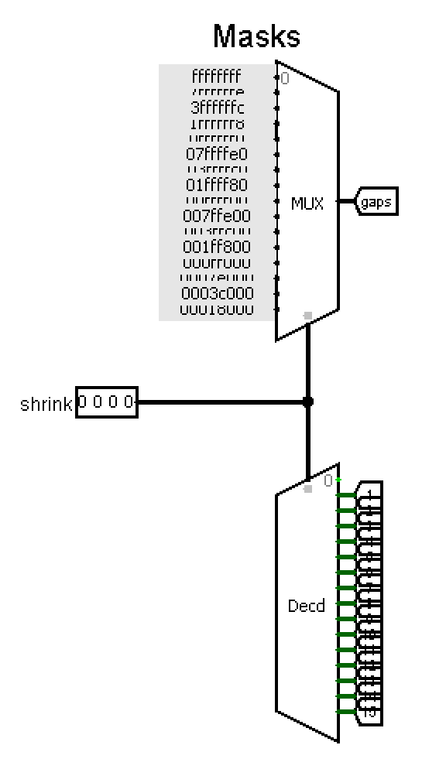
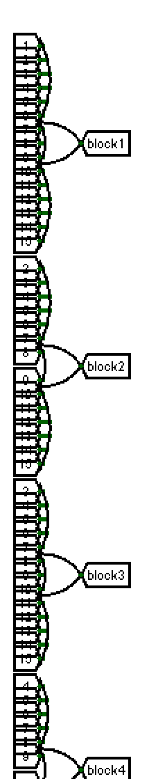
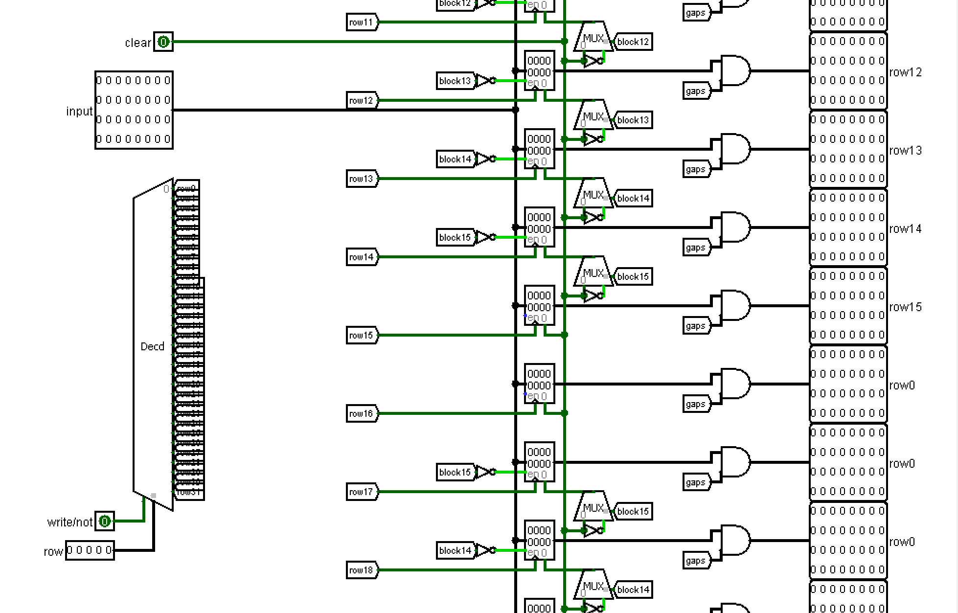
Hardware
Write
buffer
buffers
Contains 32 registers for recording input row, also masks for shrinking the field horizontally and tunnels with OR gate for shrinking vertically
horizontally
Write
Fixed
vertically
input row
There are two field states. one can be edited in the Write buffer. The other is static in the Fixed buffer.

Slide 14
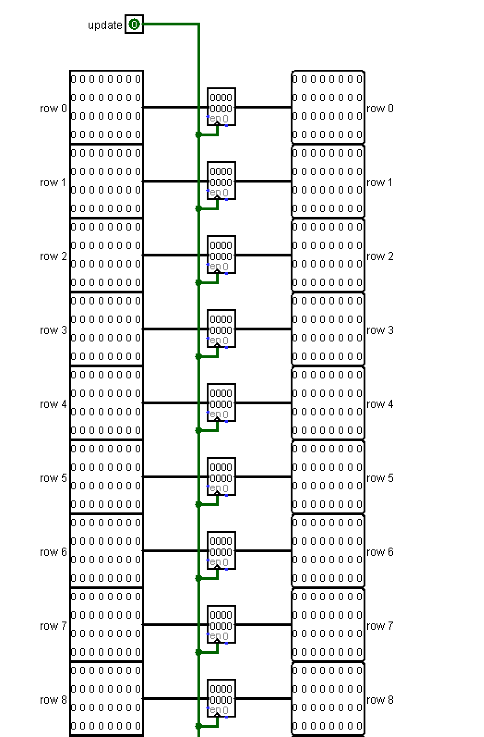
Hardware
buffers
Just contains 32 registers for recording new state of field from write buffer
Fixed
buffer
Write
Fixed
There are two field states. one can be edited in the Write buffer. The other is static in the Fixed buffer.

Slide 15
buffers
Hardware
Write
Fixed
There are two field states. one can be edited in the Write buffer. The other is static in the Fixed buffer.

Slide 16
Hardware
neighbor module
It gives the number of neighbors, the cell state and the flag that the row is completely empty

Slide 17
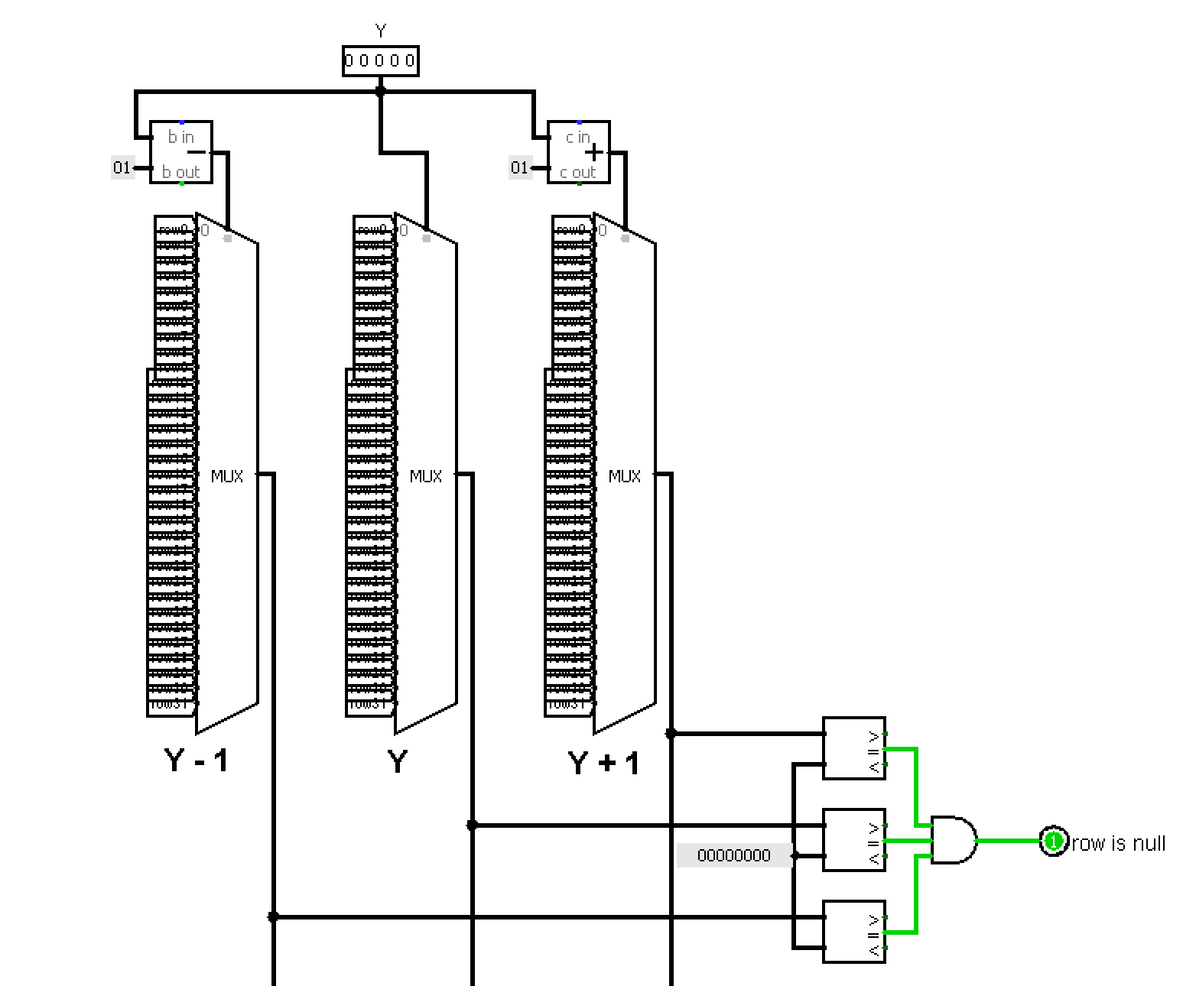
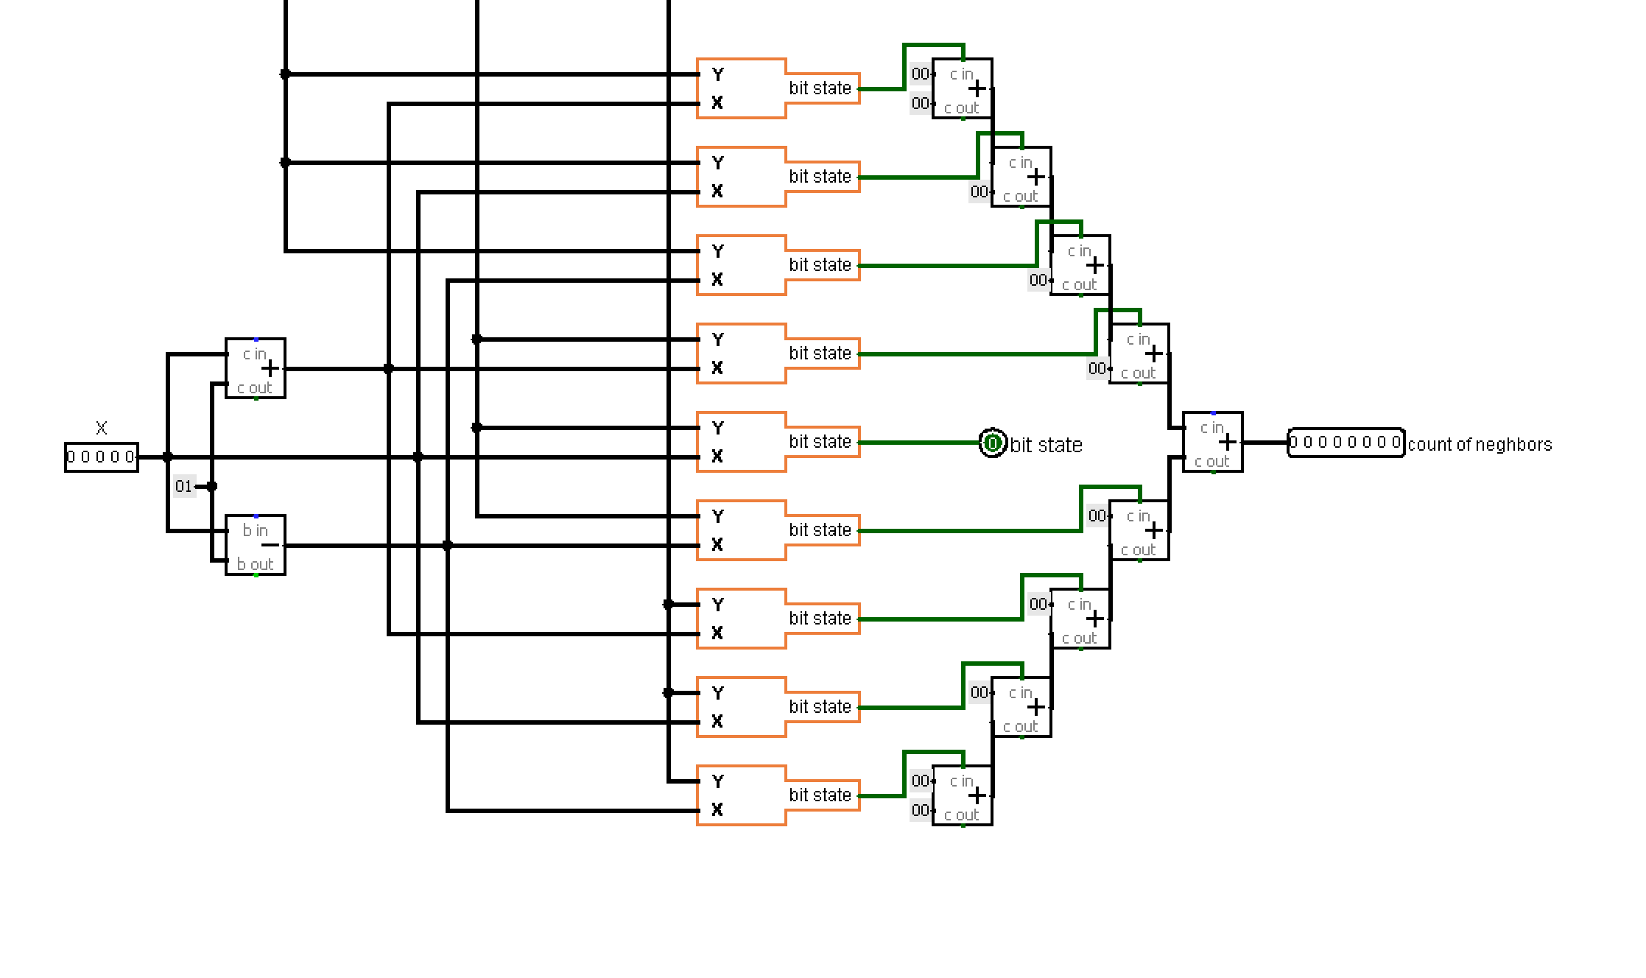
Hardware
Y-1
Y
Y+1
Takes 3 rows Y, Y-1, Y+1 and counts the number of neighbors near cell X Y. If all three rows are empty, the flag for skipping this row Y is raised.
Flag
neighbor module
number of neighbors
It gives the number of neighbors, the cell state and the flag that the row is completely empty

Slide 18
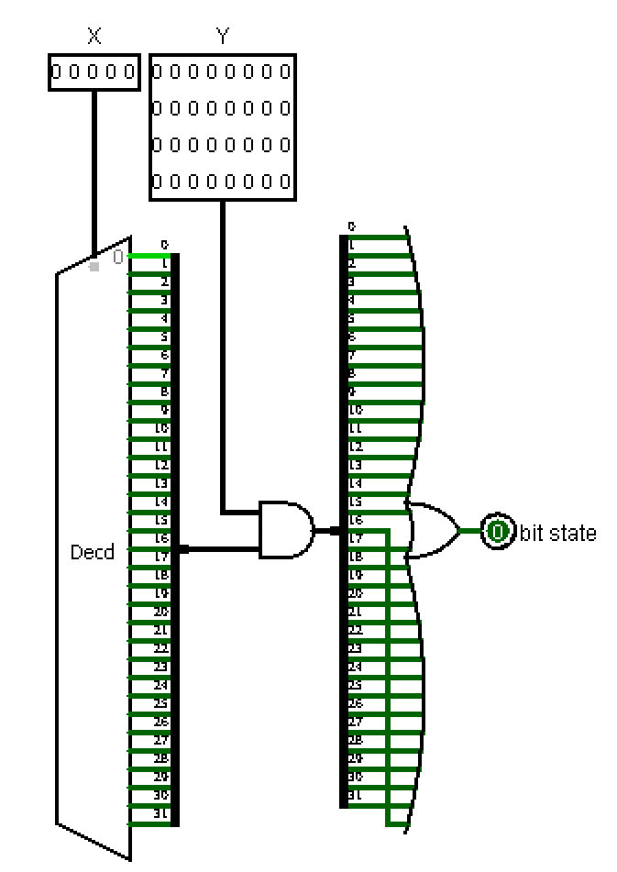
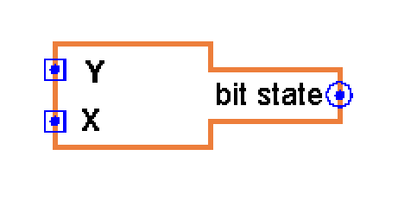
Hardware
This scheme also uses modules to get the state of cell X from row
neighbor module
It gives the number of neighbors, the cell state and the flag that the row is completely empty

Slide 19
Hardware
neighbor module
It gives the number of neighbors, the cell state and the flag that the row is completely empty

Slide 20
Hardware
survival module
Indicates victory or defeat in survival mode

Slide 21
Hardware
Visualization modules
Vizualize cursor and shrinking zones on the matrix

Slide 22
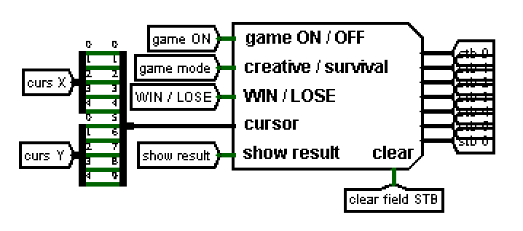
I/O
Hardware
Status bar
shows the current state of the game:
EDIT
SIMULATION
WIN
LOSE

Slide 23
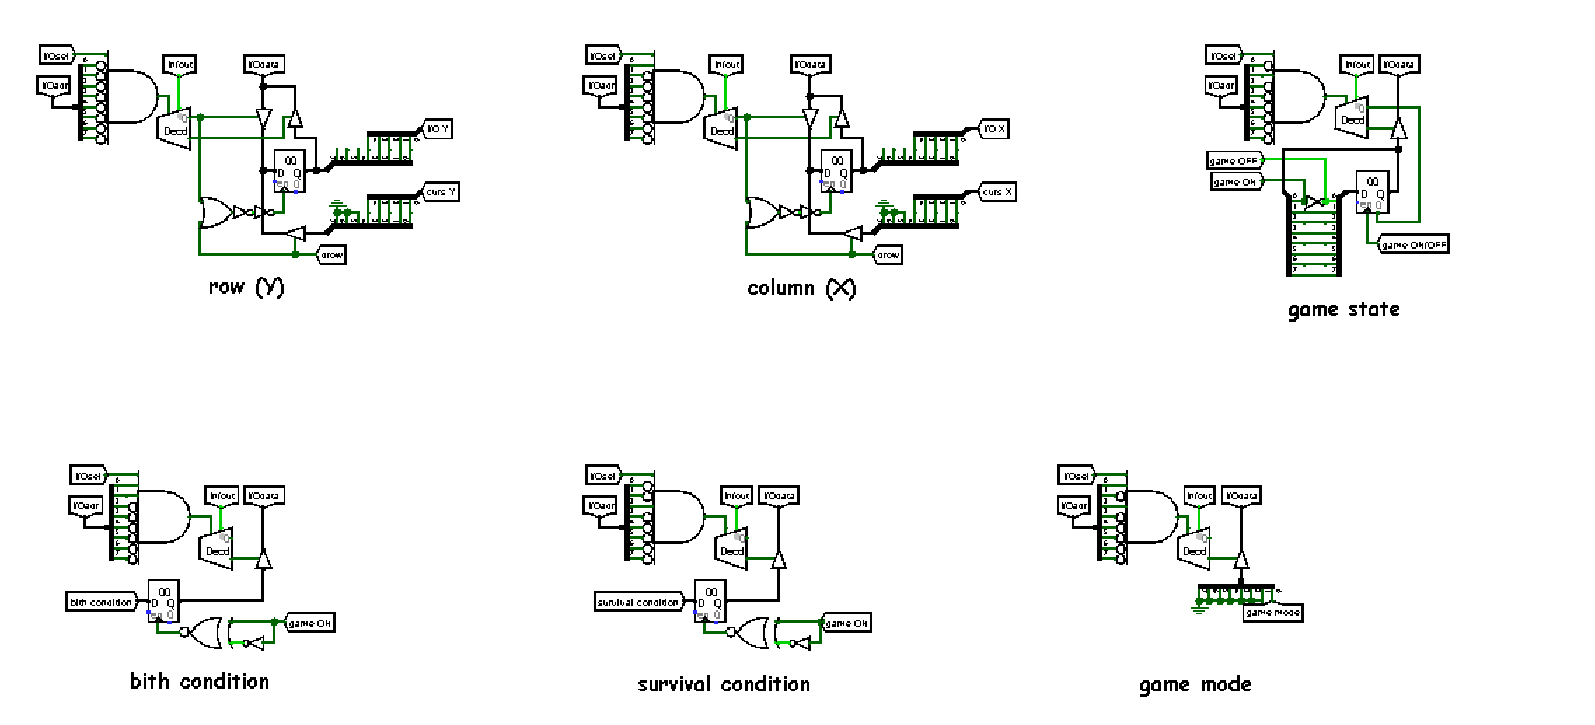
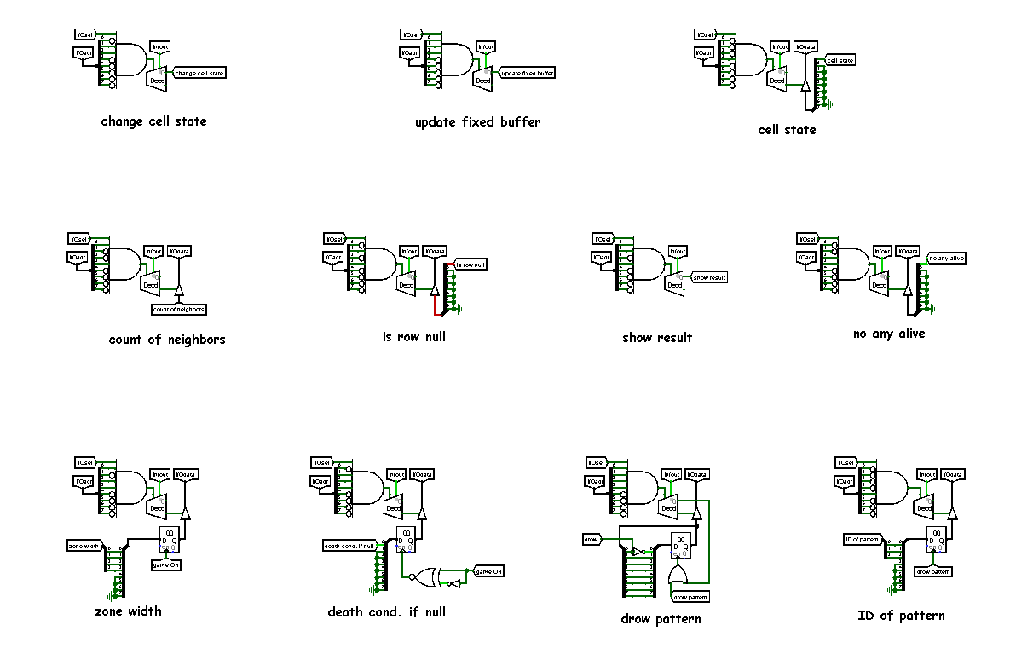
Hardware
There are a total of 17 IO devices. Let’s see the important ones
I/O

Slide 24
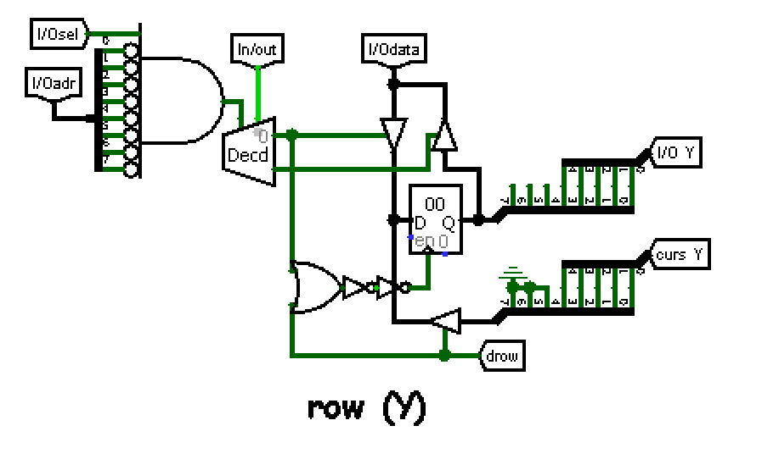
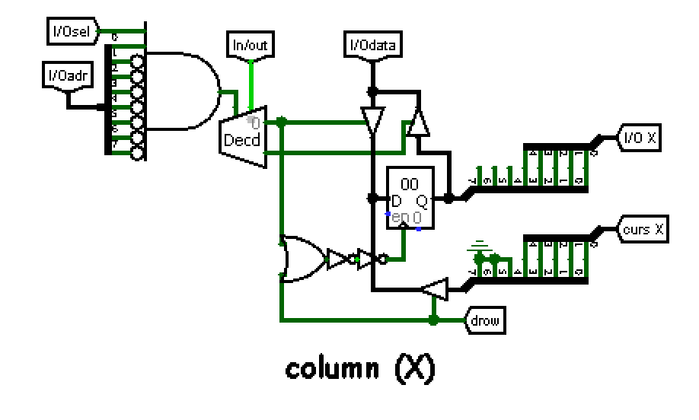
Hardware
These devices store the current X and Y that the CPU is processing now.

Slide 25
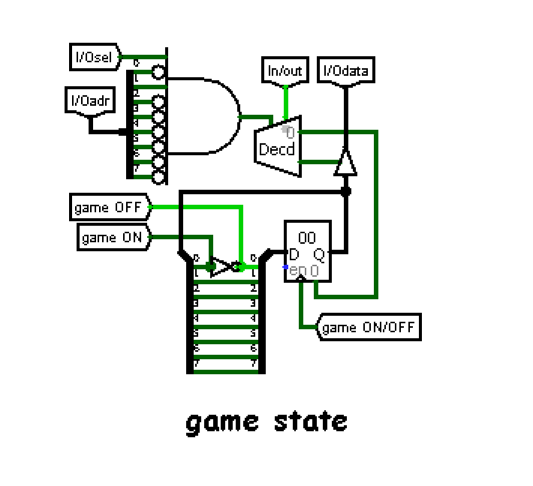
SOFTWARE
Hardware
And also, a device that stores game states (ON/OFF). The CPU and the User can change this game state

Slide 26
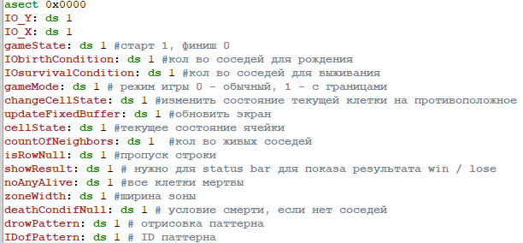
Software
Tables of conditions
SOFTWARE
There are also 17 I/O interfaces that have the same names as in the schematic.
I/O interfaces

Slide 27
Software
Tables of conditions
There are 8-bit byte birth and death condition tables for a quick check of the cell.
8 because the neighbors of the cell are 8
I/O interfaces

Slide 28
Software
Tables of conditions
Separately added survival condition with 0 number of neighbors
I/O interfaces

Slide 29
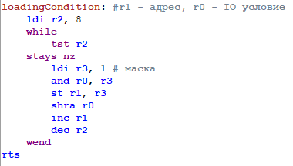
Labels referring to functions
Loading Condition
Splits an 8-bit string of condition into 8 separate bytes in order by survival or death label

Slide 30
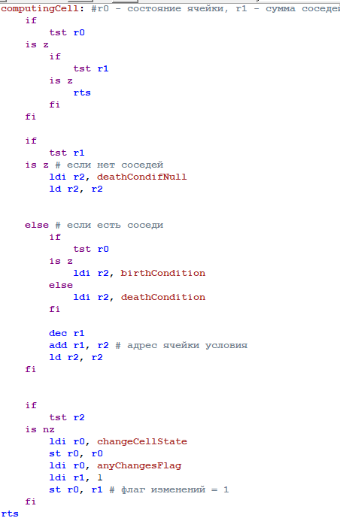
Labels referring to functions
Computing Cell
skip dead and null-neighbors cells
Determines whether to change the state of the current cell using condition tables

Slide 31
Labels referring to functions
Computing Cell
Determines whether to change the state of the current cell using condition tables
separate check if no neighbors near the live cell

Slide 32
Labels referring to functions
Computing Cell
Determines whether to change the state of the current cell using condition tables
Else using condition tables

Slide 33
Labels referring to functions
Computing Cell
Determines whether to change the state of the current cell using condition tables
After that change or not the cell state

Slide 34
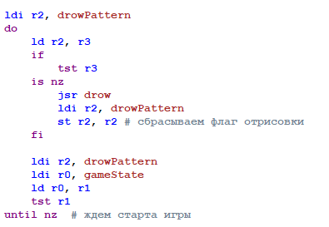
Main code
Waiting for the start
At the beginning, using the loop, we wait for the game start or for the button to draw a pattern to be pressed

Slide 35
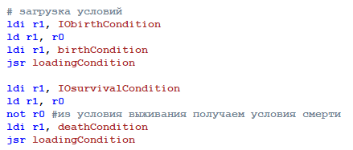
Main code
The conditions of death are produced by negating the condition of survival.
After startup, we load the survival and death conditions using loading Condition function

Slide 36
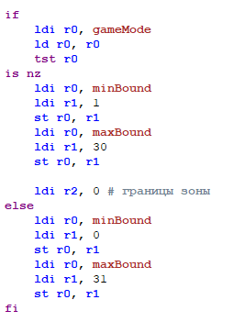
Main code
minBound
maxBound
If the mode is creative, the field boundaries are loaded from 0 to 31, if the mode is survival, the boundaries start from 1 to 30 and shrinking each generation
These labels are used to limit the field to be calculated

Slide 37
Main code
minBound
minBound - upper left border of field
maxBound - lower right border of field
maxBound

Slide 38
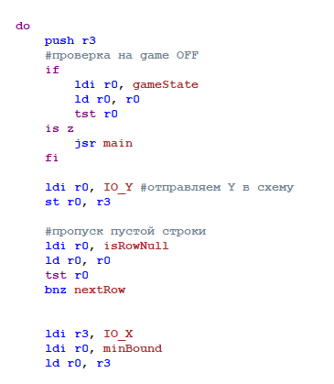
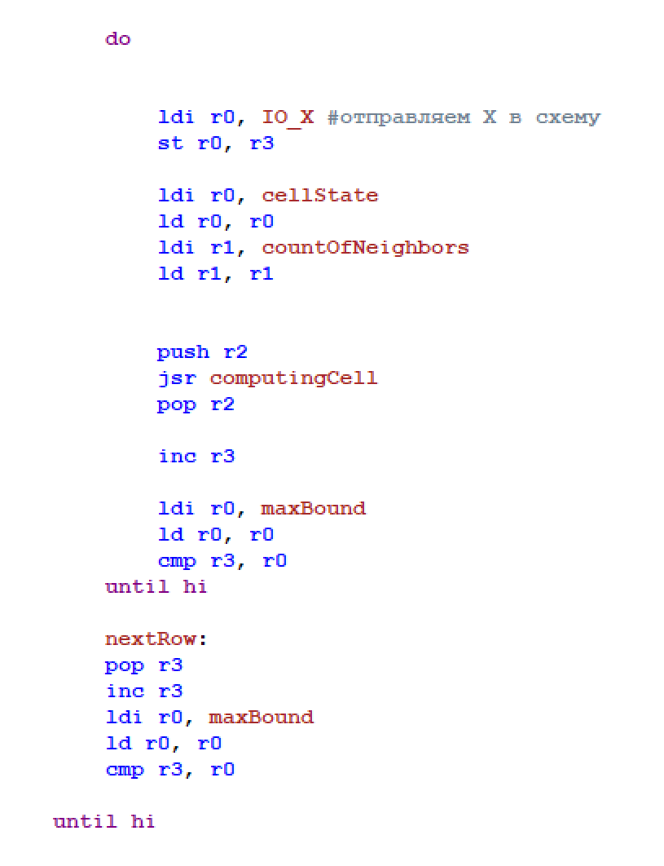
Main code
loops through Y
2 nested loops to search all cells from minbound to maxbound, it also calls the computing cell function for each cell or skip null rows
loops through X

Slide 39
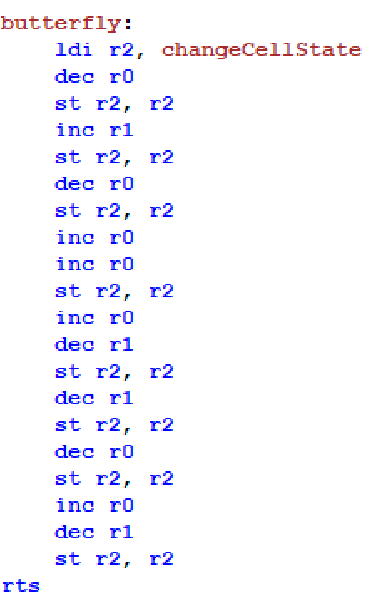
Patterns
All patterns in the game are recorded as labels of this type. There are also pattern labels in the game such as:
Glider
Blinker
Butterfly
Byflops5
Monogram
mickeyMouse
Unix
QueenBee

Slide 40
Patterns
CPU takes the current position of the cursor and based on it starts to move it and draw the pattern

Slide 41
Let’s Play
CPU takes the current position of the cursor and based on it starts to move it and draw the pattern

Slide 42
Conway game of life
Thank you for listening!

