Slide 1

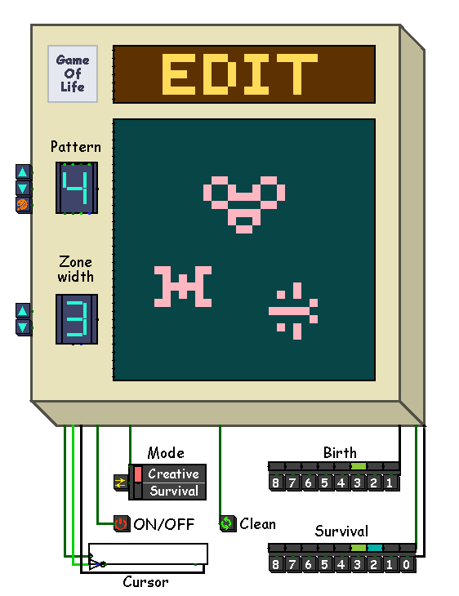
Conway game of life
Filippova Daria 24216
Muruev Denis 24216
Vilegzhanin Maksim 24216

Slide 2
Goal
Create a workable model of Conway Game of Life game combining hardware and software using CDM-8e
Filippova Daria 24216
Muruev Denis 24216
Vilegzhanin Maksim 24216

Slide 3
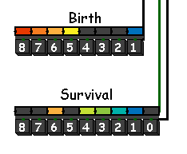
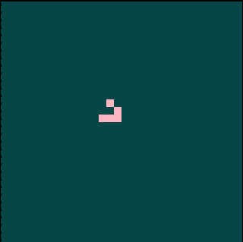
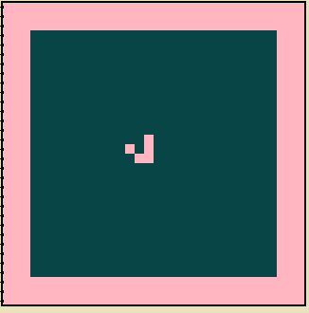
Project extensions
Parameterized birth/survival conditions
Two modes: “creative” (fixed field) and “survival” (zone shrinking).

Slide 4
Project extensions
Parameterized birth/survival conditions
Game modes:
Two modes: “creative” (fixed field) and “survival” (zone shrinking).
Survival
Creative

Slide 5






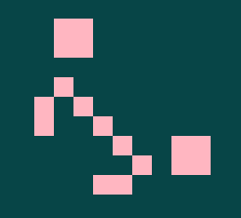

HARDWARE
Project extensions
Also added the ability to set one on of the 8 ready-made deferent patterns

Slide 6
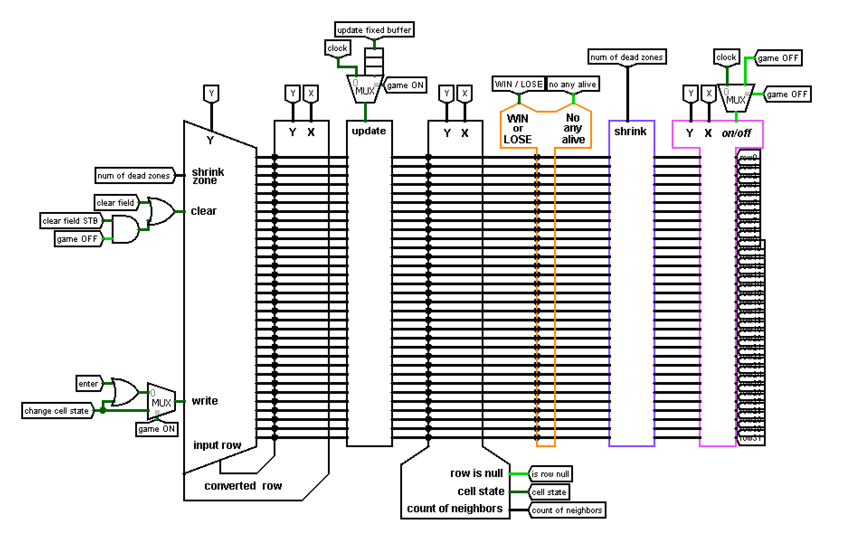
Hardware
Main sсheme
HARDWARE
combines all parts of the circuit together

Slide 7
Hardware
converter
Change X cell in the current Y row to the opposite and sends the result row to write buffer

Slide 8
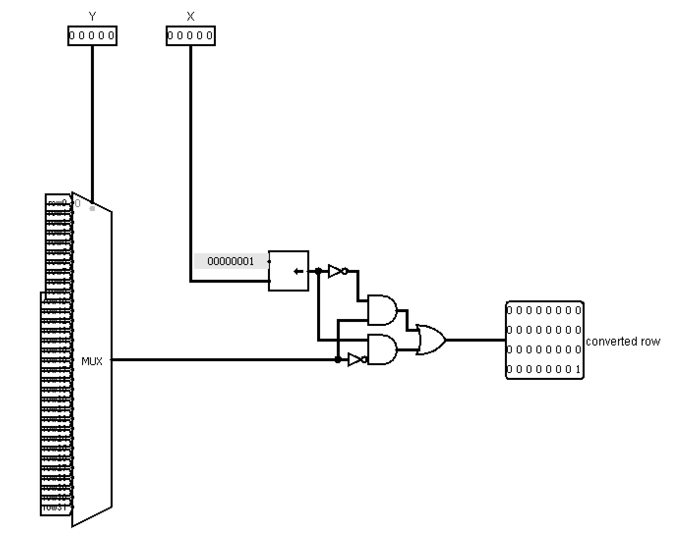
Hardware
converter
Change X cell in the current Y row to the opposite and sends the result row to write buffer

Slide 9
Hardware
converter
Change X cell in the current Y row to the opposite and sends the result row to write buffer

Slide 10
buffers
Hardware
Write
Fixed
There are two field states. one can be edited in the Write buffer. The other is static in the Fixed buffer.

Slide 11
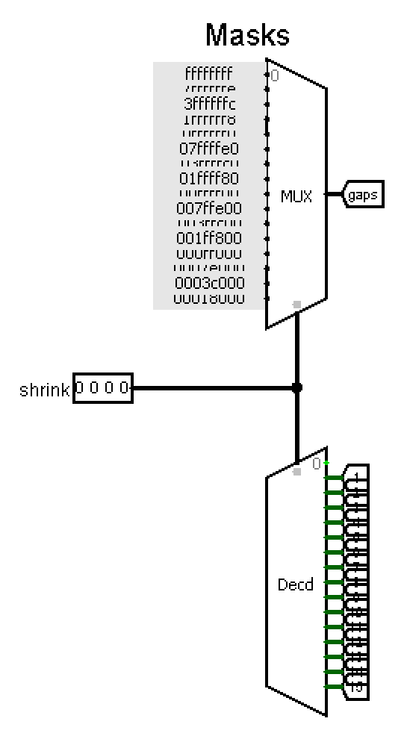
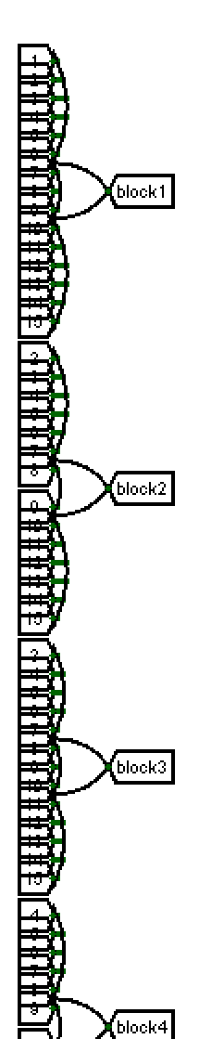
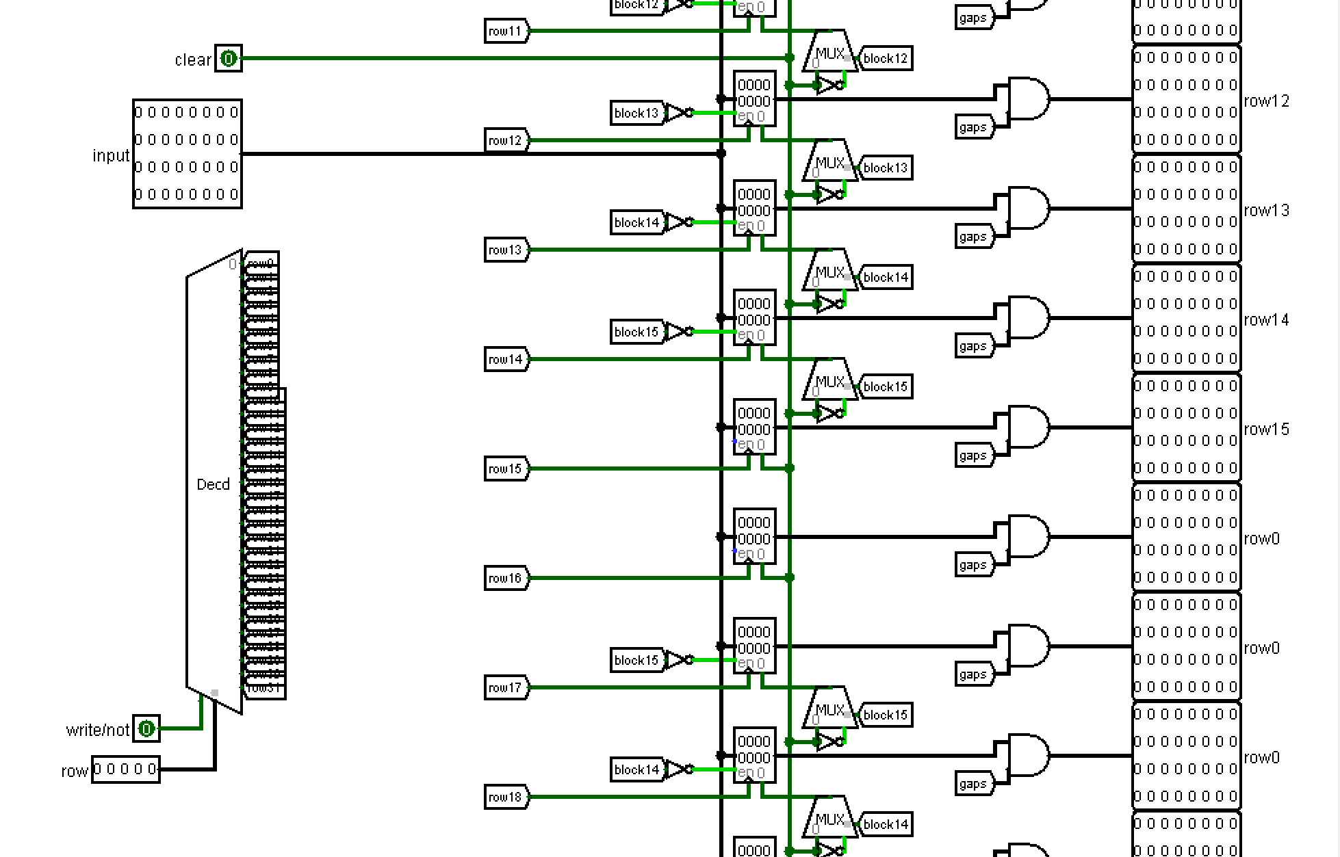
Hardware
Write
buffer
buffers
Contains 32 registers for recording input row, also masks for shrinking the field horizontally and tunnels with OR gate for shrinking vertically
horizontally
Write
Fixed
vertically
input row
There are two field states. one can be edited in the Write buffer. The other is static in the Fixed buffer.

Slide 12
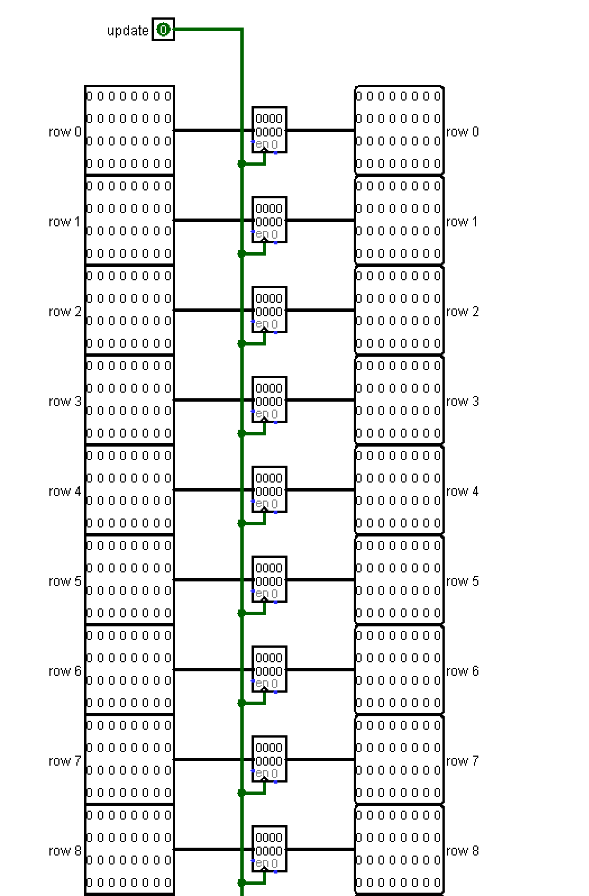
Hardware
buffers
Just contains 32 registers for recording new state of field from write buffer
Fixed
buffer
Write
Fixed
There are two field states. one can be edited in the Write buffer. The other is static in the Fixed buffer.

Slide 13
buffers
Hardware
Write
Fixed
There are two field states. one can be edited in the Write buffer. The other is static in the Fixed buffer.

Slide 14
Hardware
neighbor module
It gives the number of neighbors, the cell state and the flag that the row is completely empty

Slide 15
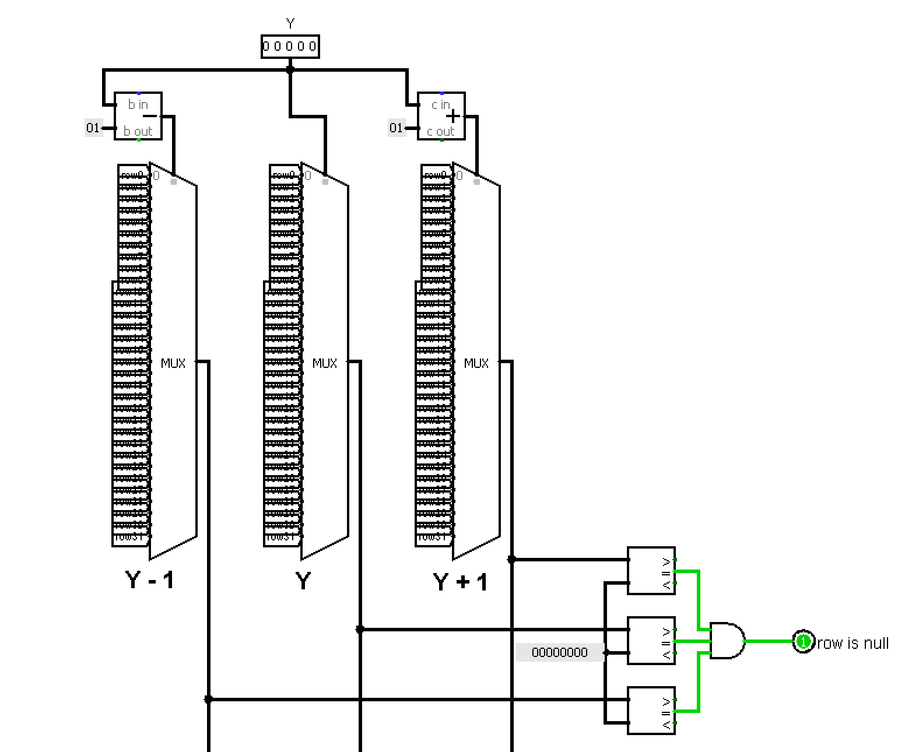
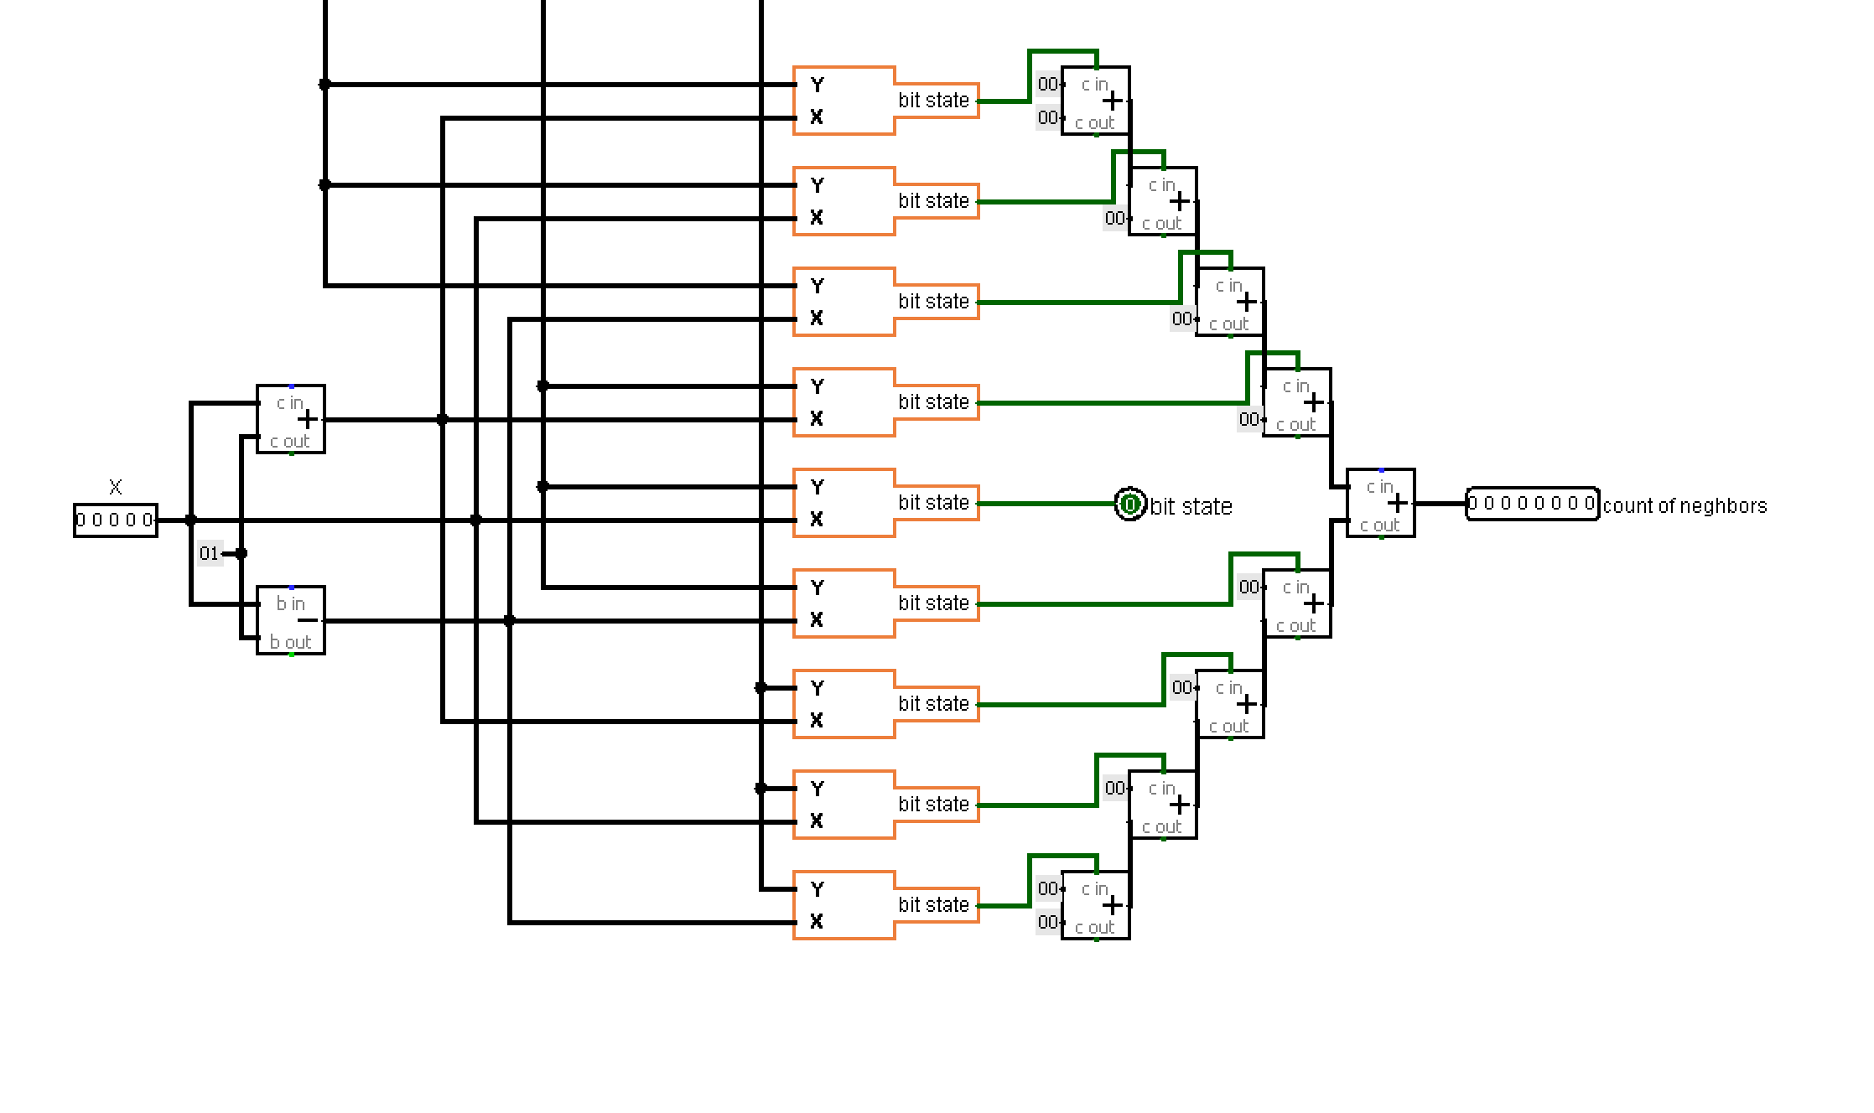
Hardware
Y-1
Y
Y+1
Takes 3 rows Y, Y-1, Y+1 and counts the number of neighbors near cell X Y. If all three rows are empty, the flag for skipping this row Y is raised.
Flag
neighbor module
number of neighbors
It gives the number of neighbors, the cell state and the flag that the row is completely empty

Slide 16
Hardware
neighbor module
It gives the number of neighbors, the cell state and the flag that the row is completely empty

Slide 17
Hardware
survival module
Indicates victory or defeat in survival mode

Slide 18
Hardware
Visualization modules
Visualize cursor and shrinking zones on the matrix

Slide 19
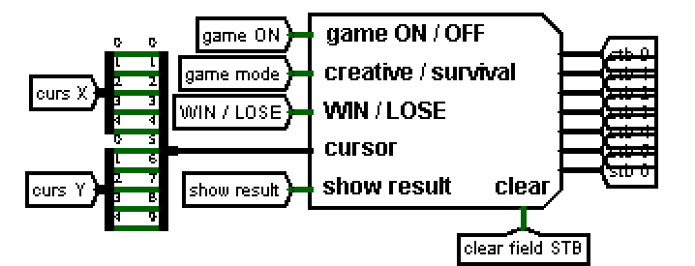
SOFTWARE
I/O
Hardware
Status bar
Shows the current state of the game:
EDIT
SIMULATION
WIN
LOSE

Slide 20
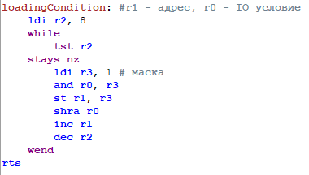
Labels referring to functions
Loading Condition
Splits an 8-bit string of condition into 8 bytes into survival or death condition tables
SOFTWARE
Tables of conditions

Slide 21
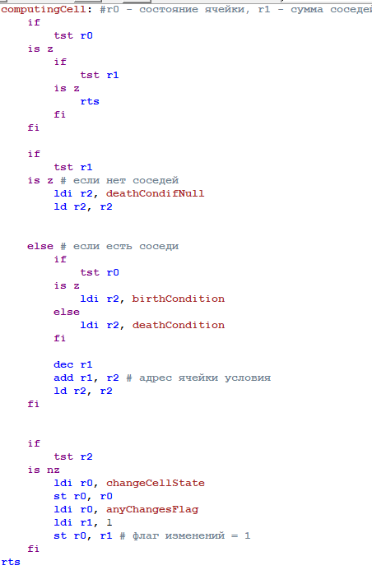
Labels referring to functions
Computing Cell
skip dead and null-neighbors cells
Determines whether to change the state of the current cell using condition tables

Slide 22
Labels referring to functions
Computing Cell
Determines whether to change the state of the current cell using condition tables
separate check if no neighbors near the live cell

Slide 23
Labels referring to functions
Computing Cell
Determines whether to change the state of the current cell using condition tables
Else using condition tables

Slide 24
Labels referring to functions
Computing Cell
Determines whether to change the state of the current cell using condition tables
After that change or not the cell state

Slide 25
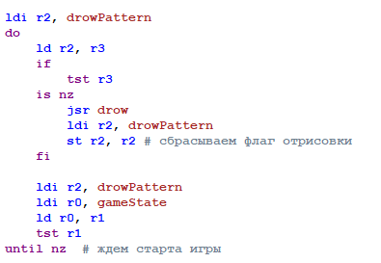
Main code
Waiting for the start
At the beginning, using the loop, we wait for the game start or for the button to draw a pattern to be pressed

Slide 26
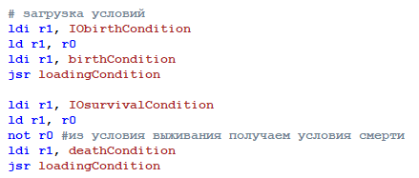
Main code
The conditions of death are produced by negating the condition of survival.
After startup, we load the survival and death conditions using loading Condition function

Slide 27
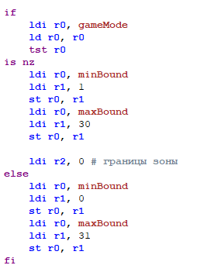

Main code
minBound
maxBound
If the mode is creative, the field boundaries are loaded from 0 to 31, if the mode is survival, the boundaries start from 1 to 30 and shrinking each generation until 1
These labels are used to limit the field to be calculated

Slide 28
Main code
minBound
minBound - upper left border of field
maxBound - lower right border of field
maxBound

Slide 29
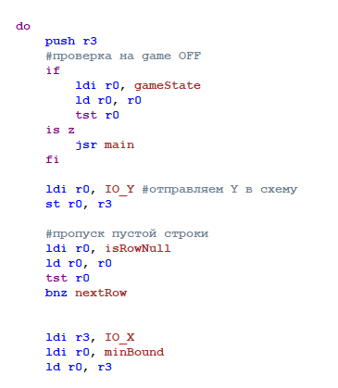
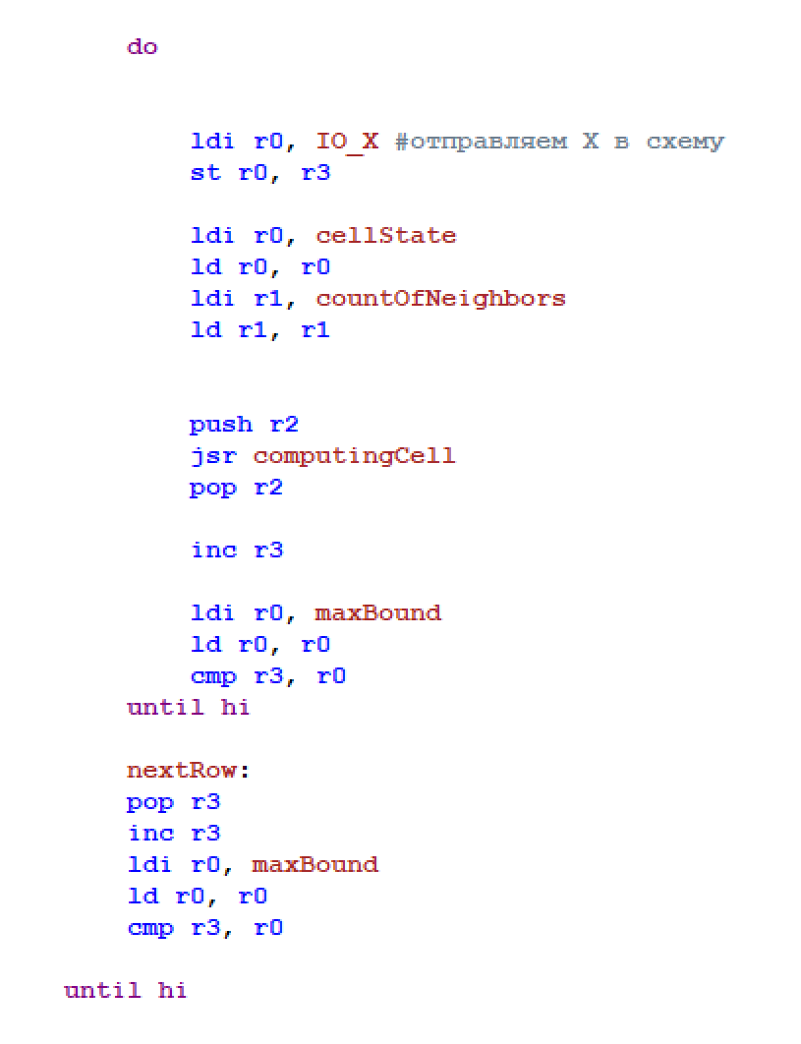
Main code
loops through Y
2 nested loops to search all cells from minbound to maxbound, it also calls the computing cell function for each cell or skip null rows
loops through X

Slide 30
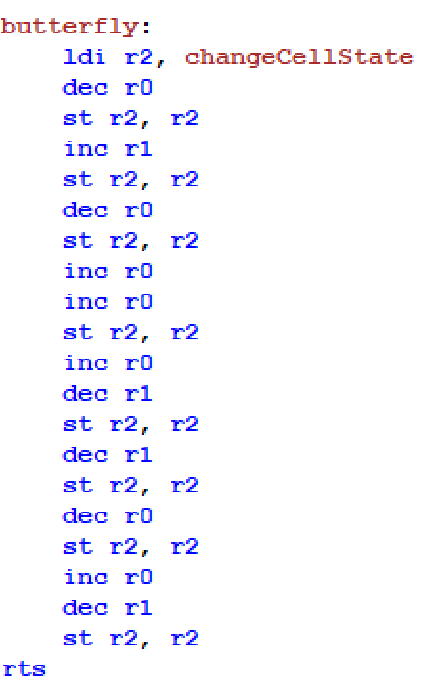
Patterns
All patterns in the game are recorded as labels of this type. There are also pattern labels in the game such as:
Glider
Blinker
Butterfly
Byflops5
Monogram
mickeyMouse
Unix
QueenBee

Slide 31
Patterns
CPU takes the current position of the cursor and based on it starts to move it and draw the pattern

Slide 32
Let’s Play
CPU takes the current position of the cursor and based on it starts to move it and draw the pattern

Slide 33
Conway game of life
Thank you for listening!

