Slide 1
Achieving Wonders with Query Store
Dennes Torres

Slide 2







Dennes Torres Data Platform MVP
Dtower Software
https://dtowersoftware.com
Trainer
MCT, Azure Solutions Architect, Azure Data Engineer and Azure DevOps Engineer
Malta Data Platform UG Leader
Malta
MMDPUG
https://www.facebook.com/MMDPUG
http://dennestorres.com
Dennes.Torres
@Dennes
https://br.linkedin.com/in/dennestorres
dennes@DTowerSoftware.com
http://youtube.com/c/dennestorres

Slide 3
Agenda
Why do we need Query Store?
The Main Question
What Query Store Does
Query Store writing architecture
Query Store reading architecture
Query Store schema
Query Store configuration

Slide 4
Why do we need Query Store?

Slide 5
Usual problems on production environments
The queries are becoming slower
The queries are sometimes slower and sometimes faster
If I change this, how will this affect my queries?

Slide 6
... And the main question is ....

Slide 7
What has changed?

Slide 8
Query Store to the rescue

Slide 9
What Query Store does
Keep record of every executed query
Keep record of each different plan for every query
Sumarize execution statistics for each query plan
How Query Store Works – The Basics
Enabled or disabled on each database
Information stored in the database

Slide 10
The Result is
If a query plan changes and the execution statistics become worse, the query store history is able to identify it
This is called Query Plan Regression
An older query plan can be easily forced – no plan guides needed

Slide 11
The Question: What has changed
Great for upgrades or other important configuration changes
Keep the old compatibility level
Keep query store enabled for some time
Change the compatibility level
Check if any query plan regression happens

Slide 12
Keeping stability during an upgrade to SQL Server 2016 (or 2017)
SQL Server 2016
QO improvements tied to the compatibility level
Upgrade the server version but keep the old compatibility level
Turn on Query Store, creating a base line
Change the CompatLevel
Fix queries regressions forcing a plan when needed
Notes:
Source: https://msdn.microsoft.com/en-us/library/dn817826(v=sql.130).aspx#Stability
Maintaining Query Performance Stability
For queries that are executed multiple times you may notice that SQL Server used different plans which resulted in different resource utilization and duration. With Query Store you can easily detect when the query performance regressed and determine the optimal plan within a period of interest. Then you can force that optimal plan for future query execution.
You can also identify inconsistent query performance for a query with parameters (either auto- parameterized or manually parameterized). Among different plans you can identify plan which is fast and optimal enough for all or most of the parameter values and force that plan; keeping predictable performance for the wider set of user scenarios.
Force or a plan for a query (apply forcing policy). When a plan is forced for a certain query, every time a query comes to execution it will be executed with the plan that is forced.
EXEC sp_query_store_force_plan @query_id = 48, @plan_id = 49;
When using sp_query_store_force_plan you can only force plans that were recorded by Query Store as a plan for that query. In other words, the only plans available for a query are those that were already used to execute Q1 while Query Store was active.
Remove plan forcing for a query. To rely again on the SQL Server query optimizer to calculate the optimal query plan, use sp_query_store_unforce_plan to unforce the plan that was selected for the query.
EXEC sp_query_store_unforce_plan @query_id = 48, @plan_id = 49;
Other notes:
De-risk upgrades: QDS PF and COMPAT LEVEL
All plans are freezed in pre-upgrade state
We changed QP to keep CE changes under compat level
Questions:
Would described scenario work in your environment?
plan freezing will keep your current forcing decisions and apply the LAST plan for other queries. Is that what you would expect?

Slide 13
Writing Architecture

Slide 14
Query Store Writing Architecture
Query store captures the data in-memory to minimize the I/O overhead
The data is asynchronously saved to the disk, in background
Query Execution
Query Store
Compile
Query and Plan Store
Query text and plan
Internal tables
async
Execute
Runtime stats store
Query exec. stats
Performance

Slide 15
Reading Architecture

Slide 16
Query Store reading architecture
Views merge in-memory and disk data
Users see the most recent data
Query Store views
Query Execution
Query Store
Compile
Query and Plan Store
Query text and plan
Internal tables
async
Execute
Runtime stats store
Query exec. stats
Performance

Slide 17
Query Store Schema

Slide 18
Query Store Schema
Internal tables
Exposed views
Query text
Query
1 - n
Plan
1 - n
Runtime
stats
sys.
Compile stats:
query_store_query_text
query_context_settings
query_store_query
query_store_plan
Context
settings
Runtime stats interval
Runtime stats:
query_store_runtime_stats_interval
query_store_runtime_stats
One line per query + plan affecting option
(example: ANSI NULLS on/off)
One line per plan
(per query)
One line per plan per time interval (example: 5 min)
Performance

Slide 19
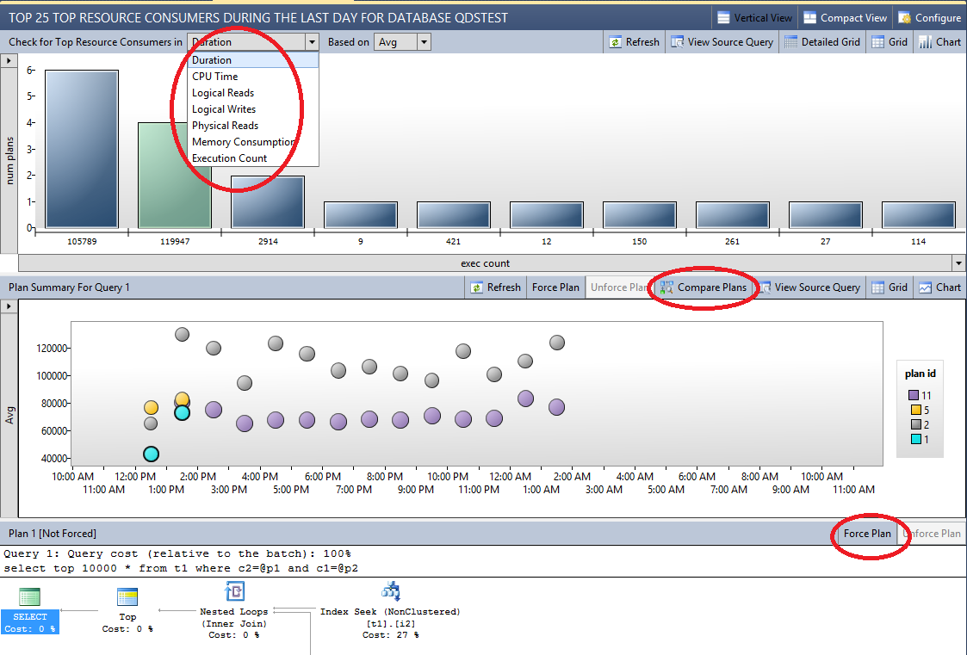
Monitoring performance using Query Store
Query Store provides insights about the performance and the query plans
Performance
Notes:
Source: https://msdn.microsoft.com/en-us/library/dn817826(v=sql.130).aspx
The point of this slide is to emphasize that Query Store comes with extraordinary UI that will help broader set of users to benefit from collected perf data immediately.
SSMS is focused around handful really the most important scenarios making feature instantly useful in everyday activities of typical DBA.
We want to encourage people to try out new UI and learn from it: it is a great knowledge source because people can easily learn first steps of using Query Store DMVs by analyzing queries generated by SSMS.

Slide 20
Demo

Slide 21
Query Store Configuration
Turning On
Operation Mode (Read Write/Read Only/Off)
Query Store Capture Mode (All/Auto/None)
Writing and Collection
Data Flush Interval (Minutes)
Statistics Collection Interval
Size and Cleanup
Size Based Cleanup Mode (Auto/Off)
Stale Query Threshold (Days)
Max Size

Slide 22
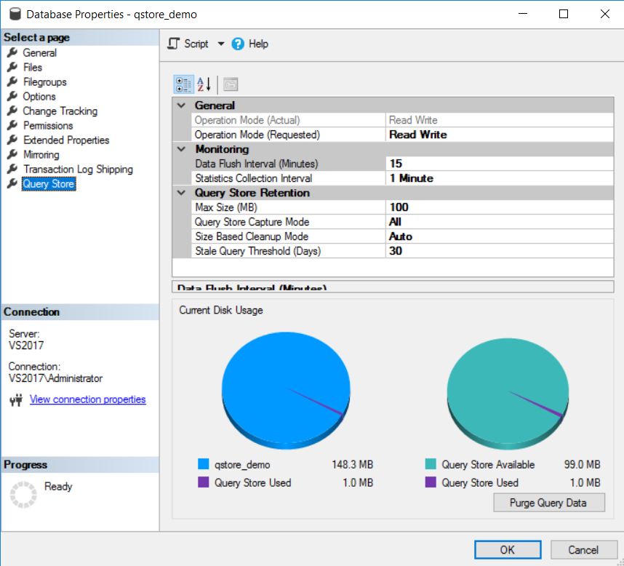

Slide 23
Example
ALTER DATABASE AdventureWorks2012
SET QUERY_STORE = ON
( OPERATION_MODE = READ_WRITE ,
CLEANUP_POLICY = ( STALE_QUERY_THRESHOLD_DAYS = 90 ) , DATA_FLUSH_INTERVAL_SECONDS = 900 , MAX_STORAGE_SIZE_MB = 1024 ,
INTERVAL_LENGTH_MINUTES = 60 );

Slide 24
Controlling Query Store Data
Flushing Data To disk
sp_query_store_flush_db
Clearing Query Store Data
alter database current set query_store clear

Slide 25
Query Store Behaviour
ShutDown of the server
Query Store saves the data
Shutdown with no wait loses data
Trace flag 7745 changes this behaviour
Start of the server
Query Store tables are started synchronously
Trace flag 7752 changes this behaviour

Slide 26
Optimize for Ad Hoc Workloads
Good practice
Avoid ad-hoc queries to be monitored
Keeps query store tables smaller and cleaner

Slide 27
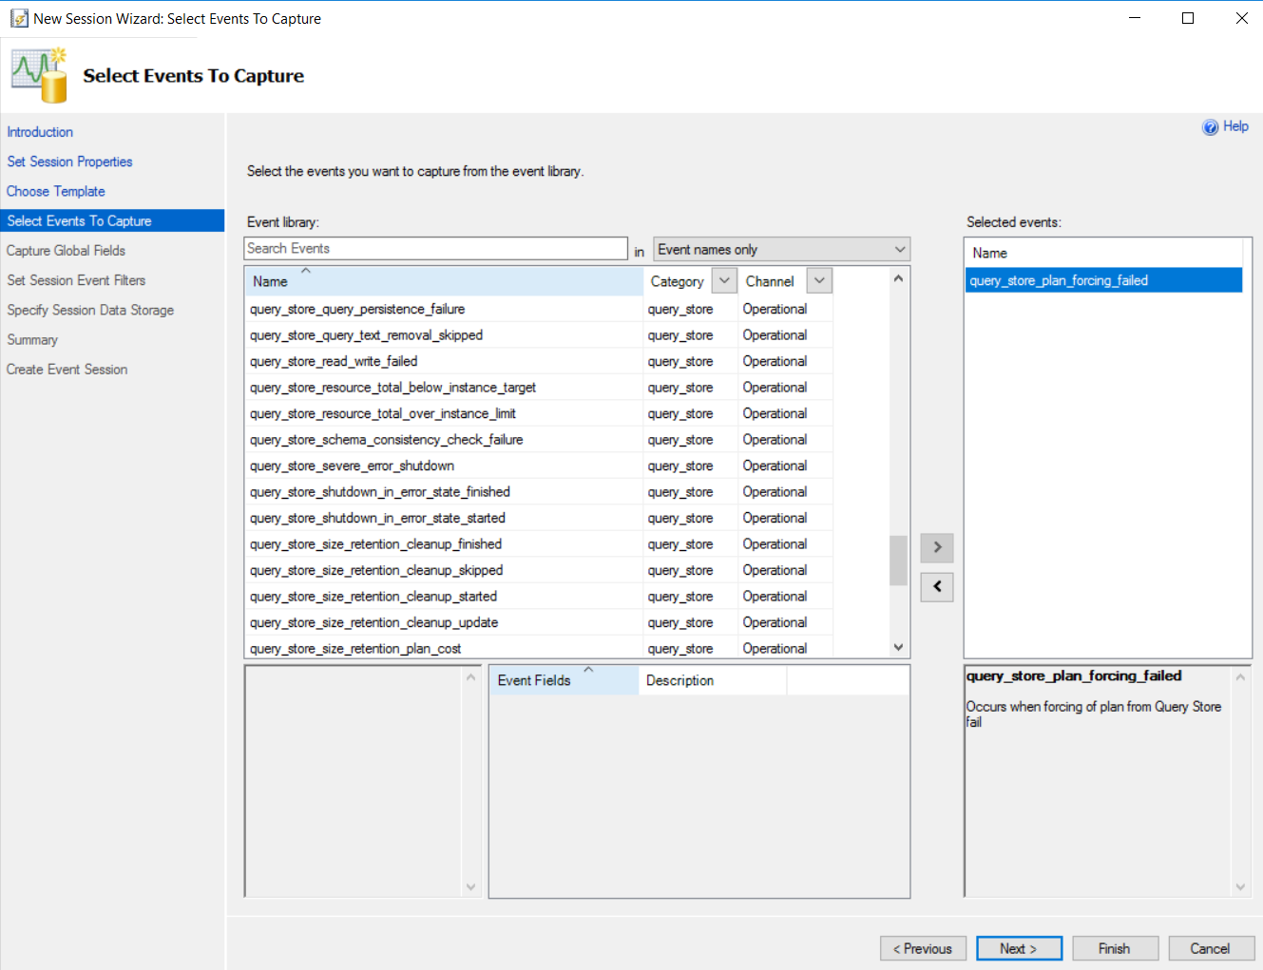
92 query store events

Slide 28
Where we are now
Query Store Hints
Parameter Sensitive Plan Optimization
DOP Feedback
Cardinality Estimator Feedback

Slide 29


Contact
https://www.red-gate.com/simple-talk/blogs/query-store-hints-powerful/ https://github.com/DennesTorres/QueryStoreDashboard
https://www.red-gate.com/simple-talk/sql/database-administration/query-store-parameterization-problems/
Dennes.Torres
@Dennes
https://br.linkedin.com/in/dennestorres
dennes@bufaloinfo.com.br
http://youtube.com/c/dennestorres

