Slide 1
RECOMMENDATION SYSTEM FOR
RETAIL CUSTOMER
Dennis Mathew
S4-MCA-A
Roll No: 42

Slide 2
01
02
TABLE OF CONTENTS
03
04
INTRODUCTION
A brief description of the project
PROPOSED SYSTEM
How we solve the problem
OUR PROCESS
Diffrent modules and datasets involved in the project
TECH STACK
Technologys used in the project

Slide 3
INTRODUCTION
Recommendation systems are a very popular and effective paradigm in retail business. With a recommendation system, shoppers can find items they like with less effort. Furthermore, they are presented with items they’ve never thought of buying, but which actually suits their needs.

Slide 4
A recommendation system is a tool that uses a series of algorithms, data analysis and artificial Intelligence (AI) to make recommendations online.
RECOMMENDATION SYSTEM

Slide 5
THE BENEFITS
Customer behaviour analysis focuses on understanding the type of customers; what do they like, what do they not like, what their pattern of interaction with the items is, customer value, etc. If we manage to model these aspects of a customer, we can anticipate their future needs.
Boost in sales
Better understanding of customers
The main benefits coming from customer behaviour analysis system are:
Long tail strategies

Slide 6
According to McKinsey, 35% of all Amazon purchases, and 70% of Netflix purchases, are driven by their recommendation systems, and the start of using recommendations significantly boosted their sales.Furthermore, during COVID-19 pandemic, many retailers went online, digitalised their businesses, and changed their business culture to adapt to the new and everchanging circumstances. According to reports, in 2020 the growth of ecommerce sales in US alone was more than 30%This provides a huge amount of online data for potential exploration, and use in building machine learning systems.

Slide 7
PROPOSED SYSTEM

Slide 8
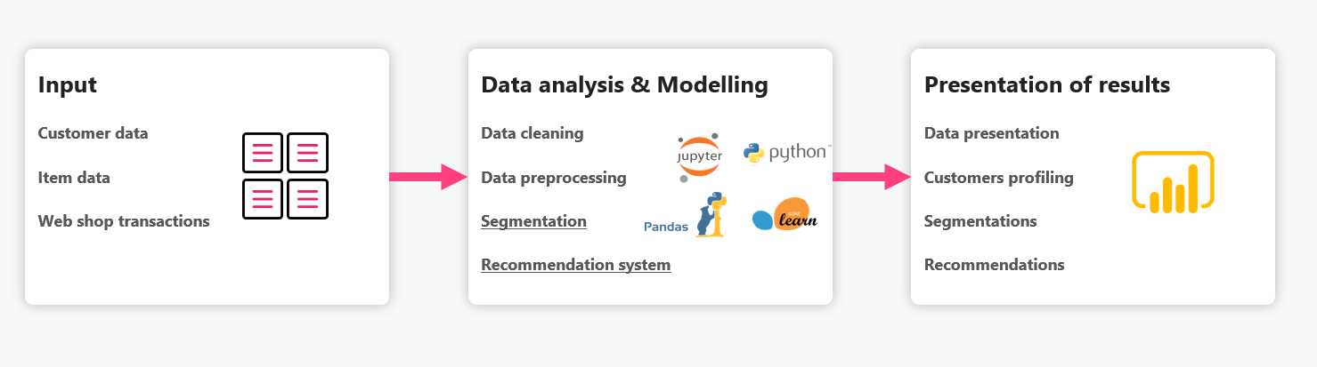
How it works?
To achieve these results, we have to set-up the infrastructure and pipeline for data analysis and modelling with machine-learning algorithms. Briefly, the pipeline is composed of an input module that connects to a data source, and sends the data into data analysis, and human behaviour modelling module. In this module, data transformations, such as cleaning and pre-processing, are done, and data segmentation and recommendation models are to be built.

Slide 9

RECOMMENDATION
SYSTEM

Slide 10

RECOMMENDATION SYSTEM
There are several methods of how to implement recommender systems, and, in this case, we used a hybrid model of
Collaborative filtering model
Content based model

Slide 11

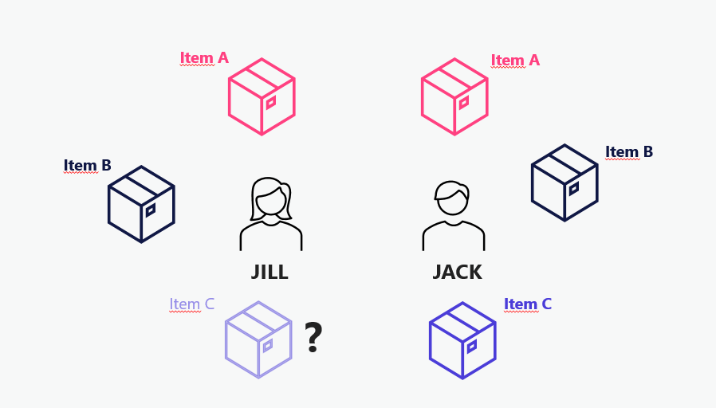
COLLABORATIVE FILTERING is an approach which uses the assumption that users who bought similar items in the past, will also agree on new items. Let us look at an example case of 2 customers – Jack and Jill. If Jill bought items A and B, and Jack bought items A, B and C, that means that, if Jack and Jill had already agreed on 2 items, there is a high possibility that Jill would also like item C. So, per collaborative filtering approach, we would recommend item C to Jill next. On the other hand, collaborative filtering has some well-known problems, one major being a cold start problem. When a new item appears, it has no interaction. This means that it would never appear under recommendations.

Slide 12

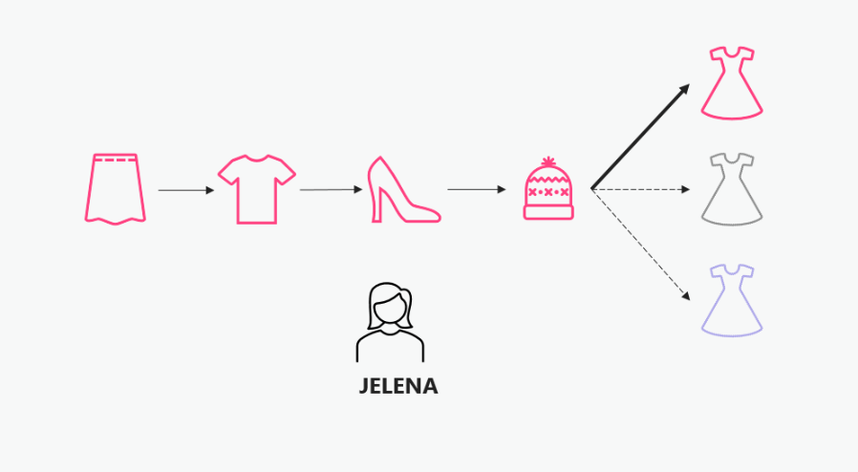
CONTENT BASED model works under the assumption that what customer liked/bought in the past, would probably be liked/bought in the future. It uses meta information of items, and a profile of the user’s preferred choices. Let us look at the example of Jelena, who often buys her clothing online. In the past several months, Jelena has bought several items online. First, she bought herself a pink skirt, then, a couple of days later, a pink T-shirt, then pink heels, and then a pink hat. It is obvious that Jelena likes pink clothes, a common feature that all items share. It is highly likely that Jelena will like a pink dress more than a black or a blue one, or even a non-clothing item. So, per content based approach, we would recommend a pink dress to Jelena next. On the other hand, content based model also has a problem of cold start. When a new user appears, it has no previous buys.

Slide 13
HYBRID APPROACH
We trying to build a recommender system that uses hybrid approach, and fine-tuned hyper parameters that yield best results.ew have to construct it step by step, feeding more features to the model on every step, and inspected the results. We split data into train and test set. Train data was used for building a model, and then we checked performance of the model on a test data.

Slide 14
OUR PROCESS
Diffrent modules and datasets involved in the project

Slide 15
DATASET
We will use an open dataset available on Kaggle. This dataset is a retail transaction, spanning from Jan 2011 to 2014
The aim here is to understand how to apply recommendation system to retailers that contains many customers or to systems that consists of multiple users.

Slide 16
DATASET
Transactions.csv
Transaction data
Customer.csv
As our recommendation engine may utilize either collaborative filtering, content-based filtering, or a hybrid of both. Since we have a sample data that perfectly (or near perfect) encapsulates not only the interaction in between users and items, but features of the users as well, we can seamlessly apply hybrid method. The transaction data (Transactions.csv) serves as a collaborative feature, because it describes the user’s (or customer’s) transaction — what and when they purchased, while the customer (Customer.csv) and product information (prod_cat_info.csv) serve as content features and item features respectively.
Customer Details
prod_cat_info.csv
Product category details

Slide 17
TRANSACTION DATA
# | transaction_id | cust_id | tran_date | prod_subcat_code | prod_cat_code
0 | 8281038869 | $1020 | $28-02-2014 | $7 | 1
1 | 9447383615 | $4896 | $27-02-2014 | $32 | 3
2 | 9446610456 | $2569 | $26-02-2014 | $18 | 4

Slide 18
PRODUCT DATA
prod_cat_code | prod_subcat_code | store_type | material
1 | 2 | e-shop | 1-2-e-shop
3 | 7 | e-shop | 3-7-e-shop
5 | 6 | e-shop | 5-6-e-shop

Slide 19
CUSTOMER DATA
customer_id | dob | gender | city_code
268408 | 02-02-1970 | M | 40
234567 | 05-07-1972 | F | 80
453234 | 17-08-1980 | M | 80

Slide 20
MODULES
Data prepocessing
Visualization
Data preprocessing is an iterative process for the transformation of the raw data into understandable and useable forms.
we can see how the data looks like and what kind of correlation is held by the attributes of data.
Model evaluation
Training the model
Model evaluation techniques in machine learning are helping us to find a better model among all other models in machine learning.
The training model is used to run the input data through the algorithm to correlate the processed output against the sample output.

Slide 21

TECH STACK
TensorRec
A Recommendation Engine Framework in TensorFlow
Python
Python is a high-level, interpreted, general-purpose programming language.

Slide 22
ALGORITHM
Here we use TensorRec module in Python, a deep-learning ML algorithm that uses Tensorflow and Keras backend with a rather simplified interface.
Many recommendation algorithms exist, from a simple association rule to a slightly more complex K-Nearest Neighbor clustering, but are they not that much robust enough to handle actual business case with millions of historical retail data, intertwined with hundreds of product category, customer hierarchy, and business goals. A prototype of collaborative filtering may work for a small father-and-mother grocery store, but if you are managing a chain of a few supermarket in a city, the amount of complexity can get multiplied enormously to millions of transactions. Hence, you need a better algorithm to process the complexity yet produce meaningful and relevant results to your business case. A hybrid deep-learning algorithm works best for complex and large dataset. Combining Pandas, Numpy, and SKLearn, together with TensorRec package module, we can harness the full potential of Python to produce a robust, solid, and relevant item recommendation.

Slide 23
TECH STACK
PYTHON
P
A
AWS
Python is a high-level, interpreted, general-purpose programming language.
Amazon Web Services is a subsidiary of Amazon that provides on-demand cloud computing platforms
TENSORREC
T
R
REACT
A Recommendation Engine Framework in TensorFlow
React is a free and open-source front-end JavaScript library for building user interfaces

Slide 24
“ All in all, with trends shifting towards higher digitalization and growth of online technologies, for every retail company to keep up with the trends of the use of recommendation systems in online retail is a must. “

Slide 25
THANKS!
Do you have any questions? om
Dennis Mathew
S4-MCA-A
Roll No: 42

