Slide 1
RECOMMENDATION SYSTEM FOR
RETAIL CUSTOMER
Dennis Mathew
S4-MCA-A
Roll No: 42

Slide 2
01
02
TABLE OF CONTENTS
03
04
INTRODUCTION
A brief description of the project
PROPOSED SYSTEM
How we solve the problem
OUR PROCESS
Diffrent modules and datasets involved in the project
TECH STACK
Technologys used in the project

Slide 3
INTRODUCTION
Recommendation systems are a very popular and effective paradigm in retail business. With a recommendation system, shoppers can find items they like with less effort. Furthermore, they are presented with items they’ve never thought of buying, but which actually suits their needs.

Slide 4
A recommendation system is a tool that uses a series of algorithms, data analysis and artificial Intelligence (AI) to make recommendations online.
RECOMMENDATION SYSTEM

Slide 5
THE BENEFITS
Customer behaviour analysis focuses on understanding the type of customers; what do they like, what do they not like, what their pattern of interaction with the items is, customer value, etc. If we manage to model these aspects of a customer, we can anticipate their future needs.
Boost in sales
Better understanding of customers
The main benefits coming from customer behaviour analysis system are:
Long tail strategies

Slide 6
According to McKinsey, 35% of all Amazon purchases, and 70% of Netflix purchases, are driven by their recommendation systems, and the start of using recommendations significantly boosted their sales.Furthermore, during COVID-19 pandemic, many retailers went online, digitalised their businesses, and changed their business culture to adapt to the new and everchanging circumstances. According to reports, in 2020 the growth of ecommerce sales in US alone was more than 30%This provides a huge amount of online data for potential exploration, and use in building machine learning systems.

Slide 7
PROPOSED SYSTEM

Slide 8
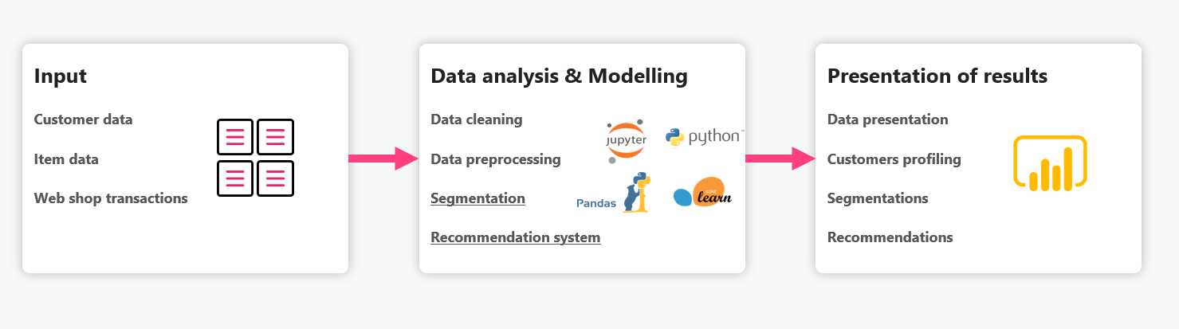
How it works?
To achieve these results, we have to set-up the infrastructure and pipeline for data analysis and modelling with machine-learning algorithms. Briefly, the pipeline is composed of an input module that connects to a data source, and sends the data into data analysis, and human behaviour modelling module. In this module, data transformations, such as cleaning and pre-processing, are done, and data segmentation and recommendation models are to be built.

Slide 9

RECOMMENDATION
SYSTEM

Slide 10

RECOMMENDATION SYSTEM
There are several methods of how to implement recommender systems, and, in this case, we used a hybrid model of
Collaborative filtering model
Content based model

Slide 11

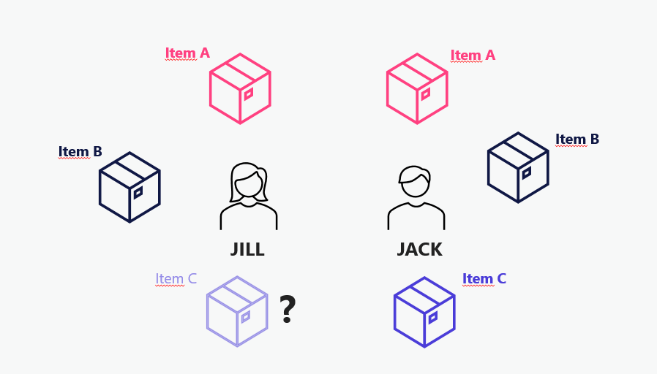
COLLABORATIVE FILTERING is an approach which uses the assumption that users who bought similar items in the past, will also agree on new items. Let us look at an example case of 2 customers – Jack and Jill. If Jill bought items A and B, and Jack bought items A, B and C, that means that, if Jack and Jill had already agreed on 2 items, there is a high possibility that Jill would also like item C. So, per collaborative filtering approach, we would recommend item C to Jill next. On the other hand, collaborative filtering has some well-known problems, one major being a cold start problem. When a new item appears, it has no interaction. This means that it would never appear under recommendations.

Slide 12

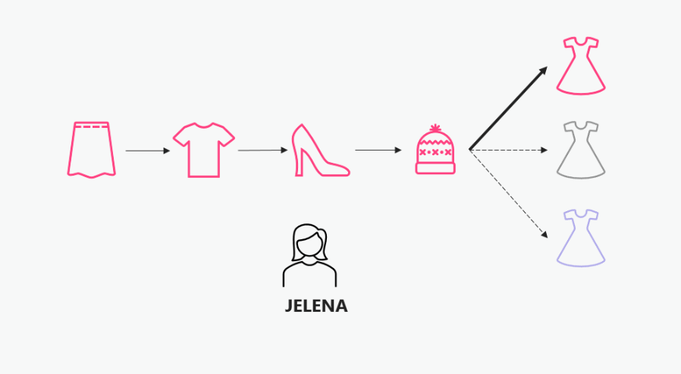
CONTENT BASED model works under the assumption that what customer liked/bought in the past, would probably be liked/bought in the future. It uses meta information of items, and a profile of the user’s preferred choices. Let us look at the example of Jelena, who often buys her clothing online. In the past several months, Jelena has bought several items online. First, she bought herself a pink skirt, then, a couple of days later, a pink T-shirt, then pink heels, and then a pink hat. It is obvious that Jelena likes pink clothes, a common feature that all items share. It is highly likely that Jelena will like a pink dress more than a black or a blue one, or even a non-clothing item. So, per content based approach, we would recommend a pink dress to Jelena next.

Slide 13
HYBRID APPROACH
We trying to build a recommender system that uses hybrid approach, and fine-tuned hyper parameters that yield best results.we have to construct it step by step, feeding more features to the model on every step, and inspected the results. We split data into content based set and collabrative filtering set. they are used for build the appropriate models

Slide 14
OUR PROCESS
Diffrent modules and datasets involved in the project

Slide 15
DATASET
We were able to obtain rich and high-resolution fashion products data set from Kaggle which consists of about 44k images of 143 unique and different
classes like T-shirt, jeans, watches, etc. The size of the images is about 2400
x 1600 which makes it a pretty huge data-set posing a great challenge in Image
pre-processing as well as training deep learning models.

Slide 16
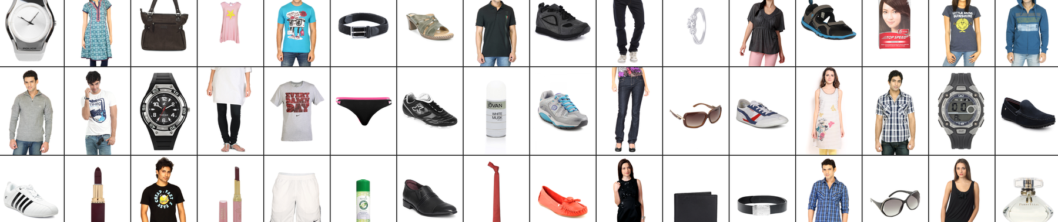
DATASET
We were able to obtain rich and high-resolution fashion products data set from Kaggle which consists of about 44k images of 143 unique and different classes like T-shirt, jeans, watches, etc.which makes it a pretty huge data-set posing a great challenge in Image pre-processing as well as training deep learning models.
In addition also contains multiple label attributes describing the product which was manually entered while cataloging. To add to this, we also have descriptive text that comments on the product characteristics.

Slide 17
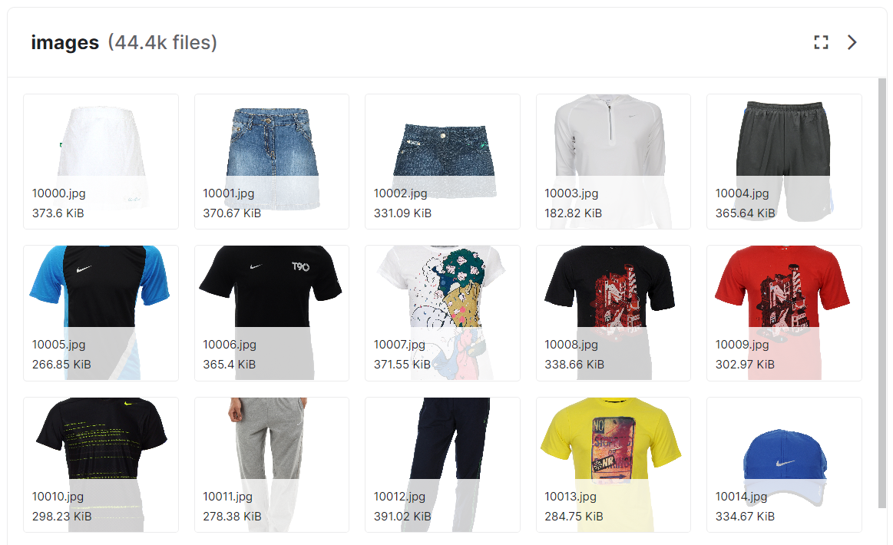
IMAGE DATA
High-resolution fashion products data set from Kaggle which consists of about 44k images of 143 unique and different
classes like T-shirt, jeans, watches, etc. The size of the images is about
2400 x 1600

Slide 18
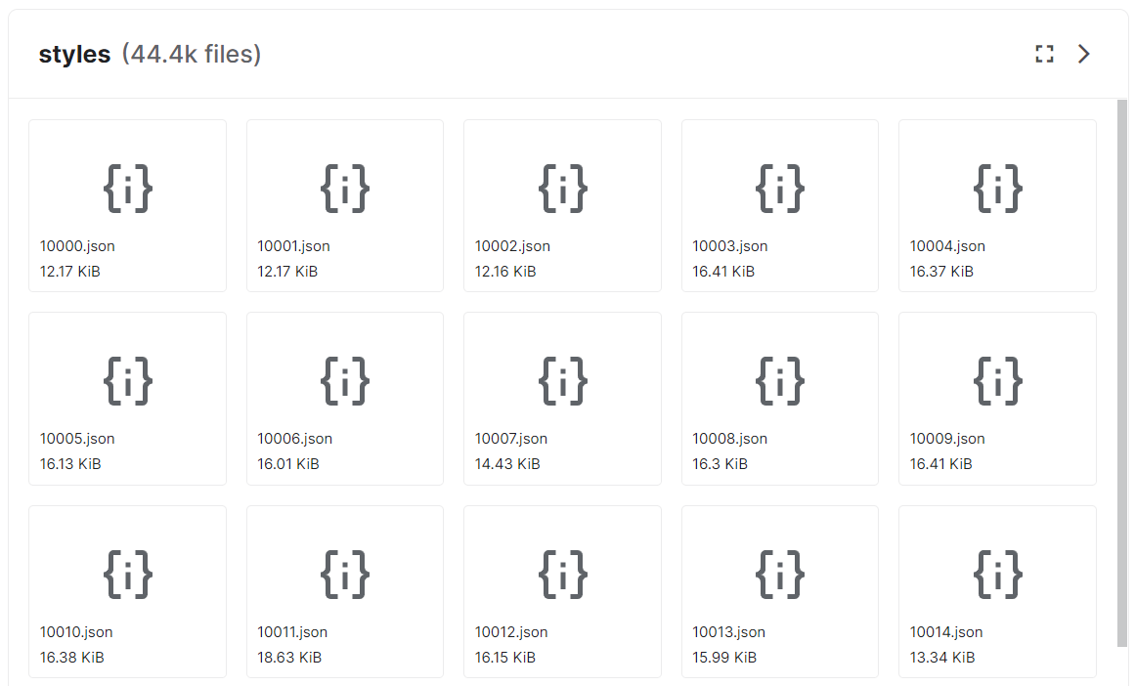
JSON
DATA

Slide 19
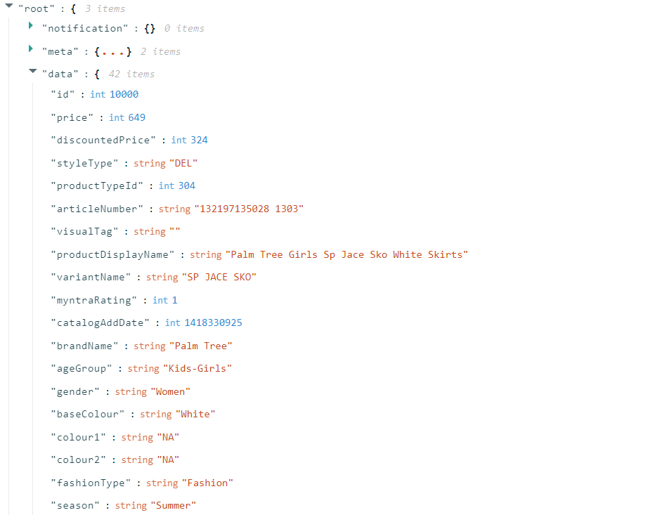
CUSTOMER
DATA
I combined 44.4k JavaScript object notation file (json) files into one
and convert in into comma separated values (csv) for training purpose and from the csv file create several sub datasets for various training purpose

Slide 20
MODULES
Data prepocessing
Visualization
Data preprocessing is an iterative process for the transformation of the raw data into understandable and useable forms.
we can see how the data looks like and what kind of correlation is held by the attributes of data.
Model evaluation
Training the model
Model evaluation techniques in machine learning are helping us to find a better model among all other models in machine learning.
The training model is used to run the input data through the algorithm to correlate the processed output against the sample output.

Slide 21
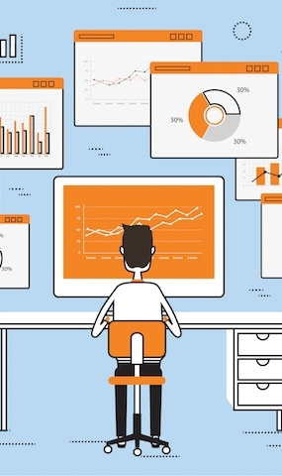
TECH STACK
TensorFlow
TensorFlow is used in deep learning recommendation
Cosine similarity
Cosine similarity is a metric that measures the cosine of the angle between two vectors

Slide 22
ALGORITHM
A commonly used approach to match similar documents is based on counting the maximum number of common words between the documents,But this approach has an inherent flaw. That is, as the size of the document increases, the number of common words tend to increase even if the documents talk about different topics.
The cosine similarity helps overcome this fundamental flaw in the ‘count-the common-words’ or Euclidean distance approach.
Cosine similarity is a metric used to measure how similar the documents are irrespective of their size. Mathematically, it measures the cosine of the angle between two vectors projected in a multi-dimensional space. The cosine similarity is advantageous because even if the two similar documents are far apart by the Euclidean distance (due to the size of the document), chances are they may still be oriented closer together. The smaller the angle, higher the cosine similarity

Slide 23
TECH STACK
PYTHON
P
A
AWS
Python is a high-level, interpreted, general-purpose programming language.
Amazon Web Services is a subsidiary of Amazon that provides on-demand cloud computing platforms
TENSORFLOW
T
R
REACT
An open-source software library for machine learning and artificial intelligence.
React is a free and open-source front-end JavaScript library for building user interfaces

Slide 24
“ All in all, with trends shifting towards higher digitalization and growth of online technologies, for every retail company to keep up with the trends of the use of recommendation systems in online retail is a must. “

Slide 25
THANKS!
Do you have any questions? om
Dennis Mathew
S4-MCA-A
Roll No: 42

