Slide 1

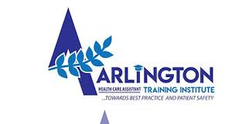
LET THE EXPERTS HELP YOU
KARIBU

Slide 2
THE BEST WAY TO PREDICT THE FUTURE IS TO CREATE IT.”
ABRAHAM LINCOLN

Slide 3
ABOUT THE SCHOOL
REGISTERED AND FULLY COMPLIANT WITH THE TVET CDACC
ACREDITTED WITH CANADA SKILLS COUNCIL
COMPLIANT WITH THE COUNTY REQUIREMENT

Slide 4
COURSES OFFERED
CNA/HCA/HSS
PERI-OPERATIVE THEATRE TECHNOLOGY
GERMAN LANGUAGE A1 TO B2

Slide 5
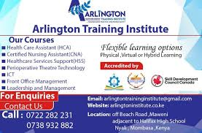
CONT..

Slide 6
ATTACHMENT
DIANI BEACH HOSPITAL
MEWA HOSPITAL
MIKINDANI MEDICAL HOSPITAL
MOTHER AMADEA HOSPITAL
BEYOND SCOPE HOSPITAL
GANJONI HOSPITAL

Slide 7
ACHIEVEMENT
TESTIMONIALS FROM ALUMNI
PHOTOS OF STUDENTS AT WORK

Slide 8
CONT..
THREE SUCCESSFUL GRADUATIONS
A TOTAL OF 57 STUDENTS GRADUATED IN 2022, 128 GRADUATED IN 2023 AND 225 IN 2024.
9% SECURED JOB IN SWITZERLAND
3% WORKING IN CANADA
3% WORKING IN THE UNITED STATES OF AMERICA

Slide 9
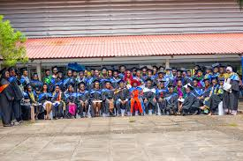
CONT..

Slide 10
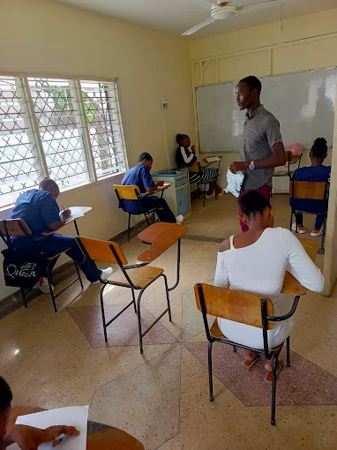
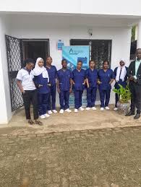
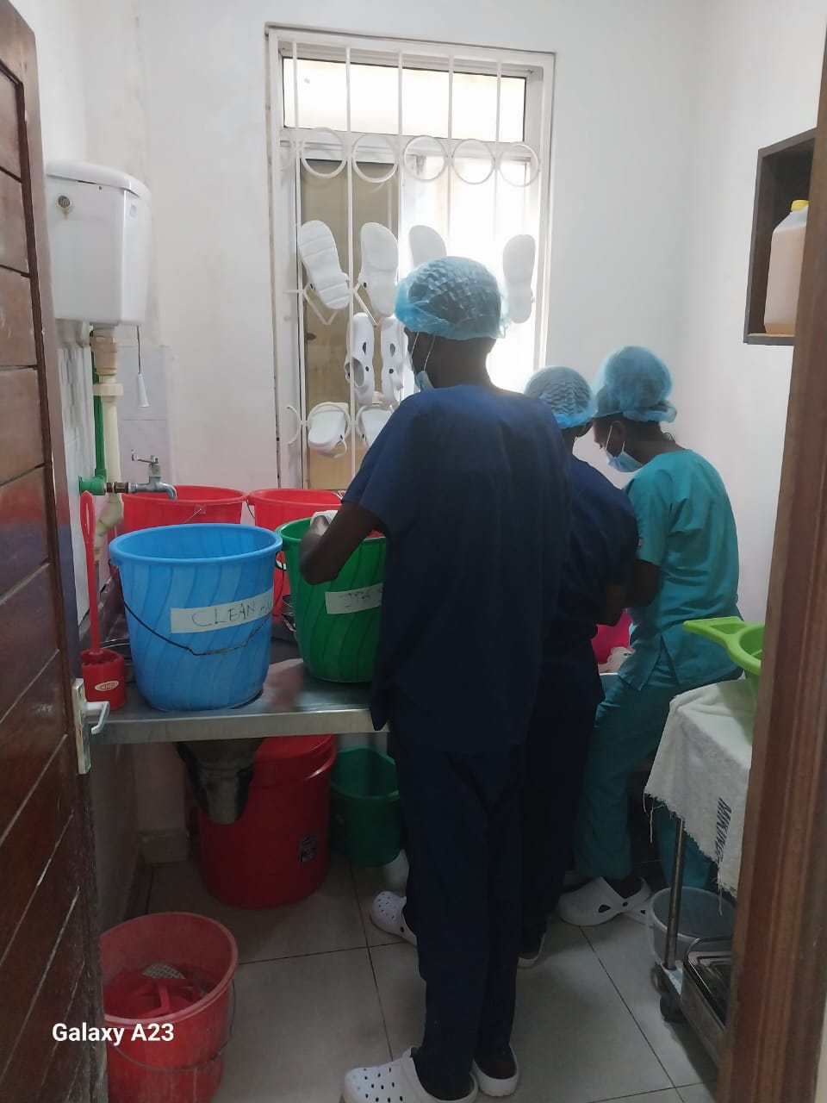
CONT..

Slide 11
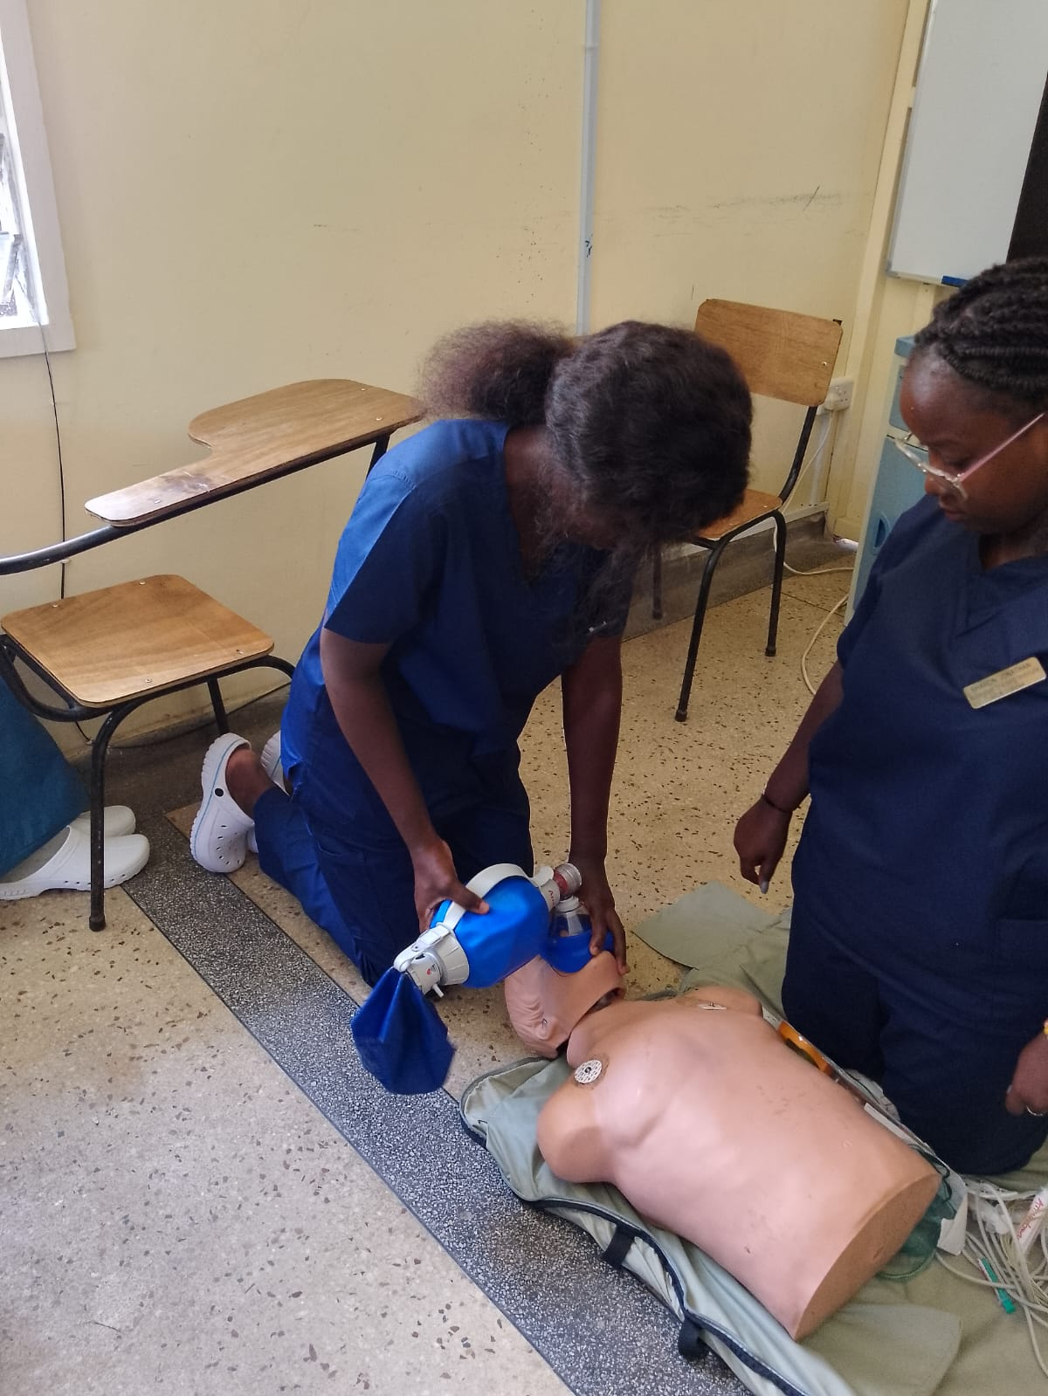
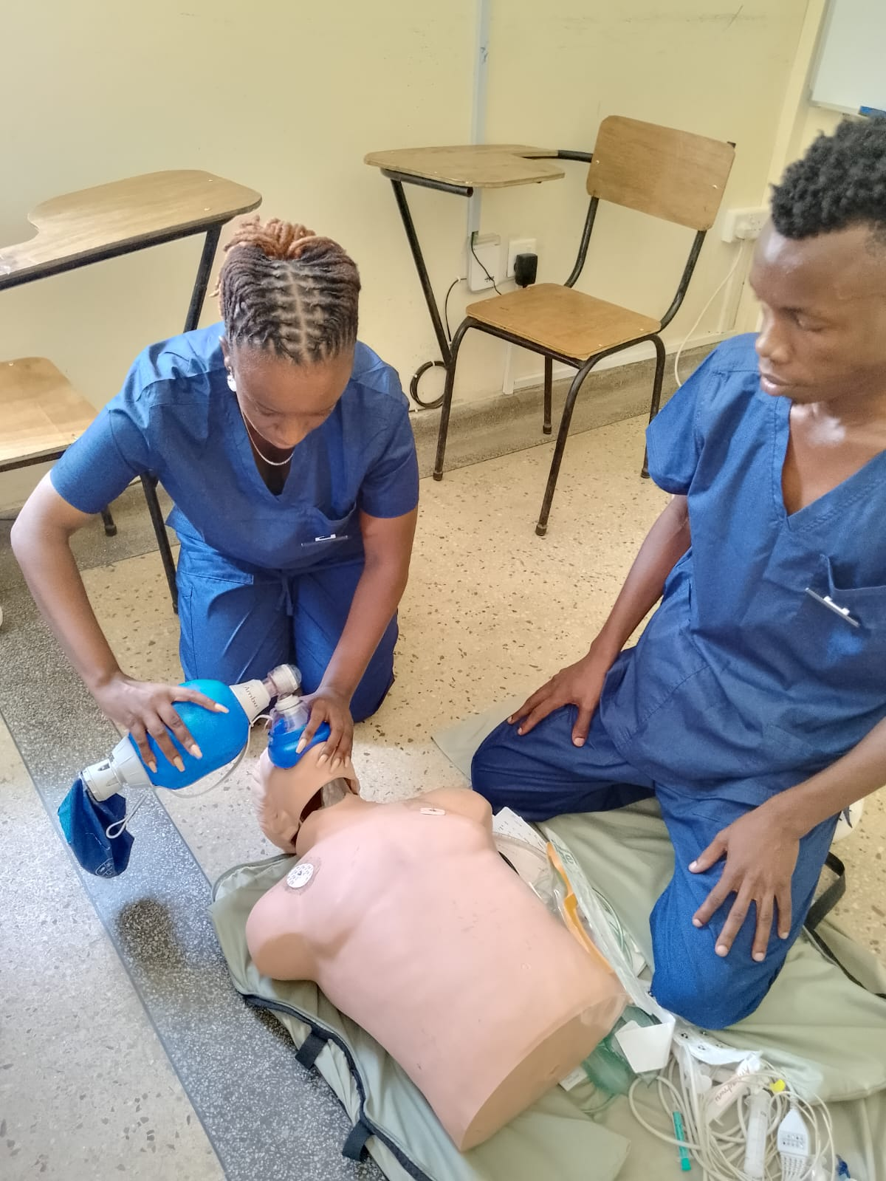
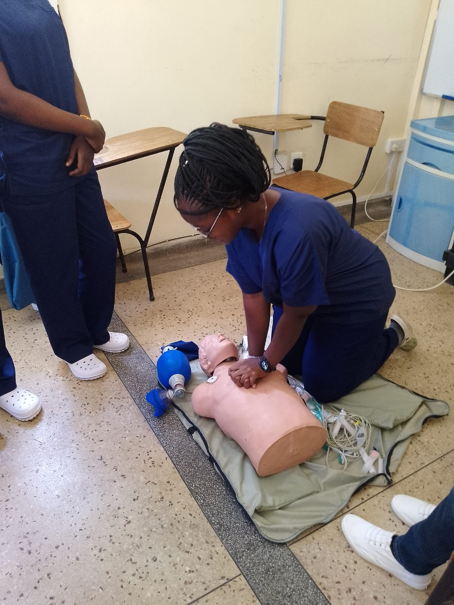
CONT..

Slide 12
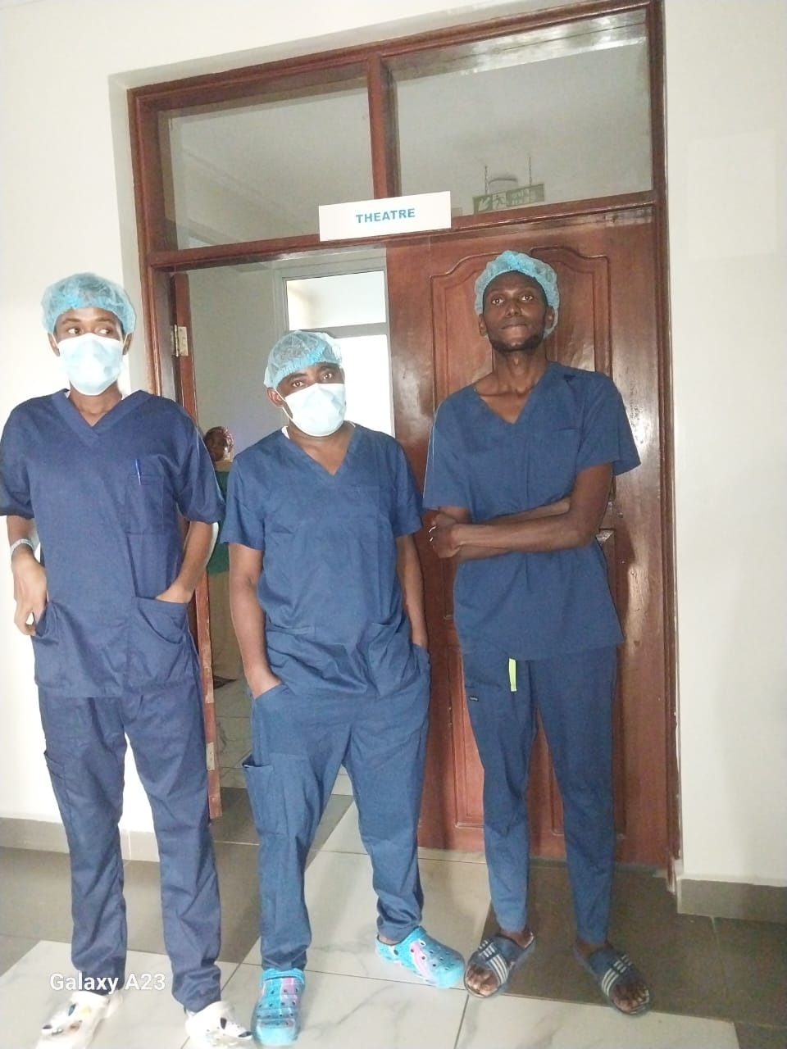
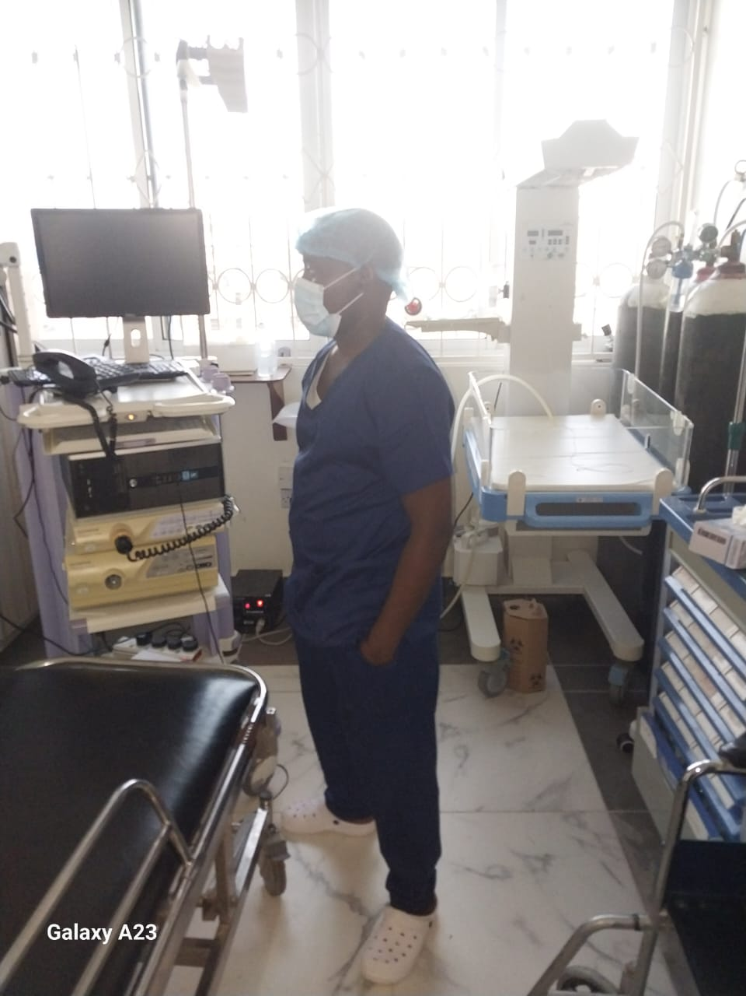
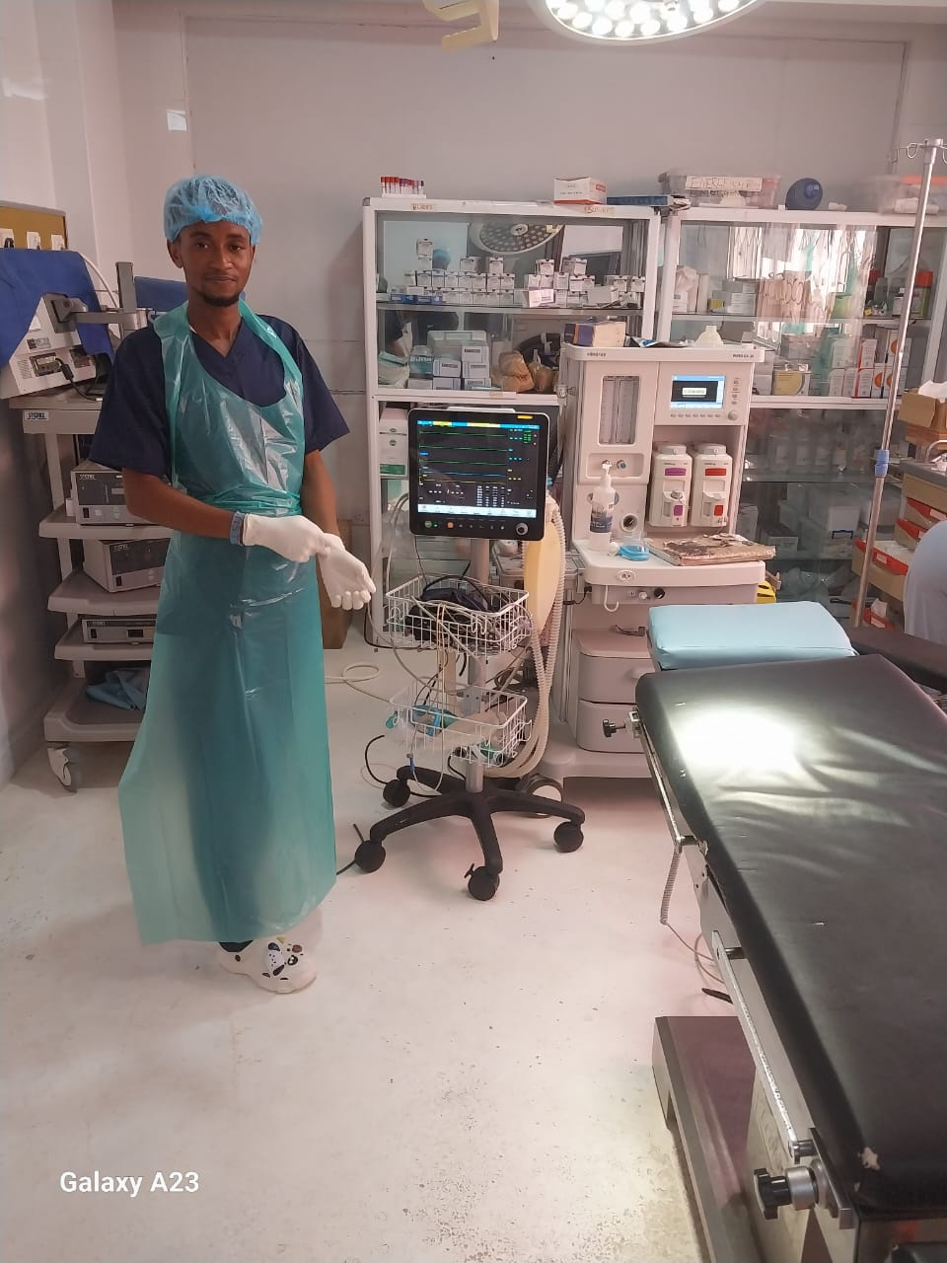
CONT..

Slide 13
IMPACT TO THE SOCIETY
Job-focused training in high-demand fields.
Learn by doing – hands-on labs and workshops
Industries are demanding job-ready skills, not just degrees
High unemployment among youth due to skill gaps
Certifications recognized by employers.

Slide 14
WHY ARLINGTON
Industry-experienced instructors
Affordable fees & scholarship support
Job placement assistance
Real-world projects and internships
Safe campus and modern facilities

Slide 15
ENTRY REQUIREMENT
Entry requirements
How to apply (online/in-person)
Deadlines for application
Scholarships & financial aid options

Slide 16
CONCLUSION
"Learn a skill. Change your life."

Slide 17
OUR CONTACT

