Slide 1
MACFin: Modernizing Medicaid and CHIP Financial Management Understanding.
By: DENNIS ANKOMAH

Slide 2
INTRODUCTION
MACFin is a user-centric financial solution for efficient and secure Medicaid and CHIP data management.
Overview: A modernization initiative replacing the outdated MBES/CBES systems.
Mission: Enhance how Medicaid and CHIP financial data is managed, reported, and analyzed.
Key Goals: Improve accuracy, increase efficiency, and enable secure data management.

Slide 3
Strategic Objectives for Financial Modernization
Streamlined Data Management: Centralized budgeting, grants, expenditures, and allotments.
Enhanced Data Quality: Automated validation reduces errors and maintains federal compliance.
User-Centric Design: Simplified, accessible interface for CMS and state agencies.
Informed Decision-Making: Supports policy decisions through consolidated, analyzable data.

Slide 4
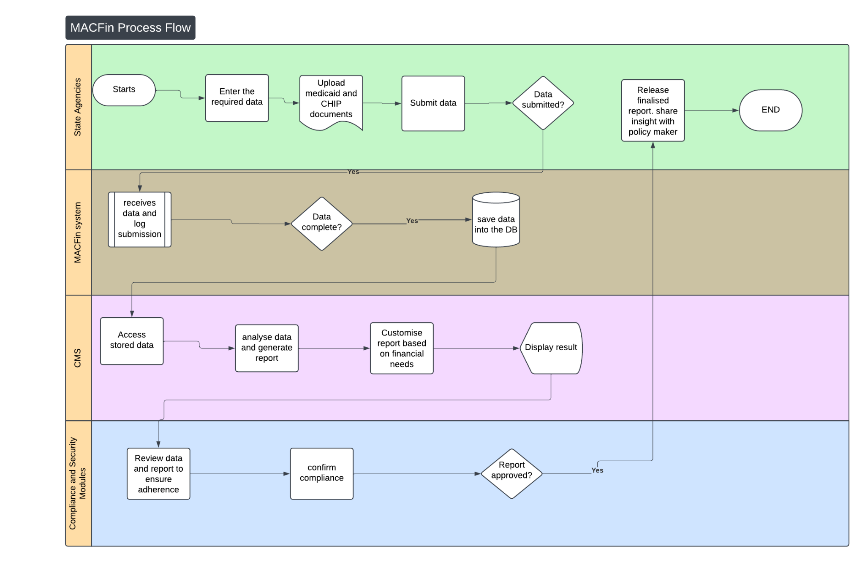

Slide 5
Value Proposition for Stakeholders
CMS: Accurate and comprehensive reporting and analytics.
State Agencies: Simplified, efficient data submission process.
Policymakers: Access to real-time, accurate data insights for decision-making.

Slide 6
Security and Compliance Assurance
Compliance Standards: Adherence to 508 accessibility, federal audit requirements, and data security.
Automated Checks: Regular validation of data quality and compliance.
Data Protection: Secure storage that safeguards sensitive financial information.

Slide 7
Use Case: Streamlined Financial Reporting for State Agencies
Scenario: A state agency needs to submit Medicaid and CHIP expenditure reports to CMS.
Challenge: Current system requires manual data entry across multiple platforms, resulting in frequent errors and delays.

Slide 8
Use case: Solution with MACFin
Centralized Entry: The agency uses MACFin’s structured modules to input data once into a unified system.
Automated Validation: MACFin instantly checks for errors, ensuring accuracy before submission.
Outcome: Time savings, reduced errors, and faster, reliable compliance with federal reporting standards.

