Slide 1
RBF-FD for Anisotropic Diffusion
Through the lens of stellarator plasma confinement
Dennis · Cornell University

Slide 2
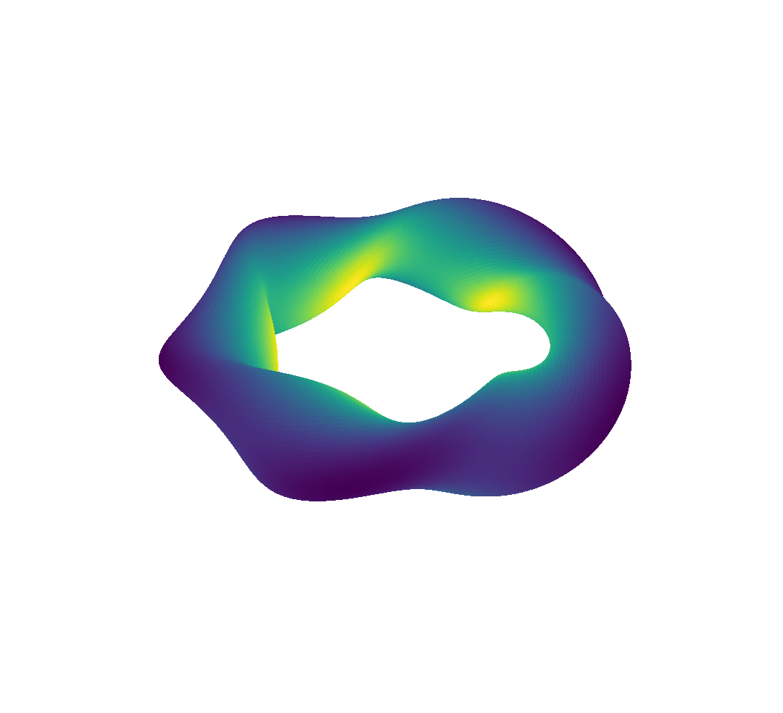
What is a stellarator?
A magnetic cage for fusion plasma: field lines wind around nested, toroidal surfaces
The twist (rotational transform ι) comes from 3D-shaped external coils, not from a large plasma current
Tokamak: axisymmetric. Stellarator: fully 3D, so no symmetry to exploit
|B| varies in all three directions (colour at right)
Rotating-ellipse model, N = 5 field periods. Colour: |B|; white curve: one field line.

Slide 3
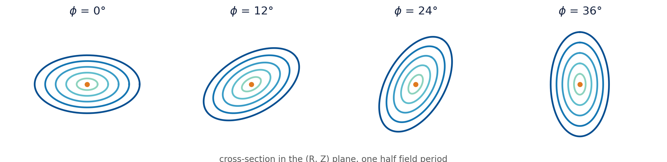
Flux surfaces: nested, twisted, never symmetric
B · ∇ψ = 0: field lines stay on their surface ψ = const
The cross-section rotates and reshapes with toroidal angle φ
Confinement means transport across ψ must stay tiny

Slide 4
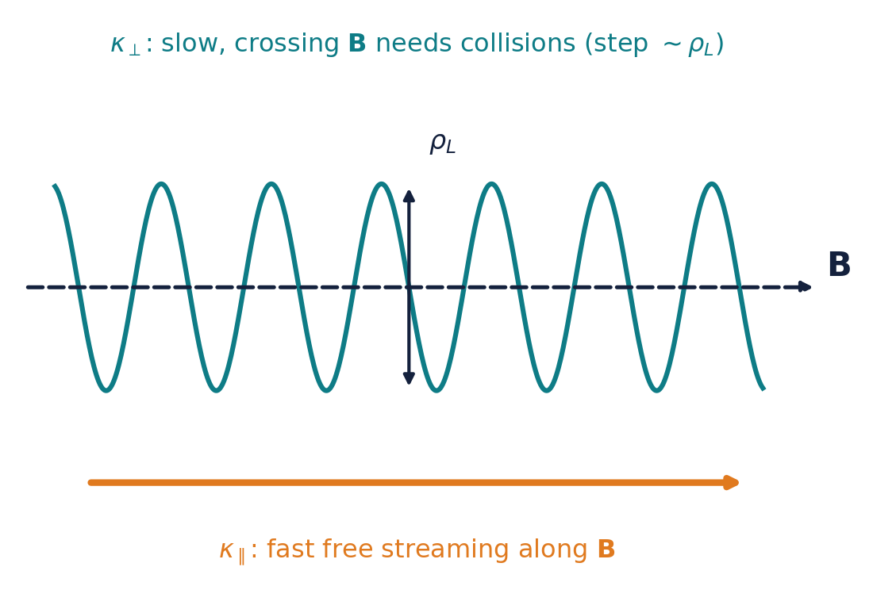
Where does anisotropy come from?
Charged particles spiral tightly around B (gyroradius ρ ≪ device size)
Along B they stream freely: very fast parallel conduction κ∥ (∝ T^5/2 for electrons)
Across B they move only via collisions: slow κ⊥
Core plasma: κ∥/κ⊥ ~ 10⁶ to 10⁹ or more

Slide 5
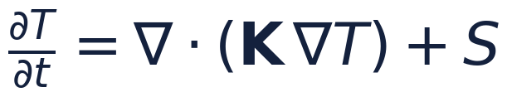
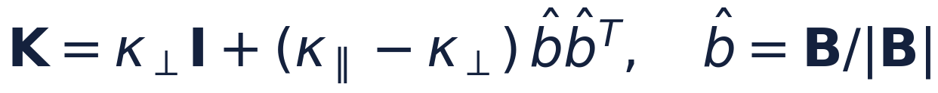
Anisotropic Diffusion
Diffusion equation
Anisotropic tensor
Expanded form
Stellarator field (flux coordinates)
Fusion plasmas: κ∥/κ⊥ ~ 10⁶ to 10⁹+, and b̂ is a 3D field with no symmetry, so grids cannot align with it.

Slide 6
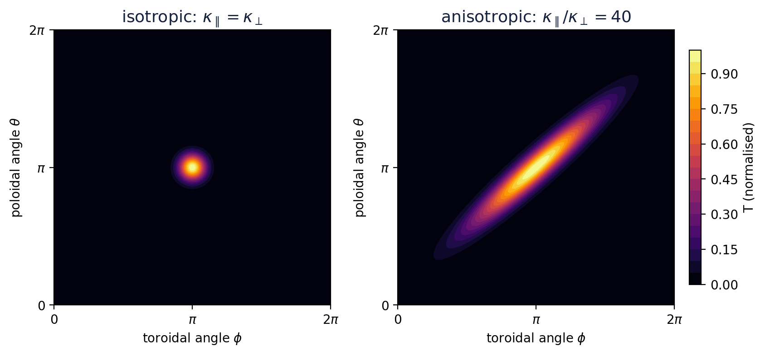
Visualizing anisotropic diffusion on a flux surface
A point source of heat streaks along b̂ and winds around the surface; across b̂ it barely spreads
In a 2D slice K = R(α) diag(κ∥, κ⊥) R(α)ᵀ: off-diagonal entries K₁₂ appear whenever b̂ is not grid-aligned

Slide 7


PDE of Interest

Slide 8

Problem Assumptions

Slide 9
RBF-FD Method
The goal is to approximate Lu ~ Lh u
  We use a set of test functions to approximate the operator L at a set of nodes.
Once we have a good approximator, we solve for the PDE of interest by applying the boundary conditions.
The goal is to approximate Lu ~ Lh u
  We use a set of test functions to approximate the operator L at a set of nodes.
Once we have a good approximator, we solve for the PDE of interest by applying the boundary conditions.

Slide 10
RBF-FD Method
The goal is to approximate Lu ~ Lh u
  We use a set of test functions to approximate the operator L at a set of nodes.
Once we have a good approximator, we solve for the PDE of interest by applying the boundary conditions.
To study the approximation scheme, we rely on the following error analysis:

Slide 11

RBF-FD Method Part 2
Approximation solution:
Approximation Operator:
Goal equation: W u = b, solve for u

Slide 12
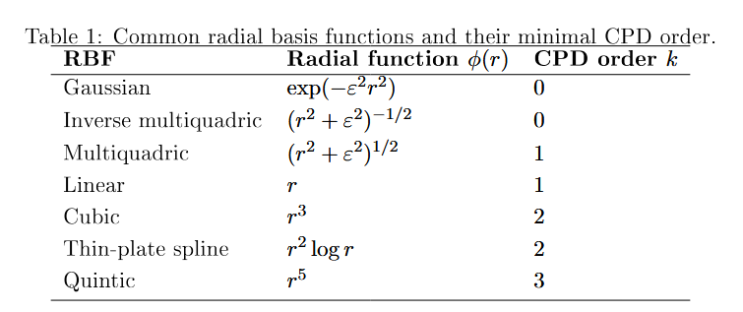
RBF-FD Method Part 3
Regular Finite Difference: Approximate the operator by Taylor Expansion
RBFFD: Approximate operator by using a basis of radial functions and solving for the exactness on the functions in the space at a set of nodes

Slide 13
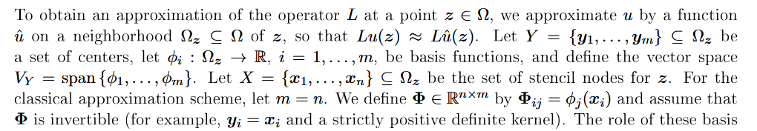
RBF-FD Method Part 4
How do we set up the system:
What is the function space we use: RKHS.
  Pick a discrete subspace
  Approximate the RKHS by increasing the dimension of the discrete space and applying completion
  A drawing of the setup

Slide 14
RBF-FD Method Part 5
Consistency:
Power function
Stability

Slide 15
RBF-FD Method Part 6-7: Drawbacks and Uncertainty
RBFFD “Heisenberg” Uncertainty Principle
  More accuracy <-> higher conditioning of the local solves
    More stencil nodes, more conditioning of the matrix
  Due to the square structure of the nodes acting as centers, the noes play a role in the consistency, as well as the stability

Slide 16
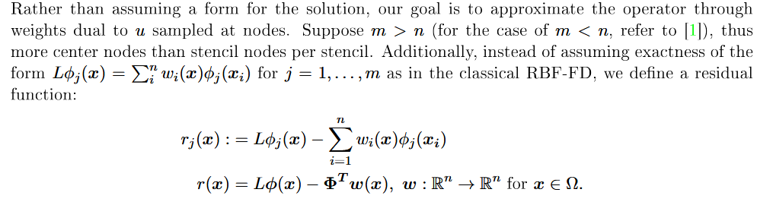
RBF-FD Method Part infty
Idea: separate stencil nodes from centers (Different sampling)
Goal:

Slide 17

RBF-FD Method Part infty+1
Exact Repreoduction on the space V_h
0=
W_LS and w_opt added to power function: minimizing for opt leads to the standard power function + an extra term referring to the eigenvalue of (1/mAA^T).
1/mAA^T -> integral k(x,z)k(y,z)dmu(z)

Slide 18
RBF-FD Method Results 1
Example Problem:
Anisotropic diffusion problem on the square domain [0, L] × [0, L]
with homogeneous Dirichlet boundary conditions.
PDE:
.. math::
\\nabla \\cdot (A \\nabla u) = f
\quad \text{in } [0,L]^2,
where A is a symmetric positive definite diffusion tensor.
Exact solution:
.. math::
u(x,y) =
A_c \sin(\\alpha \\pi x / L)\sin(\\beta \\pi y / L)
+ B_c \sin(\\beta \\pi x / L)\sin(\\alpha \\pi y / L),
with coefficients
.. math::
A_c = \\frac{\\text{Amp}}
{\\pi^2 (\\alpha^2 A_{11} + \\beta^2 A_{22}) / L^2},
\qquad
B_c = \\frac{\\text{Amp}}
{\\pi^2 (\\beta^2 A_{11} + \\alpha^2 A_{22}) / L^2}.
These ensure the manufactured solution satisfies the anisotropic
operator for any SPD matrix A and any domain size L.
Boundary conditions:
.. math::
u = 0 \quad \text{on } \partial[0,L]^2.

Slide 19
RBF-FD Method Results 2
Conditioning of matrices improve: better more reliable results
Have graphs and tables

Slide 20
RBF-FD Method Next Steps
Refinement Methods for this scheme
Show that by redefining the RKHS by setting the integral as the kernel, we get the same space of approximation from increasing the number of nodes.
Show the effect

Slide 21
