Slide 1
RBF-FD for Anisotropic Diffusion
Through the lens of stellarator plasma confinement
Dennis · Cornell University
Notes:
Overview: stellarators confine fusion plasma with 3D magnetic fields. Heat moves almost only along field lines, which makes the transport equation extremely anisotropic. This talk (Part 1) builds a meshfree RBF-FD discretisation for that equation, and ends with a new least-squares stencil construction and its error analysis.

Slide 2
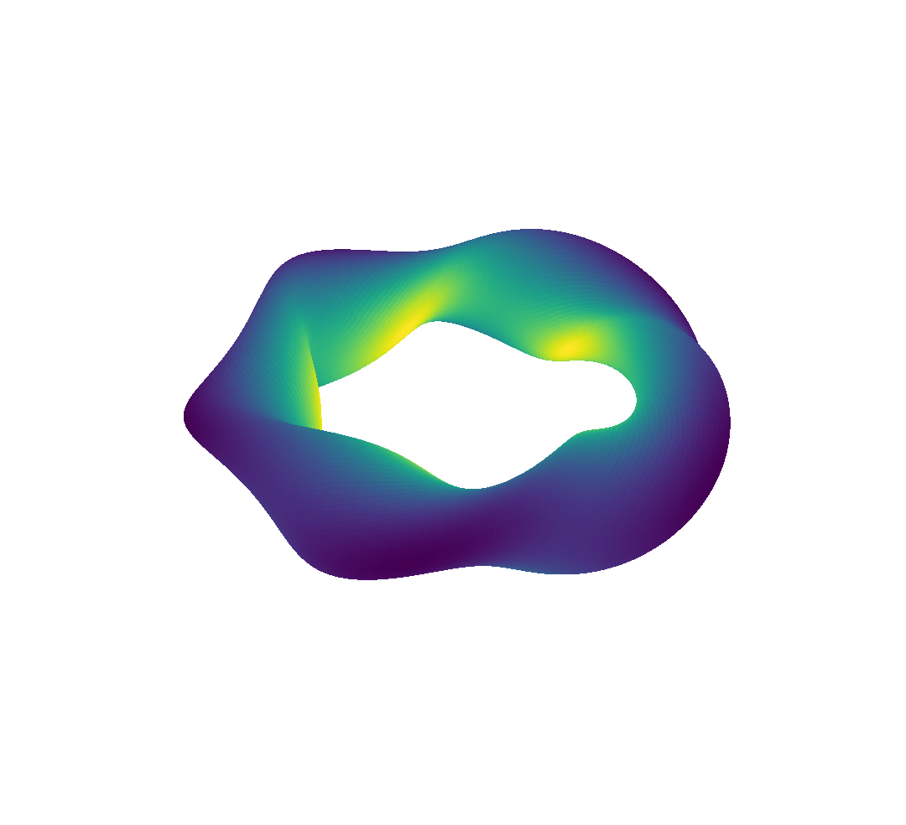
What is a stellarator?
PHYSICS
A magnetic cage for fusion plasma: field lines wind around nested, toroidal surfaces
The twist (rotational transform ι) comes from 3D-shaped external coils, not from a large plasma current
Tokamak: axisymmetric. Stellarator: fully 3D, so there is no symmetry to exploit
|B| varies in all three directions (colour at right)
Rotating-ellipse model, N = 5 field periods. Colour: |B|; white curve: one field line.
Notes:
A tokamak is axisymmetric, so one 2D cross-section describes everything. A stellarator gets its twist from the coils themselves, which buys steady-state operation but removes the symmetry. Everything downstream (grids, stencils) has to cope with a fully 3D field.

Slide 3
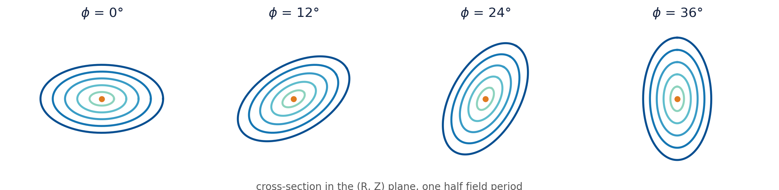
Flux surfaces: nested, twisted, never symmetric
PHYSICS
B · ∇ψ = 0: field lines stay on their surface ψ = const
The cross-section rotates and reshapes with the toroidal angle φ
Confinement means transport across ψ must stay tiny
Notes:
Each closed curve is a cross-section of a flux surface. Field lines never leave their surface, so heat that follows field lines stays confined. What matters for numerics: the surfaces change shape with the toroidal angle, so the direction of fast transport is different at every point.

Slide 4
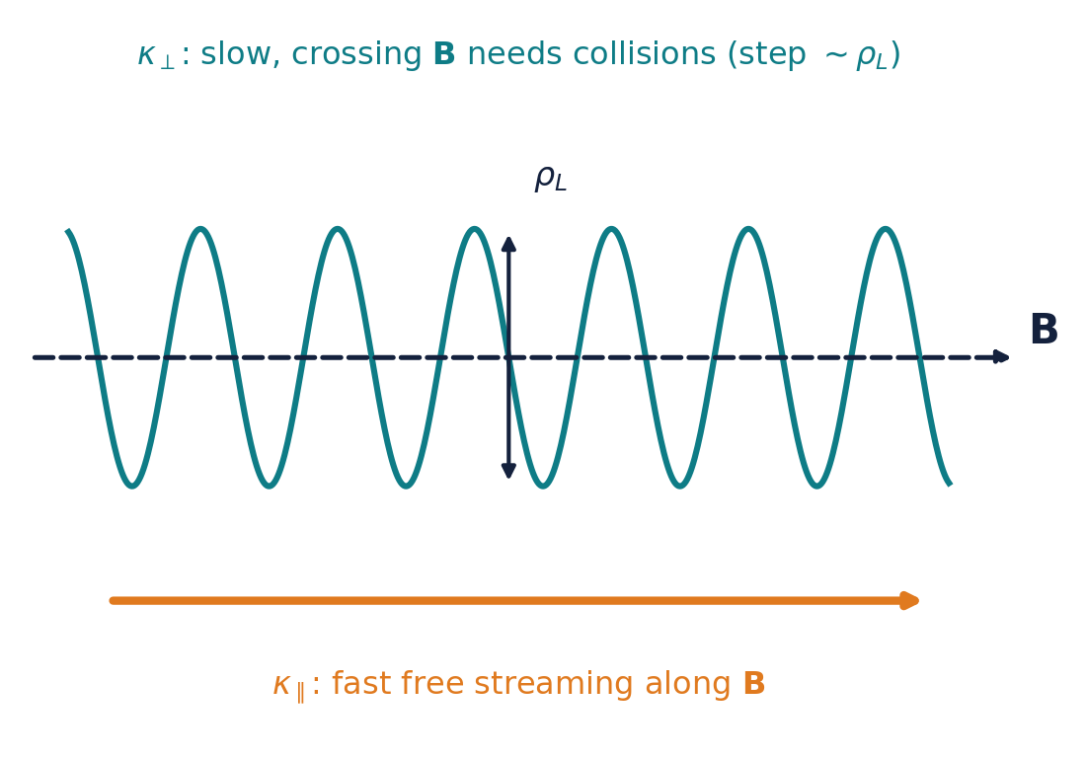
Where does anisotropy come from?
PHYSICS
Charged particles spiral tightly around B (gyroradius ρ ≪ device size)
Along B they stream freely: very fast parallel conduction κ∥ (∝ T^{5/2} for electrons)
Across B they move only via collisions: slow κ⊥
Core plasma: κ∥ / κ⊥ ~ 10⁶ to 10⁹ or more
Notes:
Particles are tied to field lines. Along B they move freely, so heat conducts very fast (strongly temperature dependent). Across B they only hop by collisions. In the hot core the ratio is a million to a billion.

Slide 5
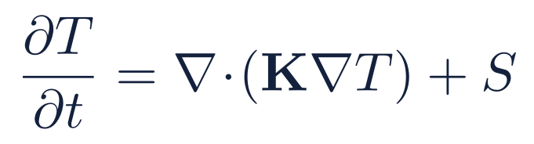
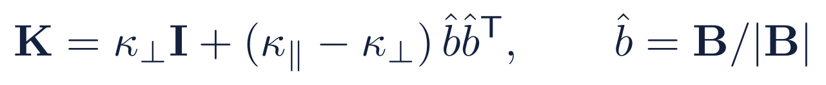
Anisotropic diffusion: the governing equations
PHYSICS
Diffusion equation
Anisotropic tensor
Expanded form
Stellarator field (flux coordinates)
!
Fusion plasmas: κ∥ / κ⊥ ~ 10⁶ to 10⁹+, and b̂ is a 3D field with no symmetry, so grids cannot align with it.
Notes:
The conductivity tensor K has a rank-one part along the unit field direction b-hat. Expanded, it is an isotropic Laplacian plus a huge directional term. Because b-hat is a general 3D vector field, no choice of grid lines up with it everywhere. That is the motivation for a meshfree method.

Slide 6
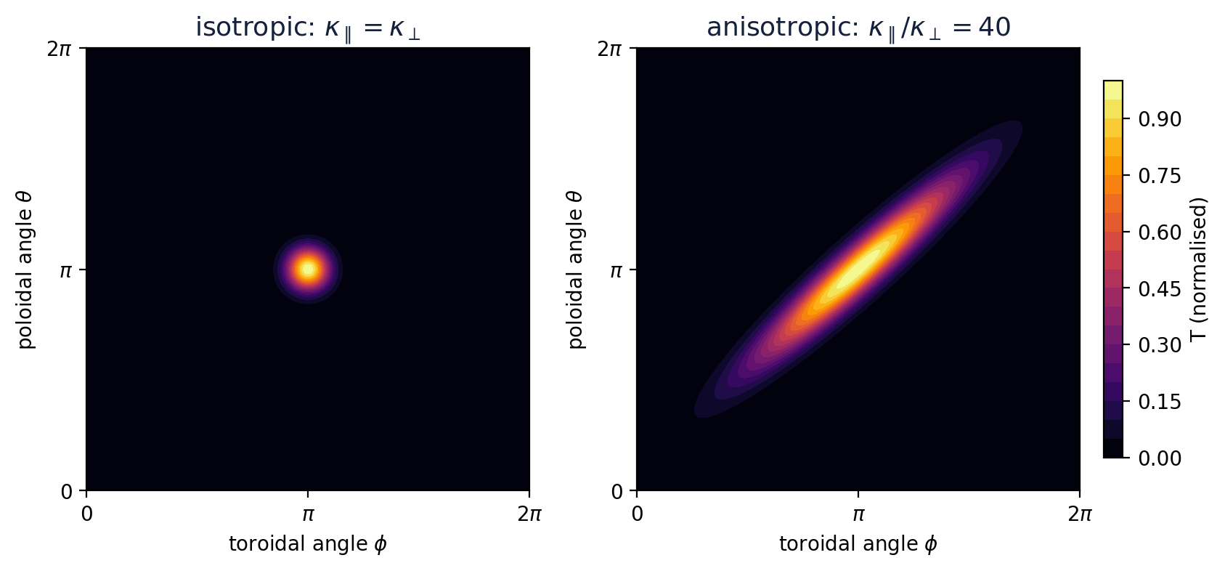
Anisotropic diffusion on a flux surface
PHYSICS
A point source of heat streaks along b̂ and winds around the surface; across b̂ it barely spreads
In a 2D slice K = R(γ) diag(κ∥, κ⊥) R(γ)^{T}, with γ the angle between b̂ and the grid
!
Whenever b̂ is not grid-aligned, K₁₂ ≠ 0: the scheme must handle mixed derivatives on scattered nodes.
Notes:
Left: isotropic diffusion spreads as a round blob. Right: with a ratio of 40 the same source becomes a streak along the field line. In a 2D slice the tensor is a rotation of a diagonal matrix, and off-diagonal entries appear as soon as the field direction is not aligned with the coordinate axes.

Slide 7
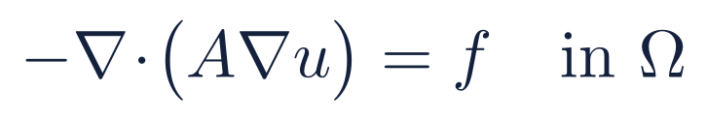

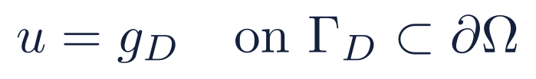
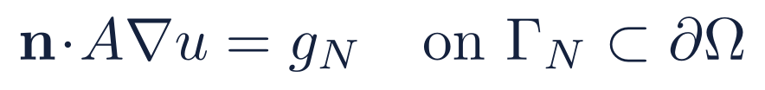
The PDE of interest
PROBLEM
Steady-state model problem (A plays the role of K)
Assumptions on the tensor
A is symmetric and uniformly elliptic; Ω ⊂ ℝᵈ and L u := ∇·(A∇u).
Regularity: Agmon–Douglis–Nirenberg estimate [2], for f ∈ W^{k−2,p}(Ω)
The data (f, g_{D}, g_{N}) control the smoothness of u. This is the yardstick for the approximation error of the scheme that follows.
Notes:
The steady heat balance gives a second-order elliptic PDE with Dirichlet and Neumann parts of the boundary. With a Lipschitz, uniformly elliptic tensor, the ADN estimate ties the Sobolev smoothness of the solution to the smoothness of the data. That smoothness is what an RBF-FD error bound will be measured against.

Slide 8
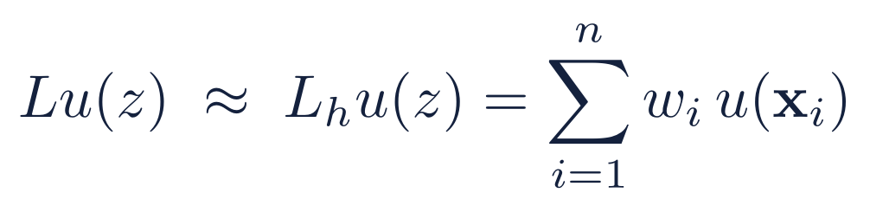
RBF-FD: replace the operator by a weighted sum
METHOD
Goal
1
Local stencil
2
Exactness on RBFs
3
Global system
At each node z, pick n neighbours X = {x₁,…,xₙ} and look for weights wᵢ.
Choose w so the formula is exact on radial functions φⱼ (classical FD: exact on Taylor polynomials).
Assemble the sparse matrix W, impose the boundary conditions, solve W u = b.
The error is a bounded linear functional ξ = L − L_{h}
One factor depends on how w is chosen (node-dependent), the other on the smoothness of u (function-dependent).
Notes:
Idea of every finite-difference-type method: approximate L u at z by a weighted sum of nearby values. Classical FD fixes the weights with Taylor polynomials; RBF-FD fixes them by demanding exactness on radial basis functions, which works on scattered nodes. Then assemble a sparse global system. The error functional is bounded by a product: a norm of its Riesz representer v times the norm of u in the native space.

Slide 9
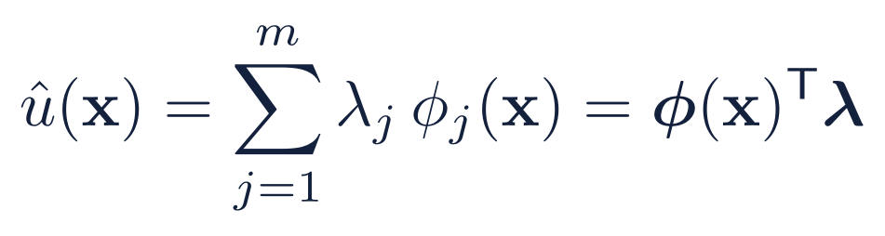
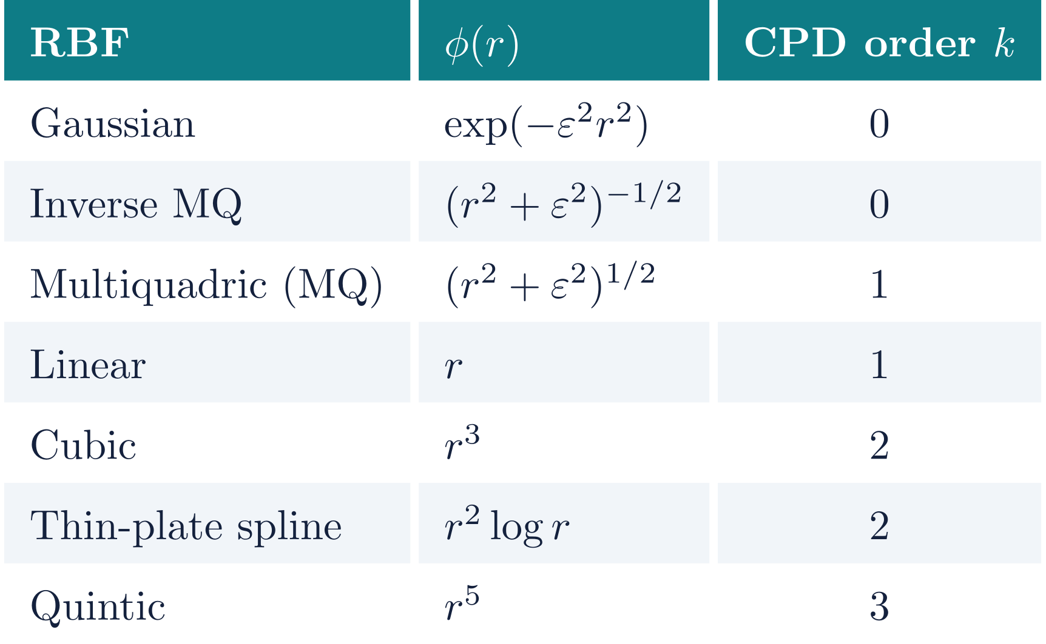
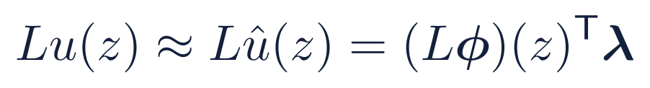
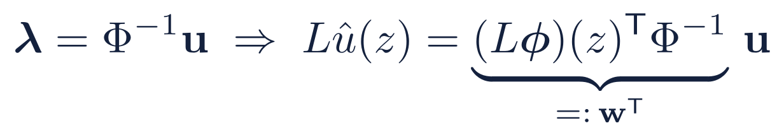
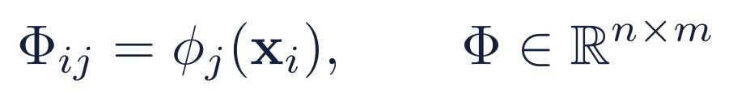
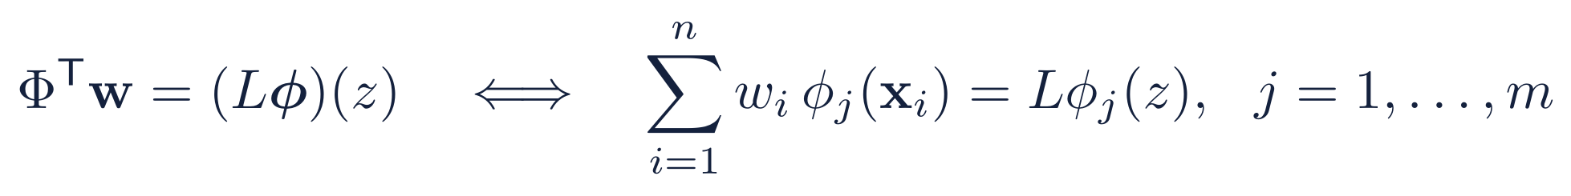
Setting up the local problem
METHOD
Approximate u by RBFs on a neighbourhood Ω_{z} of z
Apply L and use the interpolation conditions u = Φλ
Collocation matrix (X: stencil nodes, Y: centers) and the exactness conditions
Common radial basis functions, r = ‖x − y‖, ε the shape parameter. Order k > 0 needs polynomial terms of degree k − 1 in the expansion.
!
Classical RBF-FD: m = n, Y = X, Φ square.
Notes:
Write u locally as a combination of radial functions centred at Y. Applying L to the expansion and using the interpolation conditions gives the weight vector w. Equivalently, w must reproduce L phi_j(z) for every basis function, which is a linear system with the collocation matrix Phi. Classical RBF-FD uses the same points as stencil nodes and centers, so Phi is square. The table lists common choices and the polynomial degree needed for conditionally positive definite kernels.

Slide 10
Consistency, stability, and the catch
METHOD
Consistency: how small can the error be?
Stability: how sensitive is w?
ξ_{w,L,z} has Riesz representer E_{w}; its norm is the power function P_{L}(w) = ‖E_{w}‖. L acts in the z variable only.
Weights solve Φᵀw = Lφ(z), so data errors are amplified by cond(Φ)
Nearly flat or dense stencils make Φ almost singular
Unstable w destroys the accuracy that P_{L} promises
Higher-order L needs smoother K: the demands pull against each other
accuracy
stability
More stencil nodes: smaller power function, but larger cond(Φ). With Y = X the same nodes are stencil and centers, so they decide consistency and stability at once.
“Heisenberg” uncertainty principle of RBF-FD
Notes:
Consistency is governed by the power function. For a general operator L the representer is L applied in z to the kernel section, minus the stencil combination, so the constant term is a double application of L to K on the diagonal and k becomes k_L. If L has order t this needs K roughly C^2t near z, the finite-smoothness condition in Davydov [5]. Stability is about how the weights respond to perturbations. The catch: in the classical square setup adding nodes improves the first and worsens the second, and a higher-order operator tightens the smoothness demand on K at the same time.

Slide 11
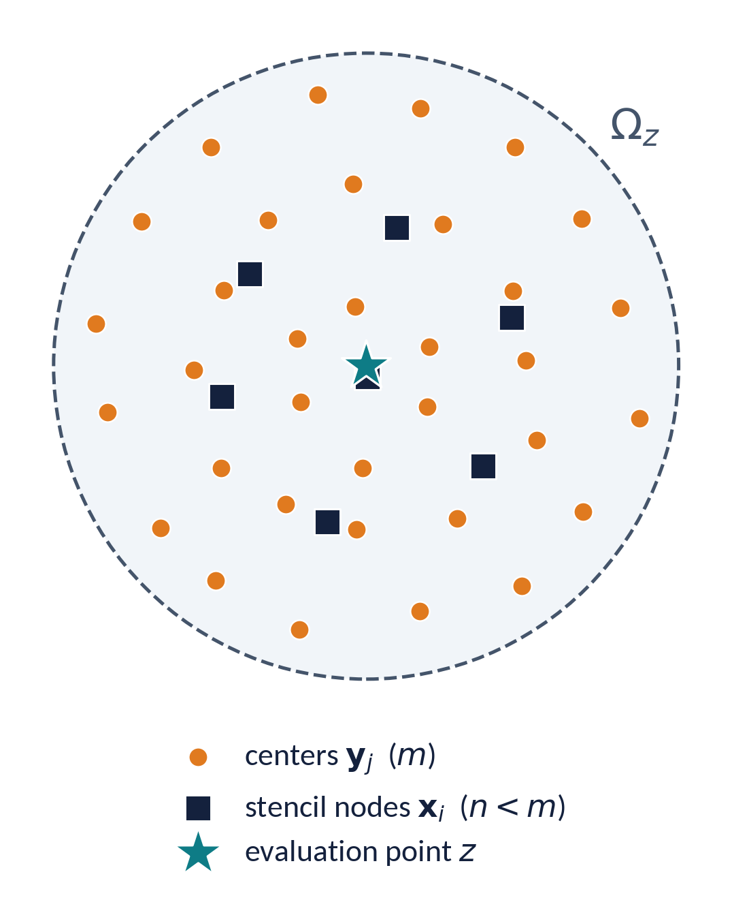
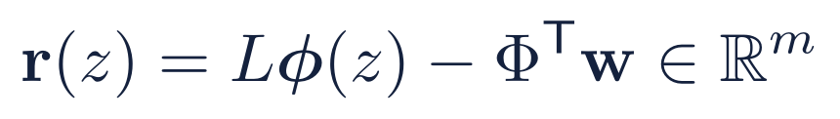
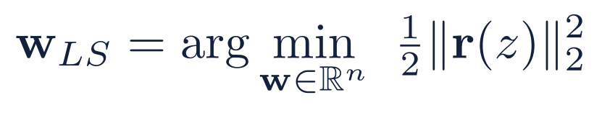
Decouple stencil nodes from centers
IDEA
Classical: m = n, Y = X. Exactness is an interpolation condition.
Oversampled: m > n centers. Exactness relaxes to a small residual (for m < n see [1]).
Payoff: place centers for stability, stencil nodes for locality.
Least-squares weights
Notes:
Keep the stencil small (n nodes) but sample the basis functions at more centers (m > n). The system Phi^T w = L phi(z) becomes overdetermined, so we minimise the residual in the 2-norm. The normal equations give a square n-by-n system. The remaining question is what this does to the error, which is the analysis on the next three slides.

Slide 12
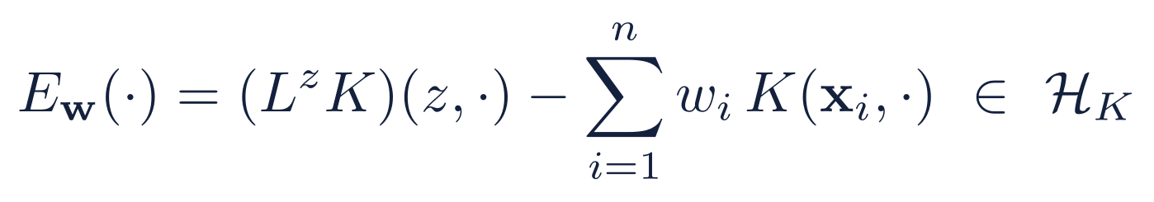
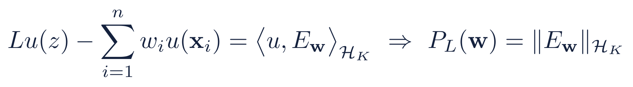
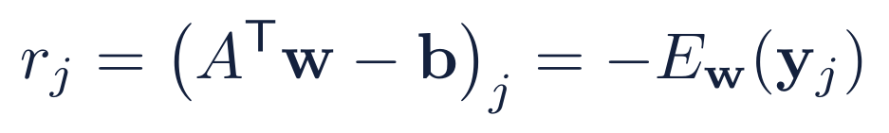
Least squares: what does the residual measure?
ANALYSIS
Setting: K strictly positive definite, φⱼ = K(·, yⱼ) so Φ = A. The data carry the operator: bⱼ = L^{z}K(z, yⱼ)
Error function (Riesz representer)
Why it matters
Residual = error function on Y
!
Only b changes with L: A, G_{X} and the chain below are untouched. P_{L}(w) = ‖E_{w}‖ is global; the residual sees E_{w} only on Y.
Notes:
Previously this was written for L = identity, where b_j was just the kernel section K(z, y_j). For a general operator we apply L in the z variable: b_j = L^z K(z, y_j). The error function E_w is then the Riesz representer of the full functional Lu(z) minus the weighted sum, so for any u in the native space the error equals the inner product of u with E_w, and the power function is its norm. The residual is still exactly minus E_w sampled on the centers. Structural point worth saying out loud: A involves no L at all, so only the right-hand side changes.

Slide 13
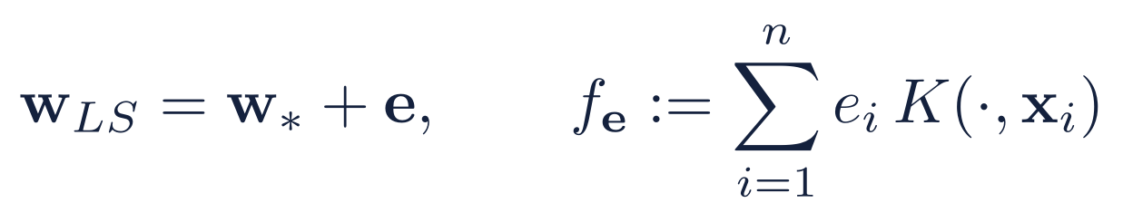
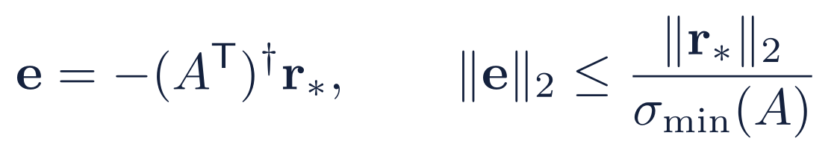

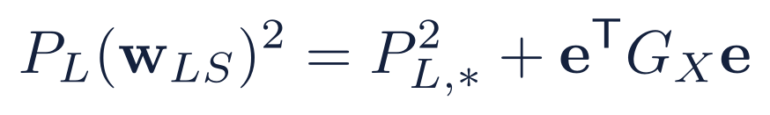
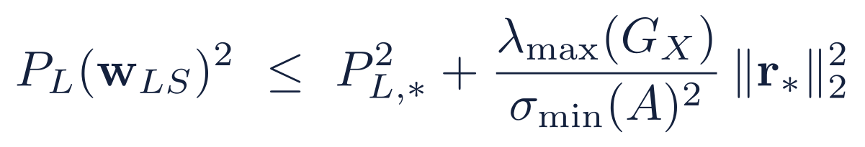
From residual to coefficient to function error
ANALYSIS
Ideal weights w*: G_{X} w* = k_{L}
Residual
r* = Aᵀw* − b = −E_{w*}|_{Y} ∈ ℝᵐ
(Aᵀ)†
Coefficient error
e = w_{LS} − w* ∈ ℝⁿ
T_{X}
Function error
f_{e} = Σ eᵢ K(·, xᵢ) ∈ H_{K}
Step 1 · uses 1 / σ_{min}(A)
Step 2 · uses λ_{max}(G_{X})
E_{w*} ⊥ f_{e} ⇒
Result
Notes:
Write the least-squares weights as the ideal weights plus an error e. Because the normal equations make the LS residual orthogonal to the range, the coefficient error is minus the pseudo-inverse applied to the residual of the ideal weights, so its norm is at most that residual over sigma-min of A. Step two converts a coefficient error to a function error through the kernel Gram matrix: the norm squared is e^T G e, which is at most lambda-max times the squared 2-norm (note: lambda-max, not its square root, appears in the squared bound). Since the ideal weights minimise P, E_{w*} is orthogonal to every K(., x_i), giving a Pythagorean identity and the bound on the slide.

Slide 14
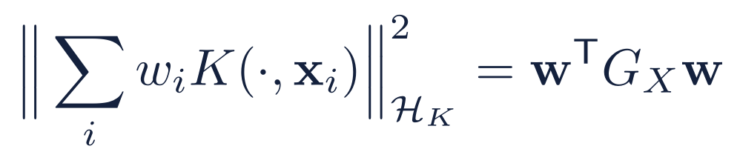
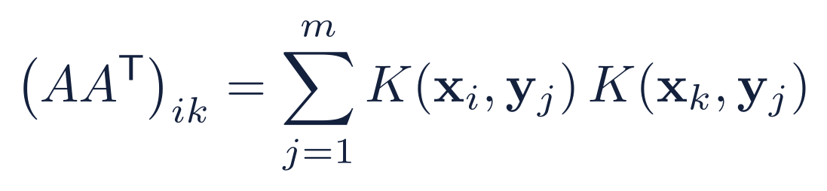
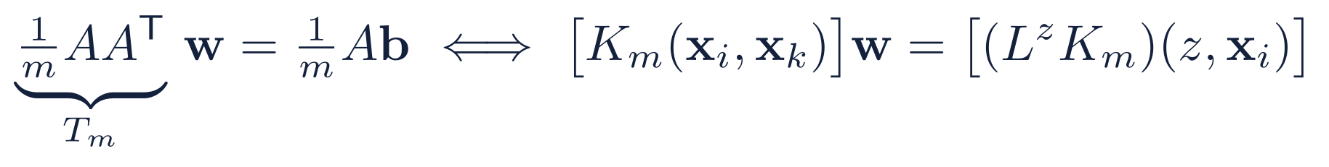
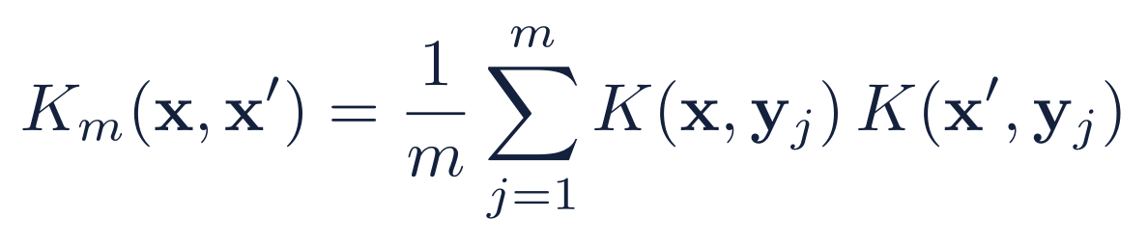
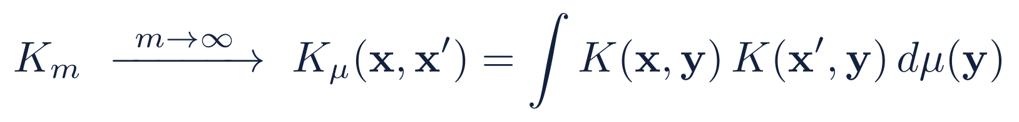
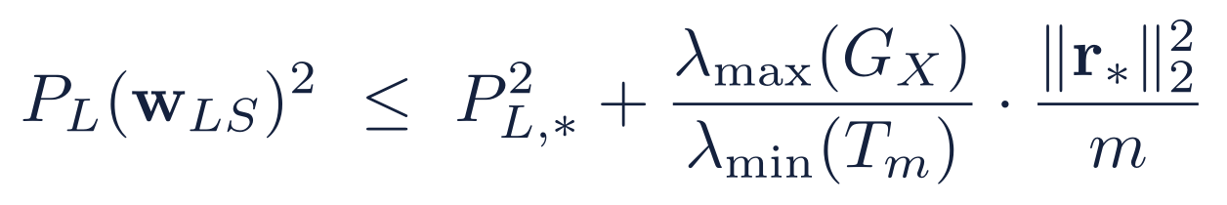
Two Gram matrices, two roles
ANALYSIS
G_{X} = [K(xᵢ, xₖ)]: RKHS geometry
A Aᵀ: least-squares geometry
Size of the function Σ wᵢK(·, xᵢ). Converts coefficient error to function error (λ_{max}).
Data Gram matrix on Y. Converts residual to coefficient error: σ_{min}(A)² = λ_{min}(AAᵀ).
Normal equations (b carries L)
Induced kernel and its limit (sampling measure μ)
L passes through the finite sum, so this is classical RBF-FD for K_{m} with the same operator L.
Result
with T_{m} = (1/m)AAᵀ and ‖r*‖²/m → ‖E_{w*}‖² in L²(μ). Larger λ_{min}(T_{m}) means a smaller stability penalty.
Notes:
Do not conflate the two matrices. G_X, built from the kernel at the stencil nodes, is the Gram matrix for the RKHS norm of the expansion. A A^T is built from the kernel evaluated at the centers; it governs the least-squares solve. Dividing by m, T_m is the Gram matrix of the induced kernel K_m, which converges to an integral kernel with respect to the sampling measure mu. Solving the normal equations is exactly classical RBF-FD with that kernel. The final bound adds to the power function of the ideal weights a penalty controlled by the ratio of lambda-max of G_X to lambda-min of T_m.

Slide 15
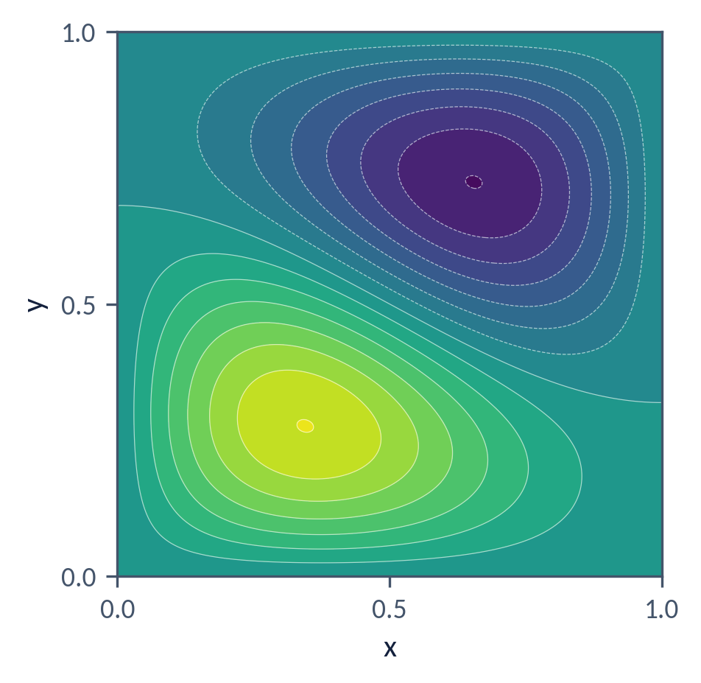
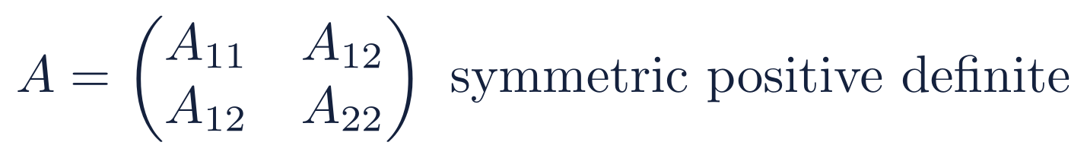
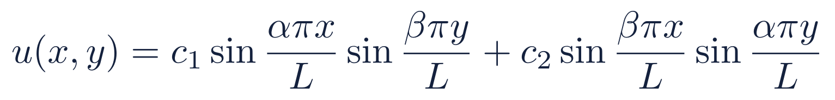
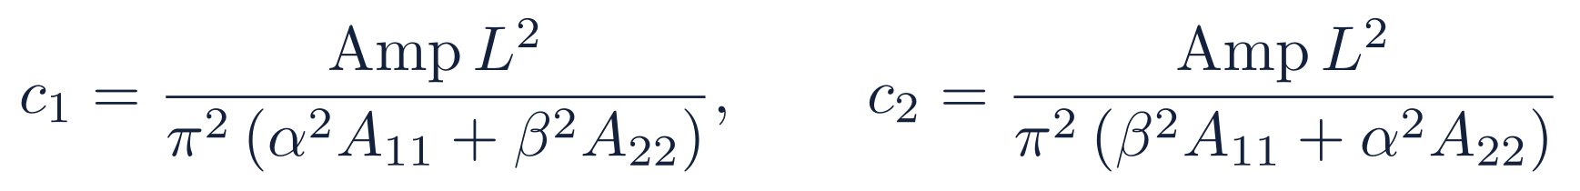
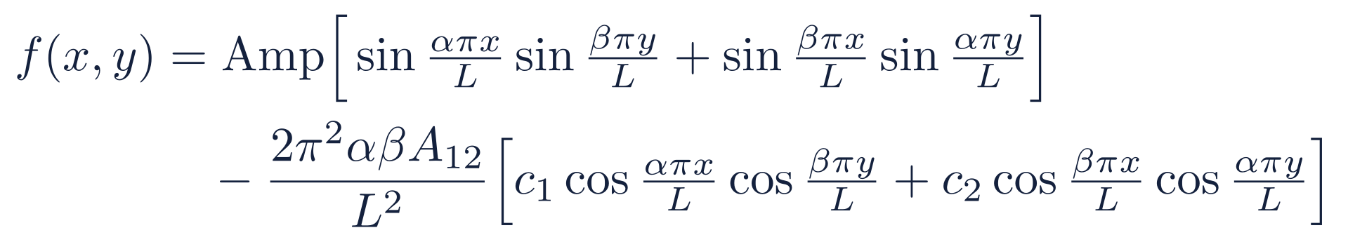
A manufactured solution for anisotropic diffusion
TEST PROBLEM
Problem on the square, homogeneous Dirichlet data
Exact solution and normalising coefficients
Illustration of u: L = 1, α = 1, β = 2, A₁₁ = 3, A₂₂ = 1
α, β ∈ ℕ make u = 0 on the boundary
A₁₂ ≠ 0 creates the cos·cos terms in f: the mixed derivative that a grid-aligned stencil misses
Rotating A by γ gives A₁₂ = (κ∥ − κ⊥) sin γ cos γ, as in the stellarator tensor
Source term, from f = −∇·(A∇u)
Notes:
A manufactured solution lets us measure the error exactly: pick u, compute f analytically, solve for u_h and compare. The coefficients c1 and c2 (A_c and B_c in the code) normalise the amplitude of the source. Alpha and beta must be integers for the sines to vanish on the boundary. The off-diagonal entry A12 produces the cosine-cosine terms in f. The illustration contour is only a picture of the formula for sample parameters.

Slide 16
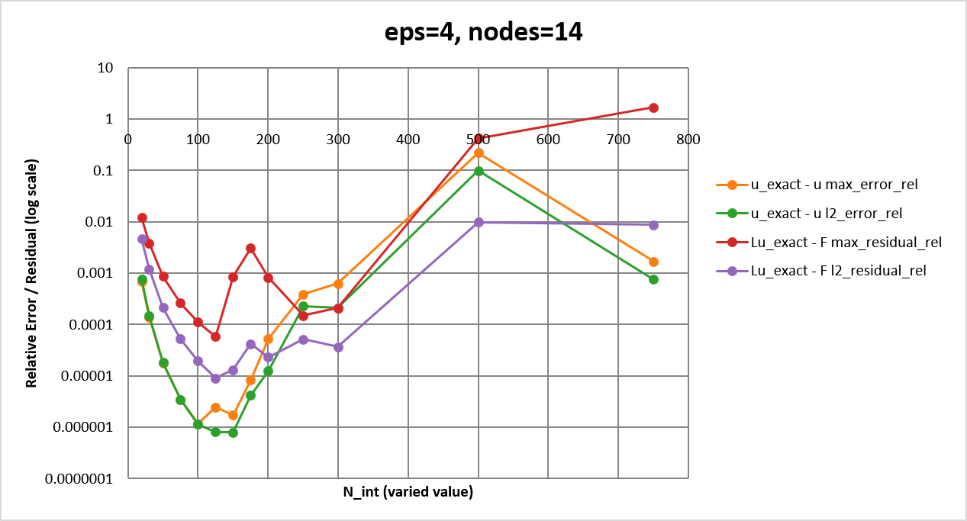
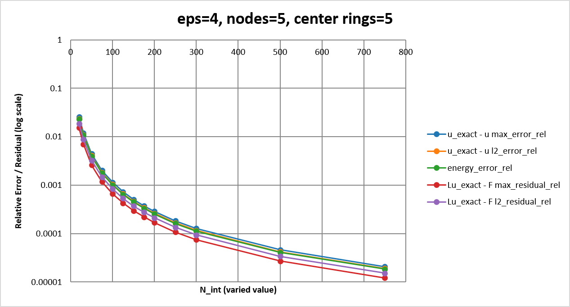
Numerical study:
RESULTS
Observation: oversampled centers give better-conditioned local systems, so the computed errors are more reliable.
✓
Prediction from the analysis: the penalty in the bound scales with λ_{max}(G_{X}) / λ_{min}(T_{m}), so conditioning enters the error explicitly.
Notes:
Add the convergence plots and conditioning tables for the test problem here. The headline observation is that the oversampled (least-squares) stencils have better-conditioned local systems, which makes the computed errors more reliable. The analysis predicts where conditioning enters: through the ratio of lambda-max(G_X) to lambda-min(T_m).

Slide 17
Numerical study: stencil conditioning
RESULTS
1
Vary
2
Measure
3
Compare
Stencil size n
Oversampling ratio m / n
Anisotropy ratio κ∥ / κ⊥
Orientation γ of the eigenvector
Condition number of the local systems
Least-squares residual ‖r‖₂
Relative error ‖u − u_h‖ / ‖u‖ on the test problem
Classical square scheme (m = n)
Least-squares scheme (m > n)
Same nodes, same kernel, same test problem
Observation: oversampled centers give better-conditioned local systems, so the computed errors are more reliable.
✓
Prediction from the analysis: the penalty in the bound scales with λ_{max}(G_{X}) / λ_{min}(T_{m}), so conditioning enters the error explicitly.
Notes:
Add the convergence plots and conditioning tables for the test problem here. The headline observation is that the oversampled (least-squares) stencils have better-conditioned local systems, which makes the computed errors more reliable. The analysis predicts where conditioning enters: through the ratio of lambda-max(G_X) to lambda-min(T_m).

Slide 18
Summary and next steps
OUTLOOK
What we showed
Next steps
1
Anisotropy with a 3D field direction rules out grid-aligned stencils; RBF-FD works on scattered nodes.
1
Refinement methods: for this scheme: where to add nodes and centers.
2
Classical RBF-FD ties accuracy to conditioning because nodes double as centers.
2
Same space, two routes: Redefine the RKHS with the integral kernel K_{μ} and show it gives the same approximation space as increasing the number of nodes.
3
Least squares with m > n separates the two; the residual is the error function sampled on Y.
3
Quantify the effect: on convergence and conditioning for anisotropic, stellarator-like tensors.
4
Error chain: residual → coefficients → function, governed by σ_{min}(A) and λ_{max}(G_{X}).
Notes:
Recap the narrative: physics gives a highly anisotropic, non-aligned diffusion tensor; RBF-FD handles scattered nodes; the classical square setup couples accuracy and conditioning; oversampling decouples them; the analysis quantifies the price through two Gram matrices. Next: refinement, the integral-kernel view, and a full quantitative study.

Slide 19
References
REFERENCES
[1] Slak, J. (2026). Adaptive RBF-FD method. PhD Thesis, University of Ljubljana.
[2] Agmon, S., Douglis, A., Nirenberg, L. (1959). Estimates near the boundary for solutions of elliptic PDEs satisfying general boundary conditions I. Comm. Pure Appl. Math. 12: 623–727.
[3] Petras, A., Ling, L., Piret, C., Ruuth, S. J. (2018). A least-squares implicit RBF-FD closest point method and applications to PDEs on moving surfaces. J. Comput. Phys. 363: 94–114.
[4] Beatson, R., Davydov, O., Levesley, J. (2009). Error bounds for anisotropic RBF interpolation. J. Approx. Theory 162(1): 1–20.
[5] Davydov, O. (2025). Error bounds for numerical differentiation using kernels of finite smoothness.
[6] Davydov, O. (2020). Approximation with conditionally positive definite kernels on deficient sets. arXiv:2006.13543.
[7] Flyer, N., Fornberg, B., Bayona, V., Barnett, G. A. (2016). On the role of polynomials in RBF-FD approximations: I. Interpolation and accuracy. J. Comput. Phys. 321: 21–38.
[8] Bayona, V. (2019). An insight into RBF-FD approximations augmented with polynomials. Comput. Math. Appl. 77(9): 2337–2353.
[9] Davydov, O., Schaback, R. (2018). Minimal numerical differentiation formulas. Numer. Math. 140(3): 555–592.
[10] Oanh, D. T., Davydov, O., Phu, H. X. (2016). Adaptive RBF-FD method for elliptic problems with point singularities in 2D. Preprint.
[11] Schaback, R. (2016). Error analysis of nodal meshless methods. Preprint.
[12] Seibold, B. (2006). M-matrices in meshless finite difference methods. Dissertation, Univ. of Kaiserslautern.
[13] Seibold, B. (2008). Minimal positive stencils in meshfree finite difference methods for the Poisson equation. Comput. Methods Appl. Mech. Eng. 198(3–4): 592–601.
[14] Stetter, H. J. (1973). Analysis of Discretization Methods for Ordinary Differential Equations. Springer, New York.
Notes:
Reference list from the original deck, retyped. [1] and [2] are cited on the slides.

