Slide 1
Dennis Davis
Mid-term Project

Slide 2

SHOWER

Slide 3
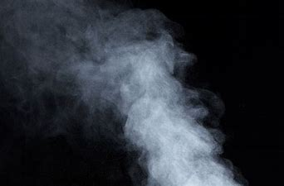
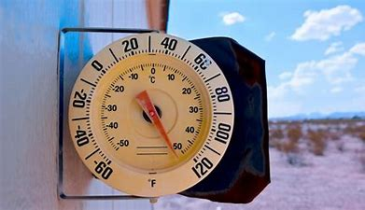
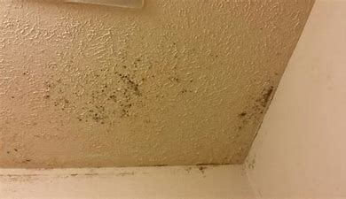
STEAM
HEAT
MOLD

Slide 4
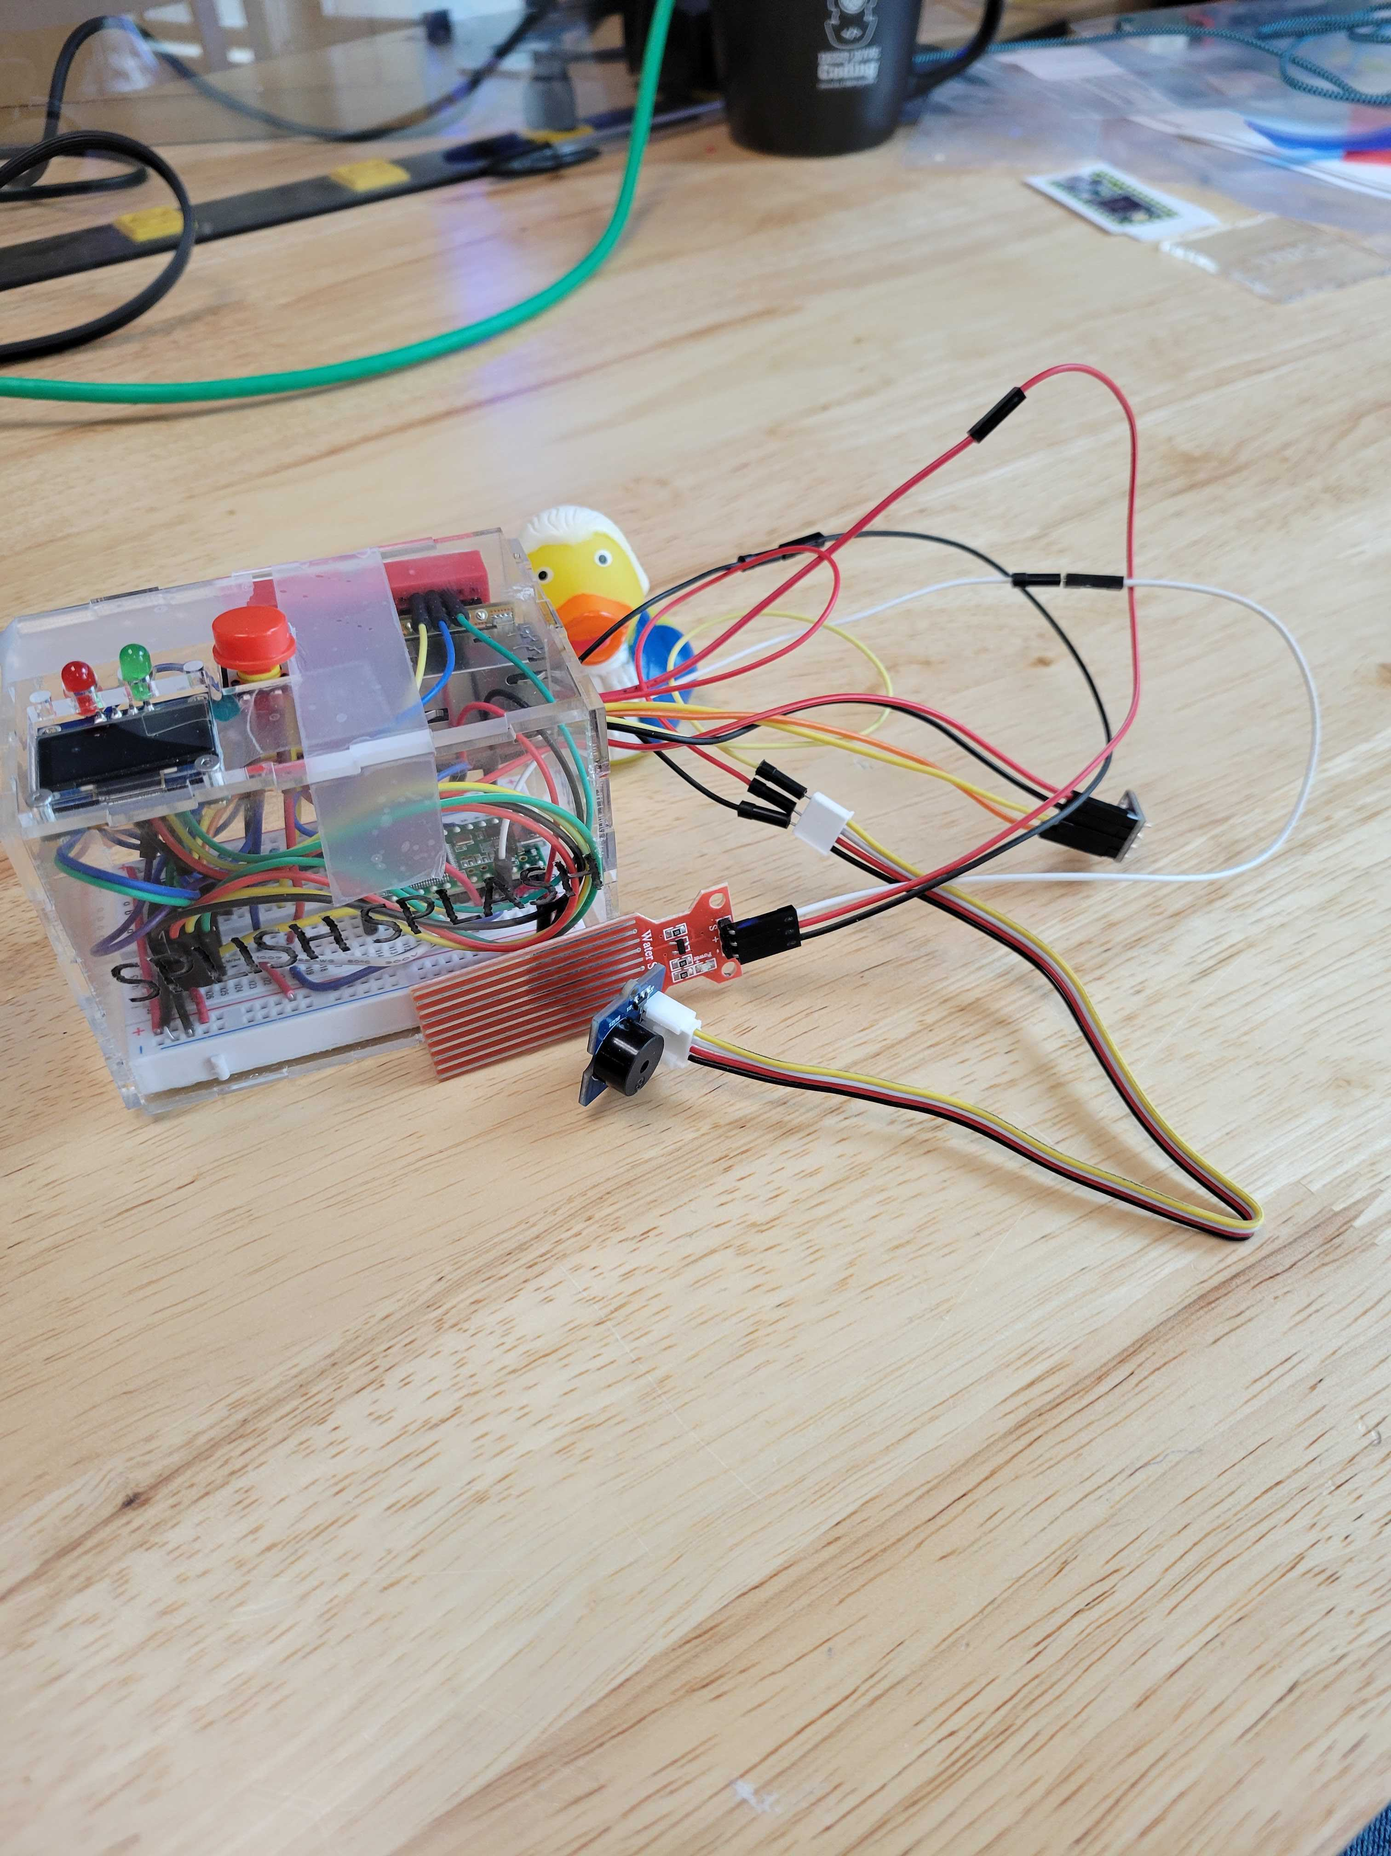

Slide 5

COLD
COOL
COMFORTABLE
WARM
HOT
BETWEEN 40 AND 90 DEGREES

