Slide 2
Build your first knowledge mining solution in a day using Azure AI services
Rodrigo Souza
Daniel Coelho
Sr Applied Data Scientists

Slide 3
This Training
Knowledge Mining Bootcamp
aka.ms/kmb
2 Days
Bot
Content Moderator

Slide 4
Other Resources
Knowledge Mining Workshop
aka.ms/kmw1
4 hours
Web Interface
Will be delivered on Thursday at 10:45 AM

Slide 5
Other Resources
Knowledge Mining Accelerator
aka.ms/kma
PowerShell Deployment
BYOD
Multi-facet Graph
Pre-Deployed demos for Healthcare, Retail, and Oil & Gas
Knowledge Mining Solution Accelerator
aka.ms/kmsolutions
PowerShell Deployment + Postman + Visual Studio
BYOD
Tabular results
To be merged!

Slide 6
This Training - What and How
What will you learn?
Azure Search
Cognitive Search
Azure Functions
Content Moderator
Bot
How will you learn?
Presentation
Hands-On-Lab
Start here
Finish later

Slide 7
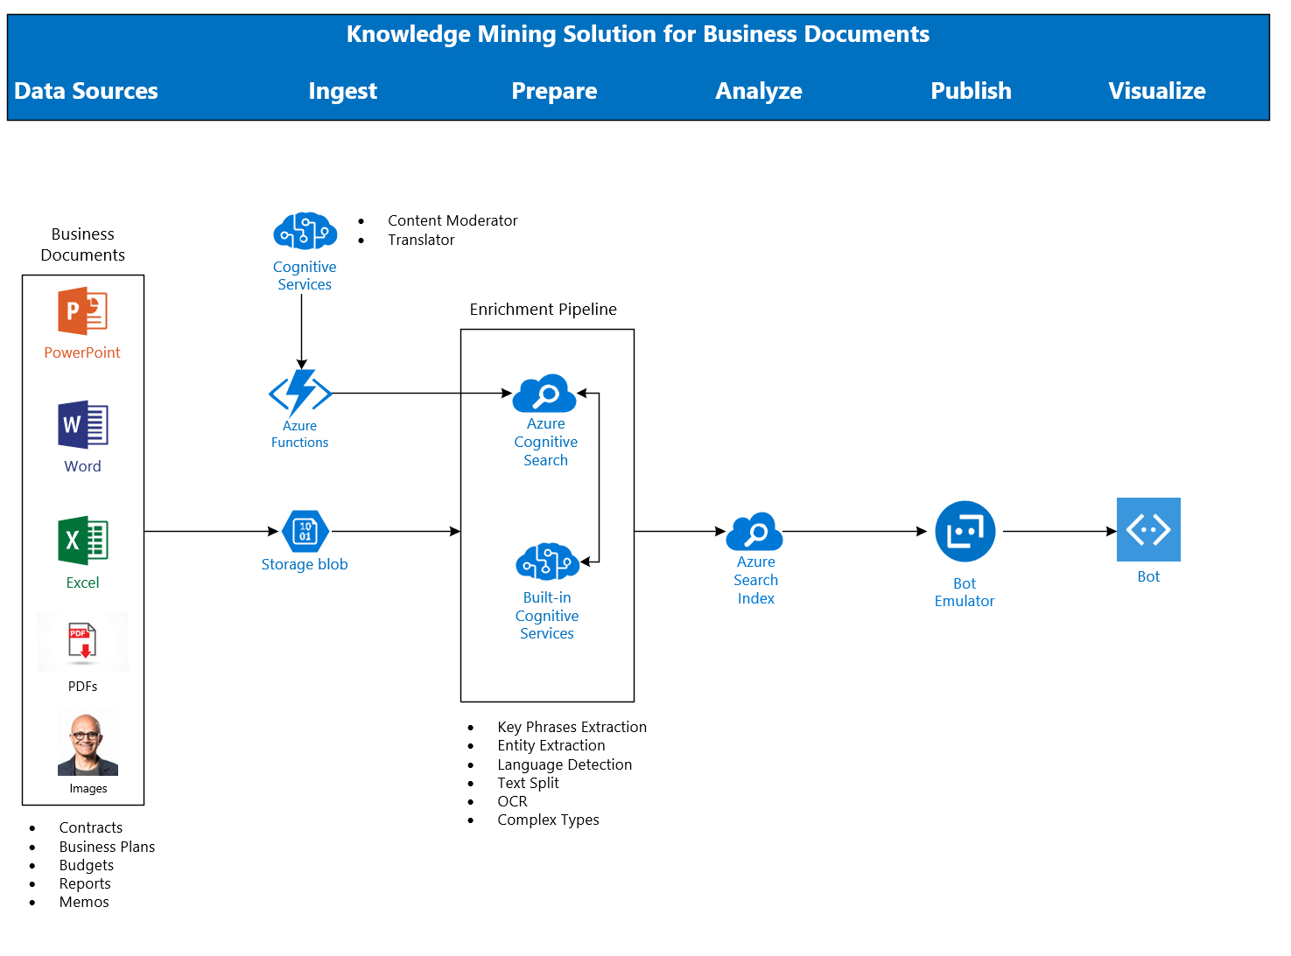
Architecture
Demo!!

Slide 8
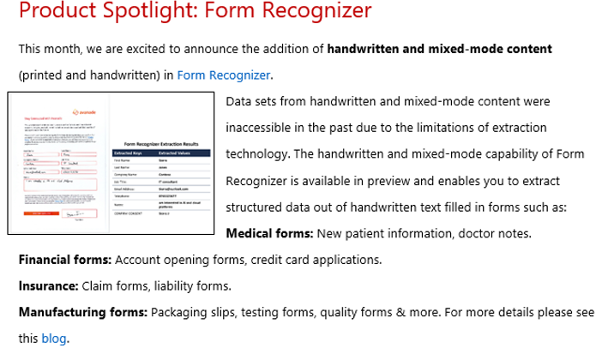

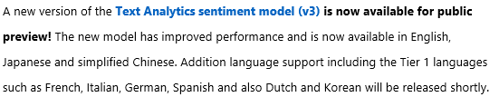
Breaking News

Slide 9
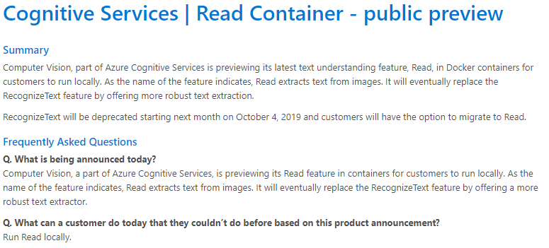
Breaking News!

Slide 10
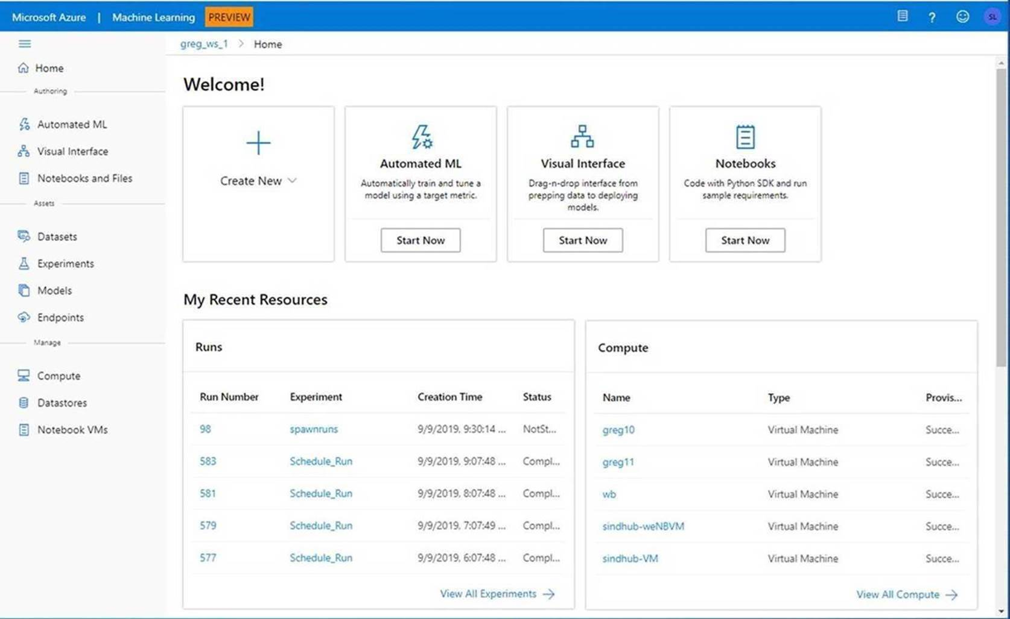
Breaking News!
Announcing the Public Preview of the new Azure Machine Learning Web Experience

Slide 11
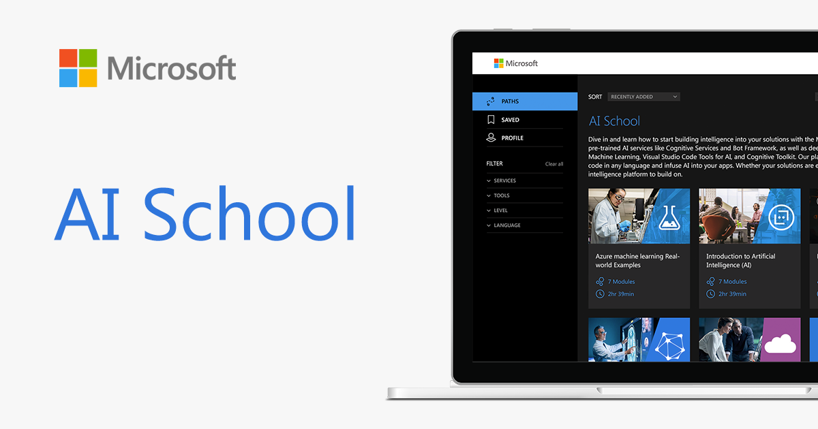
Breaking News!
http://aka.ms/ai-school

Slide 12
Key Links
AutomatedML
Hyperdrive
Azure Machine Learning Documentation
AI on IoT Edge Devices
Azure Cognitive Services
Azure Cognitive Services in Containers
Azure Machine Learning Studio

Slide 13
Key Links – ACE Team
aka.ms/ACE-Blog
aka.ms/kma
aka.ms/kmb

Slide 14
Spektra Environment
Azure Account
DSVM
Storage Account
Azure Search
Cognitive Services

Slide 15
Spektra Environment
http://bit.ly/30twupy
Activation Code = ACTIVATE4208
Confirmation email from noreply@cloudlabs.ai

Slide 16
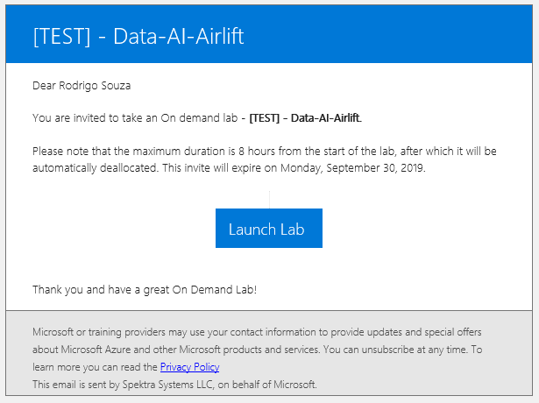
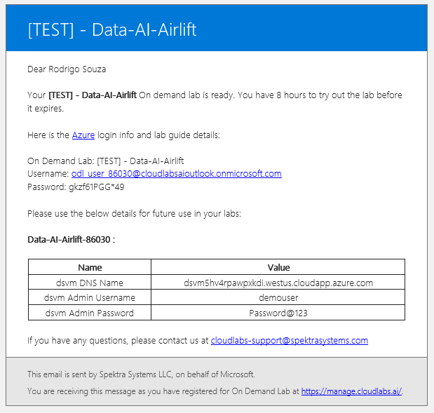
Spektra Environment

Slide 17
Let’s go! aka.ms/kmb

Slide 18
Thank you! Rodrigo Souza rosouz@microsoft.com

