Slide 1
Knowledge Mining with Cognitive Services and Azure Search
Rodrigo Souza
SR Applied Data Scientist
Cloud & AI

Slide 2
This Training aka.ms/kmb

Slide 3
What and How
What will you learn?
Azure Search
Cognitive Search
Azure Functions
Content Moderator
Bot
How will you learn?
Presentation
Hands-On-Lab
Start here
Finish later

Slide 4
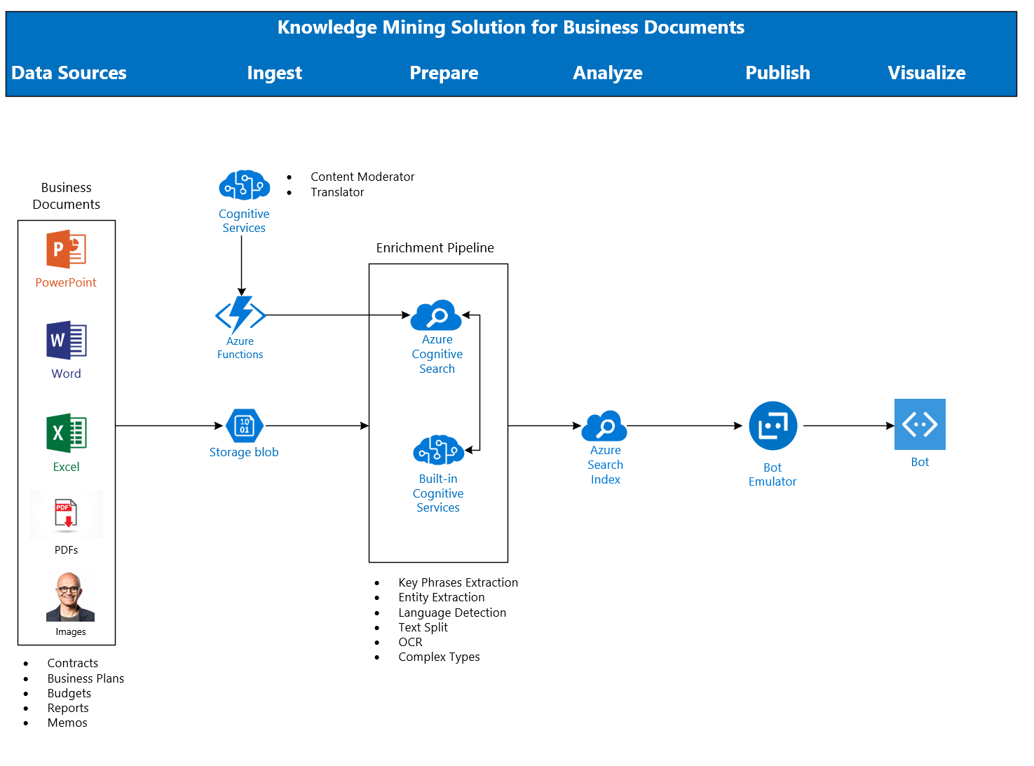
Architecture

Slide 5
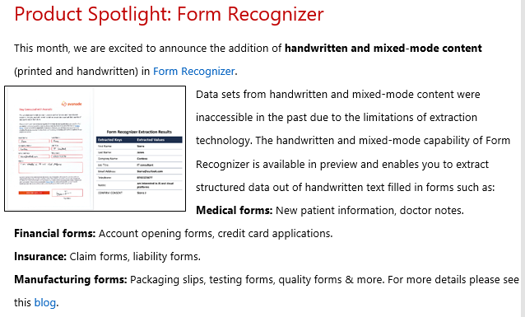

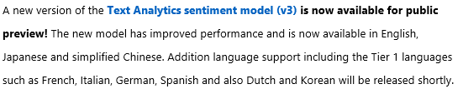
Breaking News!

Slide 6
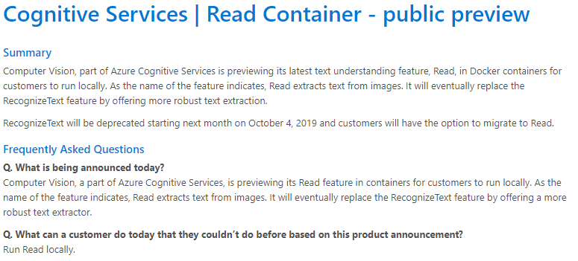
Breaking News!

Slide 7
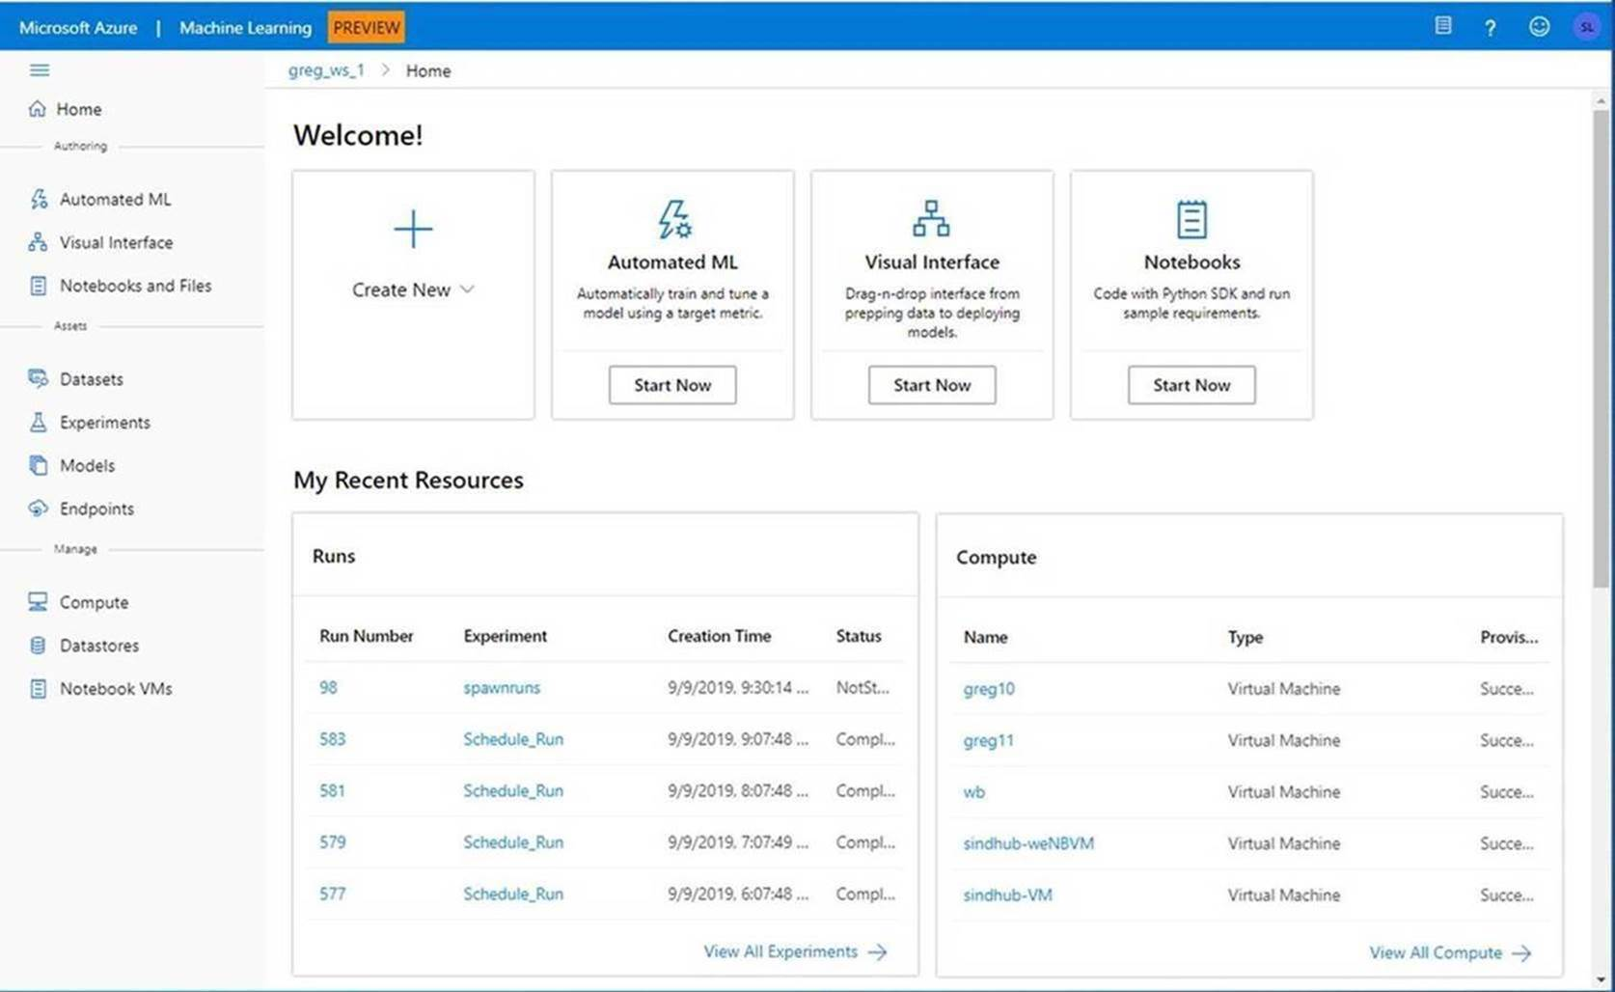
Breaking News!
Announcing the Public Preview of the new Azure Machine Learning Web Experience

Slide 8
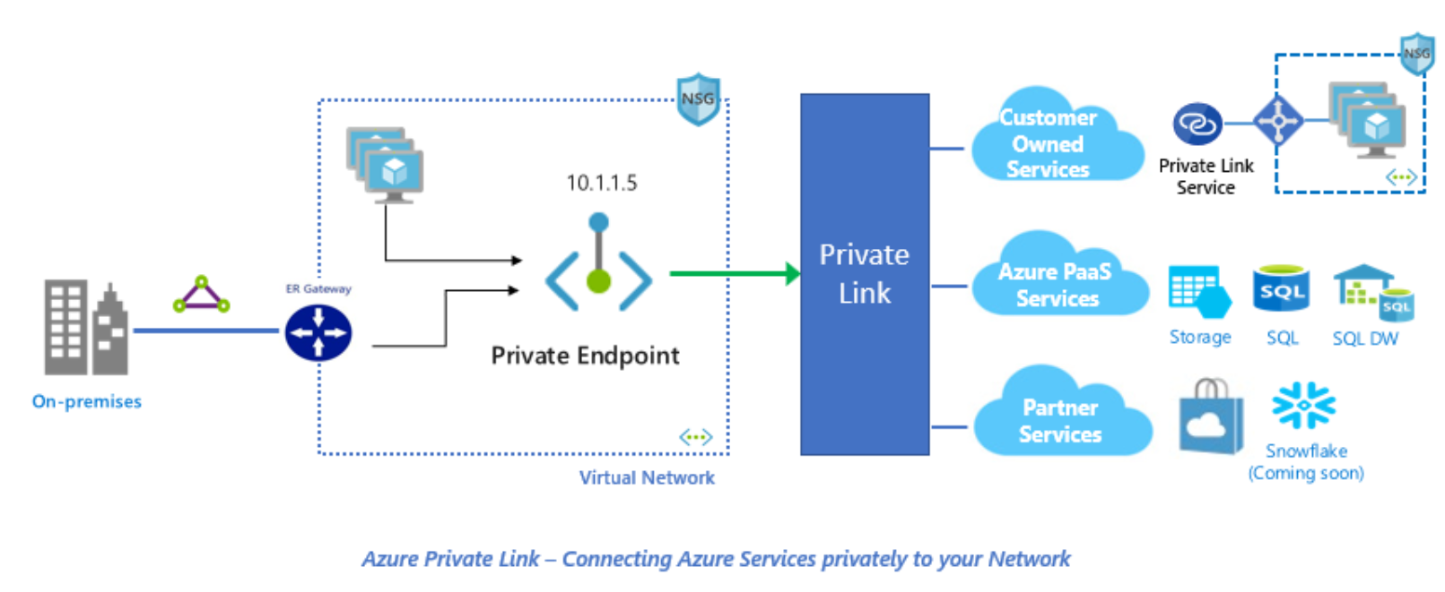
Breaking News!
Announcing Azure Private Link
Azure Private Link is a secure and scalable way for Azure customers to consume Azure Services like Azure Storage or SQL, Microsoft Partner Services or their own services privately from their Azure Virtual Network (VNet).

Slide 9
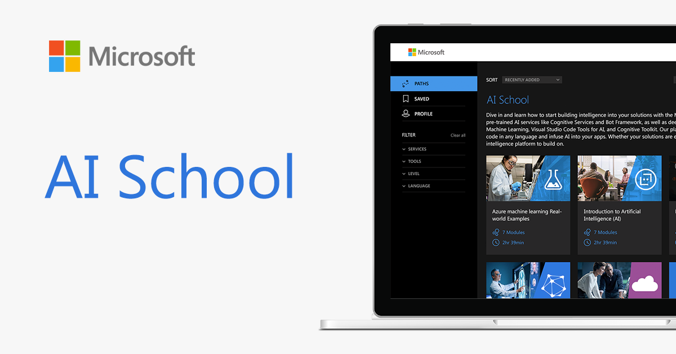
http://aka.ms/ai-school

Slide 10
Key Links
AutomatedML
Hyperdrive
Azure Machine Learning Documentation
ACE Team Blog
KMA
AI on IoT Edge Devices
Azure Cognitive Services
Azure Cognitive Services in Containers
Azure Machine Learning Studio

Slide 11
Spektra Environment
Azure Account
DSVM
Storage Account
Azure Search
Cognitive Services

Slide 12
Spektra Environment
http://bit.ly/30twupy
Activation Code = ACTIVATE4208
Confirmation email from noreply@cloudlabs.ai

Slide 13
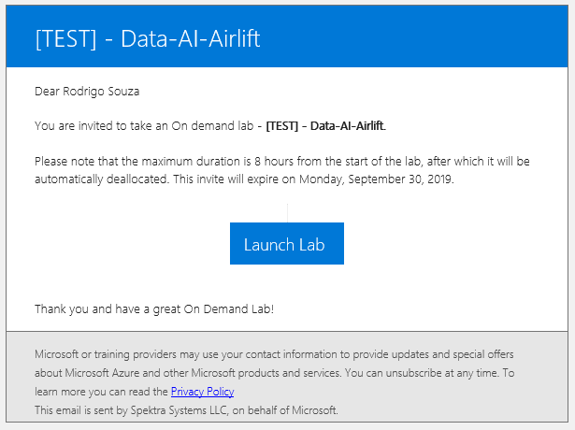
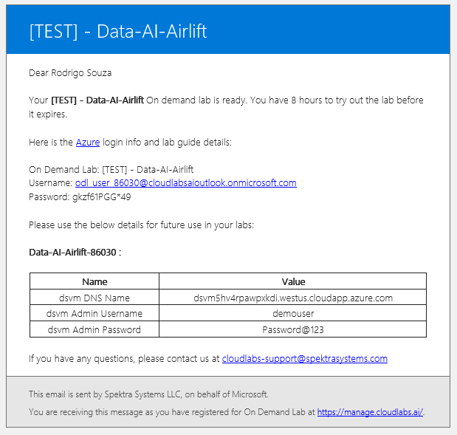
Spektra Environment

Slide 14
Let’s go! aka.ms/kmb

Slide 15
Thank you! Rodrigo Souza rosouz@Microsoft.com

Slide 16
Backup Slides

Slide 17
Tomorrow
Sign the presence sheet
Photo
Demos (including the training bot)
Survey
http://aka.ms/LearnAI-Airlift-Survey

Slide 18
Demos
Forms Understanding
AI Sandbox

Slide 19
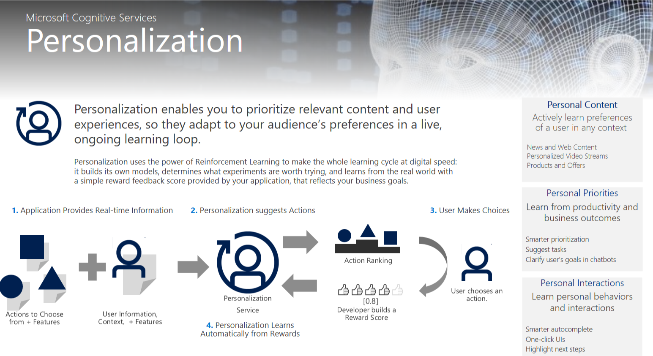
Breaking News

Slide 20
Lunch: 12 – 1 PM
KMB: 1 PM – 6 PM
http://aka.ms/LearnAI-kmb

Slide 21
Links
http://aka.ms/LearnAI-Links
Suggestions, Feedback, Redeliveries
learnai@microsoft.com
rosouz@microsoft.com
Thank you!!

Slide 22
Survey!!
http://aka.ms/LearnAI-Airlift-Survey
Suggestions, Feedback, Redeliveries
learnai@microsoft.com
rosouz@microsoft.com
Thank you!!

Slide 23
Rodrigo Souza
rosouz@micrsosoft.com

Slide 24
Custom Vision URLs
https://docs.microsoft.com/en-gb/azure/cognitive-services/custom-vision-service/getting-started-build-a-classifier
http://customvision.ai

