Slide 1
Knowledge Mining with Cognitive Services and Azure Search
Rodrigo Souza
SR Applied Data Scientist
Cloud & AI – ACE Team

Slide 2
This Training aka.ms/kmb

Slide 3
What and How
What will you learn?
Azure Search
Cognitive Search
Azure Functions
Content Moderator
Bot
How will you learn?
Presentation
Hands-On-Lab
Start here
Finish later

Slide 4
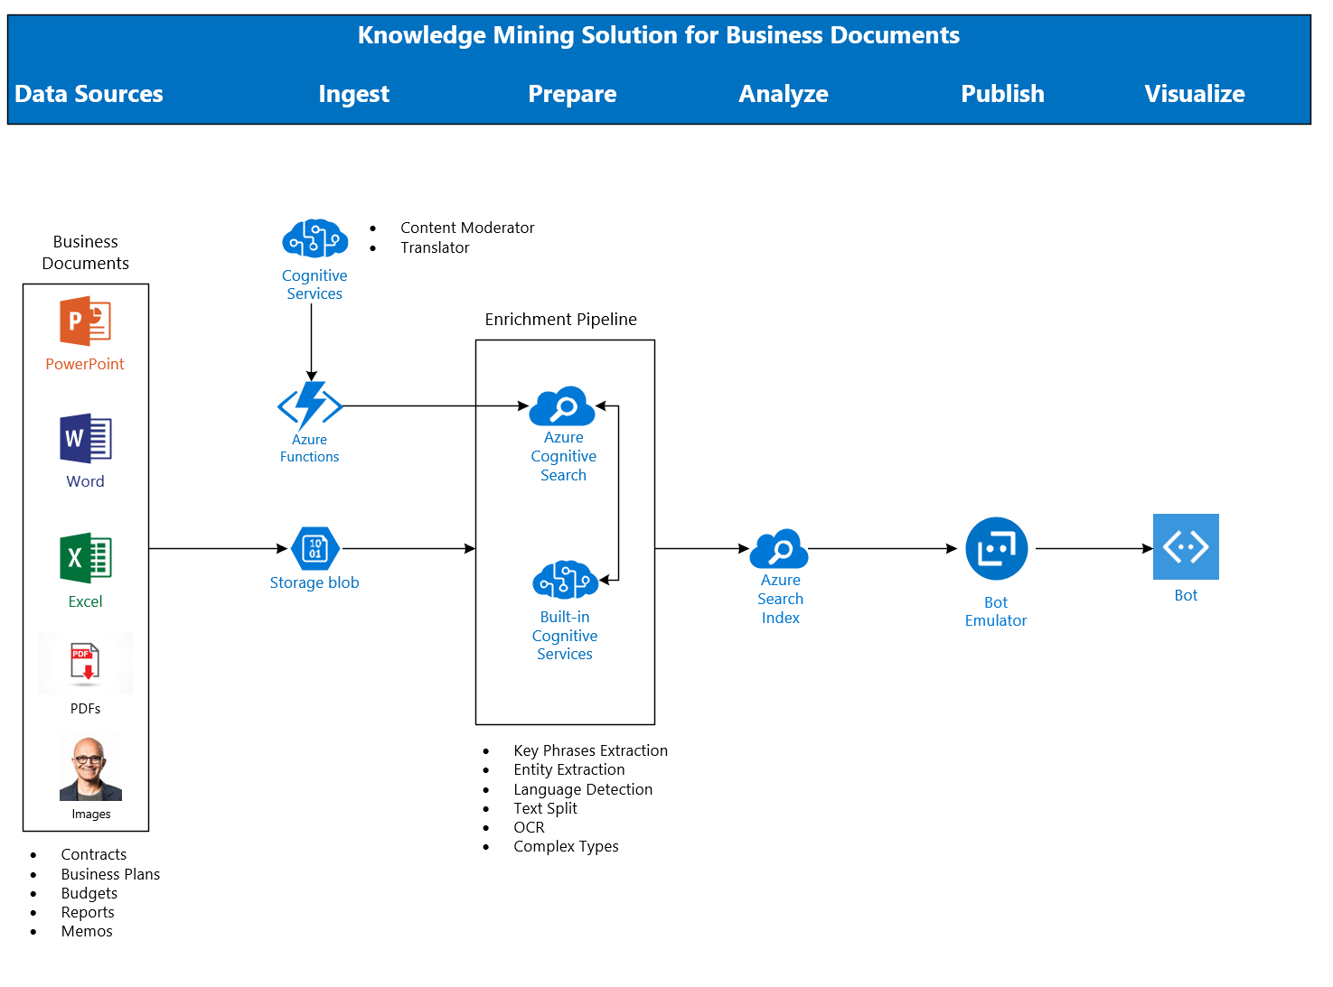
Architecture
Demo!!

Slide 5
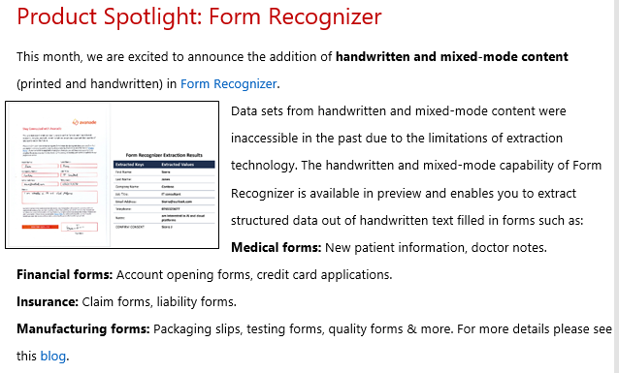

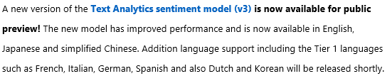
Breaking News!

Slide 6
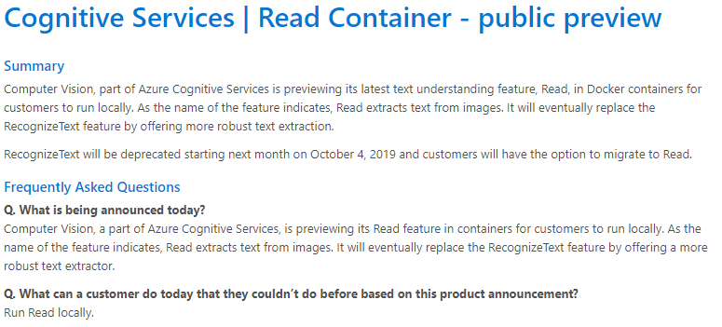
Breaking News!

Slide 7
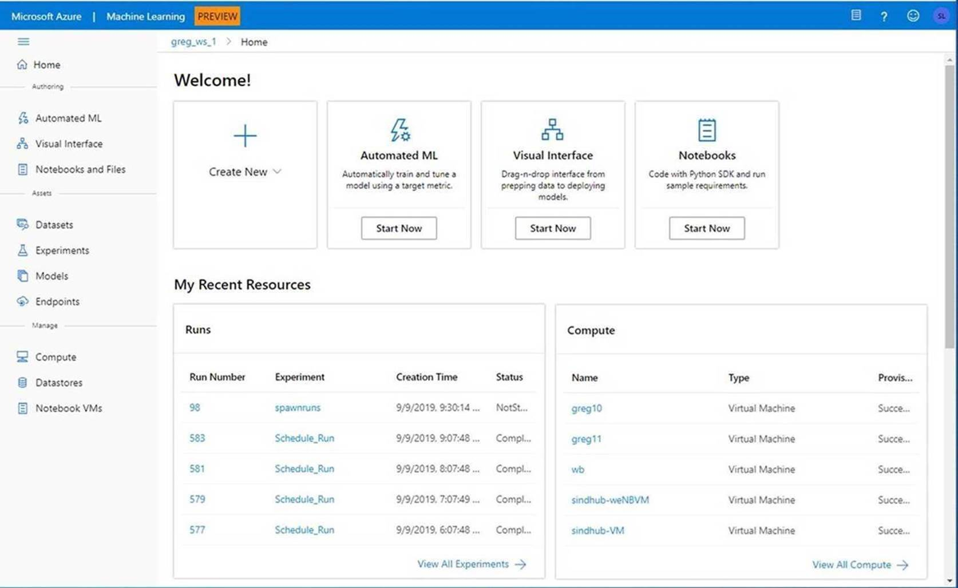
Breaking News!
Announcing the Public Preview of the new Azure Machine Learning Web Experience

Slide 8
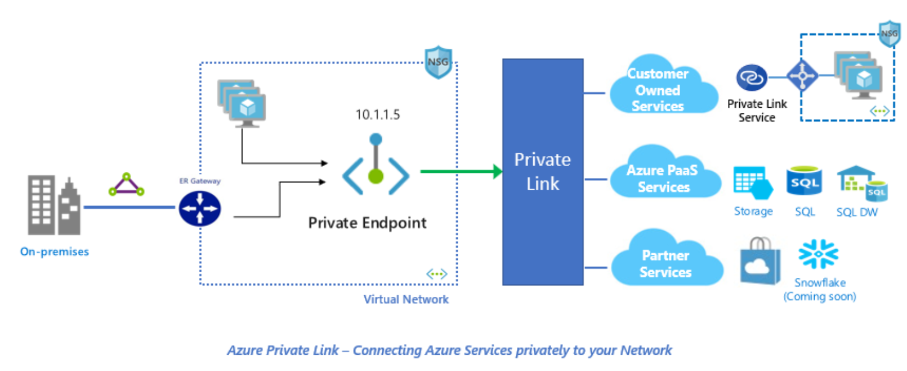
Breaking News!
Announcing Azure Private Link
Azure Private Link is a secure and scalable way for Azure customers to consume Azure Services like Azure Storage or SQL, Microsoft Partner Services or their own services privately from their Azure Virtual Network (VNet).

Slide 9
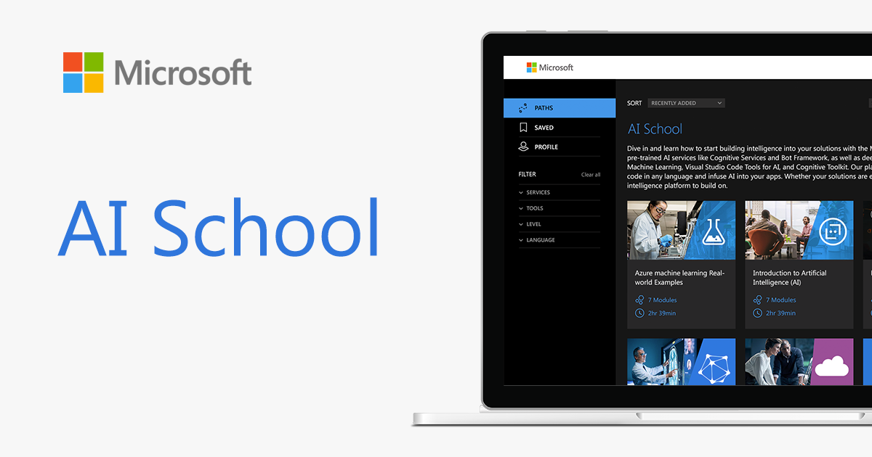
http://aka.ms/ai-school

Slide 10
Key Links
AutomatedML
Hyperdrive
Azure Machine Learning Documentation
AI on IoT Edge Devices
Azure Cognitive Services
Azure Cognitive Services in Containers
Azure Machine Learning Studio

Slide 11
Key Links – ACE Team
aka.ms/ACE-Blog
aka.ms/kma
aka.ms/kmb

Slide 12
Spektra Environment
Azure Account
DSVM
Storage Account
Azure Search
Cognitive Services

Slide 13
Spektra Environment
http://bit.ly/30twupy
Activation Code = ACTIVATE4208
Confirmation email from noreply@cloudlabs.ai

Slide 14
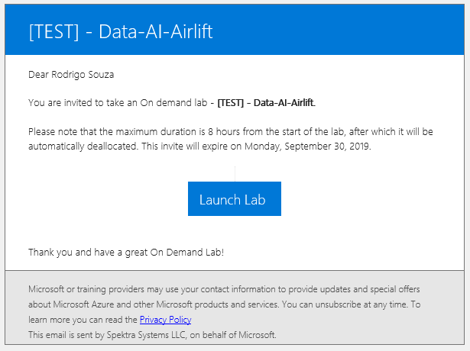
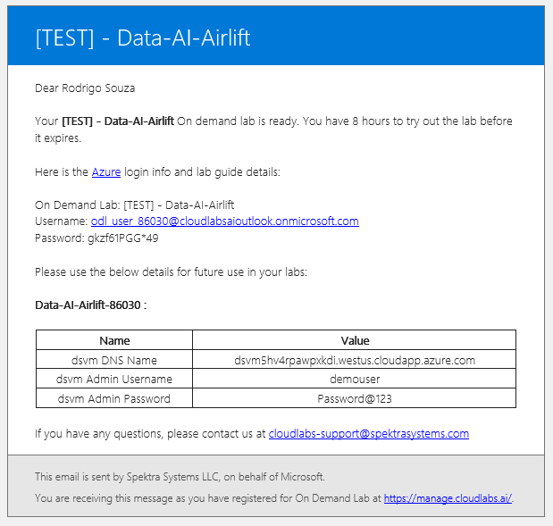
Spektra Environment

Slide 15
Let’s go! aka.ms/kmb

Slide 16
Thank you! Aka.ms/kmb aka.ms/kma Rodrigo Souza rosouz@Microsoft.com

