Slide 1
XML Method Modifications for Tune 2.0
2016-03-11
Derek J. Bailey, Ph.D.
Notes:
This is the default title slide for Thermo Fisher Scientific
Title photo options specific to end-markets will be available via commercial overview presentations due for release 2015-2016

Slide 2
Summary
Method Modifications
Goals
Edit and modify TNG method files without installing full software
Provide a way to programmatically modify TNG method files
Provide command-line tool to modify methods without needing to program
Implementation
Provided ‘workstation’ installer to be able to use the Method Editor independently from insturment
Method Modification Workflow
Create template TNG method file using standard Method Editor
Describe modifications using XML file
Validate XML against schema
Generate a new TNG method file with applied modifications
Notes:
To create a new presentation
Double-click or Open from PowerPoint > [xxxtemplate].potx file.
Start building in this template and save as a new presentation.
Avoid copy & paste or drag & drop of slides from other presentations in different templates. This often can cause master template conflicts and increased file sizes. Instead…
To leverage content from other presentations, (1) select just the content on a slide that you need (2) copy & paste into a [blank] slide in this template (3) Control pasted content appearance via the paste options button that appears immediately after a paste action and which provides the option to choose either “use destination formatting” or “maintain source formatting” of pasted content.
Applying New Template Theme to an Existing Presentation :
From the Design Tab in the ribbon, click on the “more” drop down arrow at the right of the theme ribbon
Select “Browse for Themes…”
Navigate to and select [xxxtemplate].potx file and click Apply
This will apply new Template Theme colors, fonts and layouts but will not include any of the content on the slide examples from the full template itself.
Reposition content and reapply or change layouts as needed.
Additional resources available on iConnect > Functions > Marketing > Resource Library

Slide 3
Workstation Installers
Client Installers
Two types of installers per instrument model
Full
Intended for use with a connected instrument
Can only install one ‘Full’ model per computer
Workstation
Intended for use apart from a connected instrument (laptop, server, etc..)
Provides Method editing and viewing capabilities
Launch from: C:\Thermo\Instruments\TNG\<Instrument Model>\<Instrument Version>\System\programs\TNGMethodEditor.exe
Multiple workstations can be installed at the same time
Cannot install ‘Workstation’ and ‘Full’ for the same instrument model
Can install ‘Full’ and different models of ‘Workstations’
Notes:
To create a new presentation
Double-click or Open from PowerPoint > [xxxtemplate].potx file.
Start building in this template and save as a new presentation.
Avoid copy & paste or drag & drop of slides from other presentations in different templates. This often can cause master template conflicts and increased file sizes. Instead…
To leverage content from other presentations, (1) select just the content on a slide that you need (2) copy & paste into a [blank] slide in this template (3) Control pasted content appearance via the paste options button that appears immediately after a paste action and which provides the option to choose either “use destination formatting” or “maintain source formatting” of pasted content.
Applying New Template Theme to an Existing Presentation :
From the Design Tab in the ribbon, click on the “more” drop down arrow at the right of the theme ribbon
Select “Browse for Themes…”
Navigate to and select [xxxtemplate].potx file and click Apply
This will apply new Template Theme colors, fonts and layouts but will not include any of the content on the slide examples from the full template itself.
Reposition content and reapply or change layouts as needed.
Additional resources available on iConnect > Functions > Marketing > Resource Library

Slide 4
Method Modification Requirements
Required Files
Two .NET assemblies
Thermo.TNG.MethodXMLInterface.dll
IMethodXML.cs (interface for .xml/.meth manipulation)
Exception Classes (MethodXMLException.cs, MethodXMLValidationException.cs)
Thermo.TNG.MethodXMLFactory.dll
MethodXMLFactory.cs (factory for creating IMethodXML object based on installed platforms)
Comes installed with Tune 1.2 and higher
C:\Thermo\Instruments\TNG\<Instrument Model>\<Instrument Version>\System\programs\
Both the ‘Full’ and ‘Workstation’ installers contain the assemblies
XML Schema (XSDs)
Provided independently from TNG installer (email: derek.bailey@thermofisher.com)
Used to validate XML before modifying methods
Notes:
To create a new presentation
Double-click or Open from PowerPoint > [xxxtemplate].potx file.
Start building in this template and save as a new presentation.
Avoid copy & paste or drag & drop of slides from other presentations in different templates. This often can cause master template conflicts and increased file sizes. Instead…
To leverage content from other presentations, (1) select just the content on a slide that you need (2) copy & paste into a [blank] slide in this template (3) Control pasted content appearance via the paste options button that appears immediately after a paste action and which provides the option to choose either “use destination formatting” or “maintain source formatting” of pasted content.
Applying New Template Theme to an Existing Presentation :
From the Design Tab in the ribbon, click on the “more” drop down arrow at the right of the theme ribbon
Select “Browse for Themes…”
Navigate to and select [xxxtemplate].potx file and click Apply
This will apply new Template Theme colors, fonts and layouts but will not include any of the content on the slide examples from the full template itself.
Reposition content and reapply or change layouts as needed.
Additional resources available on iConnect > Functions > Marketing > Resource Library

Slide 5
Method Modification Requirements
XSD Schema
Fusion/Lumos (MethodModifications.xsd)
Located in xsds\Calcium\<version>\
Can only modify existing TNG methods, cannot build complete method from scratch
Only certain subset of parameters can be modified at this time
Quantiva/Endura (HyperionMethod.xsd)
Located in xsds\Hyperion\<version>\
References other dependent .xsd in same directory
Can be used to modify and create TNG methods from scratch.
XSD files are versioned against the TNG methods they modify.
XSD files describe the available things that can be modified in the method
Additional requests of parameters to be able to change should be directed to derek.bailey@thermofisher.com
Notes:
To create a new presentation
Double-click or Open from PowerPoint > [xxxtemplate].potx file.
Start building in this template and save as a new presentation.
Avoid copy & paste or drag & drop of slides from other presentations in different templates. This often can cause master template conflicts and increased file sizes. Instead…
To leverage content from other presentations, (1) select just the content on a slide that you need (2) copy & paste into a [blank] slide in this template (3) Control pasted content appearance via the paste options button that appears immediately after a paste action and which provides the option to choose either “use destination formatting” or “maintain source formatting” of pasted content.
Applying New Template Theme to an Existing Presentation :
From the Design Tab in the ribbon, click on the “more” drop down arrow at the right of the theme ribbon
Select “Browse for Themes…”
Navigate to and select [xxxtemplate].potx file and click Apply
This will apply new Template Theme colors, fonts and layouts but will not include any of the content on the slide examples from the full template itself.
Reposition content and reapply or change layouts as needed.
Additional resources available on iConnect > Functions > Marketing > Resource Library

Slide 6
Method Modification Examples
Example Command Line Program
XmlMethodChanger.exe
C# .NET Solution (XmlMethodChanger.sln)
Two Projects
XmlMethodChanger.lib
Class library that wraps the two Thermo.TNG.*.dll assemblies
Most of the code is commented
XmlMethodChanger.cmd
Command-line program that uses the XmlMethodChanger.lib project to manipulate method files
Uses third-party NuGet package (Command Line Parser Library)
Can be used as-is to modify methods
Or can serve as an example of the API and how to use it
Notes:
To create a new presentation
Double-click or Open from PowerPoint > [xxxtemplate].potx file.
Start building in this template and save as a new presentation.
Avoid copy & paste or drag & drop of slides from other presentations in different templates. This often can cause master template conflicts and increased file sizes. Instead…
To leverage content from other presentations, (1) select just the content on a slide that you need (2) copy & paste into a [blank] slide in this template (3) Control pasted content appearance via the paste options button that appears immediately after a paste action and which provides the option to choose either “use destination formatting” or “maintain source formatting” of pasted content.
Applying New Template Theme to an Existing Presentation :
From the Design Tab in the ribbon, click on the “more” drop down arrow at the right of the theme ribbon
Select “Browse for Themes…”
Navigate to and select [xxxtemplate].potx file and click Apply
This will apply new Template Theme colors, fonts and layouts but will not include any of the content on the slide examples from the full template itself.
Reposition content and reapply or change layouts as needed.
Additional resources available on iConnect > Functions > Marketing > Resource Library

Slide 7
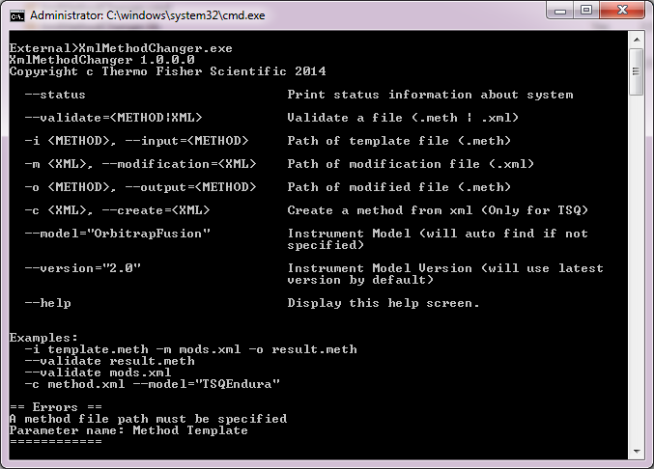
Method Modification Examples
Example Command Line Program
XmlMethodChanger.exe
Help screen show options and usage
Notes:
To create a new presentation
Double-click or Open from PowerPoint > [xxxtemplate].potx file.
Start building in this template and save as a new presentation.
Avoid copy & paste or drag & drop of slides from other presentations in different templates. This often can cause master template conflicts and increased file sizes. Instead…
To leverage content from other presentations, (1) select just the content on a slide that you need (2) copy & paste into a [blank] slide in this template (3) Control pasted content appearance via the paste options button that appears immediately after a paste action and which provides the option to choose either “use destination formatting” or “maintain source formatting” of pasted content.
Applying New Template Theme to an Existing Presentation :
From the Design Tab in the ribbon, click on the “more” drop down arrow at the right of the theme ribbon
Select “Browse for Themes…”
Navigate to and select [xxxtemplate].potx file and click Apply
This will apply new Template Theme colors, fonts and layouts but will not include any of the content on the slide examples from the full template itself.
Reposition content and reapply or change layouts as needed.
Additional resources available on iConnect > Functions > Marketing > Resource Library

Slide 8
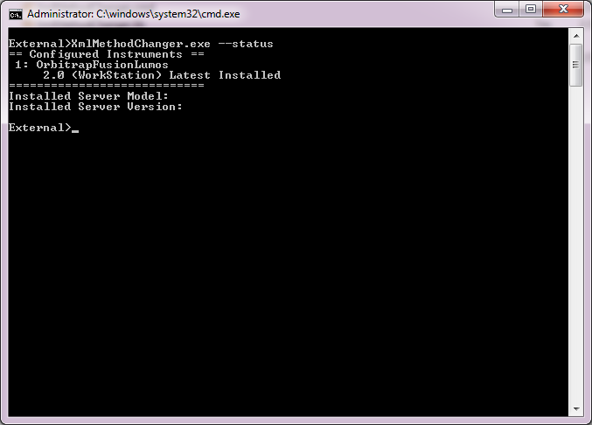
Method Modification Examples
Example Command Line Program
XmlMethodChanger.exe --status
Shows the configured instruments available
Notes:
To create a new presentation
Double-click or Open from PowerPoint > [xxxtemplate].potx file.
Start building in this template and save as a new presentation.
Avoid copy & paste or drag & drop of slides from other presentations in different templates. This often can cause master template conflicts and increased file sizes. Instead…
To leverage content from other presentations, (1) select just the content on a slide that you need (2) copy & paste into a [blank] slide in this template (3) Control pasted content appearance via the paste options button that appears immediately after a paste action and which provides the option to choose either “use destination formatting” or “maintain source formatting” of pasted content.
Applying New Template Theme to an Existing Presentation :
From the Design Tab in the ribbon, click on the “more” drop down arrow at the right of the theme ribbon
Select “Browse for Themes…”
Navigate to and select [xxxtemplate].potx file and click Apply
This will apply new Template Theme colors, fonts and layouts but will not include any of the content on the slide examples from the full template itself.
Reposition content and reapply or change layouts as needed.
Additional resources available on iConnect > Functions > Marketing > Resource Library

Slide 9
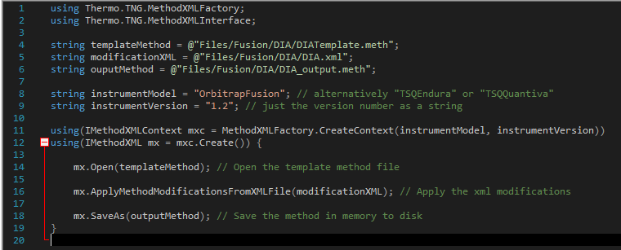
Method Modification Examples
Code Example
Complete code example in C#
See XmlMethodChanger.lib\MethodChanger.cs for complete example code
Notes:
To create a new presentation
Double-click or Open from PowerPoint > [xxxtemplate].potx file.
Start building in this template and save as a new presentation.
Avoid copy & paste or drag & drop of slides from other presentations in different templates. This often can cause master template conflicts and increased file sizes. Instead…
To leverage content from other presentations, (1) select just the content on a slide that you need (2) copy & paste into a [blank] slide in this template (3) Control pasted content appearance via the paste options button that appears immediately after a paste action and which provides the option to choose either “use destination formatting” or “maintain source formatting” of pasted content.
Applying New Template Theme to an Existing Presentation :
From the Design Tab in the ribbon, click on the “more” drop down arrow at the right of the theme ribbon
Select “Browse for Themes…”
Navigate to and select [xxxtemplate].potx file and click Apply
This will apply new Template Theme colors, fonts and layouts but will not include any of the content on the slide examples from the full template itself.
Reposition content and reapply or change layouts as needed.
Additional resources available on iConnect > Functions > Marketing > Resource Library

Slide 10
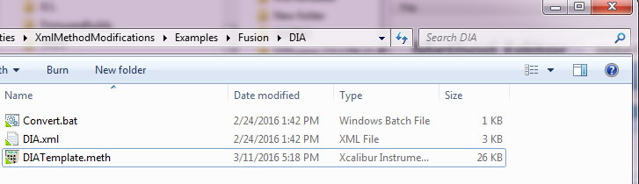
Complete Example
Examples\Fusion\DIA
Example Files
Convert.bat
Simple batch file that runs XmlMethodChanger.exe on the other files
DIATemplate.meth
2.0 Method with 2 experiments. One Full scan the other a tMS²
DIA.xml
Modifications to apply to the DIATemplate.meth

Slide 11
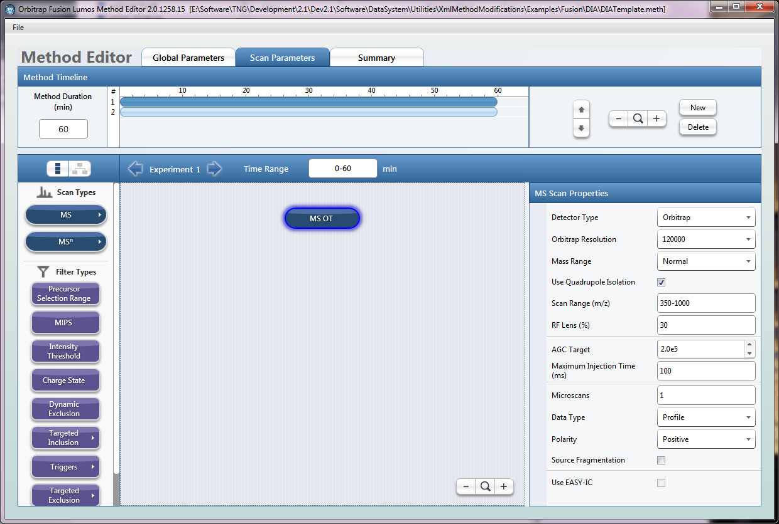
Complete Example
DIATemplate.meth
First experiment MS1 OT. Scan range 350-1000

Slide 12
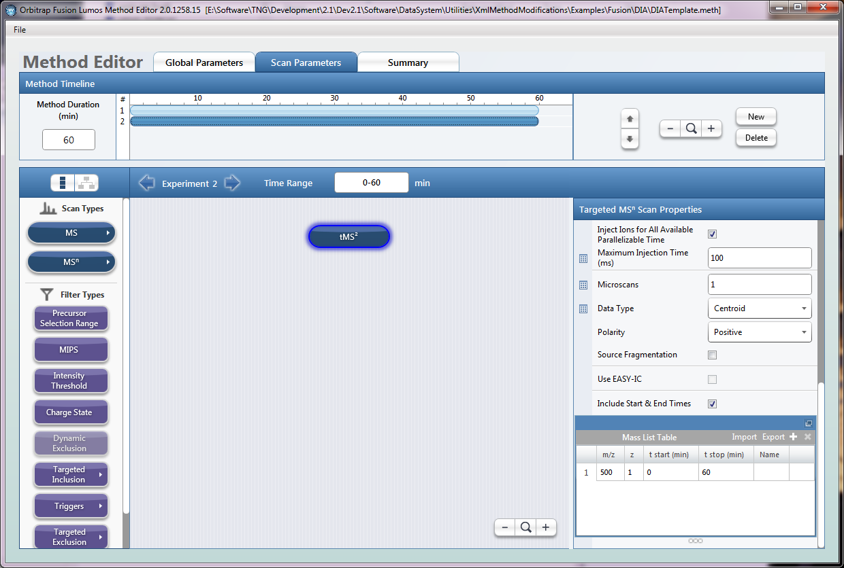
Complete Example
DIATemplate.meth
Second experiment tMS² Target List = 500 m/z

Slide 13
Complete Example
DIA.xml
Please see file on disk for actual contents, I will just describe the actions here
First modification
Change the Full Scan Range of experiment 0* (1st experiment) to 490 to 910
Change the isolation window of the tMS² (experiment 1) to 20
Second modification
Copy experiment 0 and append it to the end (new experiment 2)
Third Modification
Copy experiment 1 and append it to the end (new experiment 3)
Fourth Modification
Add three masses (510.4819, 530.491, and 550.5001) to experiment 1 mass list table
Add three masses (610.4819, 630.491, and 650.5001) to experiment 3 mass list table
Modify various scan parameters of experiment 3 tMS² node
* Experiments are index by 0, so experiment 0 is the 1st experiment in the method

Slide 14
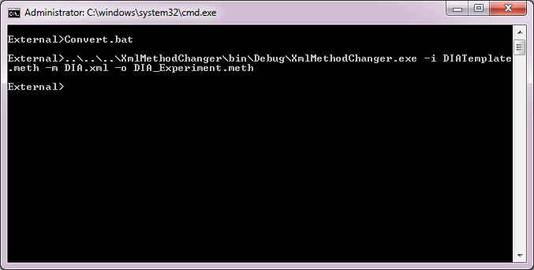
Complete Example
Convert.bat
Run the Convert.bat script
Can either double click in Windows, or run from command prompt:

Slide 15
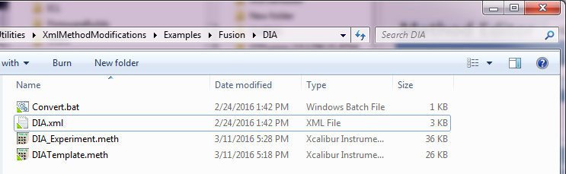
Complete Example
Examples\Fusion\DIA
Generated method file appears in folder:
DIA_Experiment.meth

Slide 16
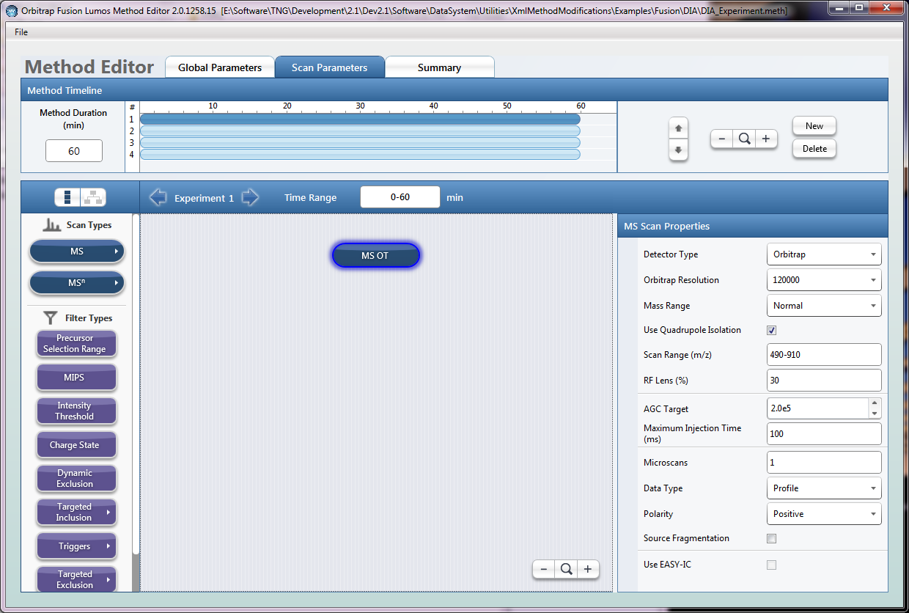
Complete Example
DIA_Experiment.meth
4 Experiments now appear
First one is still MS OT, but scan range is now modified to 490-910

Slide 17
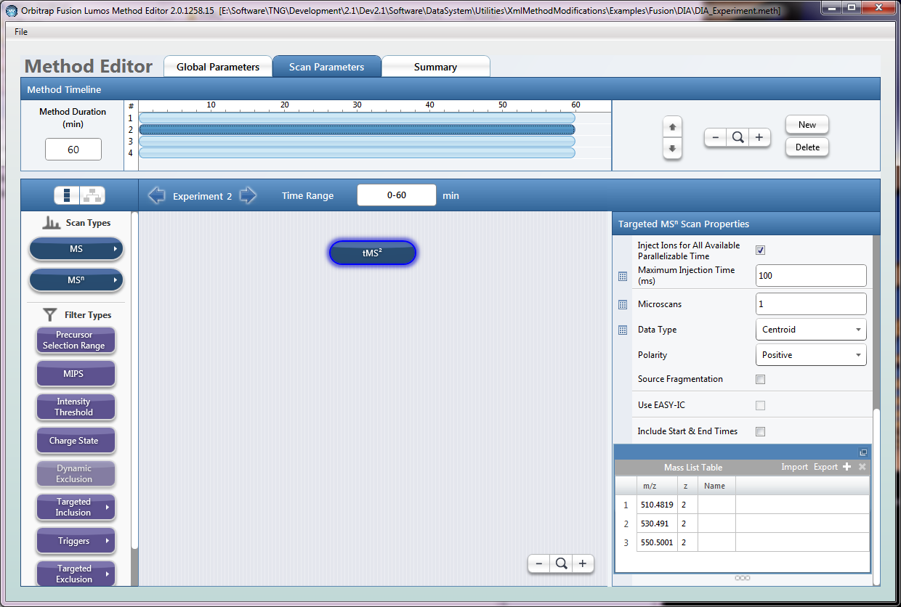
Complete Example
DIA_Experiment.meth
2 Experiment is tMS² but now has the filled in mass list table

Slide 18
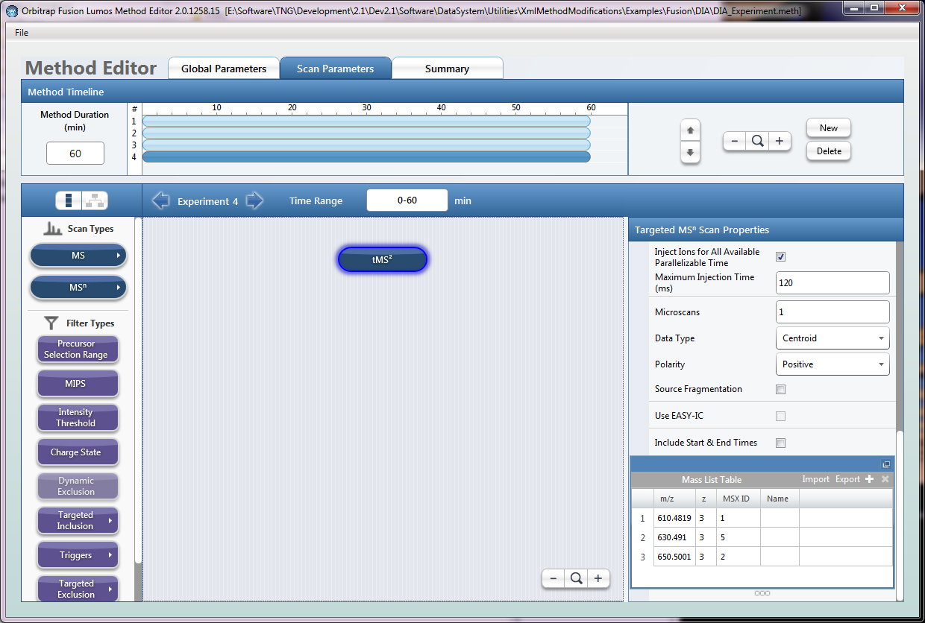
Complete Example
DIA_Experiment.meth
Skipping to experiment 4, we see new tMS² experiment with different mass list items

