Slide 1

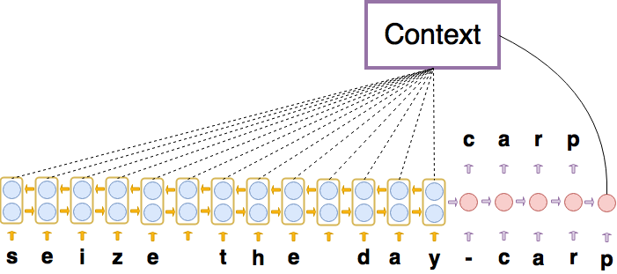
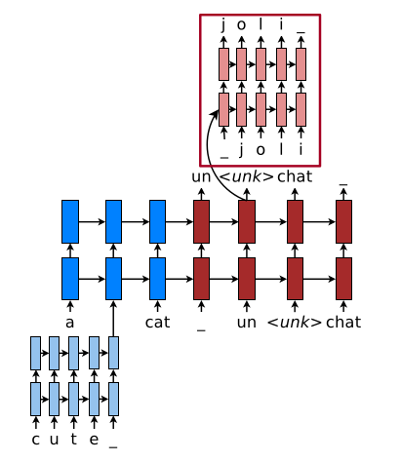
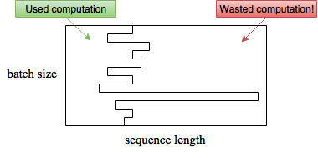
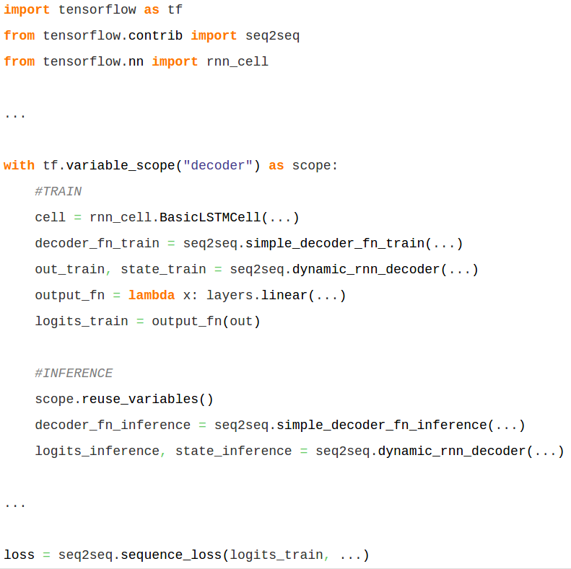
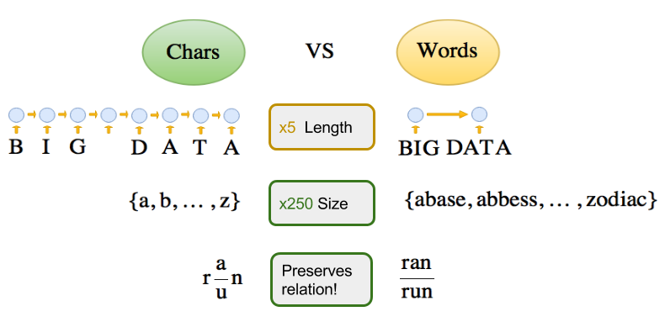
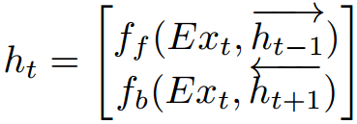
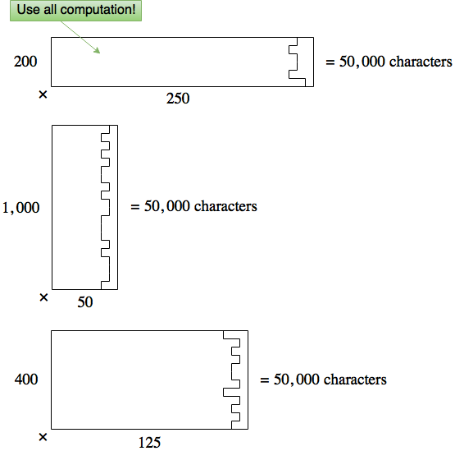
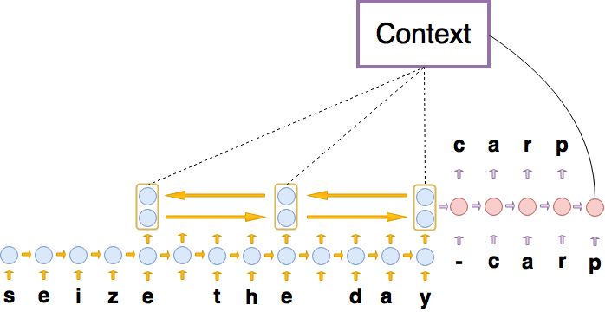
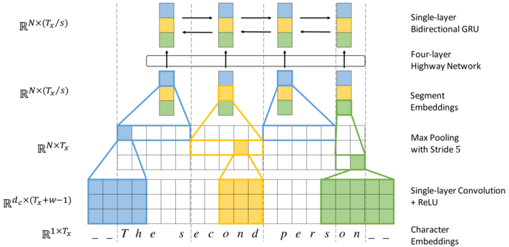

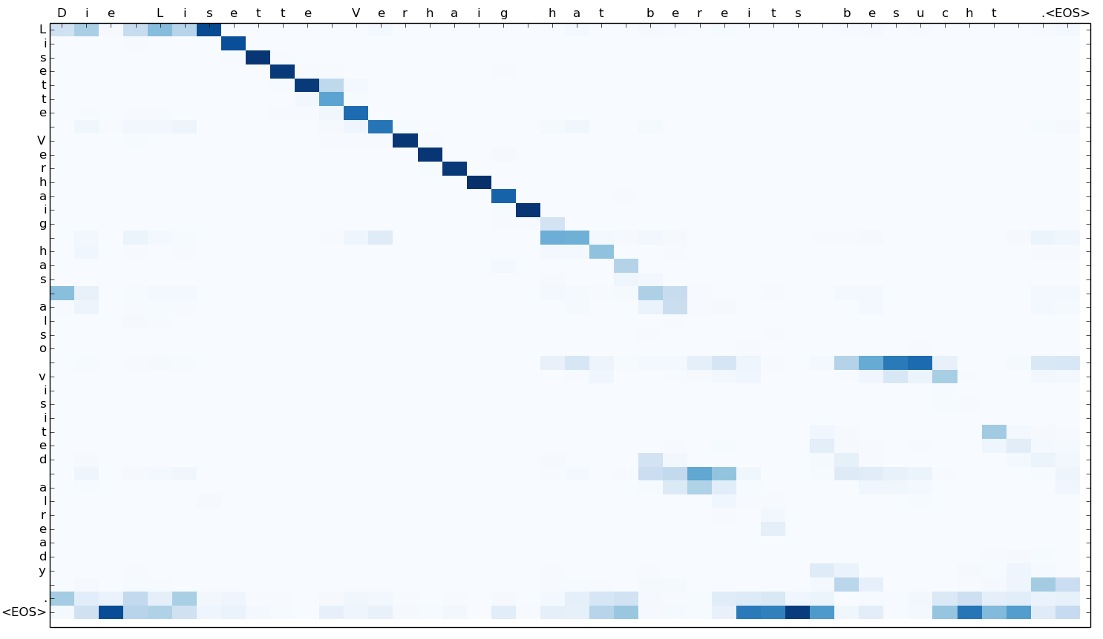
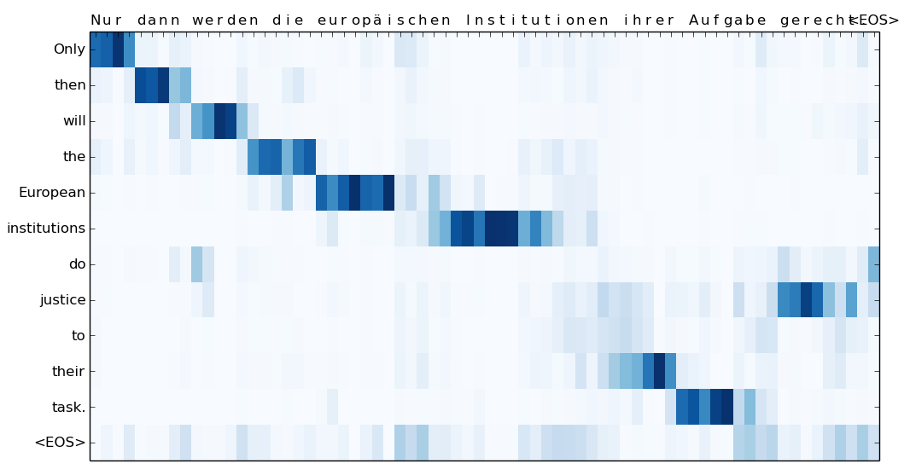
Neural Machine Translation with Characters and Hierarchical Encoding
Alexander Rosenberg Johansen, Jonas Meinertz Hansen, Elias Khazen Obeid, Casper Kaae Sønderby, Ole Winther DTU Compute, Technical University of Denmark Bioinformatics Centre, University of Copenhagen
Introduction
Model
Computation
Related Models
Neural machine translation (NMT) uses deep learning to achieve State-Of-The-Art for translation. However, most published NMT uses word-level encodings^{1,2}
char-to-char
Normal batching
Merged to TensorFlow!
Hybrid Word-Character⁶
³
Dynamic batching⁵
Is a RNN memory Cell⁴
char2word-to-char
Character Segmentation⁷
Key contributions:
Char2Word encoder mechanism
Char-to-char seq2seq interpretation
Dynamic Batching
Results - Qualitative
Replaces
Results - Quantitative
char-to-char attention plot
char2word-to-char attention plot
Model | Language | newstest2015
char-to-char | En-De | 15.14 BLEU
char2word-to-char | En-De | 17.43 BLEU
Char-level
References
Word-level
[1] Dzmitry Bahdanau, Kyunghyun Cho, and Yoshua Bengio. Neural machine translation by jointly learning to align and translate. CoRR, 2014.
[2] Ilya Sutskever, Oriol Vinyals, and Quoc V. Le. Sequence to sequence learning with neural networks. CoRR, 2014.
[3] M. Schuster and K.K. Paliwal. Bidirectional recurrent neural networks. Trans. Sig. Proc., 45(11):2673–2681, November 1997.
[4] Sepp Hochreiter and Jürgen Schmidhuber. Long short-term memory. Neural Comput., 9(8):1735–1780, November 1997.
[5] A. Y. Hannun, C. Case, J. Casper, B. Catanzaro, G. Diamos, E. Elsen, R. Prenger, S. Satheesh, S. Sengupta, A. Coates, and A. Y. Ng. Deep speech: Scaling up end-to-end speech recognition. CoRR, 2014.
[6] Minh-Thang Luong and Christopher D. Manning. Achieving open vocabulary neural machine translation with hybrid word-character models. CoRR, 2016.
[7] Jason Lee, Kyunghyun cho, Thomas Hofman. Fully Character-Level Neural Machine Translation without Explicit Segmentation. CoRR, 2016.
Notes:
‹#›

