Slide 1

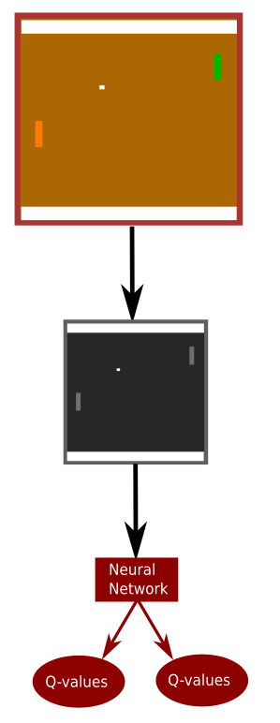

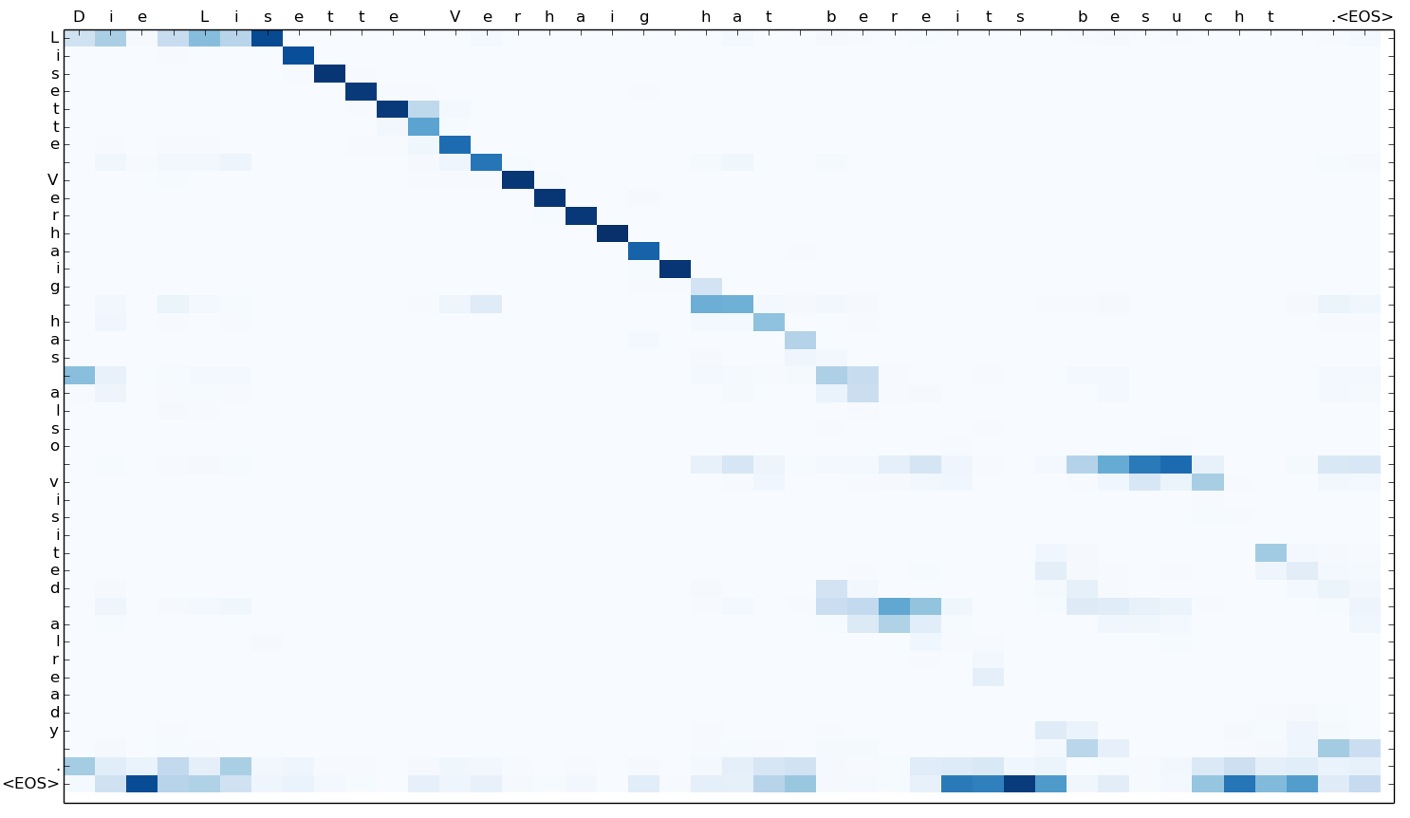
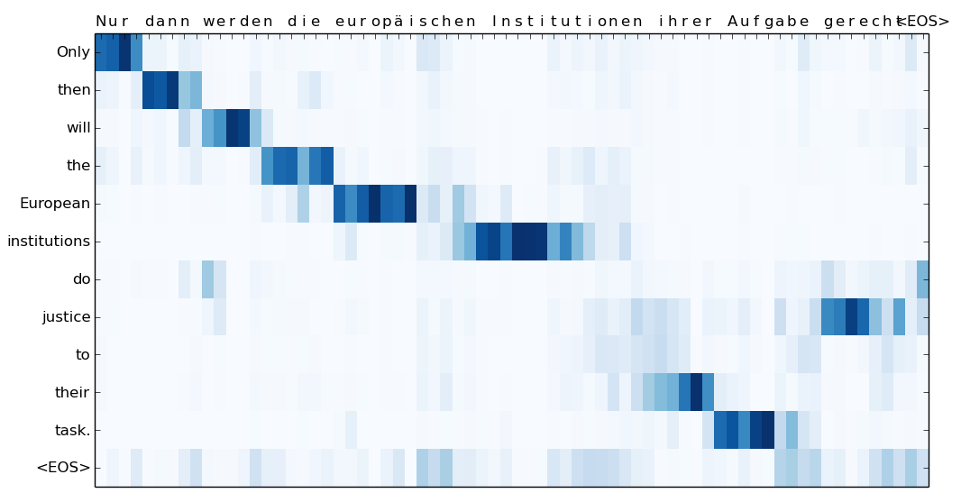
Mathias Stefan Carius Larsen - s164029, Dennis Jensen - s155629 DTU Space, Technical University of Denmark
Introduction
Deep-Q-Network
Experience Replay
Target Network
The goal is to design an AI agent that learns to play the game Pong based on raw pixels and rewards.
Pong is a good choice of game since its concept is simple, but introduces some complex DQN algorithms.
Reduces correlation of updates
Increases learning speed
Stores memory of old transitions
Reduces correlation of updates
Increases learning speed
Stores memory of old transitions
Loading Pong game using
Gym package from OpenAI
Dimension: 210x160 pixels
RGB
Preprocessing the game:
Downscale to 84x84 pixels
Grayscaling
Max and skip
Feeding the Neural Network
Output: Estimated Q-values
Replay memory
Backpropagation
Epsilon-Greedy
Reduces correlation of updates
Increases learning speed
Stores memory of old transitions
Results - Qualitative
Results - Quantitative
char-to-char attention plot
char2word-to-char attention plot
Model | Language | newstest2015
char-to-char | En-De | 15.14 BLEU
char2word-to-char | En-De | 17.43 BLEU
Char-level
References
Word-level
[1] Dzmitry Bahdanau, Kyunghyun Cho, and Yoshua Bengio. Neural machine translation by jointly learning to align and translate. CoRR, 2014.
[2] Ilya Sutskever, Oriol Vinyals, and Quoc V. Le. Sequence to sequence learning with neural networks. CoRR, 2014.
[3] M. Schuster and K.K. Paliwal. Bidirectional recurrent neural networks. Trans. Sig. Proc., 45(11):2673–2681, November 1997.
[4] Sepp Hochreiter and Jürgen Schmidhuber. Long short-term memory. Neural Comput., 9(8):1735–1780, November 1997.
[5] A. Y. Hannun, C. Case, J. Casper, B. Catanzaro, G. Diamos, E. Elsen, R. Prenger, S. Satheesh, S. Sengupta, A. Coates, and A. Y. Ng. Deep speech: Scaling up end-to-end speech recognition. CoRR, 2014.
[6] Minh-Thang Luong and Christopher D. Manning. Achieving open vocabulary neural machine translation with hybrid word-character models. CoRR, 2016.
[7] Jason Lee, Kyunghyun cho, Thomas Hofman. Fully Character-Level Neural Machine Translation without Explicit Segmentation. CoRR, 2016.
Notes:
‹#›

