Slide 1


Predicting Bitcoin price using Twitter data

Slide 2

Bitcoin
First released in 2009
Generally considered the first cryptocurrency
Currently 17.5 million in circulation
1 Bitcoin is currently worth £2,800

Slide 3
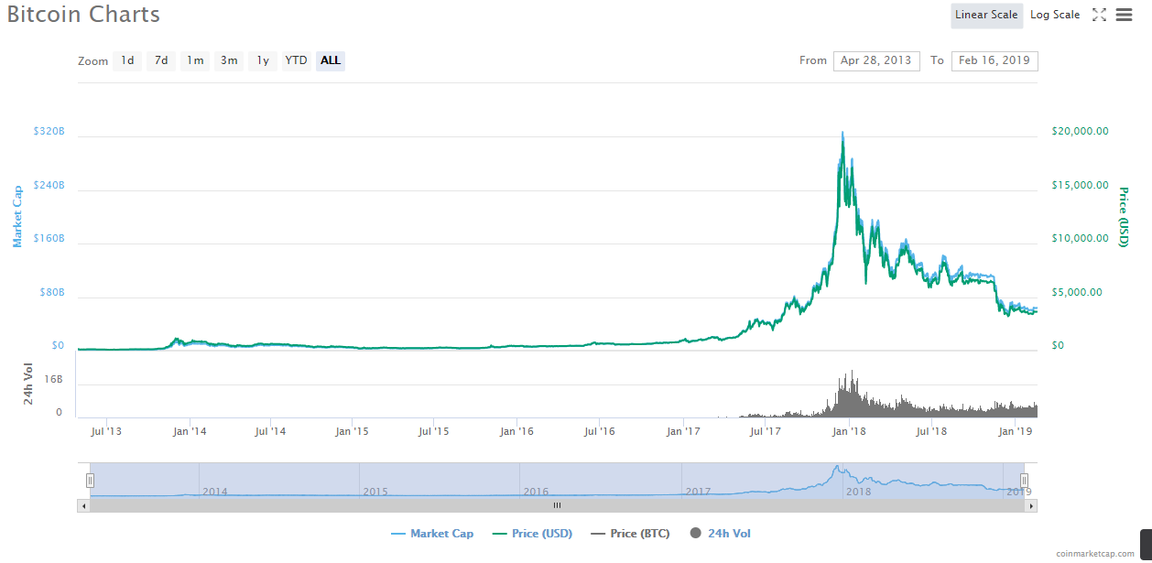
The Problem
Bitcoin price fluctuates, often massively:
Increase of 130% from 27th October 2017 to it’s peak value of $19,783 on 17th December 2017
22nd December 2017 Bitcoin lost 1/3 of it’s value in 24 hours
This often leaves people unsure of when to buy Bitcoin or sell what they have

Slide 4

Motivation to predict price
Bitcoin could be bought before it rises and sold again before price falls
=
Net profit + Bitcoin crashes avoided

Slide 5

Approach
My approach is simply based on the idea that many bitcoin buyers buying and selling behaviour is influenced by the general conversation around bitcoin.
Hypothesis: Bitcoin price is linked to what people are publicly saying about bitcoin.

Slide 6

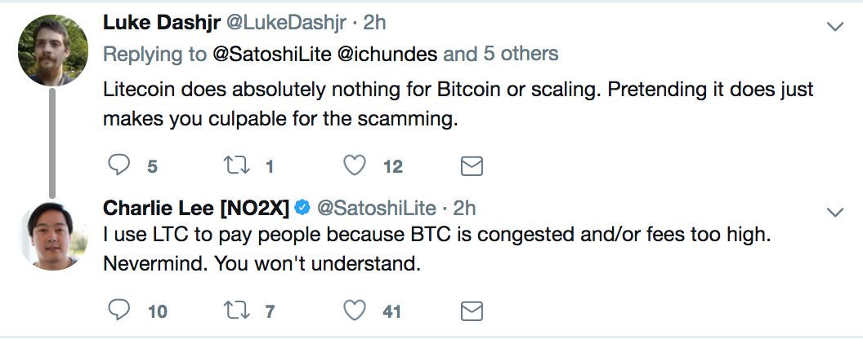
Data sourcing
Twitter for two reasons:
Source of the conversation around Bitcoin.
Accessibility – Twitter data is public and can be collected via their API.
To focus on the most relevant tweets, I looked at 57 accounts influential in cryptocurrency.
Mix of: Influential People; Cryptocurrency Exchanges; Crypto News accounts; Cryptocurrency Projects.
Total: 457,894 tweets

Slide 7
Data Processing
Text cleaning:
Removing punctuation
Replacing words containing apostrophes with their uncontracted equivalents.
Lemmatisation of words
Adding in sentiment of tweets using NLTK.
Adding in Bitcoin price 5 mins in the future to account for delay:
Actual price 5 minutes later.
Price change 5 minutes later.
Categorical column of whether the 5 minutes price change is positive.

Slide 8
Model inputs
Tweet text
Type of account i.e. Exchange, News etc
Number of Retweets
Twitter account

Slide 9

TFID
Used TF-IDF (term frequency–inverse document frequency).
Words that are common across all the tweets are supressed, and rare words given more influence.

Slide 10
Linear Regression
Predicting actual price:
RMSE (model): 3709.6
RMSE: (dumb model): 4294.4
Predicting price 5 minutes later:
RMSE (model): 34.14
RMSE: (dumb model): 34.08

Slide 11
Logistical Regression
Predicting whether price 5 minutes later is higher:
Score of 58%
In the data price change is positive 51% of the time, making the model 7% better than this baseline
Adjustments:
GridSearch provided the best model parameters
Higher number of n-grams gave more interesting coefficients, but lower model score
Higher max features improves model score, but was limited by my PCs RAM

Slide 12
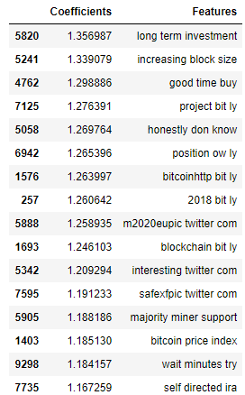
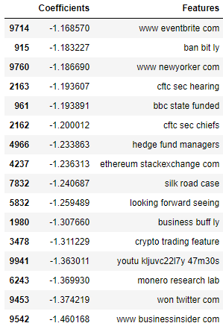
Logistical Regression - Coefficients
Biggest positives
Biggest negatives
Block size refers to Blockchain, the technology that cryptocurrencies are built
Silk Road was an darkweb marketplace that used Bitcoin in transactions
Miners make up the blockchains, and can cause cryptocurrencies to split when they disagree

Slide 13
Limitations
RAM - Number of max features was limited by memory errors at higher numbers
Lots of irrelevant tweets will add noise
Twitter users will be a certain type of person, so by only looking at the conversation there certain demographics will be missed
Including sentiment in the model as well as the tweet text may have caused slight multicollinearity

Slide 14

Possible next steps
Experiment with different numbers of n-grams, max features etc
Add data from some more Twitter accounts
Look at different time lags between tweet time and Bitcoin price
Add in buffer to account for exchange fees
Topic modelling of tweets, which could then be added into the price prediction model

