Slide 1
Using Twitter to predict traffic blockages relating to protests

Slide 2

Approach
Based on the idea that Tweets around an event or protest can indicate changes in traffic through the reach (number of retweets and favourites) and language of the tweet .
For this project, I looked specifically at Extinction Rebellion which recently held protests in London.

Slide 3
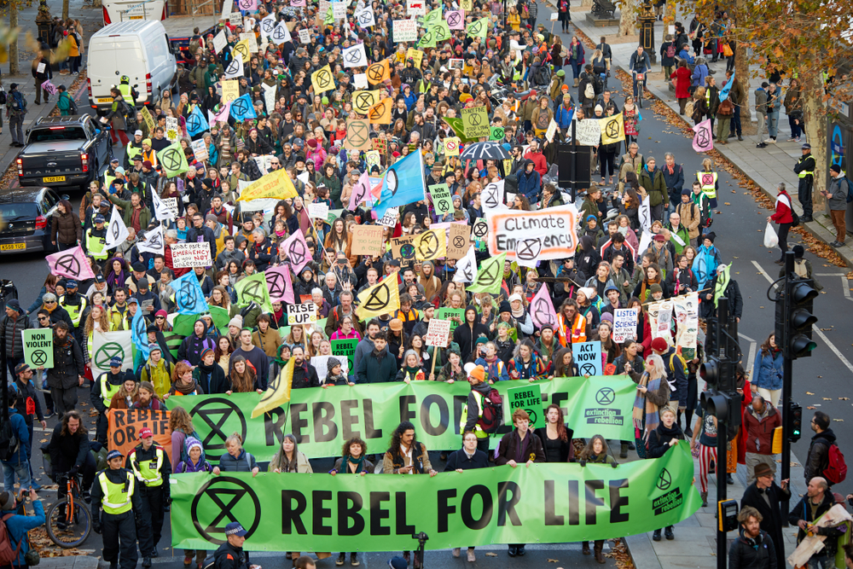
Extinction Rebellion
In April, Extinction Rebellion staged protests occupying and disrupting traffic in four sites in central London:
Oxford Circus
Marble Arch
Waterloo Bridge
The area around Parliament Square.

Slide 4
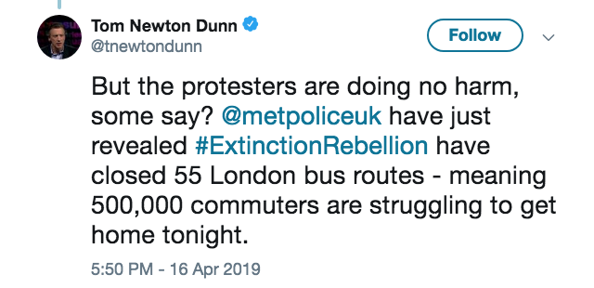
Data sourcing
Protest tweets
I gathered tweets relating to the protests using the Twitter API, grabbing all tweets posted this year that contained the phrase ‘Extinction Rebellion’.
This resulted in almost 19,000 tweets; covering periods of time where there was no protests disrupting traffic, as well as the disruption Extinction Rebellion protests caused in April.

Slide 5
Data sourcing
Traffic disruption data
Historic traffic data was more difficult to gather.
Most available data costs money to access.
@TfLTrafficNews
I worked around this by using @TfLTrafficNews tweets as my indicator of traffic disruption.
This involved flagging tweets that contained the names of the key disruption areas.
(Oxford Circus, Marble Arch, Waterloo Bridge, Parliament Square)
I briefly looked into using named entity recognition to flag road names in tweets, but directly tagging the four named locations was more accurate.
This approach works on the assumption that a mention of a location in a TfLTrafficNews tweet is due to there being traffic disruption there.

Slide 6
Data Processing
Text cleaning:
Removed punctuation.
Replaced words containing apostrophes with their uncontracted equivalents.
Added in sentiment of tweets using NLTK.
I joined the traffic disruption flag from the TfLTrafficNews data to the Extinction Rebellion tweets on the tweet datetime.
I rounded the tweet time to the nearest hour to match Extinction Rebellion tweets to traffic disruption.
I sampled the non-traffic disruption tweets to address the class imbalance.

Slide 7
Modelling
I used a logistic regression, treating traffic disruption as binary.
Model inputs:
Tweet text (using TFID to supress words common across all tweets).
Tweet sentiment.
Tweet reach (favourites and retweets).
Mention of any of the target locations in the tweet text.

Slide 8
Result
Precision of 0.57
57% of the tweets flagged as causing traffic actually had traffic at that time.
Recall of 0.61
Of the times there was traffic, the model correctly identified this from the tweets 61% of the time.

Slide 9
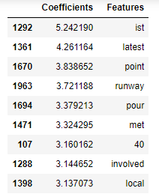
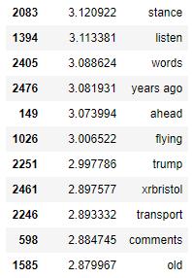
Coefficients
Re-running the model with only n-grams of 2+ would likely give more insightful coefficients

Slide 10
Limitations
Indication of traffic works on the assumption that mention of a location in a TfLTrafficNews tweet means that there is traffic disruption there; this may not always be the case.
Using TfLTrafficNews tweets doesn’t give the length of time traffic is disrupted for.
If traffic disruption lasts for several hours, but TfLTrafficNews only tweets about it once, then only the hour of the tweet is recognised as having disrupted traffic.
Computing power: 8GB RAM computer meant I had to limit the model to 2500 features.
Model requires manual identification of locations of traffic interest.
Element of multicollinearity by using tweet sentiment and direct mentions of the target locations alongside the tweet text.

Slide 11
Possible improvements
Gain access to better historical traffic data, likely through paying for access.
Re-run with higher computing power allowing a higher number of maximum features; either using a better PC or cloud computing.
Potential to topic model the Extinction Rebellion tweets, and re-run the model using just certain topics, potentially filtering out irrelevant tweets that just generate noise.

