Slide 1



Automated End-to-End Testing of GOG.com
CEN 4072: Software Testing – Spring 2026
Group Number: 15
Dennis Kerry, Myles Vinal, Robert Benstine

Slide 2

Project Goal & Motivation
Automate System Testing
Detect Regressions
Automate end-to-end testing of GOG.com to verify core user-facing features work correctly and consistently
Catch regressions from front-end updates, SPA routing changes, or UI restructuring
Validate User Flows
Identify Constraints
Test browsing, searching, login, signup, game pages, and cart/checkout without manual testing
Address CAPTCHA, GDPR banners, age-gate overlays, lazy-loaded content, and dynamic XHR tiles
Test a gaming platform that some of the group had been unfamiliar with, working with tangible metrics we care about and can understand:
Improve product quality confidence through repeatable, automated regression testing.

Slide 3
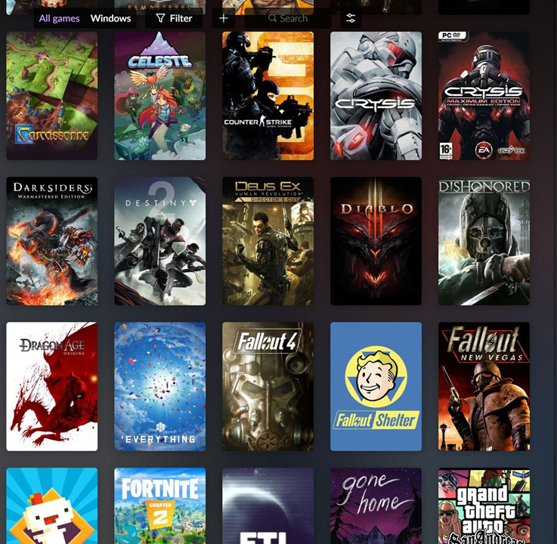

Testing Workflow
Load Config
Read config.properties for credentials and game URLs
BaseTest Setup
@BeforeClass launches ChromeDriver with anti-automation flags
TestUtils Actions
Dismiss cookie consent, perform login, wait for page load
Execute Tests
Run 7–8 @Test methods per class
TestNG Assertions
Validate pass/fail conditions
Teardown
@AfterClass quits driver
Maven Execution
Surefire runs 8 test classes via testng.xml
Report Generation
TestNG HTML report in target/surefire-reports/

Slide 4
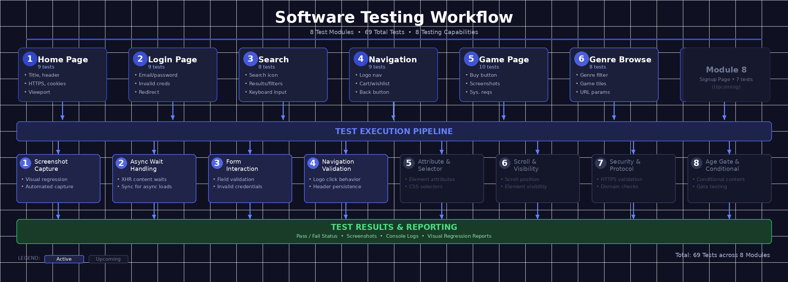
Workflow​ Diagram

Slide 5
Team Contributions
Dennis Kerry
Robert Benstine
Myles Vinal
HomePageTest (10 tests): title, header, logo, tiles, sign-in, footer, HTTPS
LoginPageTest (9 tests): form fields, invalid login error, forgot password, create account link
NavigationTest (9 tests): logo navigation, store link, catalog routing, header persistence, cart icon
GamePageTest (10 tests): product page load, title H1, buy button, description, screenshots, system requirements, HTTPS
CartPageTest (9 tests): cart page load, title, main content, empty-cart state, continue-shopping link, header, HTTPS
BaseTest & AuthenticatedTest infrastructure: ChromeDriver setup, anti-bot flags, login lifecycle
HTML Report Document
SearchTest (8 tests): search icon, results page load, result tiles, tile titles, tile images, filter controls
GenreBrowseTest (8 tests): catalog page, RPG genre filter, tile images, sort/filter controls, page heading
TestUtils shared utility: performLogin, dismissCookieConsent, waitForPageLoad, isElementPresent
testng.xml integration and Maven Surefire configuration

Slide 6
Tools & Technologies
Java 17
Selenium WebDriver 4.18.1
TestNG 7.9.0
Primary programming language
Browser automation framework
Test framework, assertions, HTML reporting
WebDriverManager 5.7.0
Maven 3 + Surefire 3.2.5
Google Chrome
Automatic ChromeDriver binary management
Build, dependency management, test execution
Browser under test
Windows 10/11
Git / GitHub
config.properties
Operating system
Version control and code repository
Externalized credential and URL configuration

Slide 7
System Under Test: GOG.com
GOG.com is a DRM-free digital PC game store owned by CD PROJEKT. The platform features an Angular-based SPA with asynchronous XHR content loading.
Features Tested
Home page, Login, and Account Sign-up flows
Search functionality and results
Game product page (The Witcher 3)
Genre browser (RPG category)
Cart and Checkout process
Header navigation persistence
Automation Constraints Encountered
GDPR cookie consent banner (handled by TestUtils.dismissCookieConsent)
Login gate button must be clicked before form fields appear
CAPTCHA/bot protection on login after repeated failures
Age-gate overlay on game detail pages
Lazy-loaded product tiles requiring timed pauses
Price/availability changes during sales (tested for presence only)
Anti-automation detection (mitigated via Chrome flags)

Slide 8
Test Architecture & Design
8 Test Classes
BaseTest Abstract Class
Each in separate Java file under com.gog.tests package
ChromeDriver setup/teardown, WebDriverWait (20s), anti-automation Chrome flags, implicit wait (10s), BASE_URL constant
AuthenticatedTest Extension
TestUtils Shared Helpers
Extends BaseTest with automatic pre-test login for authenticated test classes
Reusable utilities avoiding code duplication across all 8 classes
Sequential Execution
53 Test Methods
parallel="none" to avoid session/cookie conflicts
Total across all test classes

Slide 9
Test Coverage: 8 Functional Modules
1
Module 1 — Home Page Tests
(9 tests)
Page title, header, logo, game tiles, sign in, footer, HTTPS, screenshot, cookies, viewport
Module 2 — Login Page Tests
2
(9 tests)
Page title, HTTPS/domain, email input, password field, empty form, invalid credentials, forgot password, create account, valid credentials redirect
3
Module 3 — Search Tests
(8 tests)
Search icon, results page load, results returned, titles, images, filters, result count, keyboard input
Module 4 — Navigation Tests
4
(9 tests)
Logo navigation, store link, sign in button, catalog page, header persistence, cart/wishlist, back button, hover stability, GOG Galaxy
Module 5 — Game Page Tests
5
(10 tests)
Page load, title, buy button, description, screenshots, system requirements, HTTPS, screenshot capture, price/ownership, scrollable requirements
6
Module 6 — Genre Browse Tests
(8 tests)
Catalog load, genre filter, game tiles, images, sort/filter controls, page title, URL parameters, multiple tiles
7
Module 7 — Cart Page Tests
(9 tests)
Page load, title, main content, empty cart/heading, continue shopping, header/nav, HTTPS, cart icon attributes, scroll to bottom
8
Module 8 — Signup Page Tests
(7 tests)
Page load, email field, password field, username field, create account button, sign in link, privacy/terms link

Slide 10
Key Testing Techniques & Strategies
Advanced Selenium patterns used across the test suite
Screenshot Capture
Attribute & Selector Validation
1
5
Cart icon attribute chains (href, aria-label, data-cy, hook-test)
Fallback selector strategies
Non-empty text assertions
Full-page screenshots for visual regression and documentation
Automated capture on game pages and home page
2
Async Wait Handling
XHR content waits for game tiles and dynamic content
Proper synchronization for async-loaded elements
Scroll & Visibility Testing
6
Scroll-into-view for system requirements
Page scrollability to bottom
Footer presence validation
Form Interaction Testing
3
Email/password field validation
Empty form submission handling
Invalid credential flows
Keyboard input verification
Security & Protocol Validation
7
HTTPS enforcement across all pages
Domain verification (gog.com)
Cookie validation
Navigation & Cross-Page Validation
4
Logo click behavior
Browser back button stability
Header persistence across pages
Hover state stability
8
Age Gate & Conditional Content
Mature content gate dismissal
Setup/teardown patterns with @BeforeClass

Slide 11
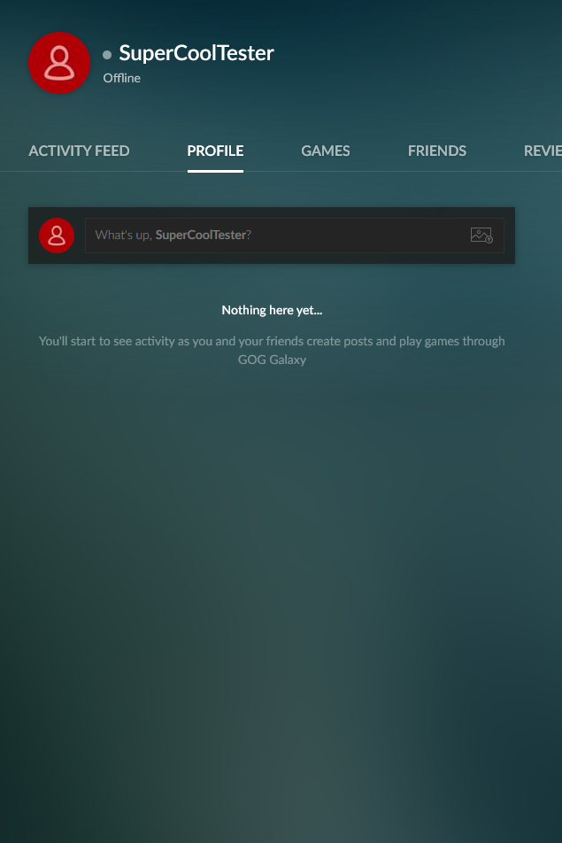
Home Page, Login & Signup Tests
HomePageTest (9 tests)
LoginPageTest (10 tests)
SignupPageTest (8 tests)
Page title contains "GOG"
Header and logo present
At least one product tile rendered
Sign In link accessible
Footer present
URL is HTTPS
Email, password, submit fields present
Forgot password and create account links present
Invalid credentials trigger error message
Email, password, username, submit fields present
Sign In and Privacy/Terms links accessible
Page loads on gog.com domain

Slide 12
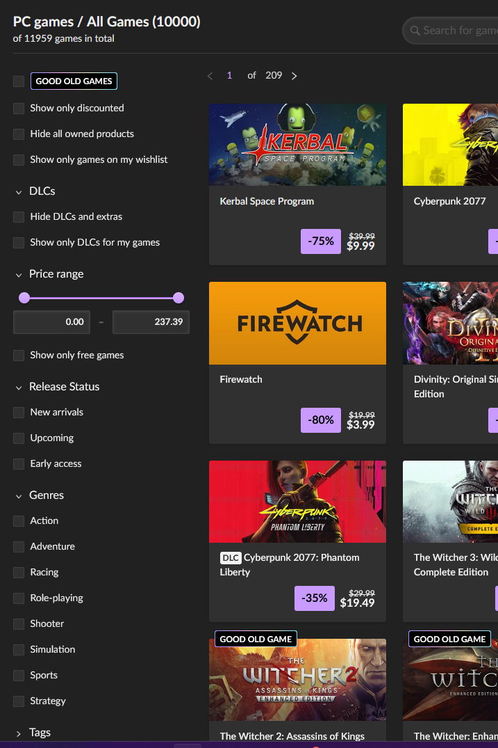
Search, Navigation & Genre Tests
SearchTest (6 tests)
NavigationTest (6 tests)
GenreBrowseTest (6 tests)
Search icon present in header
Search results page loads for "witcher" query
Product tiles, tile images, and tile titles present
Sort/filter controls visible
Logo navigates to home
Store/Games link in header
Sign In button accessible
Header persists across multiple pages
Cart/wishlist icon present
/games catalog and /games?genres=rpg load successfully
RPG genre tiles and cover images present
Sort/filter controls visible
Page heading contains "GOG" or "game"

Slide 13
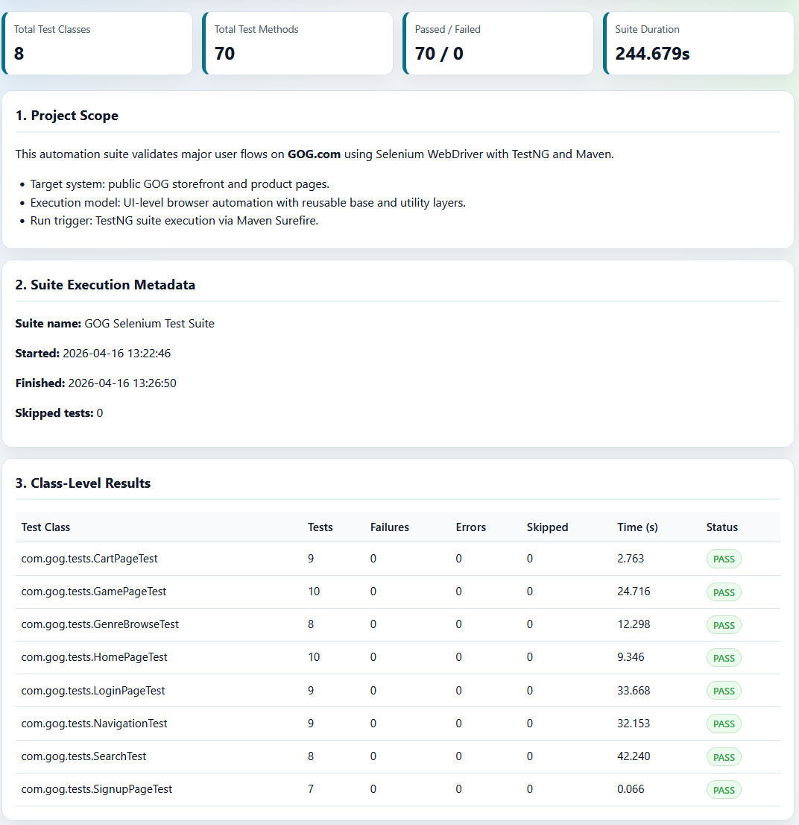
Key Takeaways
Comprehensive Coverage
Robust Architecture
53 test methods across 8 classes validate critical user flows from browsing to checkout
BaseTest and TestUtils provide reusable infrastructure, reducing code duplication and maintenance
Real-World Constraints
Successfully handled GDPR, CAPTCHA, age-gates, lazy-loading, and anti-automation detection
This automated test suite establishes a repeatable regression baseline for GOG.com, improving product quality confidence and reducing manual testing burden.

Slide 14
Future Improvements
Integrate with CI/CD (GitHub Actions)
using GitHub Actions will provide to further testing practices that tests can be automatically executed on every push or pull request. Helping catch bugs early, maintain code quality, and further bugs
Parallel Test Execution
To help further testing processes, using parallel executions, tests can be reduced from the 4-minute run time to under 90 seconds
Expand login test coverage with CAPTCHA
To consistenly authorize user access, test coverage can be built to include both CAPTCHA checks and third-party login flows (OAuth/social providers).
Parameterize test Data Test Execution
In order to use multiple search terms, and multiple game pages using TestNG. In future iterations we can use @DataProvider Add cross-browser coverage (Firefox, Edge) via WebDriverManager's built-in support Mock the GOG API responses for faster, network-independent unit-level tests
Add visual regression testing using
Using a tool like Ashot to catch UI layout changes push can help capture screenshots of your UI and compare them to baseline images, detecting unintended layout or styling changes, which can be Integrated into CI/CD, automatically flags visual differences

Slide 15
Conclusion
Our complete end-to-end test suite was designed to cover various test cases that may occur from account login to browsing and checkout.
70 test cases over 8 different test classes
All pass without failures or long executions.
form inputs, keyboard events, page scrolling, screenshots, cookie validation, HTTPS verification, attribute assertations, and navigation between pages.
Our testing suite follows the industry-standard patterns for test case creation of:
Page Object Separation via BaseTest, shared utilities in TestUtils, and external credential management via config.properties.
The testing suite also will generate a report after every execution using a customized TestNG listener.
This project demonstrated real-world SPA automation requiring working around angular rendering delays, age gates, authorization redirects, and missing semantics in HTML elements; all of which we had encountered and solved during the development of the TestNG suite.

