Slide 1

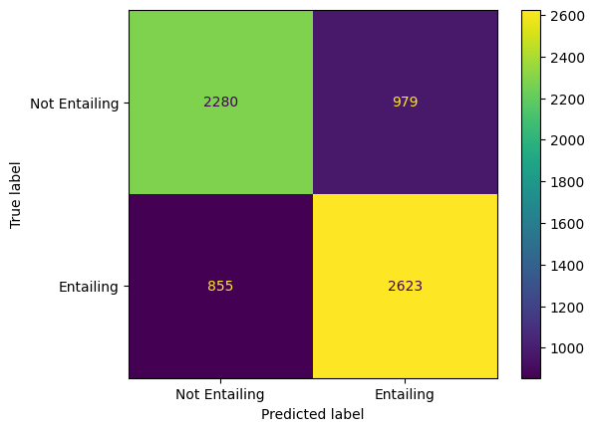
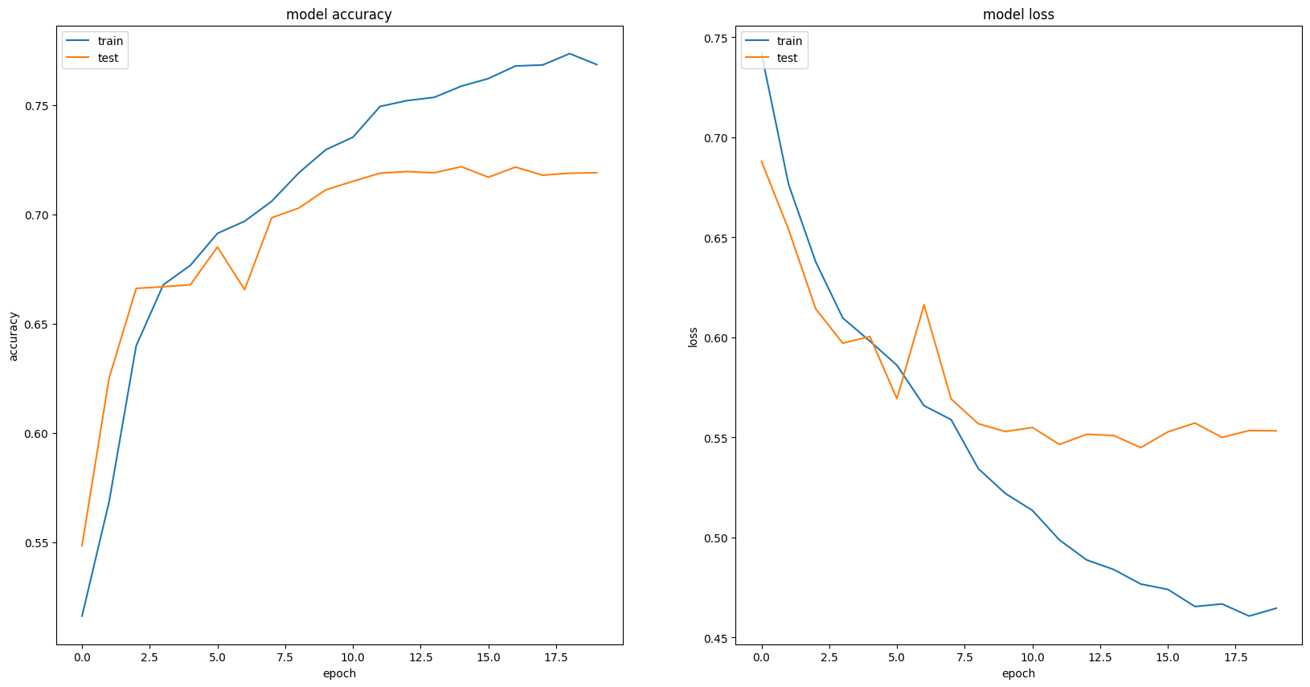
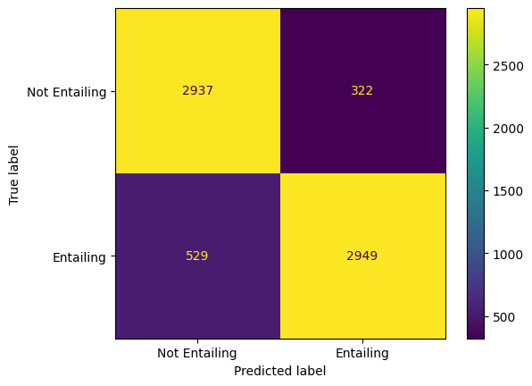
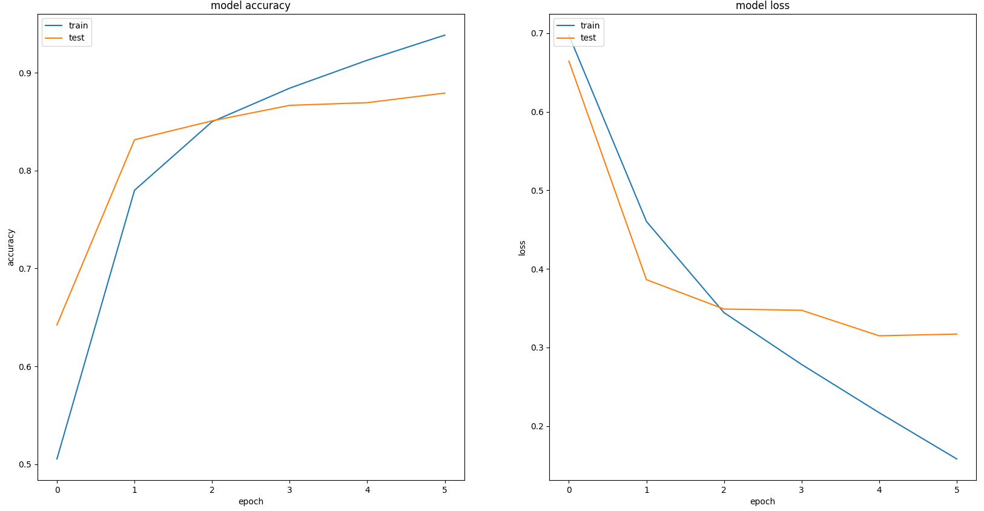
Natural Language Inference
By Jack Pay & Dennis Kiselev
Introduction
Two models were developed to solve Natural Language Inference (NLI), the task of assessing whether a premise semantically supports a hypothesis
Method B focused on using RNNs whilst C finetuned pretrained Transformer architectures
Task B: Figures
Methods
Method B:
Trained a Bi-LSTM with frozen XLNET embeddings
Utilised learning rate scheduling to approach a global optimum
LR was reduced on metric plateau
Employed subtractive & multiplicative sentence fusion, & attention to enhance sentence representations
Method C:
Finetuned the base ROBERTA Transformer model
Employed data augmentation to bolster the training data:
Synonym replacements & insertions
Word deletions & swaps
Used early stopping and LR scheduling to reduce overfitting
LR warmup and then decreasing was used
Predictions with the Highest Loss
Loss | Premise | Hypothesis
11.88 | He was the first scholar to describe in detail. | He was the first scholar to describe in detail and document the long-term cyclical relationship between global population cycles and cycles of political rebellion and revolution.
6.59 | La Barredora ("The Sweeper Truck") is a criminal gang based in the Mexican resort city of Acapulco, Guerrero and its surrounding territories. | La Barredora ("The Sweeper Truck") is a criminal gang based in the Mexican resort city of Acapulco, City and County of Denver and its surrounding territories.
5.58 | Traditional examples of background music include music played at various social gatherings and music played in certain retail venues. | Traditional examples of background music include music played at same social gatherings and music played in certain retail venues.
Task C: Figures
Conclusions
Pretrained word embeddings are key to higher performance
Transformers achieve a higher performance compared with RNN
Basic textual augmentations do not significantly improve performance
Models struggle when premise & hypotheses are ambiguous, contain disfluencies or OOV words
Predictions with the Highest Loss
Loss | Premise | Hypothesis
6.04 | okay well what are we doing about recycling in our community | Our community does not recycle.
5.90 | The port is virtually round the corner from the passeig. | It takes at least two days to go from the port to the passeig.
5.87 | and i don't know about your part of the country but uh down here in the last year oh year plus i it was last beginning with last year's Earth Day | I've never been to your part of the country.
Optimal Results
References
S. Zhang, S. Liu and M. Liu, "Natural language inference using LSTM model with sentence fusion," 2017 36th Chinese Control Conference (CCC), Dalian, China, 2017, pp. 11081-11085, doi: 10.23919/ChiCC.2017.8029126
Tarunesh, Ishan, Somak Aditya, and Monojit Choudhury. "Trusting roberta over bert: Insights from checklisting the natural language inference task." arXiv preprint arXiv:2107.07229 (2021).
Sadat, Mobashir, and Cornelia Caragea. "Scinli: A corpus for natural language inference on scientific text." arXiv preprint arXiv:2203.06728 (2022).
Method | Accuracy | Precision | Macro Precision | Weighted Macro Precision | Recall | Macro Recall | Weighted Macro Recall | F1-Score | Macro F1-Score | Weighted Macro F1-Score | MCC | Loss
B | 0.728 | 0.728 | 0.728 | 0.728 | 0.754 | 0.727 | 0.728 | 0.741 | 0.727 | 0.728 | 0.455 | 0.535
C | 0.874 | 0.902 | 0.874 | 0.875 | 0.848 | 0.875 | 0.874 | 0.874 | 0.874 | 0.874 | 0.749 | 0.333

