Slide 1

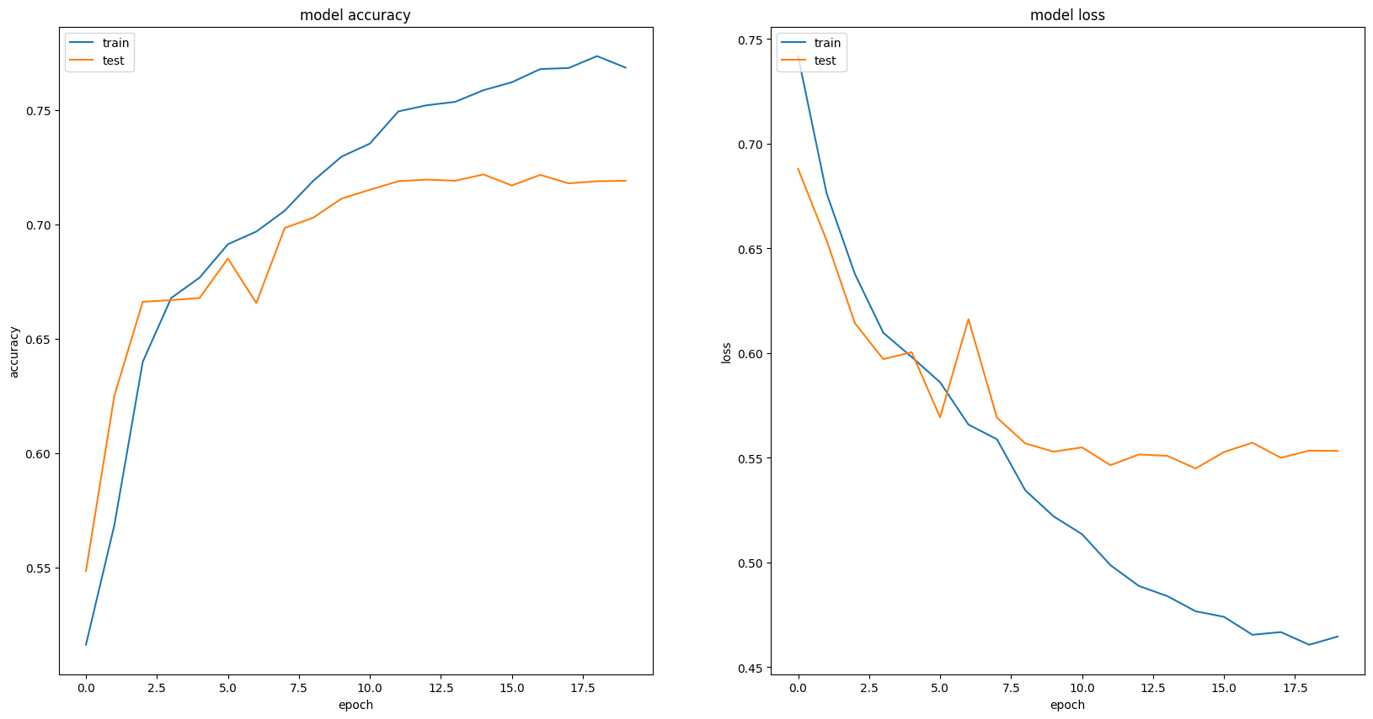
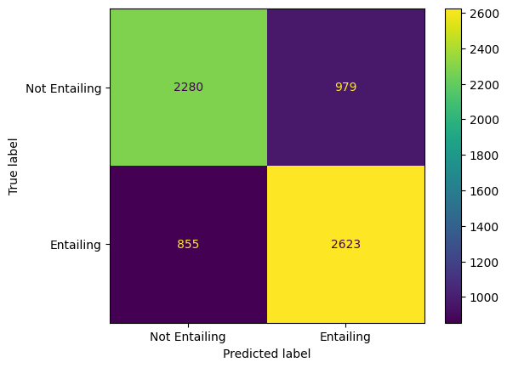
Natural Language Inference
By Jack Pay & Dennis Kiselev
Introduction
Two models were developed to solve Natural Language Inference (NLI)
Method B focused on using RNNs whilst C finetuned pretrained Transformer architectures
Task B: Figures
Methods
Method B:
Trained a Bi-LSTM with frozen XLNET embeddings
Utilised learning rate scheduling to approach a global optimum
Employed subtractive & multiplicative sentence fusion, & attention to enhance sentence representations
Method C:
Finetuned the base ROBERTA Transformer model
Employed data augmentation to bolster the training data:
Synonym replacements & insertions
Word deletions & swaps
Used early stopping and LR scheduling to reduce overfitting
Predictions with the Highest Loss
Loss | Premise | Hypothesis
11.88 | He was the first scholar to describe in detail. | He was the first scholar to describe in detail and document the long-term cyclical relationship between global population cycles and cycles of political rebellion and revolution.
6.59 | La Barredora ("The Sweeper Truck") is a criminal gang based in the Mexican resort city of Acapulco, Guerrero and its surrounding territories. | La Barredora ("The Sweeper Truck") is a criminal gang based in the Mexican resort city of Acapulco, City and County of Denver and its surrounding territories.
5.58 | Traditional examples of background music include music played at various social gatherings and music played in certain retail venues. | Traditional examples of background music include music played at same social gatherings and music played in certain retail venues.
Task C: Figures
Conclusions
Pretrained word embeddings are key to higher performance
Transformers achieve a higher performance but also loss, compared with RNNs
Likely due to low output scores from RNNs
Basic textual augmentations do not significantly improve performance
Optimal Results
Method | Accuracy | Precision | Macro Precision | Weighted Macro Precision | Recall | Macro Recall | Weighted Macro Recall | F1-Score | Macro F1-Score | Weighted Macro F1-Score | MCC | Loss
B | 0.728 | 0.728 | 0.728 | 0.728 | 0.754 | 0.727 | 0.728 | 0.741 | 0.727 | 0.728 | 0.455 | 0.535
C
References
S. Zhang, S. Liu and M. Liu, "Natural language inference using LSTM model with sentence fusion," 2017 36th Chinese Control Conference (CCC), Dalian, China, 2017, pp. 11081-11085, doi: 10.23919/ChiCC.2017.8029126
Tarunesh, Ishan, Somak Aditya, and Monojit Choudhury. "Trusting roberta over bert: Insights from checklisting the natural language inference task." arXiv preprint arXiv:2107.07229 (2021).
Sadat, Mobashir, and Cornelia Caragea. "Scinli: A corpus for natural language inference on scientific text." arXiv preprint arXiv:2203.06728 (2022).

