Slide 1

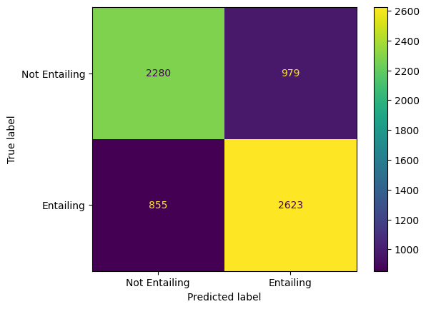
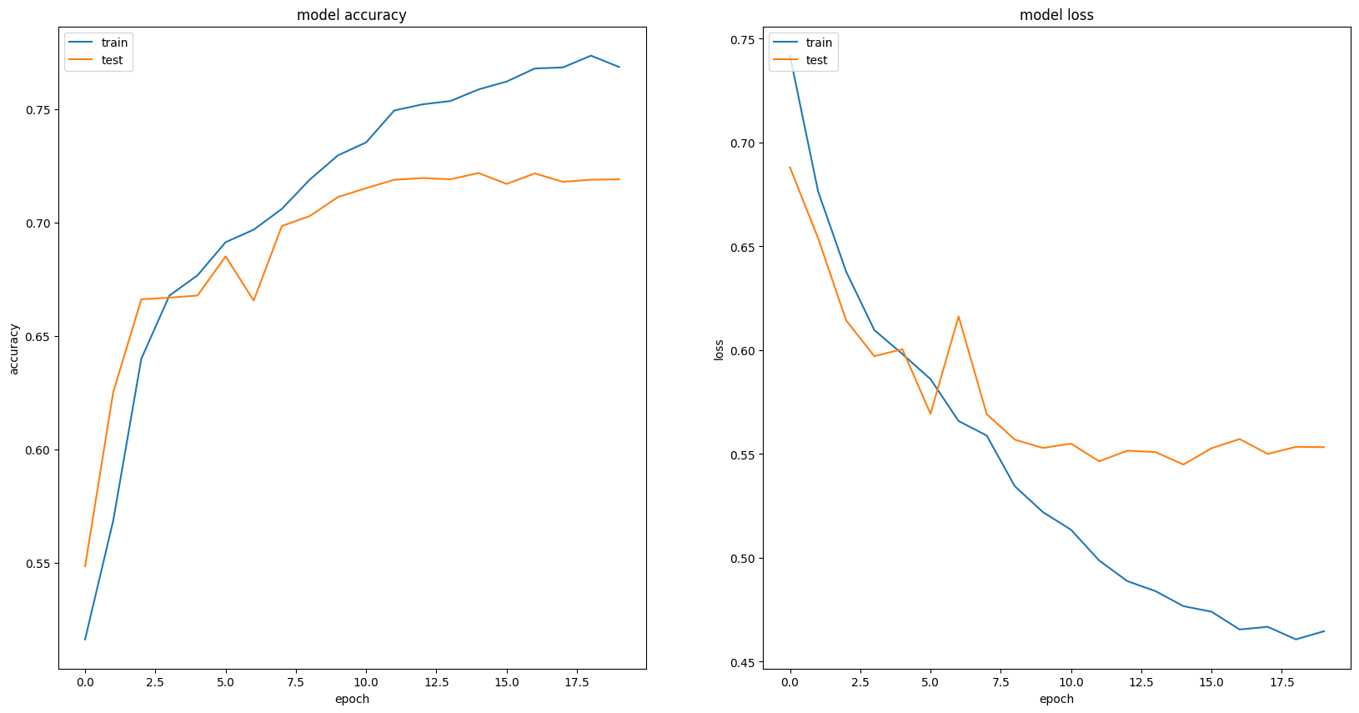
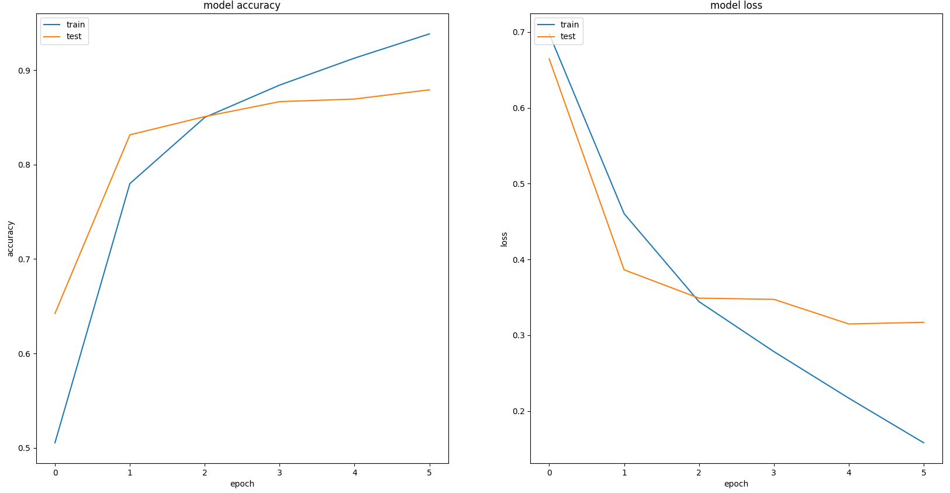
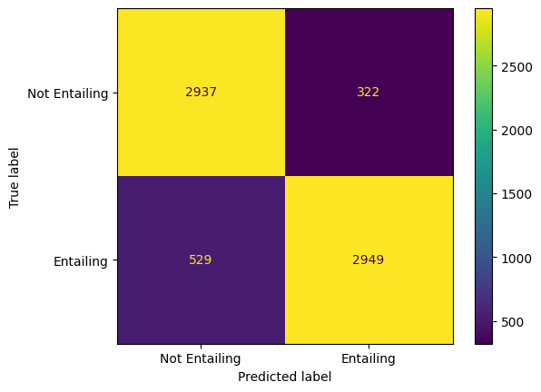
Natural Language Inference
By Jack Pay & Dennis Kiselev
Introduction
Two models were developed to solve Natural Language Inference (NLI), the task of assessing whether a premise semantically supports a hypothesis
Method B focused on using RNNs whilst C finetuned pretrained Transformer architectures
Task B: Figures
Methods
Method B:
Trained a Bi-LSTM with frozen XLNET embeddings
Utilised learning rate scheduling to approach a global optimum
LR was reduced on metric plateau
Employed subtractive & multiplicative sentence fusion, & attention to enhance sentence representations
Method C:
Finetuned the base ROBERTA Transformer model
Employed data augmentation to bolster the training data:
Synonym replacements & insertions
Word deletions & swaps
Used early stopping and LR scheduling to reduce overfitting
LR warmup and then decreasing was used
Predictions with the Highest Loss
Loss | Premise | Hypothesis
11.88 | He was the first scholar to describe in detail. | He was the first scholar to describe in detail and document the long-term cyclical relationship between global population cycles and cycles of political rebellion and revolution.
6.59 | La Barredora ("The Sweeper Truck") is a criminal gang based in the Mexican resort city of Acapulco, Guerrero and its surrounding territories. | La Barredora ("The Sweeper Truck") is a criminal gang based in the Mexican resort city of Acapulco, City and County of Denver and its surrounding territories.
5.58 | Traditional examples of background music include music played at various social gatherings and music played in certain retail venues. | Traditional examples of background music include music played at same social gatherings and music played in certain retail venues.
Task C: Figures
Conclusions
Pretrained word embeddings are key to higher performance
Transformers achieve a higher performance but also loss, compared with RNNs
Likely due to low output scores from RNNs
Basic textual augmentations do not significantly improve performance
Predictions with the Highest Loss
Loss | Premise | Hypothesis
16.12 | The traditional word for the API is pharmacon from Greek : : Ï†Î¬ÏÎ¼Î±ÎºÎ¿Î½, adapted from pharmacos which originally denoted a magical substance or drug. | The traditional word for the API is pharmacon or pharmakon (from Greek: Ï†Î¬ÏÎ¼Î±ÎºÎ¿Î½ , adapted from pharmacos) which originally denoted a magical substance or drug.
16.12 | She received basic training in music when her mother used to take her ' masterji ' for training. | She received basic training in music when her mother used to take her to a Hindustani music teacher or 'masterji' for training.
16.12 | Mon Dieu! | This person is speaking English.
Optimal Results
References
S. Zhang, S. Liu and M. Liu, "Natural language inference using LSTM model with sentence fusion," 2017 36th Chinese Control Conference (CCC), Dalian, China, 2017, pp. 11081-11085, doi: 10.23919/ChiCC.2017.8029126
Tarunesh, Ishan, Somak Aditya, and Monojit Choudhury. "Trusting roberta over bert: Insights from checklisting the natural language inference task." arXiv preprint arXiv:2107.07229 (2021).
Sadat, Mobashir, and Cornelia Caragea. "Scinli: A corpus for natural language inference on scientific text." arXiv preprint arXiv:2203.06728 (2022).
Method | Accuracy | Precision | Macro Precision | Weighted Macro Precision | Recall | Macro Recall | Weighted Macro Recall | F1-Score | Macro F1-Score | Weighted Macro F1-Score | MCC | Loss
B | 0.728 | 0.728 | 0.728 | 0.728 | 0.754 | 0.727 | 0.728 | 0.741 | 0.727 | 0.728 | 0.455 | 0.535
C | 0.874 | 0.902 | 0.874 | 0.875 | 0.848 | 0.875 | 0.874 | 0.874 | 0.874 | 0.874 | 0.749 | 1.849

