Slide 1

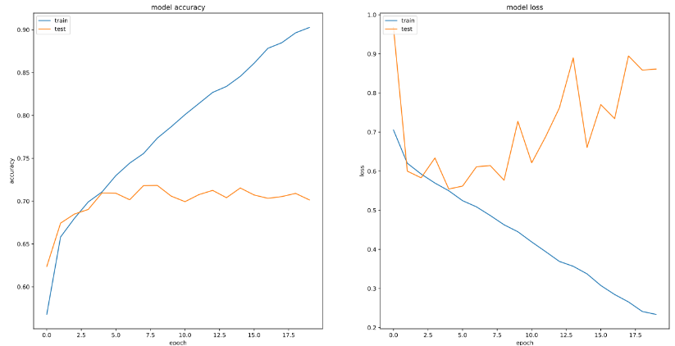
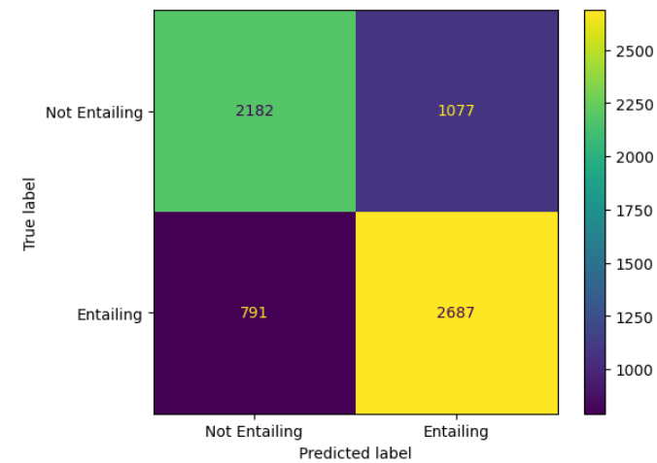
Natural Language Inference
By Jack Pay & Dennis Kiselev
Introduction
Two models were developed to solve Natural Language Inference (NLI)
Method B focused on using RNNs whilst C finetuned pretrained Transformer architectures
Task B: Figures
Loss | Premise | Hypothesis
4 | premise1 | hypothesis1
3 | Premise2 | Hypothesis2
2 | Premise3 | Hypothesis3
1 | premise4 | hypothesis4
Methods
Two methods were taken:
Method B:
Trained a Bi-LSTM with frozen XLNET embeddings
Utilised learning rate scheduling to approach a global optimum
Employed sentence fusion & attention to enhance sentence representations
Method C:
Finetuned the base ROBERTA Transformer model
Employed data augmentation to bolster the training data:
Synonym replacements & insertions
Word deletions & swaps
Used early stopping to reduce overfitting
Task C: Figures
Loss | Premise | Hypothesis
4 | premise1 | hypothesis1
3 | Premise2 | Hypothesis2
2 | Premise3 | Hypothesis3
1 | premise4 | hypothesis4
Optimal Results
Method | Accuracy | Precision | Macro Precision | Weighted Macro Precision | Recall | Macro Recall | Weighted Macro Recall | F1-Score | Macro F1-Score | Weighted Macro F1-Score | MCC | Loss
B | 0.723 | 0.718 | 0.724 | 0.724 | 0.765 | 0.722 | 0.723 | 0.741 | 0.722 | 0.723 | 0.446 | 0.587
C | 0.880 | 0.880 | 0.880 | 0.880 | 0.889 | 0.880 | 0.880 | 0.884 | 0.880 | 0.880 | 0.760 | 1.751
Conclusions
Pretrained word embeddings are key to higher performance
Transformers achieve a higher performance but also loss, compared with RNNs
Likely due to low output scores from RNNs
Basic textual augmentations do not significantly improve performance
References
input

