Slide 1



Performance Of Linemen on Pass Plays
Home Team:
TB
Away Team:
DAL
Game
Team Info
Team Info
Player
Division: NFC South
Division: NFC East
Plays
Win Prediction

Slide 2
Performance Of Linemen on Pass Plays
Matchup Prediction
Offensive Player:
Joe Smith
Defensive Player:
Eric Jordan
Game
Player Info
Player Info
Player
College: Auburn (Div I-A)
Age: 21
Height: 6’6’’
Weight: 321
College: Wisconsin (Div I-A)
Age: 28
Height: 6’8’’
Weight: 350
Plays
Player Matchup Trouble Meter

Slide 3
Performance Of Linemen on Pass Plays
Play Setup
Down:
3
Game
Yards to Go:
7
Player
Sideline:
HOME
Plays
Offensive Play Selection:
Defensive Play Selection:
Formation:
SHOTGUN
Cover:
ZONE
Personnel:
1 RB, 1 TE, 2 WR
Personnel:
4 DL, 2 LB, 5 DB
Block Type:
Pass Protection
Coverage Type:
Prevent
Drop Back Type:
TRADITIONAL

Slide 4
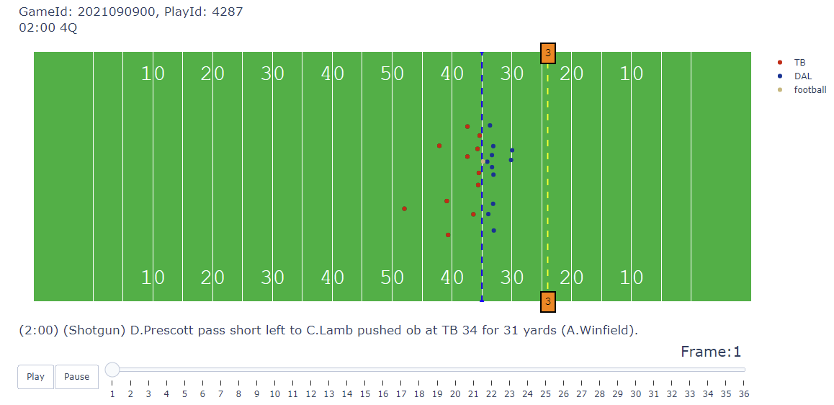
Performance Of Linemen on Pass Plays
(continued)
Play Simulation
Game
Player
Plays

Slide 5
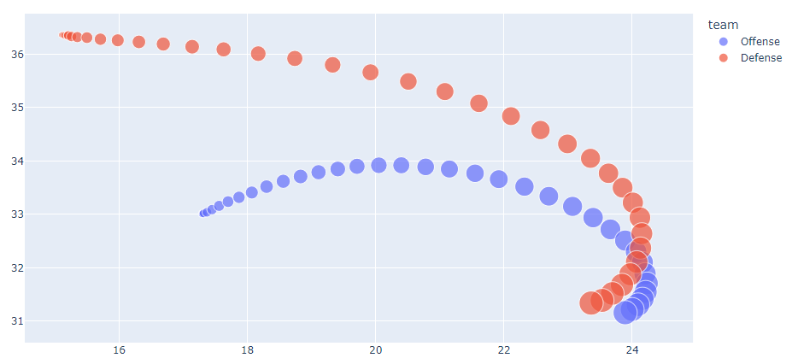
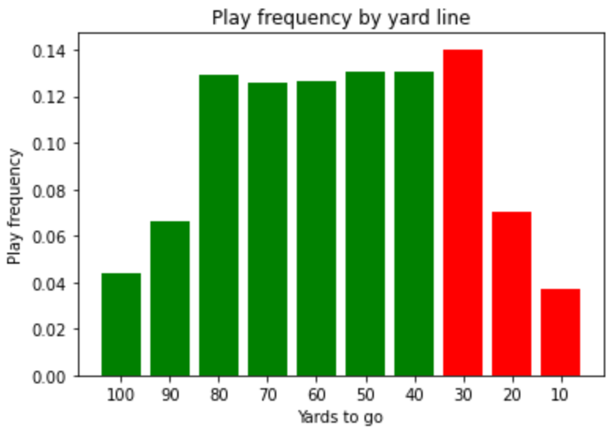
Performance Of Linemen on Pass Plays
(continued)
Game
Player
Plays

