Slide 1
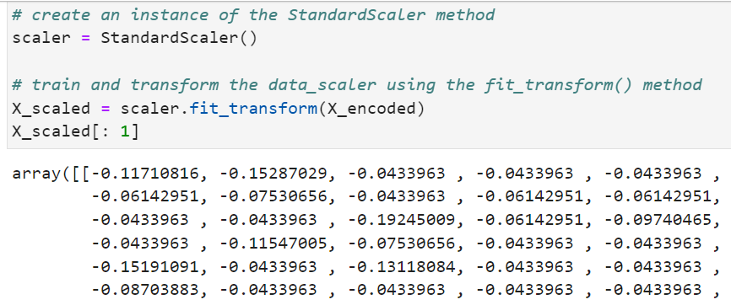
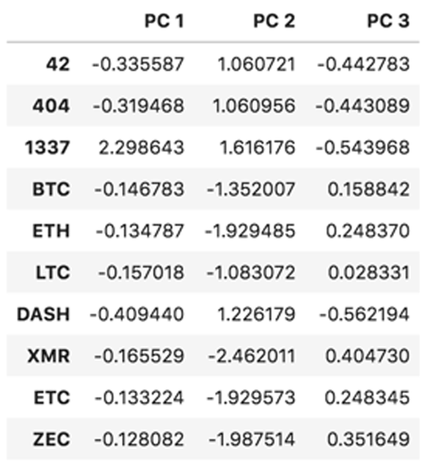

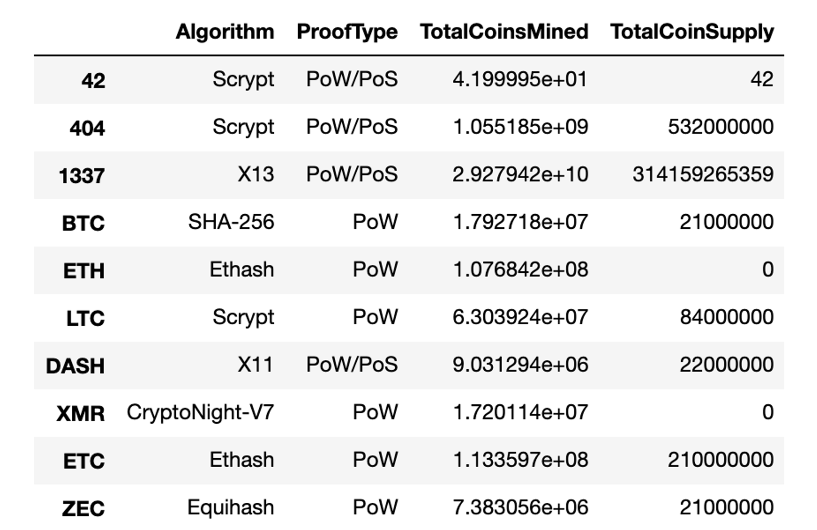

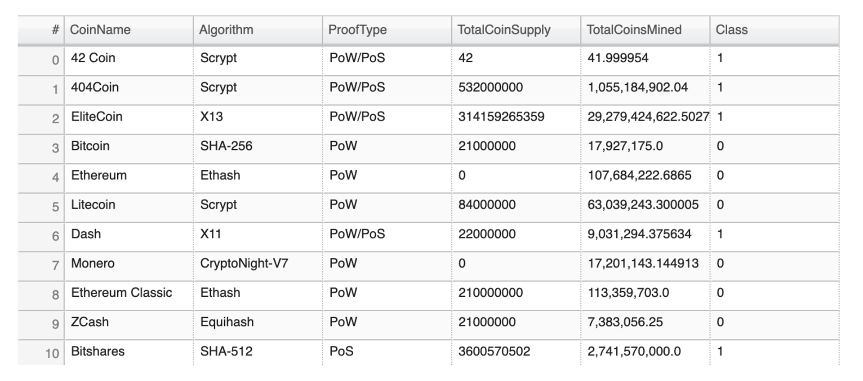
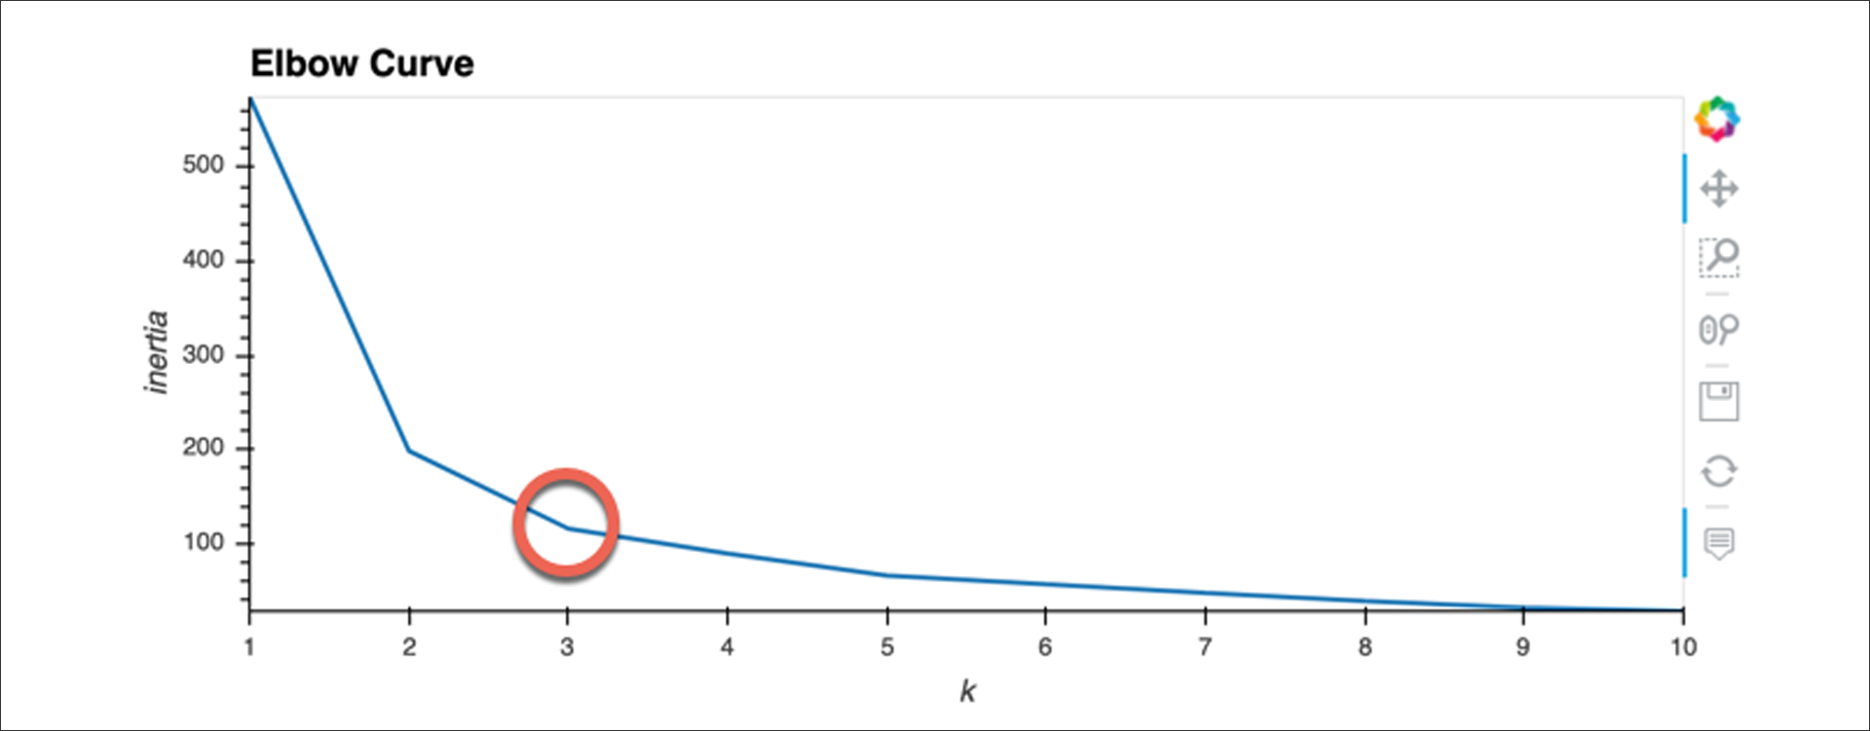
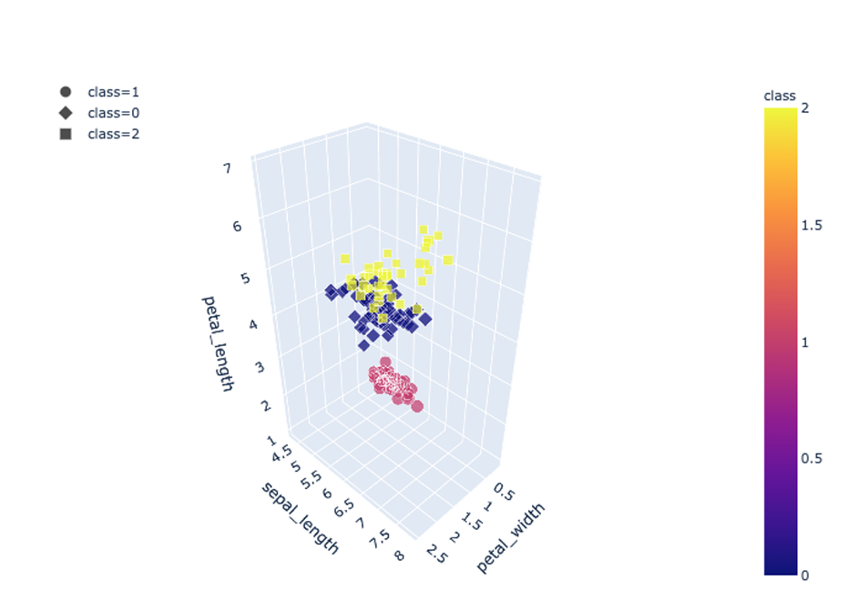
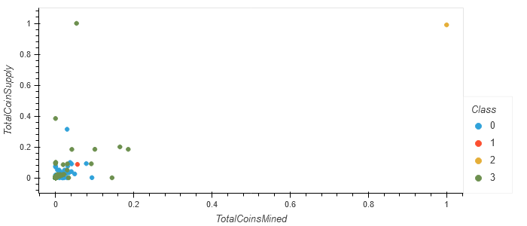
D1
Data Cleaning and Pre-Processing: Questions to be answered:
What knowledge do we hope to glean from running an unsupervised learning model?
What data is available? What type? What is missing? What can be removed?
Is the data in a format that can be passed into an unsupervised learning model?
Can I quickly hand off this data for others to use?
Reducing Data Dimensions Using PCA
D2
PCA n=3
Data Cleaning & Initial Pre-processing
Methods
set_index()
shape
info()
columns
value_counts()
drop()
isnull()
dropna
.loc[]
pd.DataFrame()
to_csv()
pd.to_numeric()
count()
pd.get_dummies()
describe()
crypto_data.csv
Shape: 1252, 7
StandardScaler()
Principal Component Analysis (PCA)
Clean_crypto.csv
Shape: 532, 4
Visualizing Cryptocurrencies using Plotly Express and HVPlot
Clustering Cryptocurrencies Using K-means
D4
hvTable
D3
hvPlot Elbow Curve
K-means algorithm
Create an elbow curve (hvPlot) to select a k
Cluster cryptocurrencies using
K-means (k=4) (Class 0, 1, 2, 3)
3D-scatter plot
hvplot scatter plot

