Slide 1
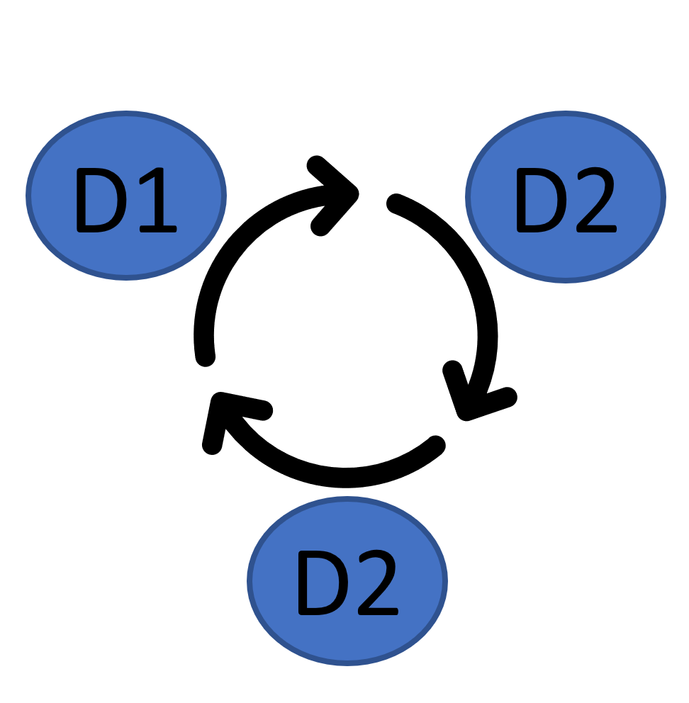
Methodology: Neural Networks
D1
Preprocessing Data for a Neural Network Model
D2
Compile, Train, and Evaluate the Model
Data Cleaning
Define the Model
Import dependencies.
Import the input dataset (charity_data.csv).
Generate categorical variable list.
Visualize the counts using value_counts() & plot.density()
Bin smaller counts using for loop and replace()
Define the model.
Add first and second hidden layers.
Add the output layer.
Check the structure of the model.
19.4.4
19.3.3
19.4.2
Data Pre-Processing
Compile, Train, Evaluate the Model
Create a OneHotEncoder instance.
Fit and transform the OneHotEncoder.
Add the encoded variable names to the DataFrame
Merge one-hot encoded features and drop the originals.
Split the preprocessed data into features and target arrays.
Split the data into training and testing dataset.
Create a StandardScaler instance.
Fit the StandardScaler.
Scale the data.
19.4.5
Compile the Model
Train the model
Evaluate the model
Implement checkpoints
Save the model to HDF5 format
Import model (check)
Evaluate the model using test data
19.4.3
19.6.1
AlphabetSoupCharity_D2.h5
19.6.2
AlphabetSoupCharity_D1.ipynb
AlphabetSoupCharity_D2.ipynb
D3
Optimize the Model
Feature Engineering, Redefine the Model, Compile, Train, Evaluate
Adjusting the input data by Dropping more or fewer columns; Creating more bins for rare occurrences in columns.
Increasing or decreasing the number of values for each bin.
Adding more neurons to a hidden layer.
Adding more hidden layers.
Using different activation functions for the hidden layers.
Adding or reducing the number of epochs to the training regimen.
AlphabetSoupCharity_D3.h5
AlphabetSoupCharity_D3.ipynb

Slide 2


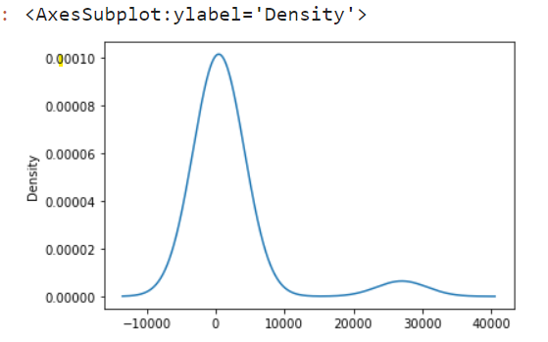
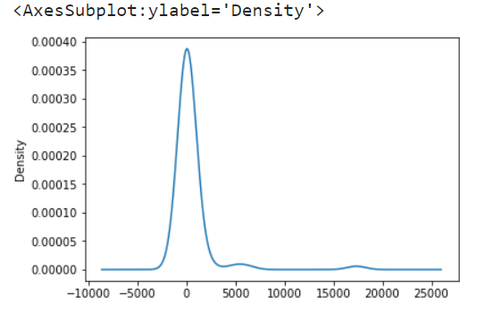
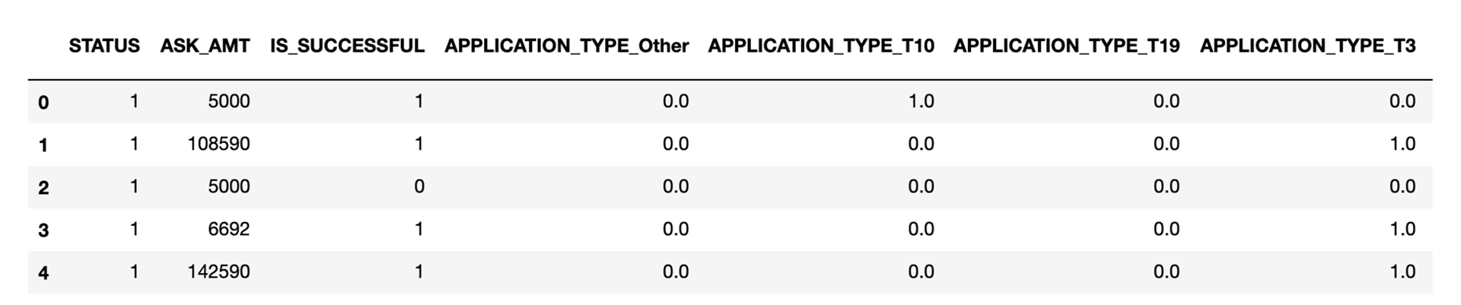
Methodology: Neural Networks
D1
D2
D1
Preprocessing Data for a Neural Network Model
charity_data.csv
application_df
Data Cleaning
D3
Import dependencies.
Import the input dataset (charity_data.csv).
Generate categorical variable list.
Visualize the counts
Bin smaller counts as necessary
Shape: 34299, 12
Shape: 34299, 12
Determine the number of unique values in each column.
Visualize value_count and bin (Application_Type, Classification)
19.3.3
19.4.2
Feature Engineering
Dropped columns “EIN, “NAME”
Binned low occurrence value counts “APPLICATION_TYPE”, “CLASSIFICATION”
Data Pre-Processing
Application_Type
Classification
Create a OneHotEncoder instance.
Fit and transform the OneHotEncoder.
Add the encoded variable names to the DataFrame.
Merge one-hot encoded features and drop the originals.
Split the preprocessed data into features and target arrays.
Split the data into training and testing dataset.
Create a StandardScaler instance.
Fit the StandardScaler.
Scale the data.
19.4.3
Apply OneHotEncoder to categorical values
Merge with application_df and drop original column(s)
AlphabetSoupCharity_D1.ipynb
Shape: 34299, 44
Split into feature matrix (X), and target (y)
Split into train and test set (using train_test_split)
Scale the feature matrix (X) using StandardScaler
X_train_scaled
X_test_scaled
y_train
y_test

Slide 3
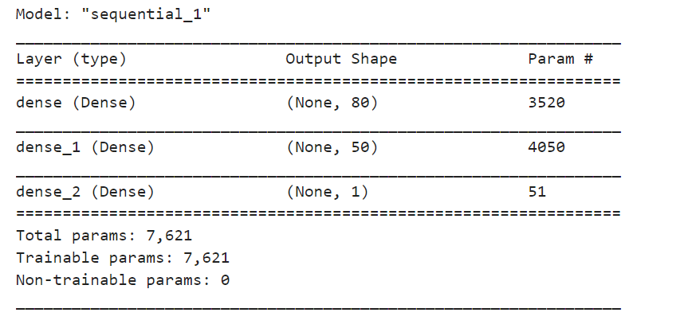
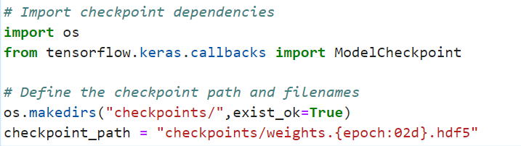
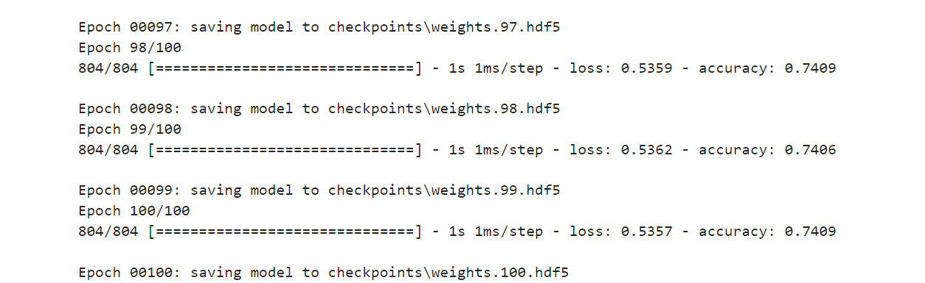

Methodology: Neural Networks
D1
D2
D2
D3
Compile, Train, and Evaluate the Model
19.4.4
Define the Model
Define the model.
Add first and second hidden layers.
Add the output layer.
Check the structure of the model.
19.4.5
Compile, Train, Evaluate the Model
19.6.1
Compile the Model
Train the model
Evaluate the model
Implement checkpoints
Save the model to HDF5 format
Import model (check)
Evaluate the model using test data
19.6.2
AlphabetSoupCharity_D2.h5
AlphabetSoupCharity_D2.ipynb
Notes:
Same feature engineering as D1
Created Neural Network with one input, two hidden layers, one output
Accuracy below benchmark(0.727), loss high(0.554)

Slide 4
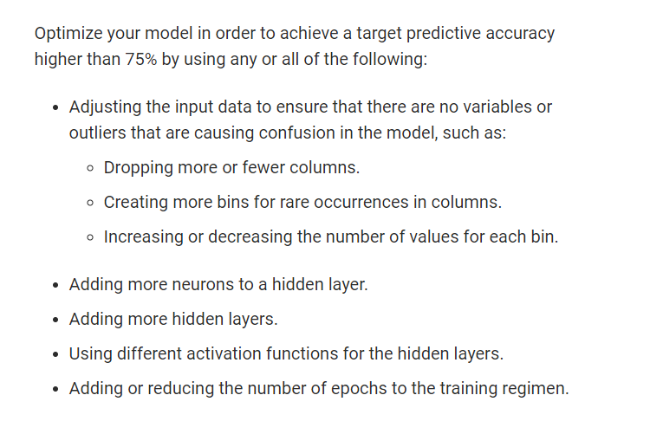
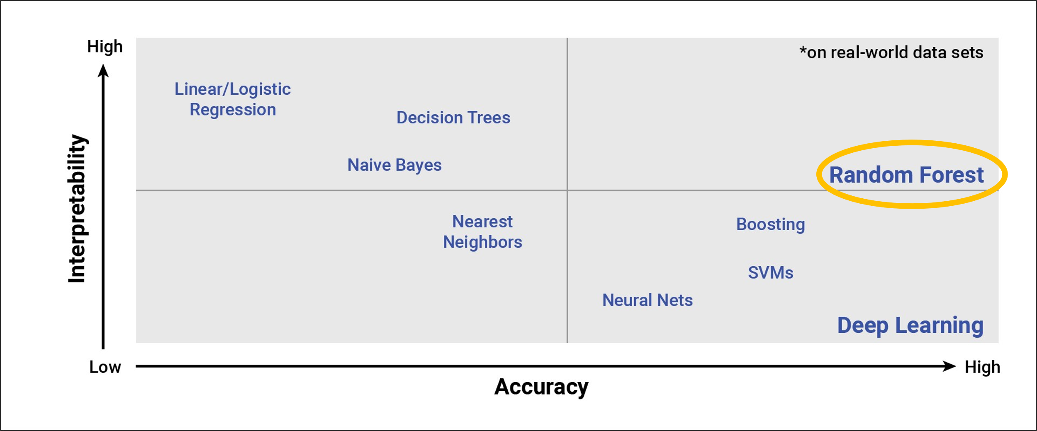
Methodology: Neural Networks
D1
D2
Neural Network: D_3_1
D3
Neural Network: D_3_2
Neural Network: D_3_3
RandomForestClassifier
D3
Optimize the Model
Feature Engineering, Redefine the Model, Compile, Train, Evaluate
Adjusting the input data by Dropping more or fewer columns; Creating more bins for rare occurrences in columns.
Increasing or decreasing the number of values for each bin.
Adding more neurons to a hidden layer.
Adding more hidden layers.
Using different activation functions for the hidden layers.
Adding or reducing the number of epochs to the training regimen.
Compare with other models
AlphabetSoupCharity_D3.h5
+
AlphabetSoupCharity_D3.ipynb

Slide 5
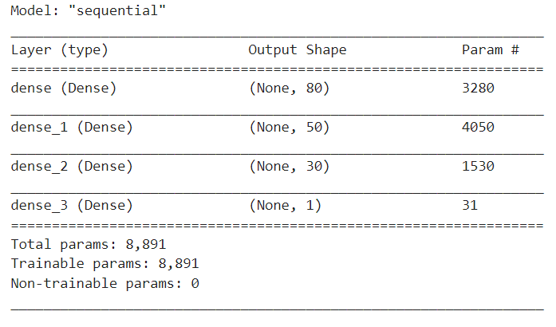
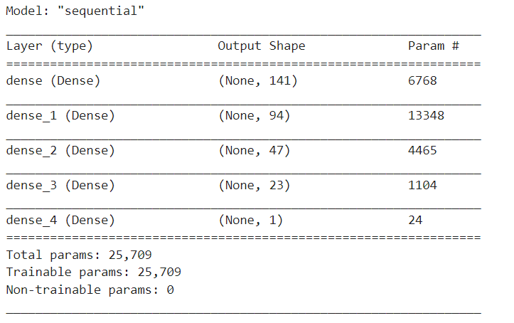
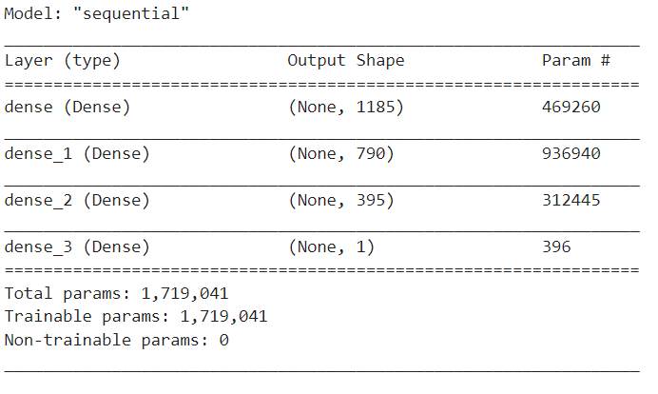
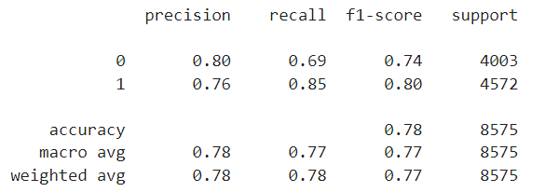
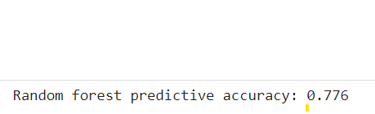
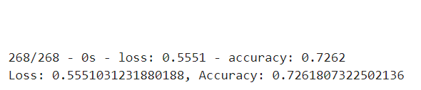


Methodology: Neural Networks
D1
D2
D3
Optimize the Model
D3
Feature Engineering, Redefine Model, Compile, Train, Evaluate
Adjusting the input data by Dropping more or fewer columns; Creating more bins for rare occurrences in columns.
Increasing or decreasing the number of values for each bin.
Adding more neurons to a hidden layer.
Adding more hidden layers.
Using different activation functions for the hidden layers.
Adding or reducing the number of epochs to the training regimen.
Compare with other models
AlphabetSoupCharity_D3_x.h5
+
AlphabetSoupCharity_D3_x.ipynb
Neural Network: D_3_1
Neural Network: D_3_2
Neural Network: D_3_3
Benchmark:
RandomForestClassifer
1
2
3
4
Notes: Add Hidden Layer
Notes: Feature Section &
Add Hidden Layer, Activation
Notes: Feature Selection – No Change to Model
Notes: Create RandomForest Classifier for Comparison
Feature Selection & Model Refinement
Dropped columns “EIN, NAME”
Dropped “low information” columns “STATUS”, “SPECIAL_CONSIDERATIONS”
Binned low occurrence value counts “APPLICATION_TYPE”, “CLASSIFICATION”
Added a hidden layer
Dropped the epochs down to 50
Feature Selection & Model Refinement
Dropped “low information” columns “STATUS”, “SPECIAL_CONSIDERATIONS”
Binned low occurrence value counts “APPLICATION_TYPE”, “CLASSIFICATION”
Bucketed “NAME” into three categories “
Added a hidden layer and changed activation functions to sigmoid
Feature Selection & Model Refinement
Dropped “low information” columns “STATUS”, “SPECIAL_CONSIDERATIONS”
Binned low occurrence value counts “APPLICATION_TYPE”, “CLASSIFICATION”
Binned “NAME” into an other category for all values less than or equal to five
No change to model
Feature Selection & Model Refinement
Created a RandomForestClassifier for comparison.

