Slide 1
THE BEST PIZZA NEAR RIT
A Data-Driven Market Entry Strategy
BANA255 Business Analytics | Fall 2025
161 Students Surveyed
52 Visualizations | 3-Component Model

Slide 2
THE ACTION FRAMEWORK
Our Analytical Approach

Slide 3
ACTION Framework Application
ASK & CLARIFY
THINK & INFORM
• Question: What defines 'best pizza' for RIT students?
• 161 consented survey responses
• 98.6% data completeness, 92/100 quality score
• 9 pizza quality factors analyzed
• Weighted importance model (Friedman test)
• ML prediction: RF, GBM, Logistic (71% acc)
• Competitive ranking with composite scores
• Van Westendorp price sensitivity analysis

Slide 4
OUR 'BEST PIZZA' MODEL
Three Components, One Answer

Slide 5
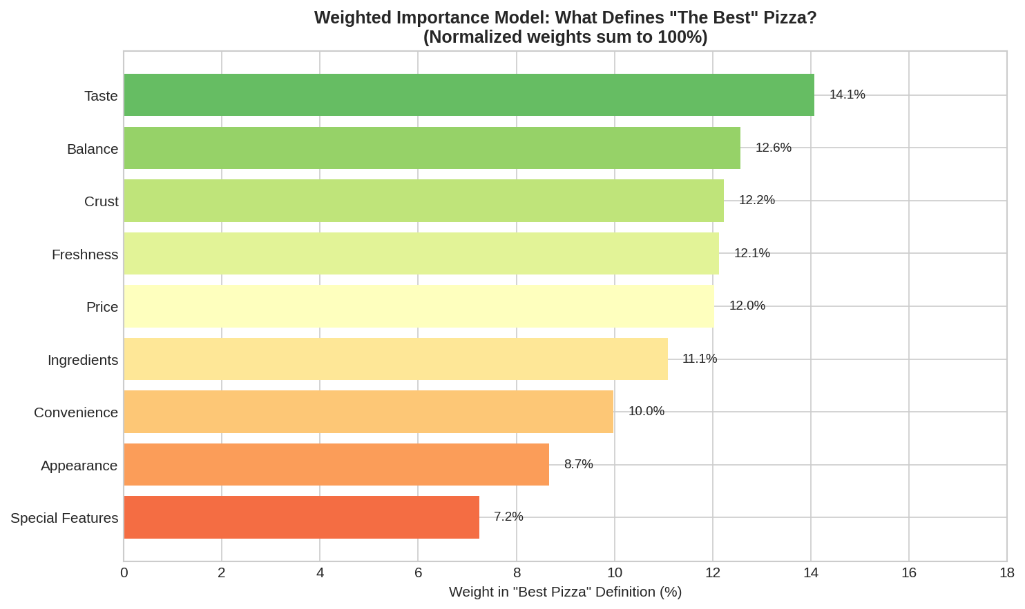
Component 1: What Makes Pizza 'Best'?
• Taste & Flavor: 14.1% weight (94% rate highly important)
• Balance: 12.6% | Crust: 12.2% | Freshness: 12.1%
• Price: 12.0% (critical value factor)
• Core Quality factors = 51% of total weight
• Friedman Test: X² = 435.85, p < 0.001

Slide 6
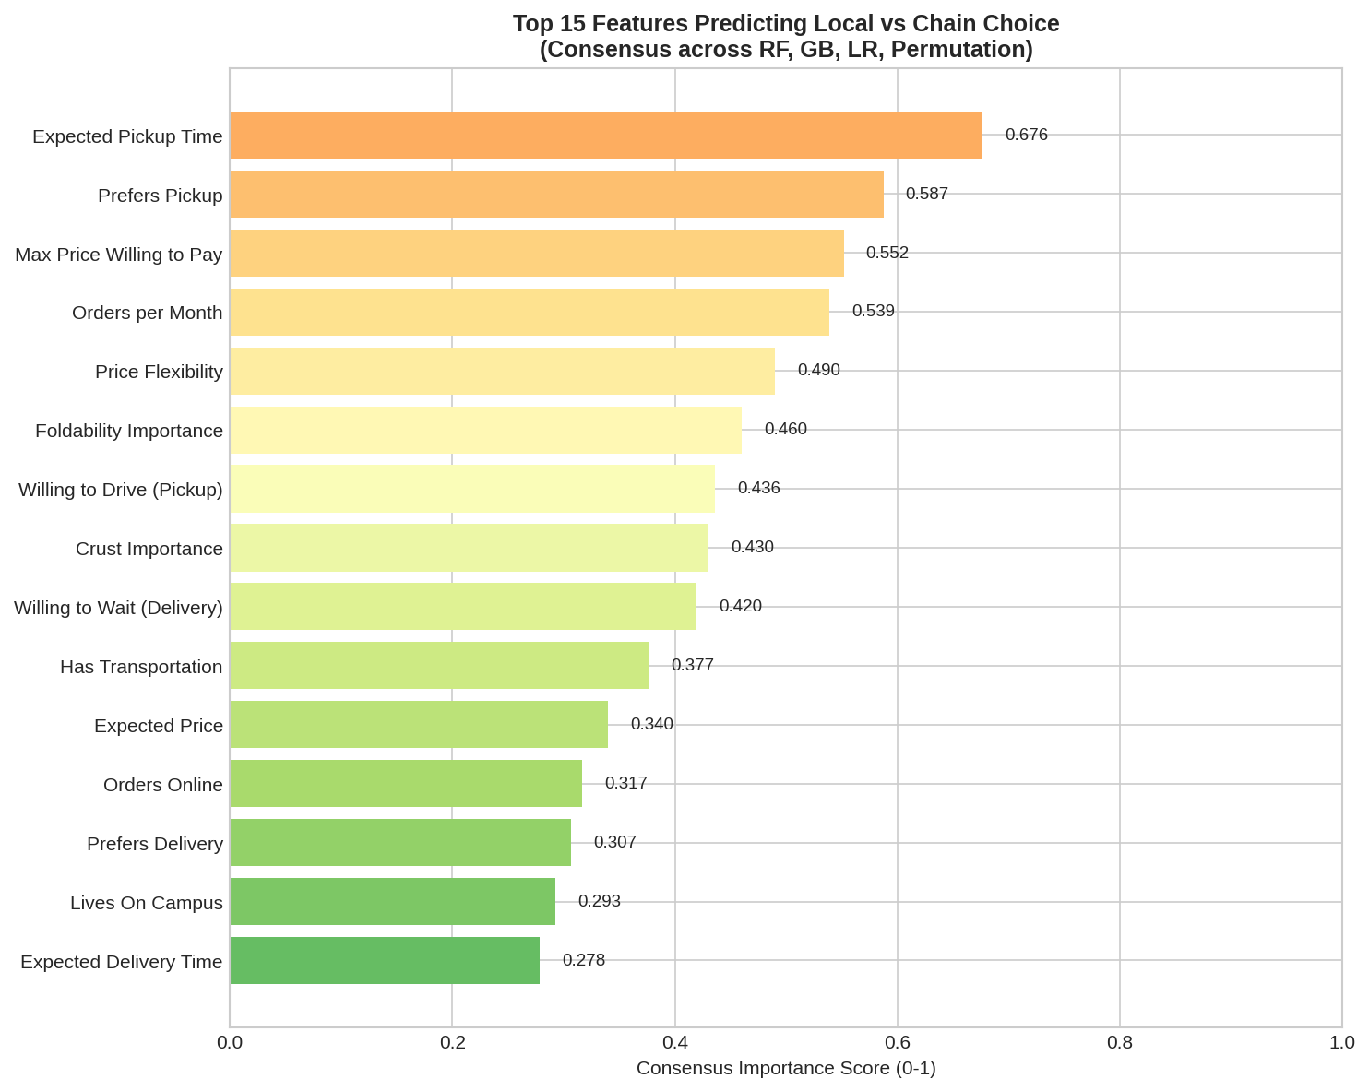
Component 2: Predicting Local vs Chain Choice
• 71.1% accuracy WITHOUT circular features
• Excluded 'states prefer local' (tautological)
• Top predictors: Pickup time, Max price, Transportation
• Students with cars: 2.7x more likely to choose local
• Key insight: Convenience drives actual behavior

Slide 7
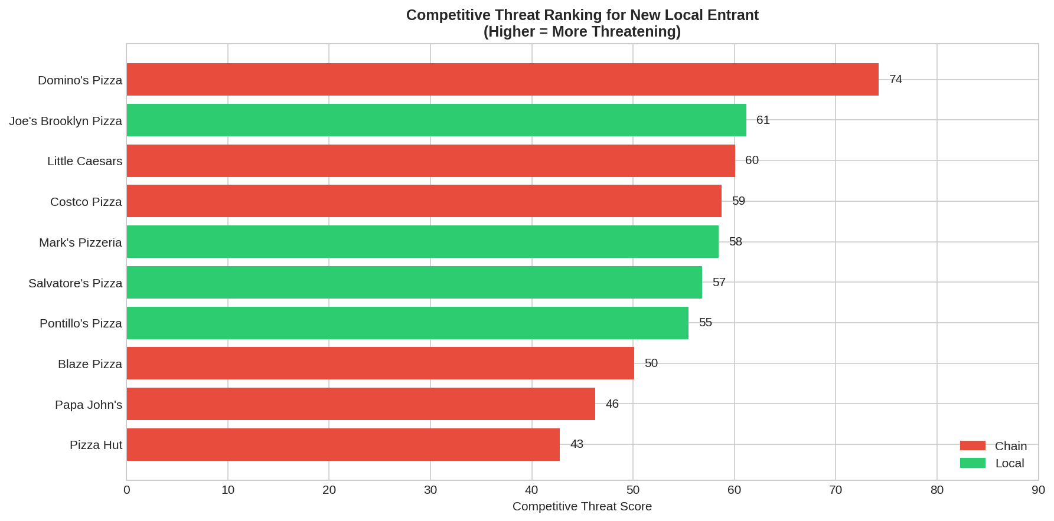
Component 3: Competitive Threat Ranking
Composite score: Market Share (30%) + Loyalty (25%) + Profile Match (25%) + Local Capture (20%)

Slide 8
THE WINNER IS...
DOMINO'S PIZZA
27.3% Market Share (44 votes)
Threat Score: 73.9/100
Statistical Significance: p = 0.0001

Slide 9
46pp
THE LOCAL-CHAIN PARADOX
84% SAY they prefer local pizza, but only 38% CHOOSE local pizza

Slide 10
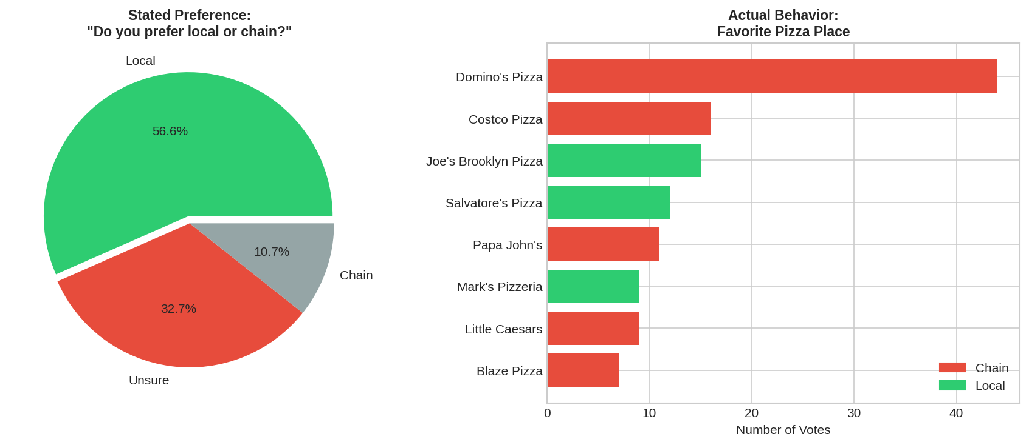
The Preference-Action Gap Explained
• 74 students WANT local but choose chains
• Why? Convenience constraints:
• - Transportation barriers (no car)
• - Time constraints (chains are faster)
• - Price perception (chains seem cheaper)
• This gap = Our market opportunity

Slide 11
MARKET ENTRY STRATEGY
Capturing the Opportunity

Slide 12
SWOT ANALYSIS: Market Entry Opportunity
STRENGTHS
WEAKNESSES
• 84% prefer local quality
• Fresh, authentic positioning
• Untapped 'persuadable' segment
• New entrant (no brand recognition)
• Higher operating costs
• Limited delivery infrastructure
OPPORTUNITIES
THREATS
• 46pp preference-action gap
• 74 students ready to switch
• $9.38 avg side order spend
• Domino's convenience dominance
• Chain price competition
• Student budget constraints

Slide 13
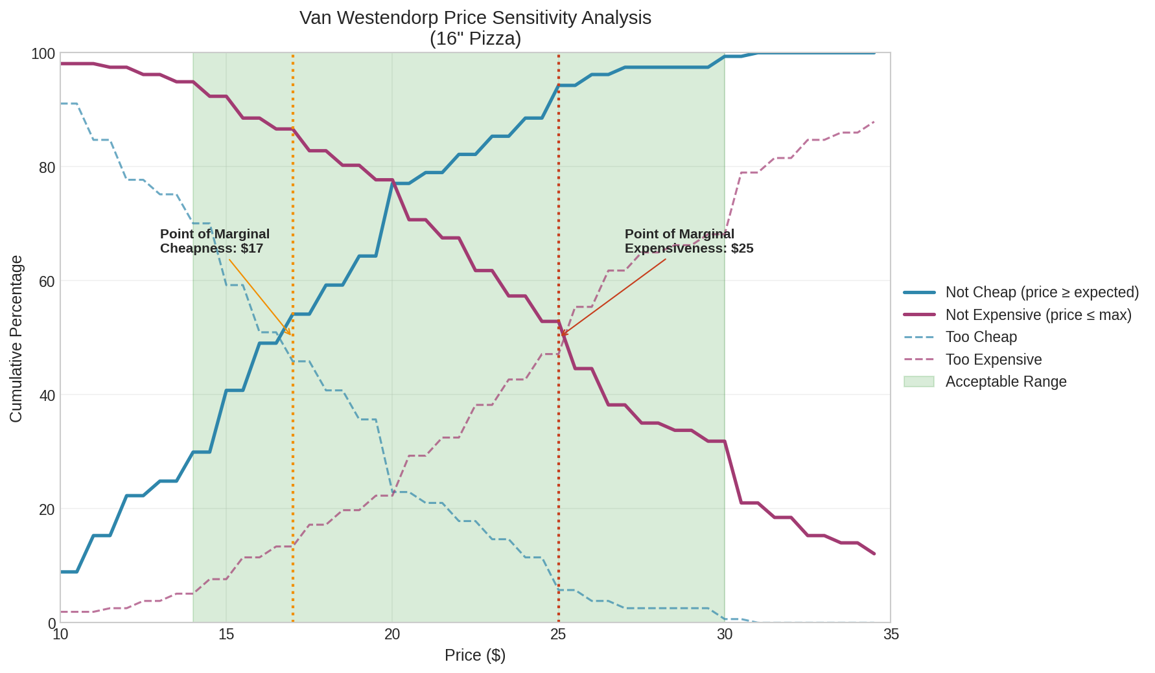
Optimal Pricing: Van Westendorp Analysis
• Optimal Price Point: $18-20 for 16" pizza
• Acceptable range: $15-22
• Below $15: Perceived as low quality
• Above $22: Too expensive for students
• Side order opportunity: $9.38 average spend

Slide 14
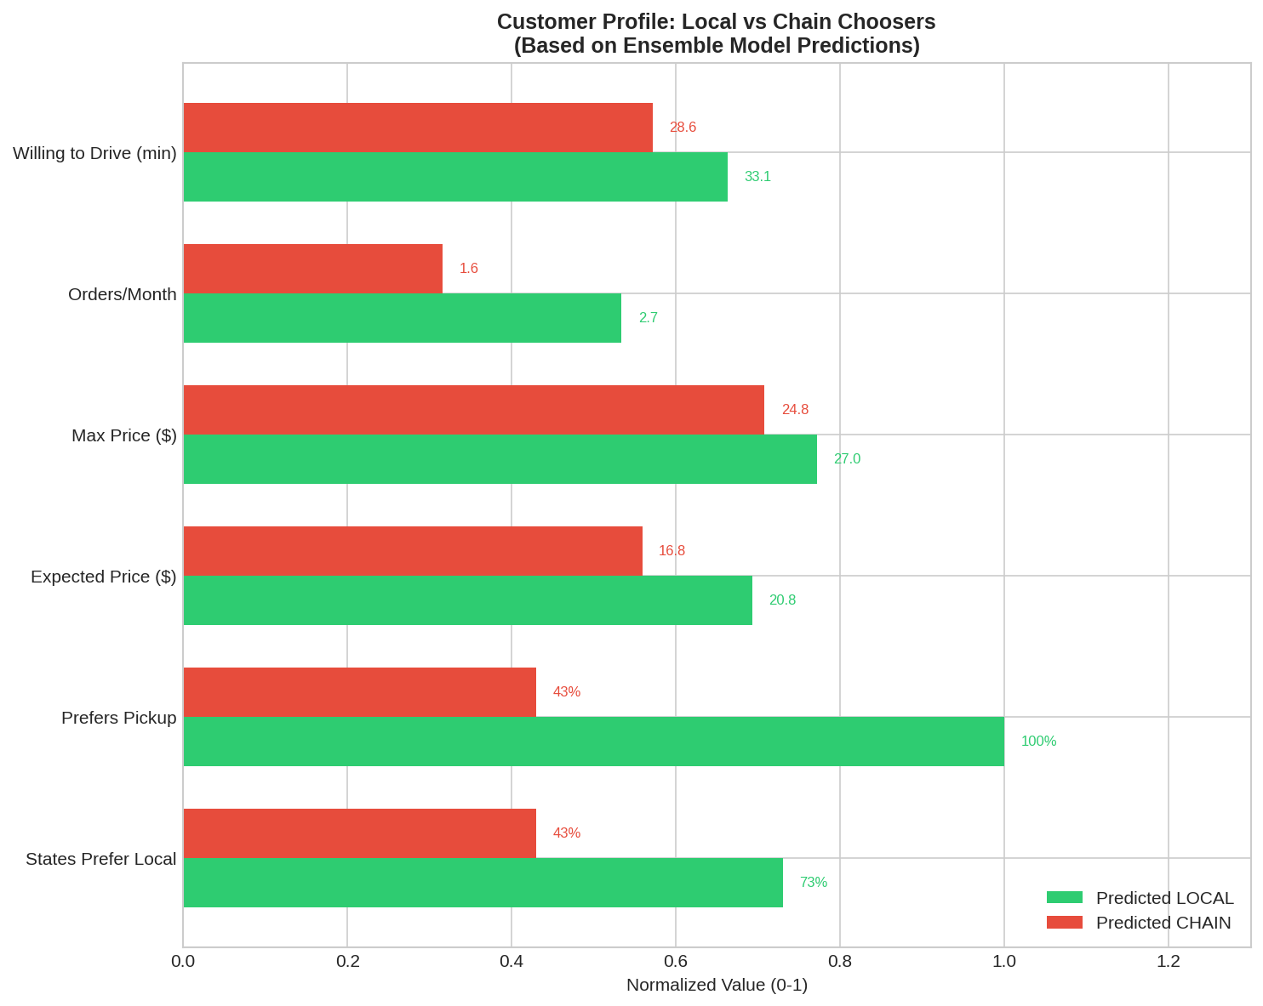
Target Customer Segments
• Primary: Quality Seekers (29%)
• - Prioritize taste over price
• - Higher price tolerance ($20+)
• Secondary: Value Hunters (35%)
• - Price-sensitive but quality-aware
• - Target with combo deals
• Key: Students with transportation access

Slide 15
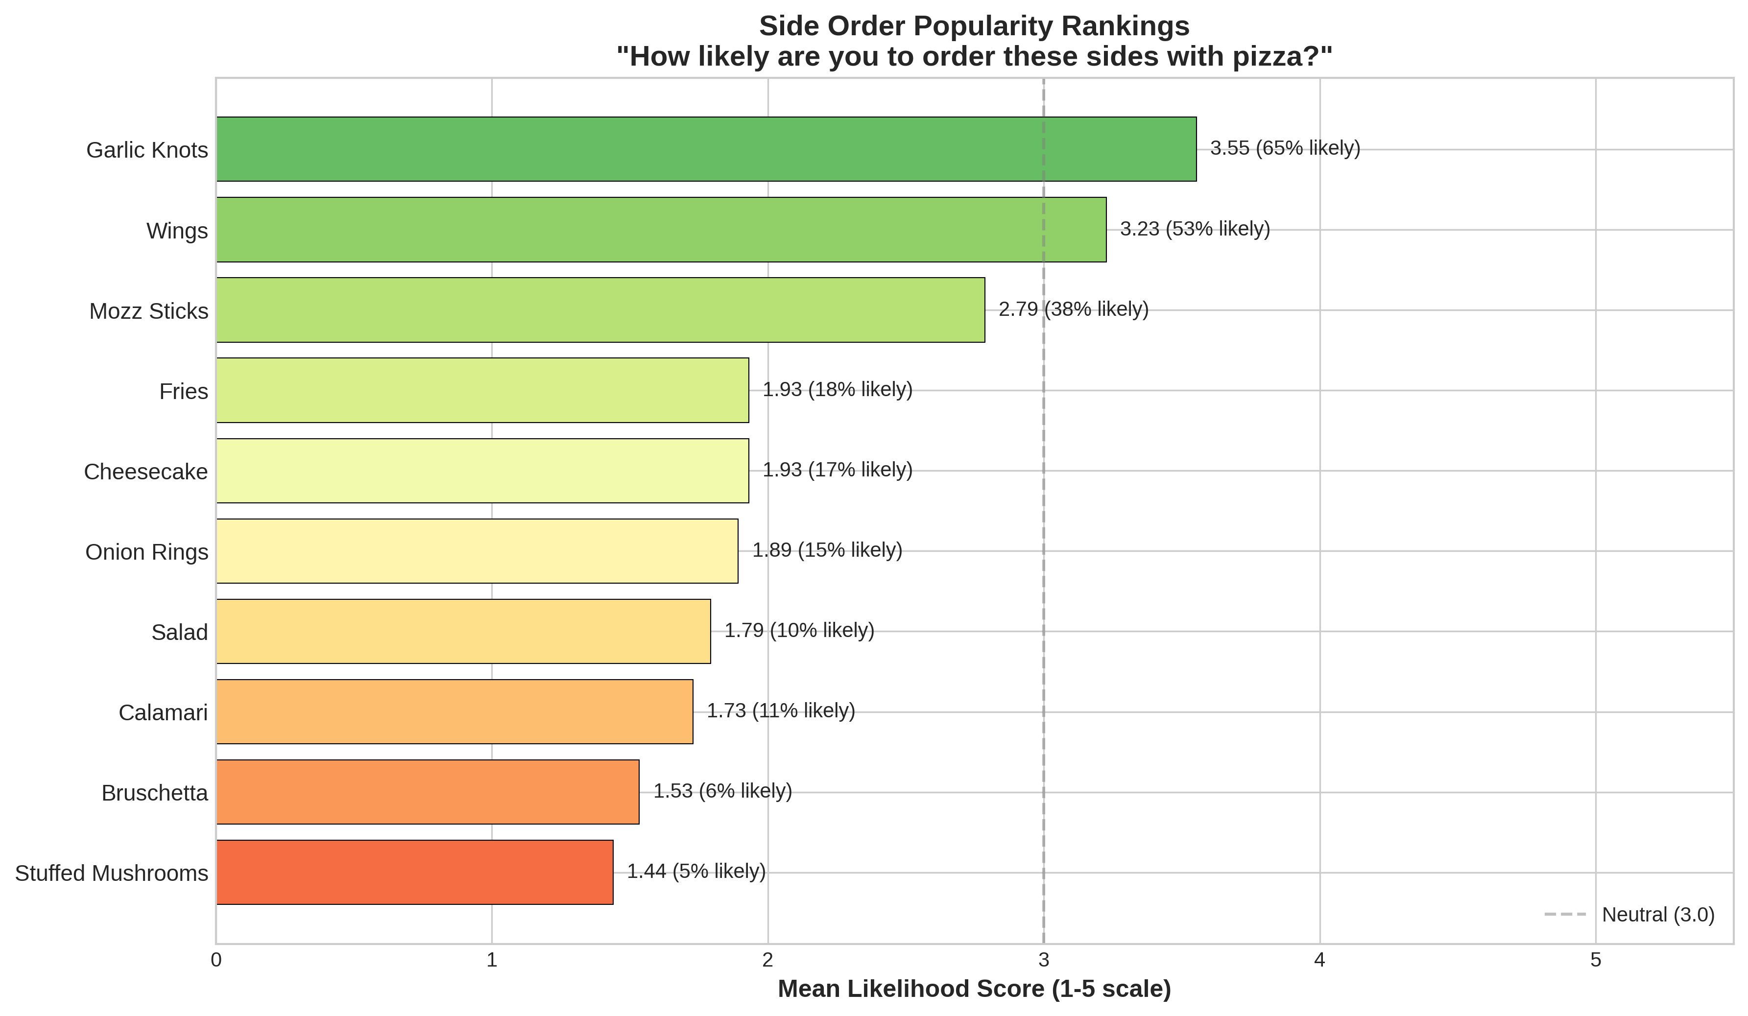
Side Order Revenue Opportunity
• Garlic knots: 65% would likely order
• Wings: 53% would likely order
• Breadsticks: 41% would likely order
• Average side spend: $9.38 per order
• Strategic recommendation: Bundle with pizza deals

Slide 16
STRATEGIC RECOMMENDATION
"LOCAL QUALITY AT CHAIN CONVENIENCE"
PRODUCT
PRICE
SERVICE
TARGET
Exceptional taste (94% priority)
Fresh ingredients, balanced flavor
$18-20 for 16" pizza
Optimal Van Westendorp point
Fast pickup (<22 min)
Reliable delivery times
Students with transportation
2.7x more likely to choose local
Capture the 74 'persuadable' students ready to switch from chains to quality local pizza

Slide 17
Key Metrics Summary
MARKET INSIGHTS
SUCCESS FACTORS
• 161 students surveyed (98.6% complete)
• Domino's leads: 27.3% market share
• 84% prefer local, 38% choose local
• 46 percentage point gap = opportunity
• 71.1% prediction accuracy
• Taste is #1 (14.1% weight, 94% priority)
• Speed matters: <22 min pickup expected
• Price sweet spot: $18-20
• Side orders: +$9.38 per ticket
• Target: Students with transportation

Slide 18
QUESTIONS?
The Best Pizza = Taste + Value + Speed
Winner: Domino's | Opportunity: 74 Persuadable Students

