Slide 1
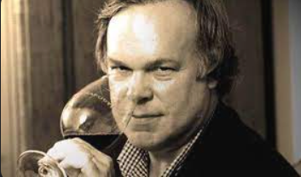
Ashenfelter is an absolute total sham. His methods are “Neanderthal” not to mention ludicrous and absurd.
He is like a movie critic who never goes to see the movie but tells you how good it is based on the actors and the director.

Slide 2

I won't have much influence on (the industry) at all. Their goal now is to ignore us. Many connoisseurs agree privately with me but refuse to say so publicly.

