Slide 1
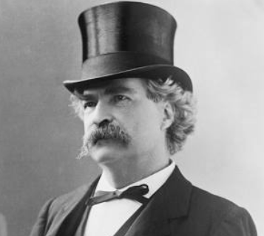
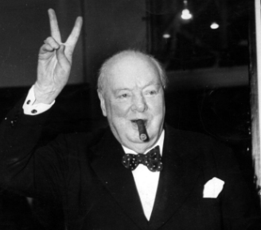
There are three kinds of lies:
lies, damned lies, and statistics.
The only statistics you can trust are those you falsified yourself.
quote popularized by Mark Twain
quote attributed to Winston Churchill

