Slide 1
Gravity learning for elastic joint robots
Robotics 2 Final Project
Master in Artificial Intelligence and Robotics
made and presented by:
Dennis Rotondi - 1834864
rotondi.1834864@studenti.uniroma1.it
Fabio Scaparro - 1834913
scaparro.1834913@studenti.uniroma1.it
Academic Year 2021-2022
Sapienza University of Rome

Slide 2
In this presentation . . .
Dennis
Understand why regularize elastic robots is important
Elastic joint robots dynamic model
Why the classic PID fails
Iterative method with a sketch of proof
Implementation on Simulink
Simulation results
Fabio
Notes:
regulation problem is important

Slide 3
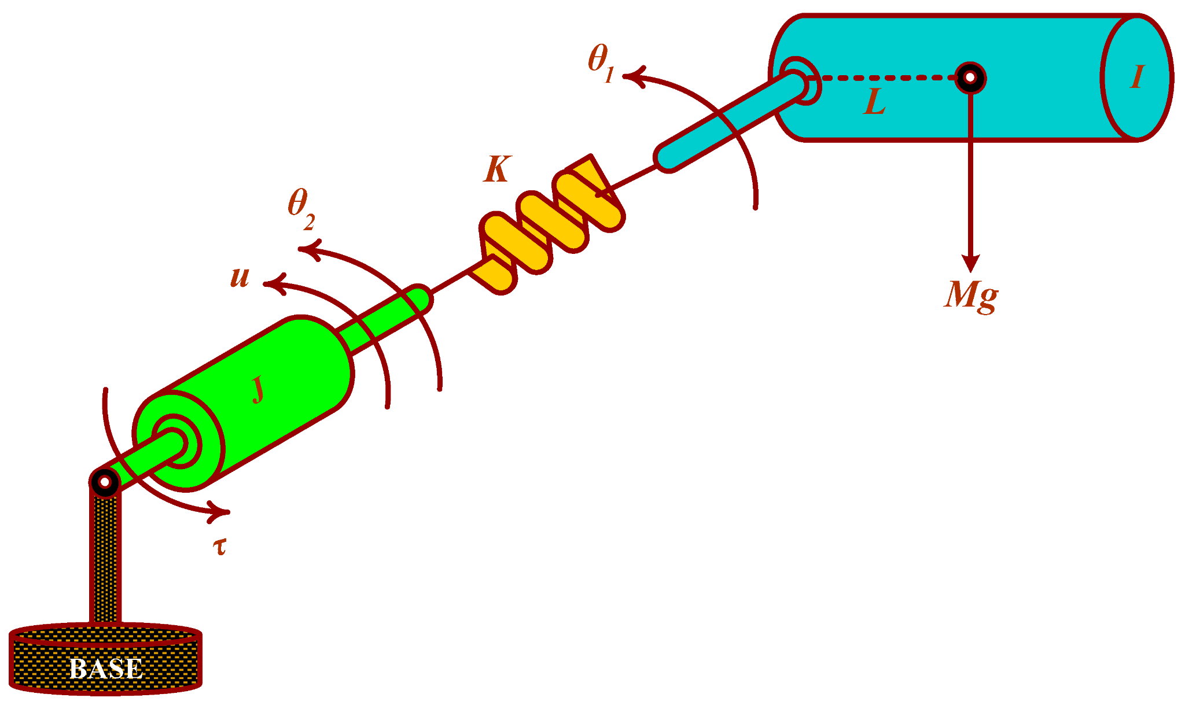
Are elastic joint robots a thing?
YES!!
Notes:
they are not found only on books, and regulation for them is not a toy problem found only in school

Slide 4
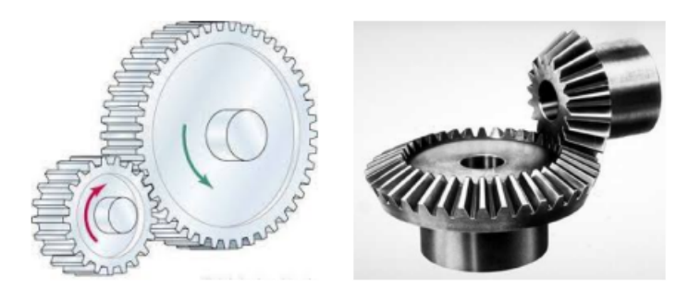
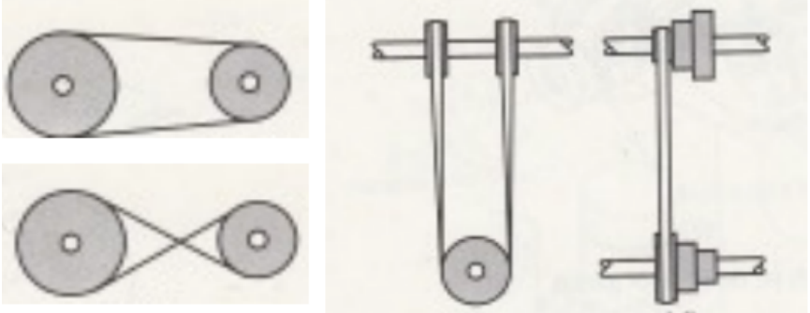
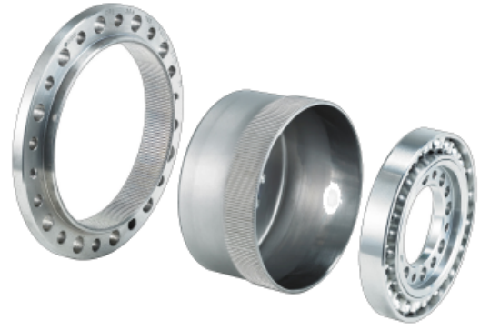
Joint flexibility is common in industrial robots
Motion transmission/reduction elements such as: belts, long shafts, cables, harmonic drives, or cycloidal gears, intrinsically introduce this property!
allow to relocate the actuators next to the robot base, thus improve power/dynamic efficiency;
are also preferred for physical human–robot interaction, since grant a decoupling between actuators and the lighter links, thus reducing the kinetic energy involved in undesired collisions with humans.

Slide 5
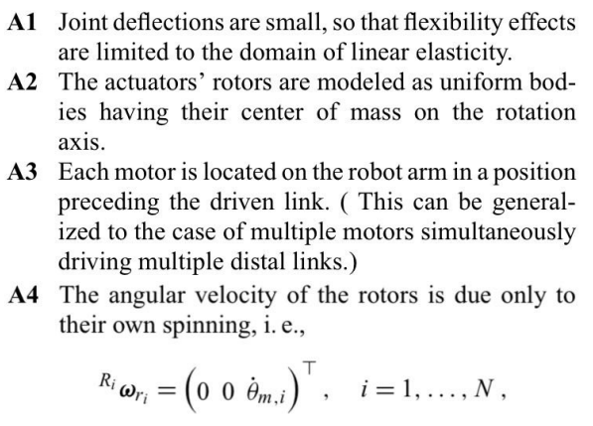
Dynamic Modeling
When reduction gearings are present, they are modeled as being placed before the joint deflection occurs. Standard assumptions and simplifications are made to ensure long life of electrical drives, linear elasticity, decoupling and independence properties.
Notes:
with A2 is the basic requirement for long life of an electrical drive and thanks to it the rotor inertia matrix is then diagonal (+ g indep from thata);thanks to A3 general expression for Riwri = sum up to i-1 of Jrij*dqj+ (0 0 thetam,i)’, A4 is true engaging large reduction ratio; A3 allow to express

Slide 6
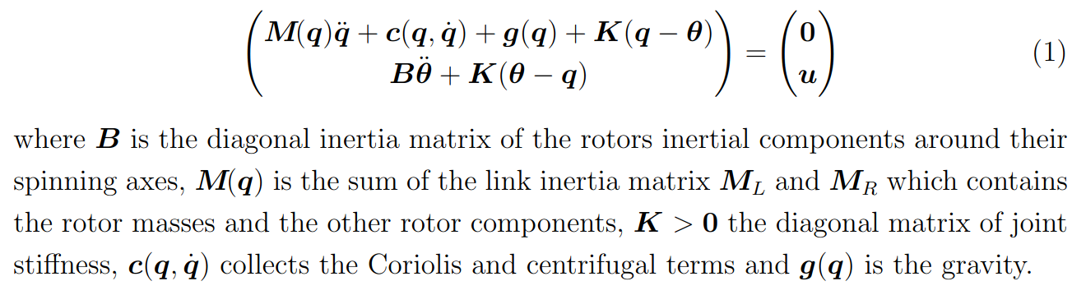
Reduced Model
In contrast with the rigid robot, here there is a displacement between motor and link frames, we need 2N variables, one for each rigid body. A1–A4 combined with Euler-Lagrange method lead to the model:
Notes:
2N generalized coordinates, this equations are also know as reduced model. Eventually it’s interesting to note that k->inf, theta->q, elastic torque K(t-q)->u, making it collapse into the standard fully rigid. we do not model any kind of friction or dampening since they only helps the control.

Slide 7
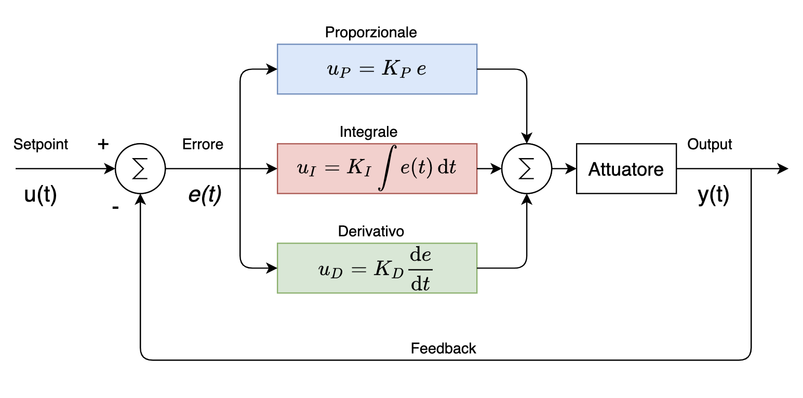
Control is harder
The price for agility and safety given by transmission elements is that we cannot rely on classic controls and therefore, in particular, it’s harder to regularize flexible joint robots.
Notes:
more complex and sophisticated control is the price to pay for the agility and safety given by the motor relocation.

Slide 8
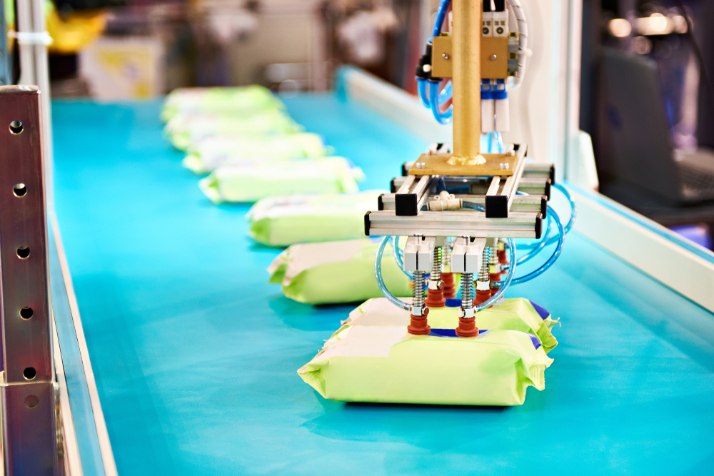
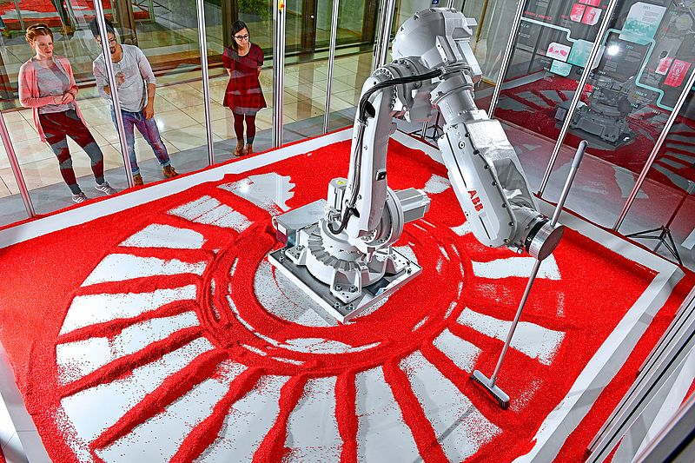
PID limitations
On several tasks there isn’t exact knowledge of the gravity vector, hence we cannot use a simple PD law with constant gravity compensation. Even PID, the go-to for the rigid case:
has no formal proof of global convergence;
is mathematically complex due to the nonlinear nature of the model;
saturation will occur during large transient phases.

Slide 9
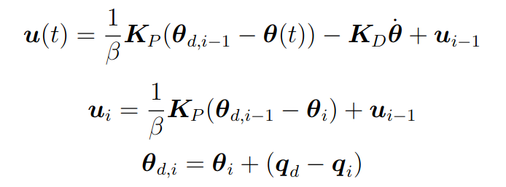
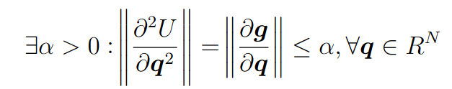
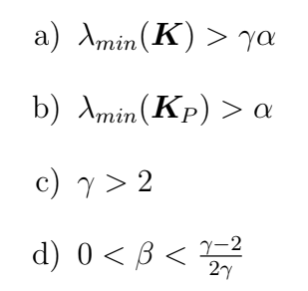
Iterative learning method
Control law:
Recalling:
This approach is based on the idea of using a PD control loop at motor level and two update rules for learning the correct compensation at the desired point. Under the assumptions a)--d) it assure global convergence to the desired configuration q_{d}!
Sufficient Assumptions:
Notes:
proportional gain, derivative gain; how to initialize u0 and thetad its most correct initialization is the desired tip position whether the arm were fully rigid

Slide 10
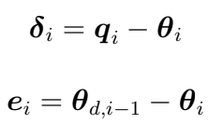

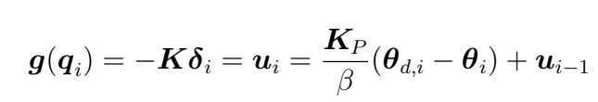


Sketch of proof
We first define then by proving that we can show .
To this purpose we need to create a contraction map for both of them.
This is possible considering that with a constant gravity approximation we end up in a steady state
, then manipulating the differences between quantities at consequent iteration and involving the structural property of the gravity term we can properly upper bound
, assumptions guarantee that the inequalities do not change sign and that they are enforced.
Notes:
contraction for e, for delta_theta_d is similar

Slide 11
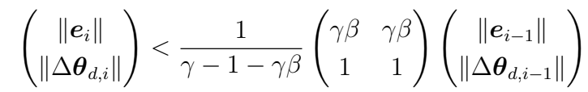

Sketch of proof
We first define then by proving that we can show .
To this purpose we need to create a contraction map for both of them.
this is the mapping we are looking for since thanks to d) the matrix has eigenvalues strictly inside the unit circle.
Then from we can easily derive the thesis.

Slide 12
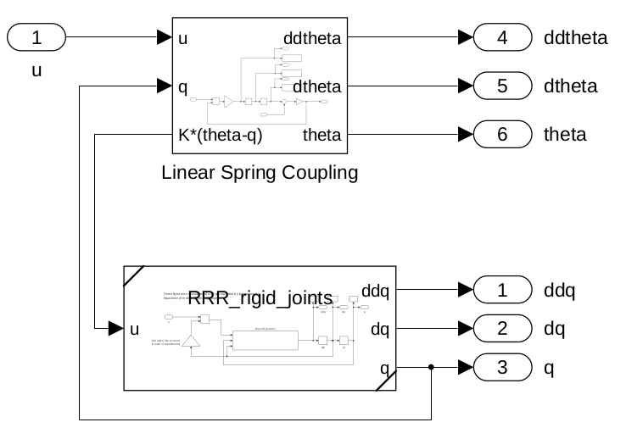
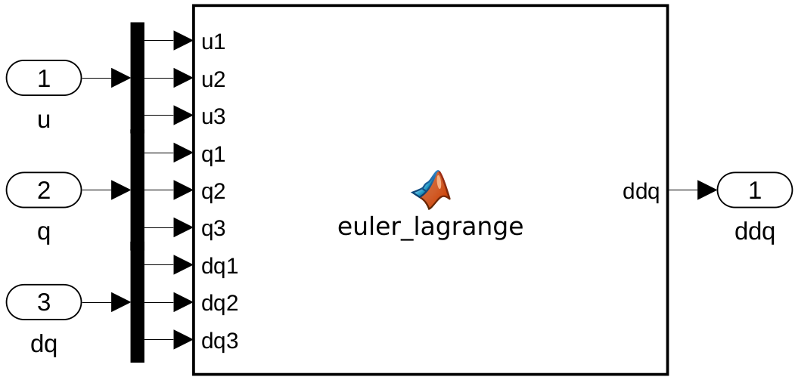
Implementation
on Simulink
Forward dynamics via Matlab Function Block:
define symbolic expression ddq = …;
compile a Matlab Function Block
ddq = directDynamics(q, dq, u).
Additional block which exchanges elastic forces between state variables.

Slide 13
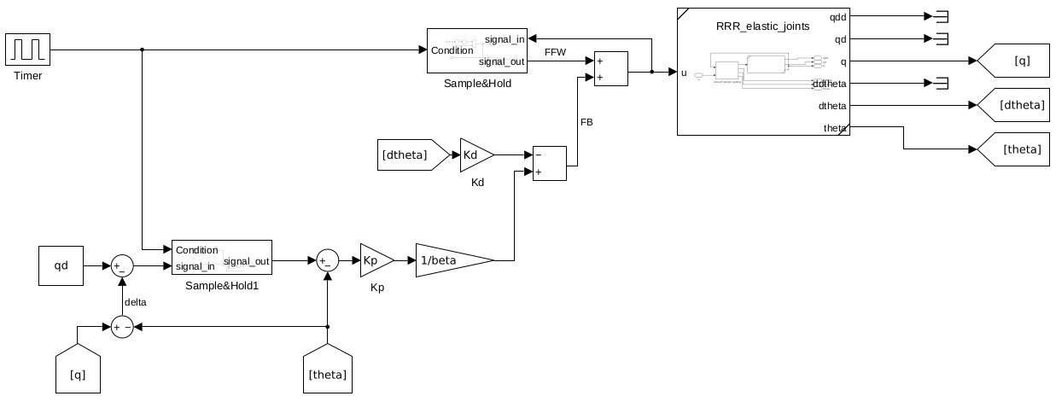
Iterative control law
The control input is composed of FB + FFW alike PD+, but:
feedforward is not constant and is sampled from the whole control input at each new iteration;
motor position reference is also variable and sampled;

Slide 14
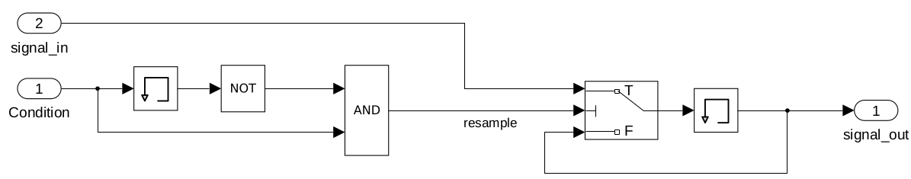
Sample and Hold
To update FFW term and reference value, we make use of a Sample&Hold block, which outputs a sampled signal_in,resampling it when condition has a rising edge.
Rising edge detector
Ideally sampling happens when the system is at ~steady state (velocities close to zero), so condition would be some steady state detection mechanism (for example a check on velocity norm).
In our case it is hard to dampen link velocities due to our modeling choices and the check would never trigger. We iterate at periodic intervals instead. Thus condition is just a clock.

Slide 15
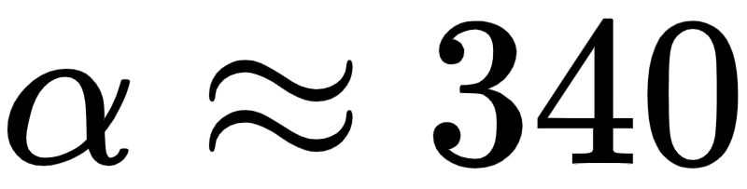
Simulations
Links have the same length 1 [m] Uniformly distributed masses: - m1 = 10 [kg] - m2 = 7.5 [kg] - m3 = 5 [kg]
Three different stiffness configurations to test the limits of the iterative approach:
HIGH stiffness
MEDIUM stiffness
LOW stiffness
We also test the hypotheses of the proof to demonstrate that in some cases we can attain convergence despite having low gains / soft joints.
at q = [-pi/2; 0; 0] (estimated through sampling random configurations)

Slide 16
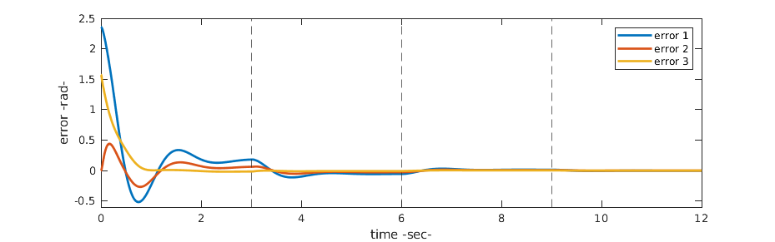
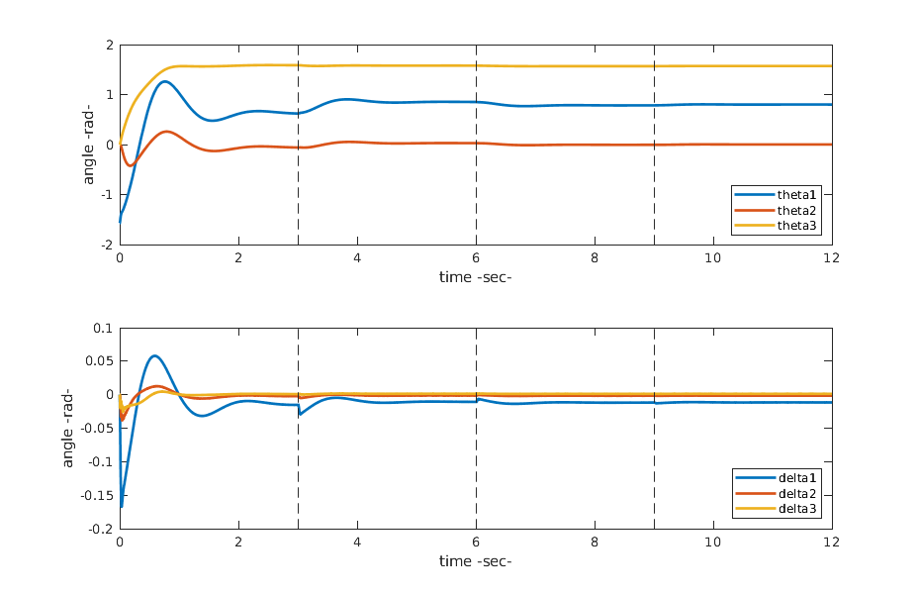
High stiffness
Link position error
Dashed lines indicate iterations
K = diag{14210, 29800, 13500} [Nm rad^-1]
Kp = diag{600, 500, 400} Kd = diag{200, 200, 200}
γ = 35 β = 0.47
Motor positions
Very rigid joints produce a behavior that is very similar to the rigid case
No proof’s hypotheses are violated
Link displacements
Small rebound (3 deg) on the first joint
Constant displacement at steady state

Slide 17
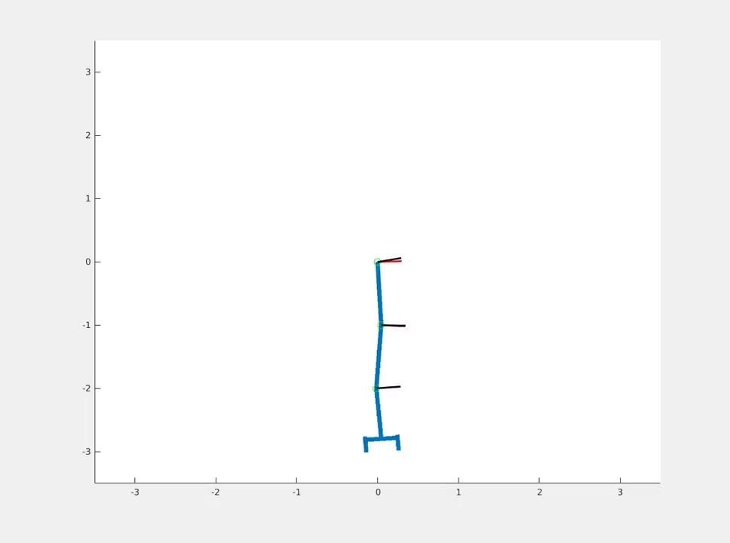
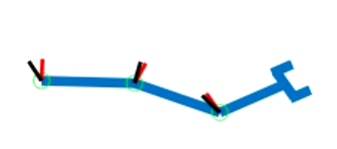
High stiffness – video
Red marker indicates link positions
Black marker indicates motor positions

Slide 18
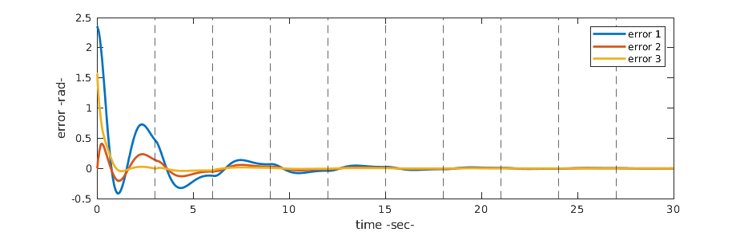
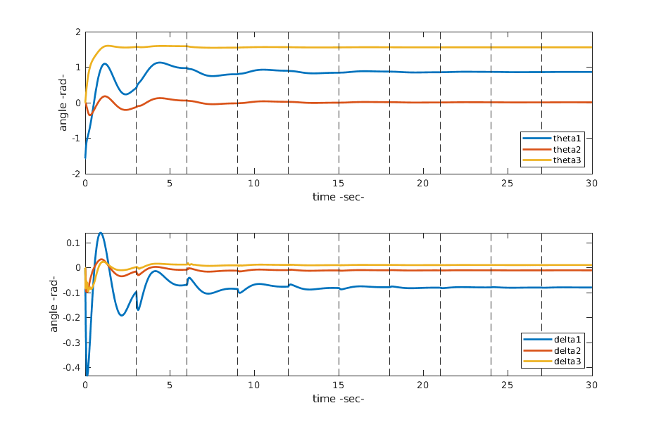
Medium stiffness
Link position error
K = diag{2100, 4500, 1500} [Nm rad^-1]
Kp = diag{200, 200, 200} Kd = diag{150, 150, 150}
γ = 5 β = 0.3
Predictably slower convergence
Violated hypotheses:
Kp < α
K3 < γα
Big overshoot despite small gains
Motor positions
Link displacements
The displacement is much more visible in this case

Slide 19
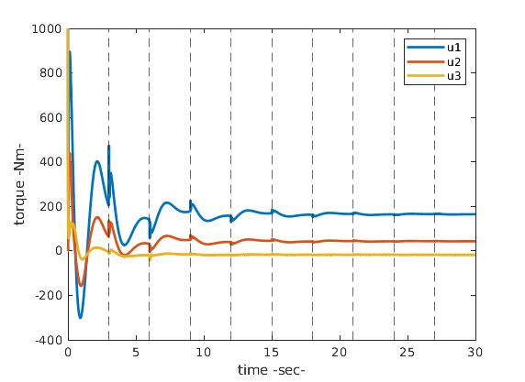
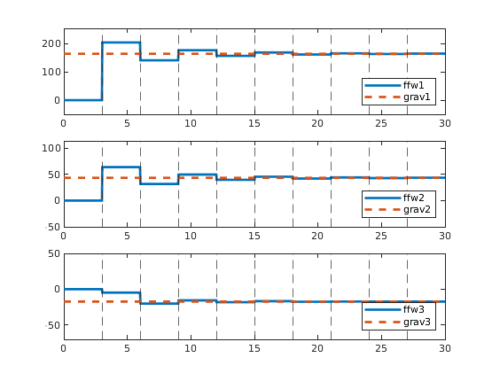
Medium stiffness
At steady state the robot balances gravity at the desired configuration, the control effort is just the feedforward term
Control effort
Gravity compensation (ffw term)
Spikes due to the sudden change of reference value and modified feedforward

Slide 20
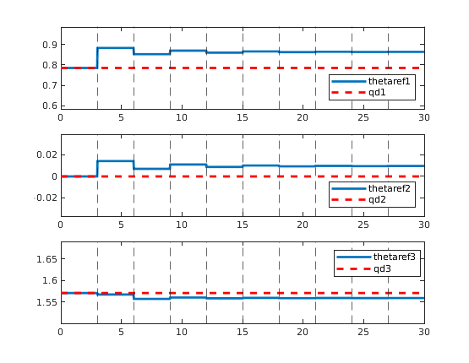
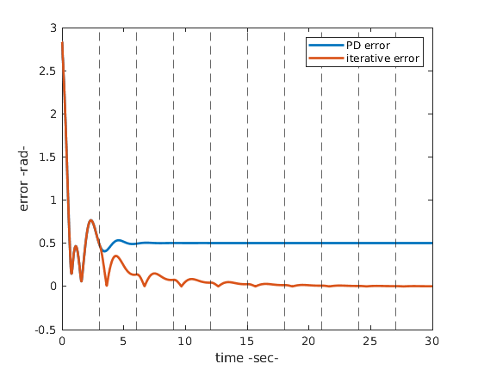
Medium stiffness
Motor position reference θ_{d}
Iterative and PD comparison
Identical behavior before the first iteration. Then, PD controller cannot recover the constant error while the iterative law learns to compensate for it

Slide 21
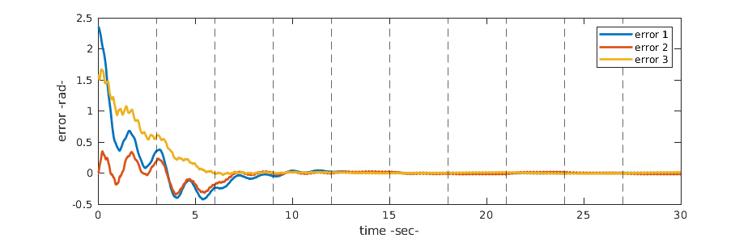
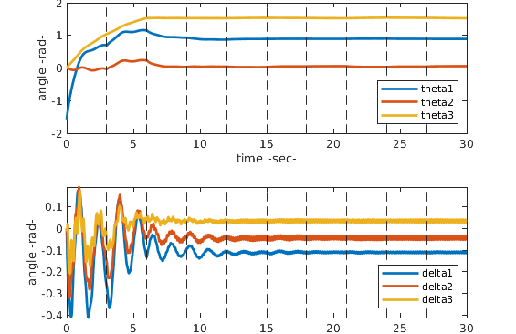
Low stiffness – Sim. 1
Link position error
K = diag{1500, 1000, 500} [Nm rad^-1]
Kp = diag{7.5, 5, 0.75} Kd = diag{2000,1000,800}
γ = 2.01 β = 1/400
Violated hypotheses:
Kp < α
K < γα
Motor positions
High derivative gains allow the motors to slowly move to their target, without oscillating
Link displacements
Convergence is NOT achieved: despite the fact that motors are still, the links keep oscillating at high frequencies

Slide 22

Medium vs low stiffness comparison
=
Medium stiffness
Low stiffness

Slide 23
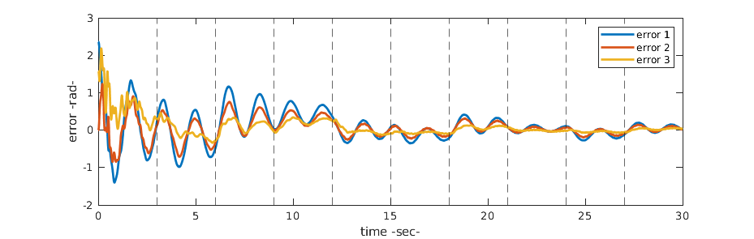
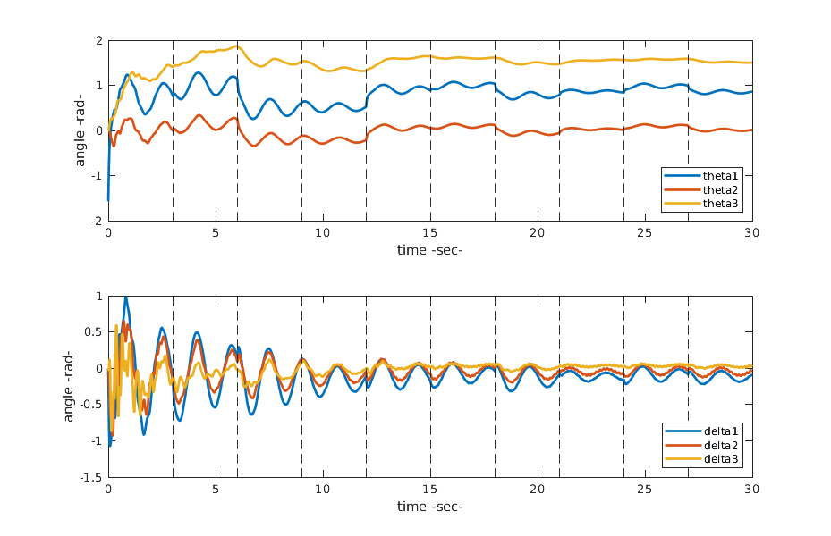
Low stiffness – Sim. 2
Link position error
No convergence at all
What happens if we lower the derivative gains?
It should not matter, because there’s no requirement for Kd in the proof, but we’re already violating many of the hypotheses
With the values Kd = diag{200, 200, 200} we get nowhere near convergence
Motor positions
Very high displacements (around 60°) because the motors accelerate so fast
Link displacements

Slide 24
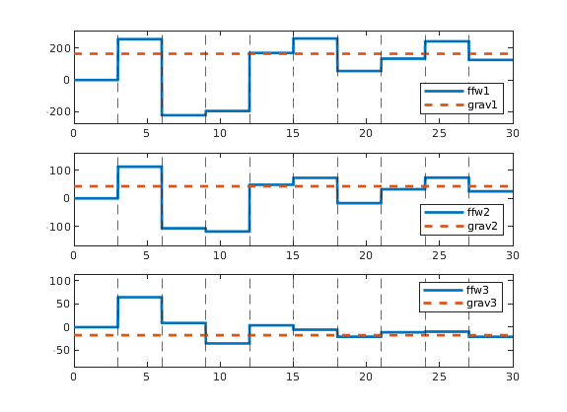
Low stiffness – Sim. 2
Gravity compensation on low stiffness configuration
Why do we need such high derivative gains in low stiffness configurations?
Avoid oscillations on motor positions which in turn make the links oscillate even more
If we iterate when the robot is far from a steady state, we get very bad estimates for the updated variables
We could increase the iteration time, but that implies longer convergence times (>30s) which in practice is not useful
“Bad” iterations can be highlighted especially 6 and 15 seconds into the simulation

Slide 25
Conclusions
Notwithstanding the notorious challenge in control elastic joint robots, by this extension of the rigid case we have accomplished astonishing results for the regulation task.
Does not require knowledge about the robot and converges even with unknown payloads;
Globally Asymptotically stable (with easily satisfiable conditions);
Provides knowledge about the gravity term at the desired configuration;
No indication about the number of iterations necessary for convergence (and consequentially for the convergence time);
Requires measures also on the link side;
Down to very soft robots need to be rethought.
Notes:
we want to highlight the pros and cons; need to be revised

Slide 26
References
Papers:
[1] P. Tomei. A simple PD controller for robots with elastic joints. IEEE Transactions
on Automatic Control, 36(10):1208–1213, 1991.
[2] A. De Luca and S. Panzieri. Learning Gravity Compensation in Robots: Rigid
Arms, Elastic Joints, Flexible Links. Int. J. Adapt. Control Signal Process.,
7(5):417–433, 1993.
[3] A. De Luca and S. Panzieri. End-effector regulation of robots with elastic elements
by an iterative scheme. International Journal of Adaptive Control and Signal
Processing, 10(4-5):379–393, 1996.
[4] B. Siciliano and O. Khatib. Springer Handbook of Robotics. Springer-Verlag, Berlin,
Heidelberg, 2007.
[5] A. De Luca and B. Siciliano. An Asymptotically Stable Joint PD Controller for
Robot Arms with Flexible Links Under Gravity. In Proceedings of the 31st IEEE
Conference on Decision and Control, pages 325–326 vol.1, 1992.
Slides:
https://github.com/pietro-nardelli/sapienza-ppt-template (restyle of Sapienza NLP group slides) [Attribution-NonCommercial-ShareAlike 4.0 International (CC BY-NC-SA 4.0)]

Slide 27
Thank you for the attention!
made and presented by:
Dennis Rotondi - 1834864
rotondi.1834864@studenti.uniroma1.it
Fabio Scaparro - 1834913
scaparro.1834913@studenti.uniroma1.it
Academic Year 2021-2022
Sapienza University of Rome

